Slide 1

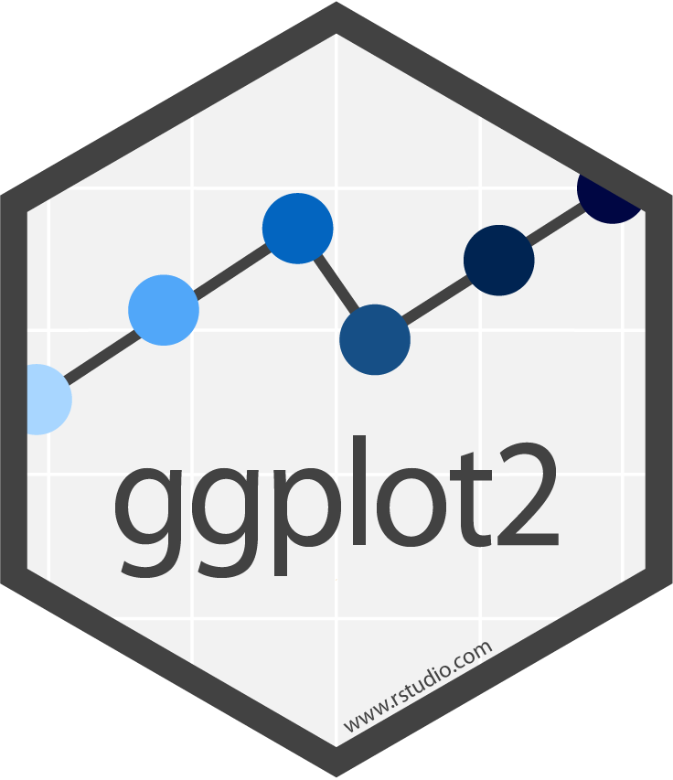








Data visualization with ggplot2 : : CHEAT SHEET
Basics
Geoms
Use a geom function to represent data points, use the geom’s aesthetic properties to represent variables. Each function returns a layer.
ggplot2 is based on the grammar of graphics, the idea that you can build every graph from the same components: a data set, a coordinate system, and geoms—visual marks that represent data points.
GRAPHICAL PRIMITIVES
TWO VARIABLES
both continuous
e <- ggplot(mpg, aes(cty, hwy))
continuous bivariate distribution
h <- ggplot(diamonds, aes(carat, price))
a <- ggplot(economics, aes(date, unemploy))
b <- ggplot(seals, aes(x = long, y = lat))
F | M | A
+
=
a + geom_blank() and a + expand_limits() Ensure limits include values across all plots.
b + geom_curve(aes(yend = lat + 1, xend = long + 1), curvature = 1) - x, xend, y, yend, alpha, angle, color, curvature, linetype, size
a + geom_path(lineend = "butt", linejoin = "round", linemitre = 1) x, y, alpha, color, group, linetype, size
a + geom_polygon(aes(alpha = 50)) - x, y, alpha, color, fill, group, subgroup, linetype, size
b + geom_rect(aes(xmin = long, ymin = lat, xmax = long + 1, ymax = lat + 1)) - xmax, xmin, ymax, ymin, alpha, color, fill, linetype, size
a + geom_ribbon(aes(ymin = unemploy - 900, ymax = unemploy + 900)) - x, ymax, ymin, alpha, color, fill, group, linetype, size
e + geom_label(aes(label = cty), nudge_x = 1, nudge_y = 1) - x, y, label, alpha, angle, color, family, fontface, hjust, lineheight, size, vjust
e + geom_point() x, y, alpha, color, fill, shape, size, stroke
e + geom_quantile() x, y, alpha, color, group, linetype, size, weight
e + geom_rug(sides = “bl") x, y, alpha, color, linetype, size
e + geom_smooth(method = lm) x, y, alpha, color, fill, group, linetype, size, weight
e + geom_text(aes(label = cty), nudge_x = 1, nudge_y = 1) - x, y, label, alpha, angle, color, family, fontface, hjust, lineheight, size, vjust
h + geom_bin2d(binwidth = c(0.25, 500)) x, y, alpha, color, fill, linetype, size, weight
h + geom_density_2d() x, y, alpha, color, group, linetype, size
h + geom_hex() x, y, alpha, color, fill, size
data
geom
x = F · y = A
coordinate system
plot
To display values, map variables in the data to visual properties of the geom (aesthetics) like size, color, and x and y locations.
F | M | A
continuous function
i <- ggplot(economics, aes(date, unemploy))
+
=
i + geom_area() x, y, alpha, color, fill, linetype, size
i + geom_line() x, y, alpha, color, group, linetype, size
i + geom_step(direction = "hv") x, y, alpha, color, group, linetype, size
data
geom
x = F · y = A
color = F
size = A
coordinate system
plot
Complete the template below to build a graph.
LINE SEGMENTS
common aesthetics: x, y, alpha, color, linetype, size
required
ggplot (data = <DATA> ) +
<GEOM_FUNCTION> (mapping = aes( <MAPPINGS> ),
stat = <STAT> , position = <POSITION> ) +
<COORDINATE_FUNCTION> +
<FACET_FUNCTION> +
<SCALE_FUNCTION> +
<THEME_FUNCTION>
one discrete, one continuous
f <- ggplot(mpg, aes(class, hwy))
visualizing error
df <- data.frame(grp = c("A", "B"), fit = 4:5, se = 1:2)
j <- ggplot(df, aes(grp, fit, ymin = fit - se, ymax = fit + se))
Not required, sensible defaults supplied
b + geom_abline(aes(intercept = 0, slope = 1))
b + geom_hline(aes(yintercept = lat))
b + geom_vline(aes(xintercept = long))
b + geom_segment(aes(yend = lat + 1, xend = long + 1))
b + geom_spoke(aes(angle = 1:1155, radius = 1))
f + geom_col() x, y, alpha, color, fill, group, linetype, size
f + geom_boxplot() x, y, lower, middle, upper, ymax, ymin, alpha, color, fill, group, linetype, shape, size, weight
f + geom_dotplot(binaxis = "y", stackdir = “center") x, y, alpha, color, fill, group
f + geom_violin(scale = “area") x, y, alpha, color, fill, group, linetype, size, weight
j + geom_crossbar(fatten = 2) - x, y, ymax, ymin, alpha, color, fill, group, linetype, size
j + geom_errorbar() - x, ymax, ymin, alpha, color, group, linetype, size, width Also geom_errorbarh().
j + geom_linerange() x, ymin, ymax, alpha, color, group, linetype, size
j + geom_pointrange() - x, y, ymin, ymax, alpha, color, fill, group, linetype, shape, size
ggplot(data = mpg, aes(x = cty, y = hwy)) Begins a plot that you finish by adding layers to. Add one geom function per layer.
last_plot() Returns the last plot.
ggsave("plot.png", width = 5, height = 5) Saves last plot as 5’ x 5’ file named "plot.png" in working directory. Matches file type to file extension.
ONE VARIABLE continuous
c <- ggplot(mpg, aes(hwy)); c2 <- ggplot(mpg)
c + geom_area(stat = "bin") x, y, alpha, color, fill, linetype, size
c + geom_density(kernel = "gaussian") x, y, alpha, color, fill, group, linetype, size, weight
c + geom_dotplot() x, y, alpha, color, fill
c + geom_freqpoly() x, y, alpha, color, group, linetype, size
c + geom_histogram(binwidth = 5) x, y, alpha, color, fill, linetype, size, weight
c2 + geom_qq(aes(sample = hwy)) x, y, alpha, color, fill, linetype, size, weight
both discrete
g <- ggplot(diamonds, aes(cut, color))
maps
data <- data.frame(murder = USArrests$Murder, state = tolower(rownames(USArrests))) map <- map_data("state") k <- ggplot(data, aes(fill = murder))
Aes
Common aesthetic values.
g + geom_count() x, y, alpha, color, fill, shape, size, stroke
e + geom_jitter(height = 2, width = 2) x, y, alpha, color, fill, shape, size
color and fill - string ("red", "#RRGGBB")
linetype - integer or string (0 = "blank", 1 = "solid", 2 = "dashed", 3 = "dotted", 4 = "dotdash", 5 = "longdash", 6 = "twodash")
lineend - string ("round", "butt", or "square")
linejoin - string ("round", "mitre", or "bevel")
size - integer (line width in mm)
shape - integer/shape name or a single character ("a")
k + geom_map(aes(map_id = state), map = map)
+ expand_limits(x = map$long, y = map$lat)
map_id, alpha, color, fill, linetype, size
THREE VARIABLES
seals$z <- with(seals, sqrt(delta_long^2 + delta_lat^2)); l <- ggplot(seals, aes(long, lat))
discrete d <- ggplot(mpg, aes(fl))
l + geom_contour(aes(z = z)) x, y, z, alpha, color, group, linetype, size, weight
l + geom_contour_filled(aes(fill = z)) x, y, alpha, color, fill, group, linetype, size, subgroup
l + geom_raster(aes(fill = z), hjust = 0.5, vjust = 0.5, interpolate = FALSE) x, y, alpha, fill
l + geom_tile(aes(fill = z)) x, y, alpha, color, fill, linetype, size, width
d + geom_bar() x, alpha, color, fill, linetype, size, weight
RStudio® is a trademark of RStudio, PBC • CC BY SA RStudio • info@rstudio.com • 844-448-1212 • rstudio.com • Learn more at ggplot2.tidyverse.org • ggplot2 3.3.5 • Updated: 2021-08

Slide 2




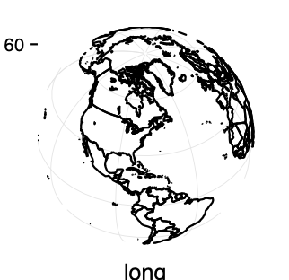



















Stats
Scales
Coordinate Systems
Faceting
An alternative way to build a layer.
Override defaults with scales package.
A stat builds new variables to plot (e.g., count, prop).
Scales map data values to the visual values of an aesthetic. To change a mapping, add a new scale.
r <- d + geom_bar()
r + coord_cartesian(xlim = c(0, 5)) - xlim, ylim The default cartesian coordinate system.
r + coord_fixed(ratio = 1/2) ratio, xlim, ylim - Cartesian coordinates with fixed aspect ratio between x and y units.
ggplot(mpg, aes(y = fl)) + geom_bar() Flip cartesian coordinates by switching x and y aesthetic mappings.
r + coord_polar(theta = "x", direction=1) theta, start, direction - Polar coordinates.
r + coord_trans(y = “sqrt") - x, y, xlim, ylim Transformed cartesian coordinates. Set xtrans and ytrans to the name of a window function.
π + coord_quickmap() π + coord_map(projection = "ortho", orientation = c(41, -74, 0)) - projection, xlim, ylim
Map projections from the mapproj package (mercator (default), azequalarea, lagrange, etc.).
Facets divide a plot into subplots based on the values of one or more discrete variables.
t <- ggplot(mpg, aes(cty, hwy)) + geom_point()
t + facet_grid(cols = vars(fl)) Facet into columns based on fl.
t + facet_grid(rows = vars(year)) Facet into rows based on year.
t + facet_grid(rows = vars(year), cols = vars(fl)) Facet into both rows and columns.
t + facet_wrap(vars(fl)) Wrap facets into a rectangular layout.
Set scales to let axis limits vary across facets.
t + facet_grid(rows = vars(drv), cols = vars(fl), scales = "free") x and y axis limits adjust to individual facets: "free_x" - x axis limits adjust "free_y" - y axis limits adjust
Set labeller to adjust facet label:
t + facet_grid(cols = vars(fl), labeller = label_both)
t + facet_grid(rows = vars(fl),
labeller = label_bquote(alpha ^ .(fl)))
fl | cty | cyl
x | ..count..
+
=
n <- d + geom_bar(aes(fill = fl))
data
stat
geom
x = x · y = ..count..
coordinate system
plot
scale_
aesthetic to adjust
prepackaged scale to use
scale-specific arguments
n + scale_fill_manual(
values = c("skyblue", "royalblue", "blue", "navy"),
limits = c("d", "e", "p", "r"), breaks =c("d", "e", "p", “r"),
name = "fuel", labels = c("D", "E", "P", "R"))
Visualize a stat by changing the default stat of a geom function, geom_bar(stat="count") or by using a stat function, stat_count(geom="bar"), which calls a default geom to make a layer (equivalent to a geom function).
Use ..name.. syntax to map stat variables to aesthetics.
range of values to include in mapping
title to use in legend/axis
labels to use in legend/axis
breaks to use in legend/axis
geom to use
stat function
geommappings
GENERAL PURPOSE SCALES
Use with most aesthetics
scale_*_continuous() - Map cont’ values to visual ones.
scale_*_discrete() - Map discrete values to visual ones.
scale_*_binned() - Map continuous values to discrete bins.
scale_*_identity() - Use data values as visual ones.
scale_*_manual(values = c()) - Map discrete values to manually chosen visual ones.
scale_*_date(date_labels = "%m/%d"), date_breaks = "2 weeks") - Treat data values as dates.
scale_*_datetime() - Treat data values as date times. Same as scale_*_date(). See ?strptime for label formats.
i + stat_density_2d(aes(fill = ..level..),
geom = "polygon")
variable created by stat
c + stat_bin(binwidth = 1, boundary = 10) x, y | ..count.., ..ncount.., ..density.., ..ndensity..
c + stat_count(width = 1) x, y | ..count.., ..prop..
c + stat_density(adjust = 1, kernel = "gaussian") x, y | ..count.., ..density.., ..scaled..
e + stat_bin_2d(bins = 30, drop = T) x, y, fill | ..count.., ..density..
e + stat_bin_hex(bins = 30) x, y, fill | ..count.., ..density..
e + stat_density_2d(contour = TRUE, n = 100) x, y, color, size | ..level..
e + stat_ellipse(level = 0.95, segments = 51, type = "t")
l + stat_contour(aes(z = z)) x, y, z, order | ..level..
l + stat_summary_hex(aes(z = z), bins = 30, fun = max) x, y, z, fill | ..value..
l + stat_summary_2d(aes(z = z), bins = 30, fun = mean) x, y, z, fill | ..value..
f + stat_boxplot(coef = 1.5) x, y | ..lower.., ..middle.., ..upper.., ..width.. , ..ymin.., ..ymax..
f + stat_ydensity(kernel = "gaussian", scale = "area") x, y | ..density.., ..scaled.., ..count.., ..n.., ..violinwidth.., ..width..
e + stat_ecdf(n = 40) x, y | ..x.., ..y..
e + stat_quantile(quantiles = c(0.1, 0.9), formula = y ~ log(x), method = "rq") x, y | ..quantile..
e + stat_smooth(method = "lm", formula = y ~ x, se = T, level = 0.95) x, y | ..se.., ..x.., ..y.., ..ymin.., ..ymax..
ggplot() + xlim(-5, 5) + stat_function(fun = dnorm, n = 20, geom = “point”) x | ..x.., ..y..
ggplot() + stat_qq(aes(sample = 1:100)) x, y, sample | ..sample.., ..theoretical..
e + stat_sum() x, y, size | ..n.., ..prop..
e + stat_summary(fun.data = "mean_cl_boot")
h + stat_summary_bin(fun = "mean", geom = "bar")
e + stat_identity()
e + stat_unique()
Position Adjustments
X & Y LOCATION SCALES
Use with x or y aesthetics (x shown here)
scale_x_log10() - Plot x on log10 scale.
scale_x_reverse() - Reverse the direction of the x axis.
scale_x_sqrt() - Plot x on square root scale.
Position adjustments determine how to arrange geoms that would otherwise occupy the same space.
s <- ggplot(mpg, aes(fl, fill = drv))
s + geom_bar(position = "dodge") Arrange elements side by side.
s + geom_bar(position = "fill") Stack elements on top of one another, normalize height.
e + geom_point(position = "jitter") Add random noise to X and Y position of each element to avoid overplotting.
e + geom_label(position = "nudge") Nudge labels away from points.
s + geom_bar(position = "stack") Stack elements on top of one another.
Each position adjustment can be recast as a function with manual width and height arguments:
s + geom_bar(position = position_dodge(width = 1))
fl: c
fl: d
fl: e
fl: p
fl: r
Labels and Legends
COLOR AND FILL SCALES (DISCRETE)
n + scale_fill_brewer(palette = "Blues") For palette choices: RColorBrewer::display.brewer.all()
n + scale_fill_grey(start = 0.2, end = 0.8, na.value = "red")
Use labs() to label the elements of your plot.
t + labs(x = "New x axis label", y = "New y axis label", title ="Add a title above the plot", subtitle = "Add a subtitle below title", caption = "Add a caption below plot", alt = "Add alt text to the plot",
<aes> = "New <aes> legend title")
t + annotate(geom = "text", x = 8, y = 9, label = “A") Places a geom with manually selected aesthetics.
p + guides(x = guide_axis(n.dodge = 2)) Avoid crowded or overlapping labels with guide_axis(n.dodge or angle).
n + guides(fill = “none") Set legend type for each aesthetic: colorbar, legend, or none (no legend).
n + theme(legend.position = "bottom") Place legend at "bottom", "top", "left", or “right”.
n + scale_fill_discrete(name = "Title", labels = c("A", "B", "C", "D", "E")) Set legend title and labels with a scale function.
COLOR AND FILL SCALES (CONTINUOUS)
o <- c + geom_dotplot(aes(fill = ..x..))
o + scale_fill_distiller(palette = “Blues”)
o + scale_fill_gradient(low="red", high=“yellow")
o + scale_fill_gradient2(low = "red", high = “blue”, mid = "white", midpoint = 25)
o + scale_fill_gradientn(colors = topo.colors(6)) Also: rainbow(), heat.colors(), terrain.colors(), cm.colors(), RColorBrewer::brewer.pal()
<AES>
<AES>
Themes
r + theme_bw() White background with grid lines.
r + theme_gray() Grey background (default theme).
r + theme_dark() Dark for contrast.
r + theme_classic()
r + theme_light()
r + theme_linedraw()
r + theme_minimal() Minimal theme.
r + theme_void() Empty theme.
SHAPE AND SIZE SCALES p <- e + geom_point(aes(shape = fl, size = cyl))
p + scale_shape() + scale_size()
p + scale_shape_manual(values = c(3:7))
p + scale_radius(range = c(1,6))
p + scale_size_area(max_size = 6)
Zooming
Without clipping (preferred):
t + coord_cartesian(xlim = c(0, 100), ylim = c(10, 20))
With clipping (removes unseen data points):
t + xlim(0, 100) + ylim(10, 20)
t + scale_x_continuous(limits = c(0, 100)) + scale_y_continuous(limits = c(0, 100))
r + theme() Customize aspects of the theme such as axis, legend, panel, and facet properties. r + ggtitle(“Title”) + theme(plot.title.postion = “plot”) r + theme(panel.background = element_rect(fill = “blue”))
RStudio® is a trademark of RStudio, PBC • CC BY SA RStudio • info@rstudio.com • 844-448-1212 • rstudio.com • Learn more at ggplot2.tidyverse.org • ggplot2 3.3.5 • Updated: 2021-08

