Slide 1
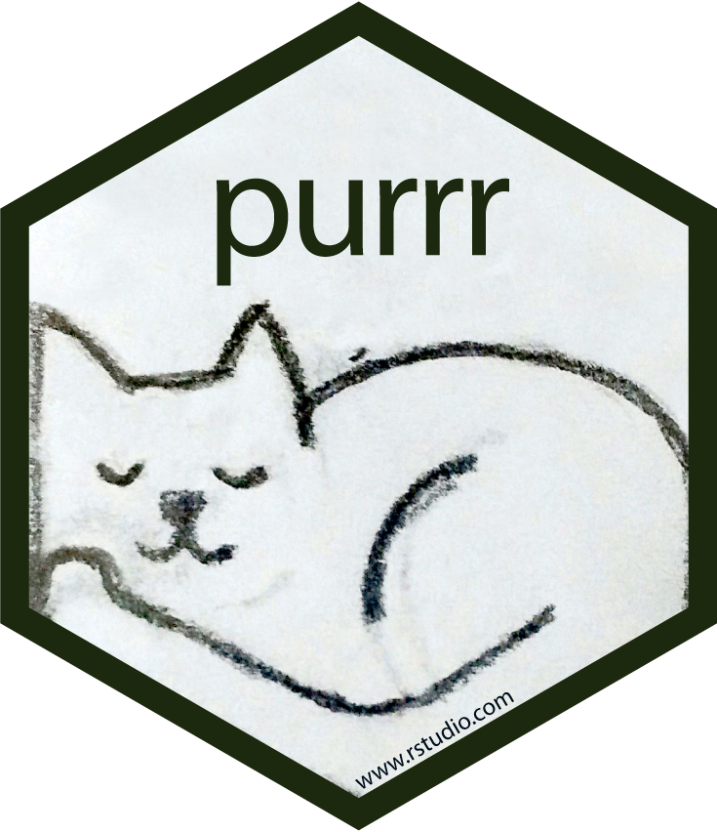

Apply functions with purrr : : CHEAT SHEET
Map Functions
ONE LIST
TWO LISTS
MANY LISTS
LISTS AND INDEXES
map(.x, .f, …) Apply a function to each element of a list or vector, return a list. x <- list(1:10, 11:20, 21:30) l1 <- list(x = c("a", "b"), y = c("c", "d")) map(l1, sort, decreasing = TRUE)
map2(.x, .y, .f, …) Apply a function to pairs of elements from two lists or vectors, return a list. y <- list(1, 2, 3); z <- list(4, 5, 6); l2 <- list(x = "a", y = "z") map2(x, y, ~ .x * .y)
pmap(.l, .f, …) Apply a function to groups of elements from a list of lists or vectors, return a list. pmap(list(x, y, z), ~ ..1 * (..2 + ..3))
imap(.x, .f, ...) Apply .f to each element and its index, return a list. imap(y, ~ paste0(.y, ": ", .x))
map( , fun, …)
fun( ,…)
fun( ,…)
fun( ,…)
map2( , ,fun,…)
fun( , ,…)
fun( , ,…)
fun( , ,…)
pmap( ,fun,…)
fun( , , ,…)
fun( , , ,…)
fun( , , ,…)
imap( , fun, …)
fun( , 1, …)
fun( , 2, …)
fun( , 3, …)
1.0
2.5
3.0
map_dbl(.x, .f, …) Return a double vector. map_dbl(x, mean)
map_int(.x, .f, ...) Return an integer vector. map_int(x, length)
map_chr(.x, .f, …) Return a character vector. map_chr(l1, paste, collapse = "")
map_lgl(.x, .f, …) Return a logical vector. map_lgl(x, is.integer)
map_dfc(.x, .f, ...) Return a data frame created by column-binding. map_dfc(l1, rep, 3)
map_dfr(.x, .f, ..., .id = NULL) Return a data frame created by row-binding. map_dfr(x, summary)
walk(.x, .f, ...) Trigger side effects, return invisibly. walk(x, print)
1.0
2.5
3.0
map2_dbl(.x, .y, .f, …) Return a double vector. map2_dbl(y, z, ~ .x / .y)
map2_int(.x, .y, .f, …) Return an integer vector. map2_int(y, z, `+`)
map2_chr(.x, .y, .f, …) Return a character vector. map2_chr(l1, l2, paste, collapse = ",", sep = ":")
map2_lgl(.x, .y, .f, …) Return a logical vector. map2_lgl(l2, l1, `%in%`)
map2_dfc(.x, .y, .f, ...) Return a data frame created by column-binding. map2_dfc(l1, l2, ~ as.data.frame(c(.x, .y)))
map2_dfr(.x, .y, .f, ..., .id = NULL) Return a data frame created by row-binding. map2_dfr(l1, l2, ~ as.data.frame(c(.x, .y)))
walk2(.x, .y, .f, ...) Trigger side effects, return invisibly. walk2(objs, paths, save)
1.0
2.5
3.0
pmap_dbl(.l, .f, …) Return a double vector. pmap_dbl(list(y, z), ~ .x / .y)
pmap_int(.l, .f, …) Return an integer vector. pmap_int(list(y, z), `+`)
pmap_chr(.l, .f, …) Return a character vector. pmap_chr(list(l1, l2), paste, collapse = ",", sep = ":")
pmap_lgl(.l, .f, …) Return a logical vector. pmap_lgl(list(l2, l1), `%in%`)
pmap_dfc(.l, .f, ...) Return a data frame created by column-binding. pmap_dfc(list(l1, l2), ~ as.data.frame(c(.x, .y)))
pmap_dfr(.l, .f, ..., .id = NULL) Return a data frame created by row-binding. pmap_dfr(list(l1, l2), ~ as.data.frame(c(.x, .y)))
pwalk(.l, .f, ...) Trigger side effects, return invisibly. pwalk(list(objs, paths), save)
1.0
2.5
3.0
imap_dbl(.x, .f, …) Return a double vector. imap_dbl(y, ~ .y)
imap_int(.x, .f, ...) Return an integer vector. imap_int(y, ~ .y)
imap_chr(.x, .f, …) Return a character vector. imap_chr(y, ~ paste0(.y, ": ", .x))
imap_lgl(.x, .f, …) Return a logical vector. imap_lgl(l1, ~ is.character(.y))
imap_dfc(.x, .f, ...) Return a data frame created by column-binding. imap_dfc(l2, ~ as.data.frame(c(.x, .y)))
imap_dfr(.x, .f, ..., .id = NULL) Return a data frame created by row-binding. imap_dfr(l2, ~ as.data.frame(c(.x, .y)))
iwalk(.x, .f, ...) Trigger side effects, return invisibly. iwalk(z, ~ print(paste0(.y, ": ", .x)))
1
2
3
1.0
2.5
3.0
1
2
3
1
2
3
a
b
c
1.0
2.5
3.0
a
b
c
a
b
c
T
T
F
1.0
2.5
3.0
T
F
T
T
T
F
Function Shortcuts
Use ~ . with functions like map() that have single arguments.
Use ~ .x .y with functions like map2() that have two arguments.
Use ~ ..1 ..2 ..3 etc with functions like pmap() that have many arguments.
Use ~ .x .y with functions like imap(). .x will get the list value and .y will get the index.
map(l, ~ . + 2) becomes map(l, function(x) x + 2 ))
map2(l, p, ~ .x +.y) becomes map2(l, p, function(l, p) l + p)
pmap(list(a, b, c), ~ ..3 + ..1 - ..2) becomes pmap(list(a, b, c), function(a, b, c) c + a -b)
imap(list(a, b, c), ~ paste0(.y, ": ", .x) outputs "index: value" for each item
Use a string or an integer with any map function to index list elements by name or position. map(l, "name") becomes map(l, function(x) x[["name"]])
RStudio® is a trademark of RStudio, PBC • CC BY SA RStudio • info@rstudio.com • 844-448-1212 • rstudio.com • Learn more at purrr.tidyverse.org • purrr 0.3.4 • Updated: 2021-07

Slide 2
Work with Lists
Filter
Index
Modify
List- Columns
a
b
keep(.x, .p, …) Select elements that pass a logical test. Conversely, discard(). keep(x, is.na)
compact(.x, .p = identity) Drop empty elements. compact(x)
head_while(.x, .p, …) Return head elements until one does not pass. Also tail_while(). head_while(x, is.character)
detect(.x, .f, ..., dir = c("forward", "backward"), .right = NULL, .default = NULL) Find first element to pass. detect(x, is.character)
detect_index(.x, .f, ..., dir = c("forward", "backward"), .right = NULL) Find index of first element to pass. detect_index(x, is.character)
every(.x, .p, …) Do all elements pass a test? every(x, is.character)
some(.x, .p, …) Do some elements pass a test? some(x, is.character)
none(.x, .p, …) Do no elements pass a test? none(x, is.character)
has_element(.x, .y) Does a list contain an element? has_element(x, "foo")
vec_depth(x) Return depth (number of levels of indexes). vec_depth(x)
a
b
pluck(.x, ..., .default=NULL) Select an element by name or index. Also attr_getter() and chuck(). pluck(x, "b") x %>% pluck("b")
assign_in(x, where, value) Assign a value to a location using pluck selection. assign_in(x, "b", 5) x %>% assign_in("b", 5)
modify_in(.x, .where, .f) Apply a function to a value at a selected location. modify_in(x, "b", abs) x %>% modify_in("b", abs)
a
a
modify(.x, .f, ...) Apply a function to each element. Also modify2(), and imodify(). modify(x, ~.+ 2)
modify_at(.x, .at, .f, ...) Apply a function to selected elements. Also map_at(). modify_at(x, "b", ~.+ 2)
modify_if(.x, .p, .f, ...) Apply a function to elements that pass a test. Also map_if(). modify_if(x, is.numeric,~.+2)
modify_depth(.x, .depth, .f, ...) Apply function to each element at a given level of a list. Also map_depth(). modify_depth(x, 2, ~.+ 2)
b
b
b
b
c
c
c
c
List-columns are columns of a data frame where each element is a list or vector instead of an atomic value. Columns can also be lists of data frames. See tidyr for more about nested data and list columns.
d
d
d
max | seq
3 | <int [3]>
4 | <int [4]>
5 | <int [5]>
a
a
a
NULL
b
b
b
b
c
c
c
NULL
a
a
d
d
WORK WITH LIST-COLUMNS
b
b
c
c
Manipulate list-columns like any other kind of column, using dplyr functions like mutate() and transmute(). Because each element is a list, use map functions within a column function to manipulate each element.
a
a
d
d
a
a
b
b
b
b
c
c
c
d
d
d
a
a
x
y
x
y
b
fun( )
a
a
a
c
c
c
b
b
map(), map2(), or pmap() return lists and will create new list-columns.
b
d
d
c
c
c
list function, return list
list-columns
Reshape
Combine
starwars %>% transmute(ships = map2(vehicles, starships, append)
a
3
column function
b
a
flatten(.x) Remove a level of indexes from a list. Also flatten_chr() etc. flatten(x)
array_tree(array, margin = NULL) Turn array into list. Also array_branch(). array_tree(x, margin = 3)
cross2(.x, .y, .filter = NULL) All combinations of .x and .y. Also cross(), cross3(), and cross_df(). cross2(1:3, 4:6)
transpose(.l, .names = NULL) Transposes the index order in a multi-level list. transpose(x)
set_names(x, nm = x) Set the names of a vector/list directly or with a function. set_names(x, c("p", "q", "r")) set_names(x, tolower)
+
append(x, values, after = length(x)) Add values to end of list. append(x, list(d = 1))
prepend(x, values, before = 1) Add values to start of list. prepend(x, list(d = 1))
splice(…) Combine objects into a list, storing S3 objects as sub-lists. splice(x, y, "foo")
c
b
c
Suffixed map functions like map_int() return an atomic data type and will simplify list-columns into regular columns.
a
FALSE
+
b
c
list function, return int
a
TRUE
starwars %>% mutate(n_films = map_int(films, length))
b
+
c
+
+
column function
list-column
a
TRUE
b
Reduce
c
a
TRUE
a
x
y
a
x
y
reduce(.x, .f, ..., .init, .dir = c("forward", "backward")) Apply function recursively to each element of a list or vector. Also reduce2(). reduce(x, sum)
accumulate(.x, .f, ..., .init) Reduce a list, but also return intermediate results. Also accumulate2(). accumulate(x, sum)
b
b
b
c
c
c
x
y
z
2
a
b
a
b
a
a
a
p
func +
a
b
c
d
func( , )
func +
a
b
c
d
func( , )
b
b
q
c
c
func( , )
c
c
r
func( , )
d
d
func( , )
func( , )
RStudio® is a trademark of RStudio, PBC • CC BY SA RStudio • info@rstudio.com • 844-448-1212 • rstudio.com • Learn more at purrr.tidyverse.org • purrr 0.3.4 • Updated: 2021-07

