Slide 1


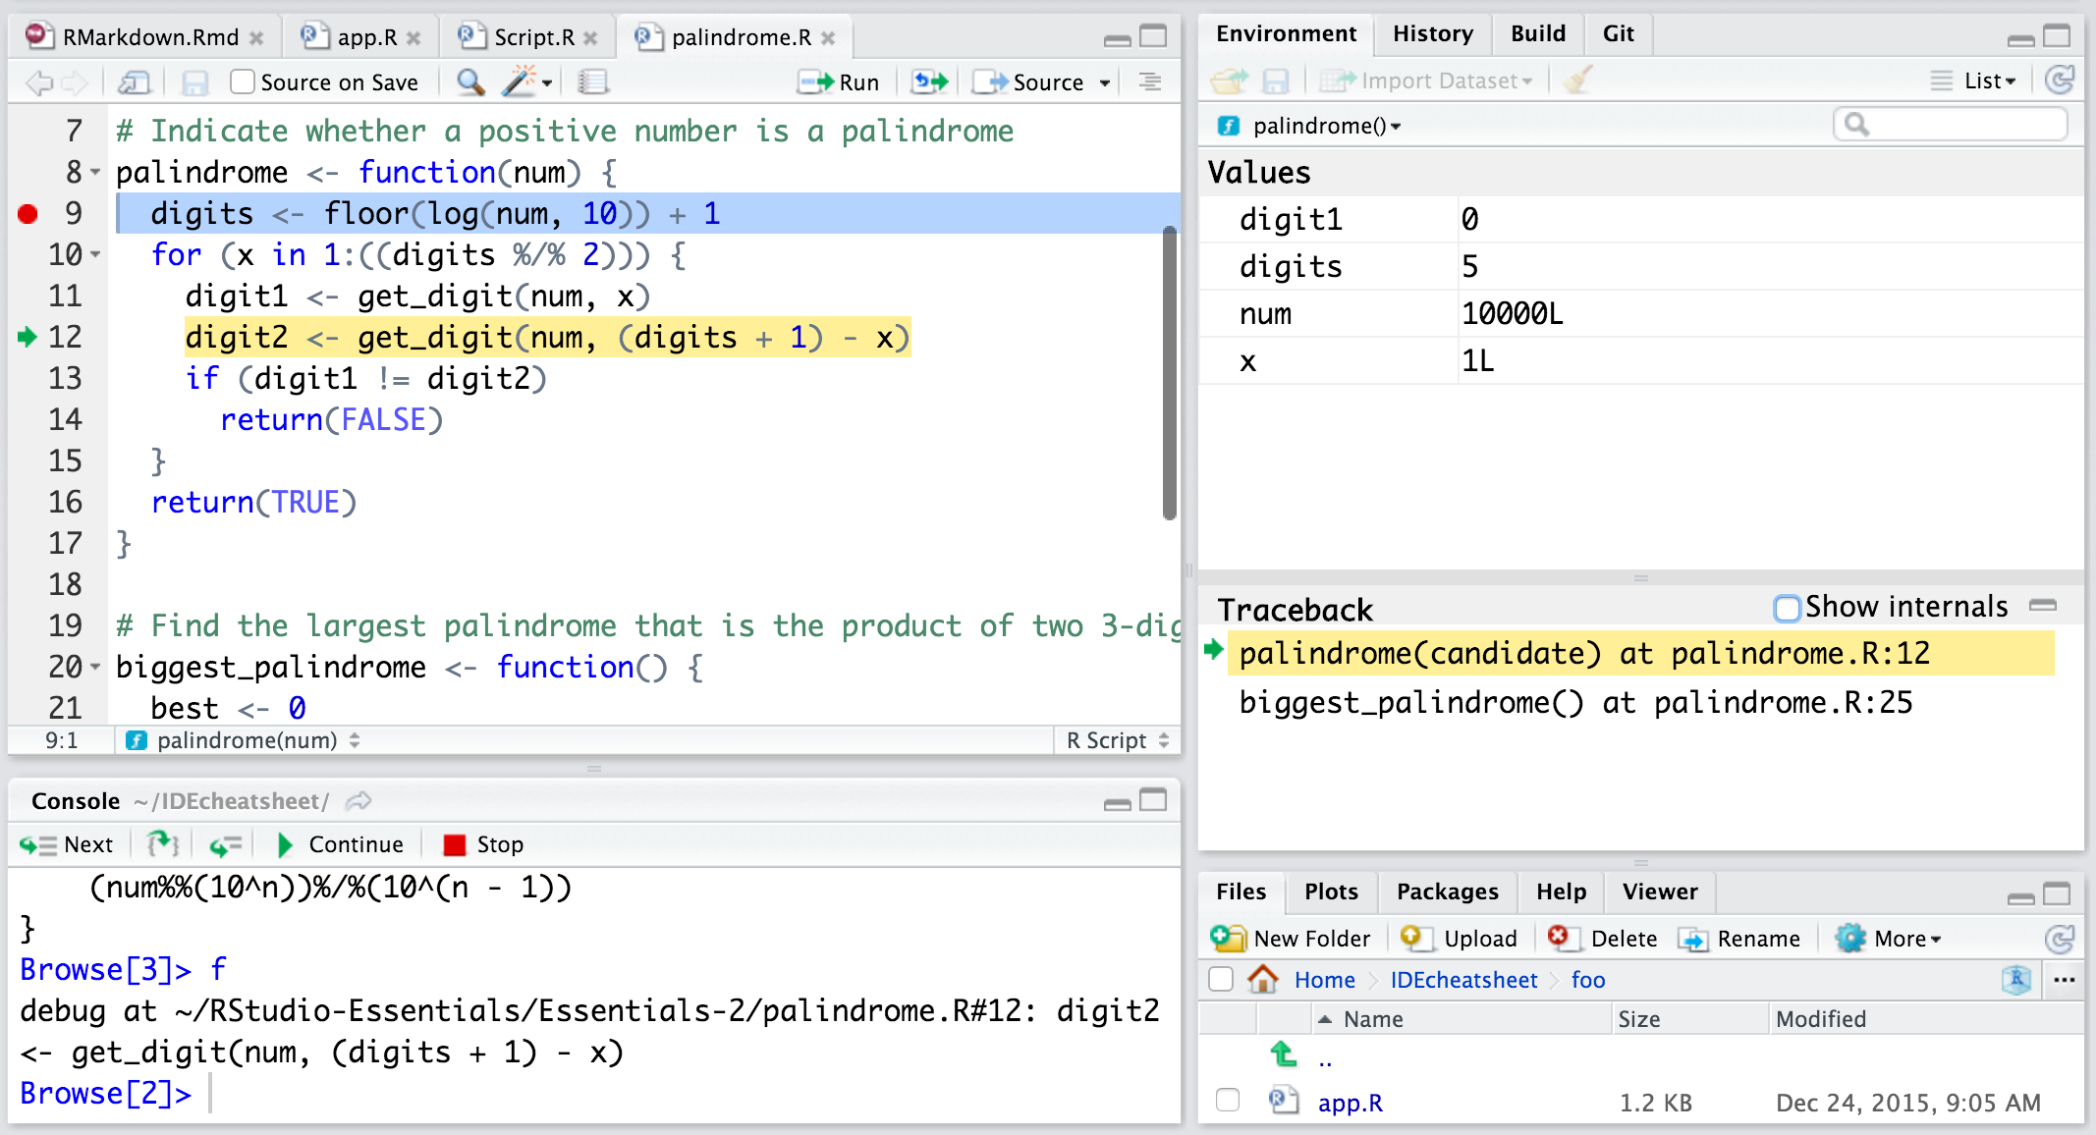

RStudio IDE : : CHEAT SHEET
Documents and Apps
Source Editor
Tab Panes
Version
Control
Open Shiny, R Markdown, knitr, Sweave, LaTeX, .Rd files and more in Source Pane
Navigate backwards/forwards
Open in new window
Save
Find and replace
Compile as notebook
Run selected code
Import data with wizard
History of past commands to run/copy
Manage external databases
View memory usage
R tutorials
Turn on at Tools > Project Options > Git/SVN
Check spelling
Render output
Choose output format
Configure render options
Insert code chunk
Added
Deleted
Modified
Renamed
Untracked
Publish to server
A
M
?
D
R
Re-run previous code
Source with or w/out Echo or as a Local Job
Show file outline
Stage files:
Commit staged files
Push/Pull to remote
View History
Current branch
Load workspace
Save workspace
Clear R workspace
Search inside environment
Jump to previous chunk
Jump to next chunk
Run code
Show file outline
Visual Editor (reverse side)
Multiple cursors/column selection with Alt + mouse drag.
Choose environment to display from list of parent environments
Display objects as list or grid
Open shell to type commands
Code diagnostics that appear in the margin. Hover over diagnostic symbols for details.
Show file diff to view file differences
Jump to section or chunk
Run this and all previous code chunks
Run this code chunk
Syntax highlighting based on your file's extension
Set knitr chunk options
Tab completion to finish function names, file paths, arguments, and more.
Displays saved objects by type with short description
View in data viewer
View function source code
Access markdown guide at
Help > Markdown Quick Reference See reverse side for more on Visual Editor
Multi-language code snippets to quickly use common blocks of code.
More file options
Debug Mode
Jump to function in file
Change file type
Create folder
Delete file
Rename file
Change directory
Use debug(), browser(), or a breakpoint and execute your code to open the debugger mode.
RStudio recognizes that files named app.R, server.R, ui.R, and global.R belong to a shiny app
Path to displayed directory
Launch debugger mode from origin of error
Open traceback to examine the functions that R called before the error occurred
Working Directory
Run scripts in separate sessions
Maximize, minimize panes
A File browser keyed to your working directory. Click on file or directory name to open.
Run app
Choose location to view app
Publish to shinyapps.io or server
Manage publish accounts
Ctrl/Cmd + arrow-up to see history
R Markdown Build Log
Drag pane boundaries
Package Development
RStudio opens plots in a dedicated Plots pane
RStudio opens documentation in a dedicated Help pane
Click next to line number to add/remove a breakpoint.
Highlighted line shows where execution has paused
Create a new package with File > New Project > New Directory > R Package
Enable roxygen documentation with Tools > Project Options > Build Tools
Navigate recent plots
Open in window
Export plot
Delete plot
Delete all plots
Home page of helpful links
Search within help file
Search for help file
Roxygen guide at Help > Roxygen Quick Reference
See package information in the Build Tab
GUI Package manager lists every installed package
Viewer pane displays HTML content, such as Shiny apps, RMarkdown reports, and interactive visualizations
Install package and restart R
Run devtools::load_all() and reload changes
Install Packages
Update Packages
Browse package site
Stop Shiny app
Publish to shinyapps.io, rpubs, RSConnect, …
Refresh
Run commands in environment where execution has paused
Examine variables in executing environment
Select function in traceback to debug
Run R CMD check
Clear output and rebuild
Customize package build options
Run package tests
Click to load package with library(). Unclick to detach package with detach().
Package version installed
Delete from library
View(<data>) opens spreadsheet like view of data set
Filter rows by value or value range
Sort by values
Search for value
Step through code one line at a time
Step into and out of functions to run
Resume execution
Quit debug mode
RStudio® is a trademark of RStudio, PBC • CC BY SA RStudio • info@rstudio.com • 844-448-1212 • rstudio.com • Learn more at rstudio.com • Font Awesome 5.15.3 • RStudio IDE 1.4.1717 • Updated: 2021-07

Slide 2
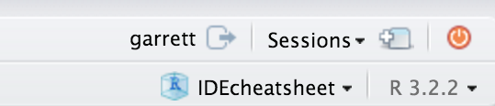
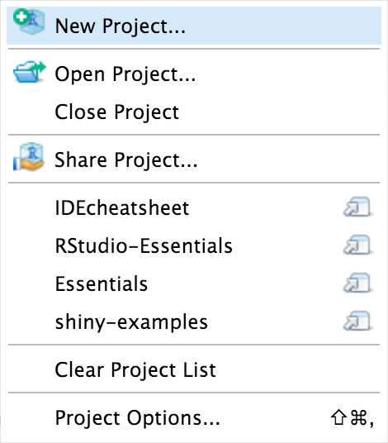
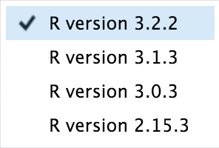
Keyboard Shortcuts
RStudio
Workbench
RUN CODE | Windows/Linux | Mac
Search command history | Ctrl+arrow-up | Cmd+arrow-up
Interrupt current command | Esc | Esc
Clear console | Ctrl+L | Ctrl+L
NAVIGATE CODE
Go to File/Function | Ctrl+. | Ctrl+.
WRITE CODE
Attempt completion | Tab or Ctrl+Space | Tab or Ctrl+Space
Insert <- (assignment operator) | Alt+- | Option+-
Insert %>% (pipe operator) | Ctrl+Shift+M | Cmd+Shift+M
(Un)Comment selection | Ctrl+Shift+C | Cmd+Shift+C
MAKE PACKAGES | Windows/Linux | Mac
Load All (devtools) | Ctrl+Shift+L | Cmd+Shift+L
Test Package (Desktop) | Ctrl+Shift+T | Cmd+Shift+T
Document Package | Ctrl+Shift+D | Cmd+Shift+D
DOCUMENTS AND APPS
Knit Document (knitr) | Ctrl+Shift+K | Cmd+Shift+K
Insert chunk (Sweave & Knitr) | Ctrl+Alt+I | Cmd+Option+I
Run from start to current line | Ctrl+Alt+B | Cmd+Option+B
MORE KEYBOARD SHORTCUTS
Keyboard Shortcuts Help | Alt+Shift+K | Option+Shift+K
Show Command Palette | Ctrl+Shift+P | Cmd+Shift+P
WHY RSTUDIO WORKBENCH?
Extend the open source server with a commercial license, support, and more:
open and run multiple R sessions at once
tune your resources to improve performance
administrative tools for managing user sessions
collaborate real-time with others in shared projects
switch easily from one version of R to a different version
integrate with your authentication, authorization, and audit practices
work in the RStudio IDE, JupyterLab, Jupyter Notebooks, or VS Code
View the Keyboard Shortcut Quick Reference with Tools > Keyboard Shortcuts or Alt/Option + Shift + K
Search for keyboard shortcuts with Tools > Show Command Palette or Ctrl/Cmd + Shift + P.
Download a free 45 day evaluation at
www.rstudio.com/products/workbench/evaluation/
Share Projects
File > New Project
Visual Editor
RStudio saves the call history, workspace, and working directory associated with a project. It reloads each when you re-open a project.
Start new R Session in current project
Close R Session in project
Check spelling
Render output
Choose output format
Choose output location
Insert code chunk
Jump to previous chunk
Jump to next chunk
Run selected lines
Publish to server
Show file outline
Back to Source Editor (front page)
T
H
J
Block format
Active shared collaborators
Citations
File outline
Name of current project
Lists and block quotes
Links
Images
Insert blocks, citations, equations, and special characters
Insert and edit tables
Select
R Version
Clear formatting
More formatting
Share Project with Collaborators
Insert verbatim code
Run Remote Jobs
Run R on remote clusters (Kubernetes/Slurm) via the Job Launcher
Add/Edit attributes
Monitor launcher jobs
Launch a job
Set knitr chunk options
Run this and all previous code chunks
Jump to chunk or header
Run this code chunk
Run launcher jobs remotely
RStudio® is a trademark of RStudio, PBC • CC BY SA RStudio • info@rstudio.com • 844-448-1212 • rstudio.com • Learn more at rstudio.com • Font Awesome 5.15.3 • RStudio IDE 1.4.1717 • Updated: 2021-07

