Slide 1
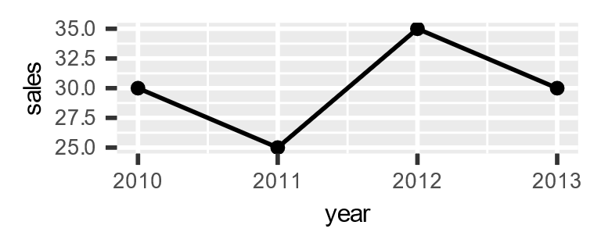
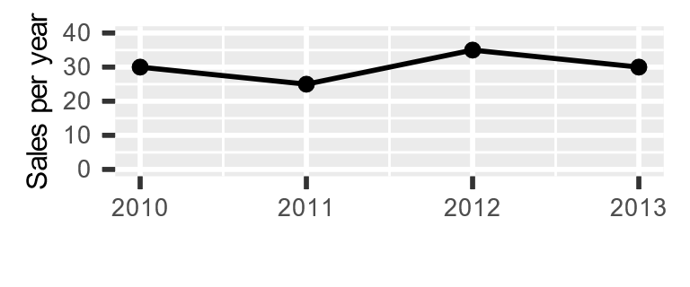
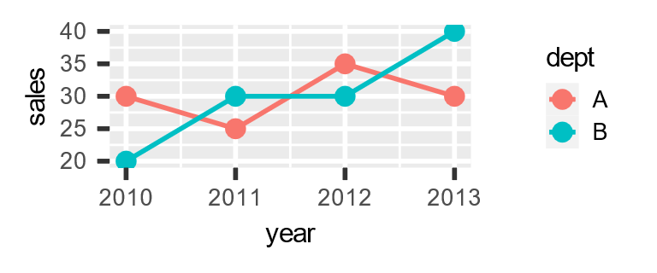
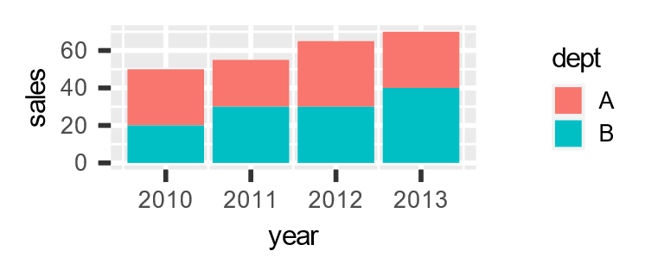
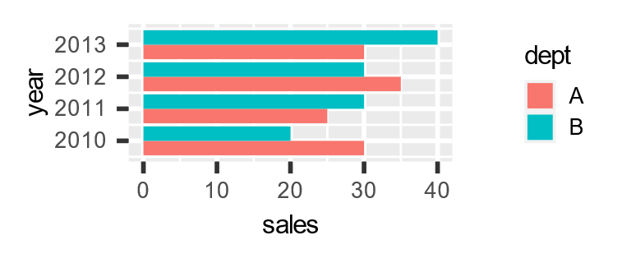
SAS <-> R :: CHEAT SHEET
Introduction
This guide aims to familiarise SAS users with R. R examples make use of tidyverse collection of packages.
Install tidyverse: Attach tidyverse packages for use: |  | install.packages("tidyverse") library(tidyverse)
R data here in ‘data frames’, and occasionally vectors (via c( ) ) Other R structures (lists, matrices…) are not explored here.
Keyboard shortcuts: <- Alt + - %>% Ctrl + Shift + m
Datasets; drop, keep & rename variables
data new_data; set old_data; run; | new_data <- old_data
data new_data (keep=id); set old_data (drop=job_title) ; run; | new_data <- old_data %>% select(-job_title) %>% select(id)
data new_data (drop= temp: ); set old_data; run; | new_data <- old_data %>% select( -starts_with("temp")
data new_data; set old_data; rename old_name = new_name; run; | new_data <- old_data %>% rename(new_name = old_name)
Conditional filtering
data new_data; set old_data; if Sex = "M"; run; | new_data <- old_data %>% filter(Sex == "M")
data new_data; set old_data; if year in (2010,2011,2012); run; | new_data <- old_data %>% filter(year %in% c(2010,2011,2012))
data new_data; set old_data; by id ; if first.id ; run; | new_data <- old_data %>% group_by( id ) %>% slice(1)
data new_data; set old_data; if dob > "25APR1990"d; run; | new_data <- old_data %>% filter(dob > as.Date("1990-04-25"))
New variables, conditional editing
data new_data; set old_data; total_income = wages + benefits ; run; | new_data <- old_data %>% mutate(total_income = wages + benefits)
data new_data; set old_data; if hours > 30 then full_time = "Y"; else full_time = "N"; run; | new_data <- old_data %>% mutate(full_time = if_else(hours > 30 , "Y" , "N"))
data new_data; set old_data; if temp > 20 then weather = "Warm"; else if temp > 10 then weather = "Mild"; else weather = "Cold"; run; | new_data <- old_data %>% mutate(weather = case_when( temp > 20 ~ "Warm", temp > 10 ~"Mild", TRUE ~ "Cold" ) )
Counting and Summarising
proc freq data = old_data ; table job_type ; run; | old_data %>% count( job_type )
proc freq data = old_data ; table job_type*region ; run; | old_data %>% count( job_type , region )
proc summary data = old_data nway ; class job_type region ; output out = new_data ; run; | new_data <- old_data %>% group_by( job_type , region ) %>% summarise( Count = n( ) )
proc summary data = old_data nway ; class job_type region ; var salary ; output out = new_data sum( salary ) = total_salaries ; run; | new_data <- old_data %>% group_by( job_type , region ) %>% summarise( total_salaries = sum( salary ) , Count = n( ) )
Combining datasets
data new_data ; set data_1 data_2 ; run; | new_data <- bind_rows( data_1 , data_2 )
data new_data ; merge data_1 (in= in_1) data_2 ; by id ; if in_1 ; run; | new_data <- left_join( data_1 , data_2 , by = "id")
Some plotting in R
ggplot( my_data , aes( year , sales ) ) + geom_point( ) + geom_line( )
ggplot( my_data , aes( year , sales ) ) + geom_point( ) + geom_line( ) + ylim(0, 40) + labs(x = "" , y = "Sales per year")
ggplot(my_data, aes( year, sales, colour = dept) ) + geom_point( ) + geom_line( )
ggplot( my_data , aes( year, sales, fill = dept) ) + geom_col( )
ggplot( my_data , aes( year, sales, fill = dept) ) + geom_col( position = "dodge" ) + coord_flip( )
C.f. contains( ) , ends_with( )
For percent, add:
%>% mutate(percent = n*100/sum(n))
Note order differs
Equivalent without nway not trivially produced
Lots of summary functions in both languages
Swap summarise( ) for mutate( ) to add summary data to original data
Note ‘colour’ for lines & points, ‘fill’ for shapes
Could use slice(n( )) for last
C.f. rbind( ) which produces error if columns are not identical
C.f. full_join( ) , right_join( ) , inner_join( )
C.f. position = "fill" for 100% stacked bars/cols
CC BY SA Brendan O’Dowd • brendanjodowd@gmail.com • Updated 2022-05

Slide 2
Sorting and Row-Wise Operations
proc sort data=old_data out=new_data; by id descending income ; run; | new_data <- old_data %>% arrange( id , desc( income ) )
proc sort data=old_data nodup; by id job_type; run; | old_data <- old_data %>% arrange( id , job_type)) %>% distinct( )
proc sort data=old_data nodupkey; by id ; run; | old_data <- old_data %>% arrange( id ) %>% group_by( id ) %>% slice( 1 )
data new_data; set old_data; by id descending income ; if first.id ; run; | new_data <- old_data %>% group_by( id ) %>% slice(which.max( income ))
data new_data; set old_data; prev_id= lag( id ); run; | new_data <- old_data %>% mutate( prev_id = lag( id , 1 ))
data new_data; set old_data; by id; counter +1 ; if first.id then counter = 1; run; | new_data <- old_data %>% group_by( id ) %>% mutate( counter = row_number( ) )
Converting and Rounding
data new_data; set old_data ; num_var = input("5" , 8. ); text_var = put( 5 , 8. ); run; | new_data <- old_data %>% mutate(num_var = as.numeric("5" )) %>% mutate(text_var = as.character( 5 ))
data new_data ; set old_data; nearest_5 = round( x , 5 ) two_decimals = round( x , 0.01) run; | new_data <- old_data %>% mutate(nearest_5 = round(x/5)*5) %>% mutate(two_decimals = round( x , digits = 2)
Creating functions to modify datasets
%macro add_variable(dataset_name); data &dataset_name; set &dataset_name; new_variable = 1; run; %mend; %add_variable( my_data ); | add_variable <- function( dataset_name ){ dataset_name <- dataset_name %>% mutate(new_variable = 1) return( dataset_name ) } my_data <- add_variable( my_data )
Dealing with strings
data new_data; set old_data; if find( job_title , "Health" ); run; | new_data <- old_data %>% filter( str_detect( job_title , "Health" ))
data new_data; set old_data; if job_title =: "Health" ; run; | new_data <- old_data %>% filter( str_detect( job_title , "^Health" ))
data new_data; set old_data; substring = substr( big_string , 3 , 4 ); run; | new_data <- old_data %>% mutate( substring = str_sub( big_string , 3 , 6 ))
data new_data; set old_data; address = tranwrd( address , "Street" , "St" ); run; | new_data <- old_data %>% mutate( address = str_replace_all( address , "Street" , "St" ))
data new_data; set old_data; full_name = catx(" " , first_name , surname ); run; | new_data <- old_data %>% mutate( full_name = str_c( first_name , surname , sep = " " ))
data new_data; set old_data; first_word = scan( sentence , 1 ); run; | new_data <- old_data %>% mutate( first_word = word( sentence , 1 ))
data new_data; set old_data; house_number = compress( address , , "dk" ); run; | new_data <- old_data %>% mutate( house_number = str_extract( address , "\\d*" ))
File operations
Operate in ‘Work’ library. Use libname to define file locations | Operate in a particular ‘working directory’ (identify using getwd( ) ) Move to other locations using setwd( )
libname library_name "file_location"; data library_name.saved_data; set data_in_use; run; | saveRDS(data_in_use , file="file_location/saved_data.rds") or setwd("file_location") saveRDS( data_in_use , file = "saved_data.rds")
libname library_name "file_location"; data data_in_use ; set library_name.saved_data ; run; | data_in_use <- readRDS("file_location/saved_data.rds" ) or setwd("file_location") data_in_use <- readRDS("saved_data.rds")
proc export data = my_data outfile = "my_file.csv" dbms = csv replace; run; | write_csv(my_data , "my_file.csv")
proc import datafile = "my_file.csv" out = my_data dbms = csv; run; | my_data <- read_csv("my_file.csv")
Note nodup relies on adjacency of duplicate rows, distinct( ) does not
Use ^ for start of string, $ for end of string, e.g. "Health$"
Returns characters 3 to 6. Note SAS uses <start>, <length>, R uses <start>, <end>
C.f.which.min( )
Swap to preserve duplicate maxima: … slice.max( income )
Alternatively: … filter(income==max(income))
C.f. str_replace( ) for first instance of pattern only
C.f. lead( ) for subsequent rows
Drop sep = " " for equivalent to cats( ) in SAS
R example preserves punctuation at the end of words, SAS doesn’t
Wide range of regexps in both languages, this example extracts digits only
Note SAS can modify within the macro,
whereas R creates a copy within the function
Both examples assume column headers in csv file
CC BY SA Brendan O’Dowd • brendanjodowd@gmail.com • Updated 2022-05

