Slide 1
UPass: A Database for Amusement Park Attraction Reservations
Abinashi Singh & Lily Sabirova

Slide 2
Objectives:
UPass (The Ultimiate Pass) enables a park guest who has purchased the app to receive a number of timed reservations for entry to park attractions
Goal: to develop a data model for representing entities and relationships in this multi-pass wallet application

Slide 3
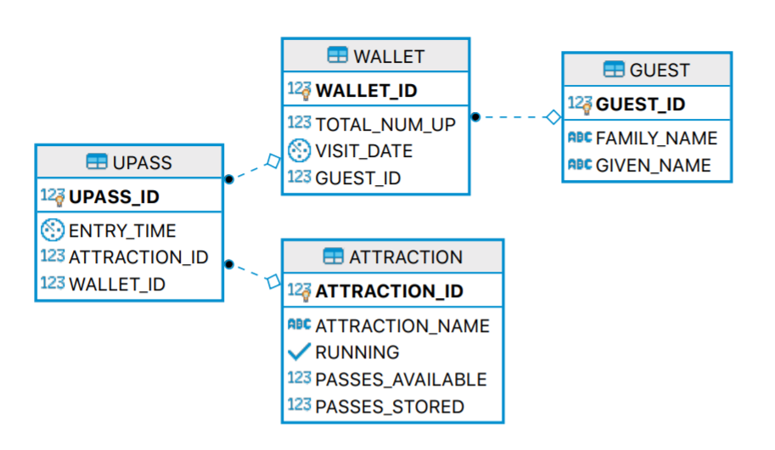
ER Diagram

Slide 4
Restriction | Trigger condition | Result
Expired wallet | current_date > newWallet.visit_date | UPass not issued
Max passes per wallet | select count (*) from UPASS where (wallet_id = newUpass.wallet_id)) >max value | UPass not issued
Max passes per hour per wallet | count where hour (entry_time) is between hour(entry_time) and hour ((entry_time )+1)) > Wallet.total_num_UP | UPass not issued
Attraction down | update of “running” status | Delete corresponding UPasses Set available passes to zero
Attraction back up | update of “running” status | Reset the available passes using the stored variable
Operating hours | UPass.entry_time between 22:00 - 7:00 | UPass not issued

Slide 5
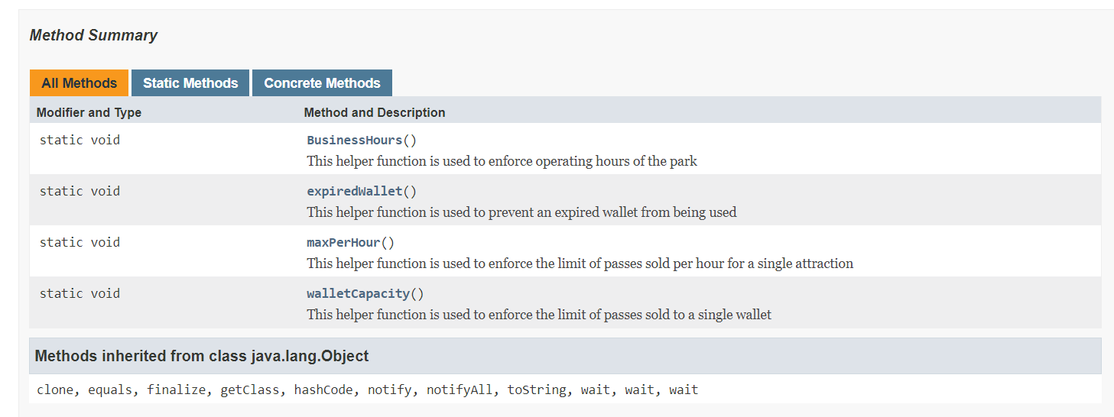
Use of exceptions in trigger output

Slide 6
Deleting entities
If a guest is deleted, his or her wallet is also deleted: ON DELETE CASCADE
If the wallet is deleted, all UPasses are also deleted: ON DELETE CASCADE
If a UPass is deleted, number of available passes for corresponding attraction goes back up

Slide 7
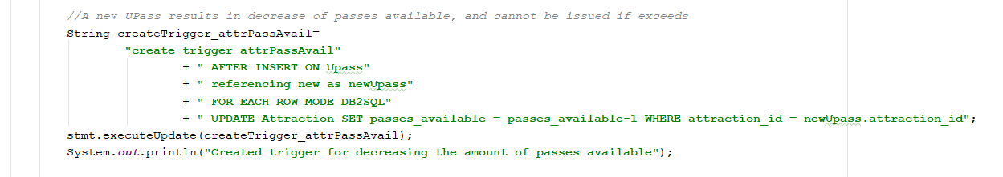
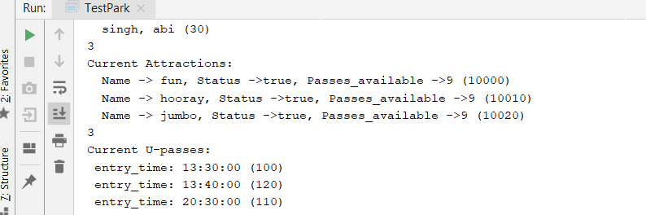
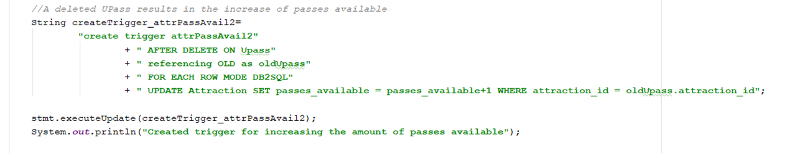
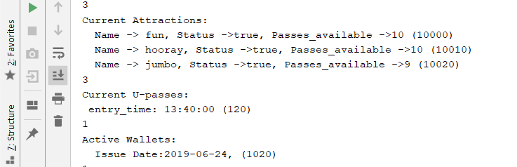
3 new UPasses issued,
# of available passes decreases
2 wallets are deleted,
1 UPass left,
# of available passes increases

Slide 8
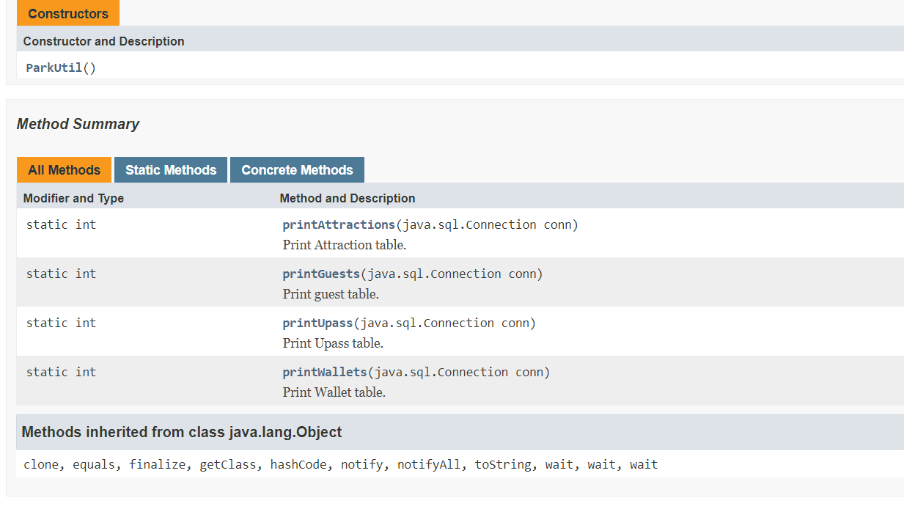
Helper functions for testing
count and print the number of
guests/passes/wallets/attractions
at present

Slide 9
Potential improvements:
If the waiting time for the attraction entry is too long, present customer with alternative schedule
Additional constraints for small children
Free ticket to the 100th customer
Create the front-end part of this cell phone application!

