Slide 1










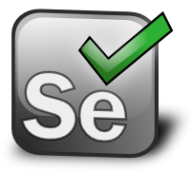

OPERATE
DEVOPS
BUILD
&
INSPECT
DEPLOY
TEST
&
ARCHIVE

