Slide 1
INTRODUCTION TO SCIENTIFIC COMPUTING
By
Abinav.R email: abinav.ravi@tum.de

Slide 2
About Me
Research Assistant ,Chair of Acoustics and Mobile system, Technical University Munich
1 year as a Design Engineer, Robert Bosch Engineering and Business Solutions
B.Tech, Mechanical Engineering, 2012-2016 Amrita School Of Engineering Bangalore.

Slide 3
Agenda
Introduction to Python
Introduction to Numpy
Explicit Numerical Methods to Solve Ordinary Differential Equations
Implicit Numerical Methods to Solve ODE
Stationary PDE (Solution of the Poisson Equation)
Time Dependant ODE ( Poisson Equation)

Slide 4
Aim of the Workshop
Introduce the world of Scientific Computing
To create interest to write code for solving Mathematical Models.
End Goal : Write CFD of FEM code for a Application problem (I am also working on the same) so as to reduce dependency on Commercial Codes and tools

Slide 5
Why Python?
User friendly
Simple Syntax
Has very powerful Libraries for Numerical Methods such as Numpy and Scipy.
Lots of Support across the web

Slide 6
Ordinary Differential Equations
•
Equation with a function y(t) and derivatives of y(t)
y
(
)+
(
)=
t
y
t
0
˙
n
∑
(
)
a
i
(
)=
y
t
0
=
i
i
0
•
typical: development of a variable over time
y
(
)=
(
(
))
˙
t
f
t , y
t

Slide 7
Ordinary Differential Equations
•
Example: radioactive decay
–
Half-life: Period of time in which half of the
atoms decay
–
Decay constant k: Describes rate of decay
and thus half-life
dr
(
t
)
=
−
k
⋅
r
(
t
)
dt

Slide 8
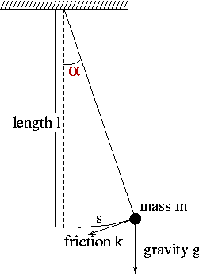
Ordinary Differential Equations
•
Example: pendulum
2
α
α
d
k
d
g
+
⋅
+
⋅
α
=
sin(
)
0
dt
2
m
dt
l

Slide 9
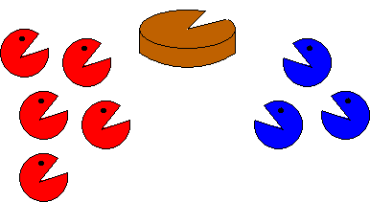
Ordinary Differential Equations
•
Example: population growth
•
populations P and Q
competition
dp


t
=
2
−
p
−
q
⋅
p
dt
dq


t
=
2
−
p
−
q
⋅
q
dt

Slide 10
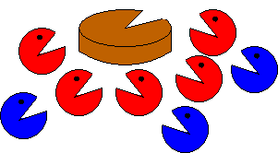
Ordinary Differential Equations
Example: population growth
populations P and Q – predator-prey
dp


t
=
2
−
p

q
⋅
p
dt
dq


t
=
2
−
10p
−
q
⋅
q
dt

Slide 11
Explicit Discretization
•
explicit Euler
•
method of Heun
•
Runge-Kutta
y
=
F
(
y
, t
Δ
)
➢
,
t
n
+
1
n
n

Slide 12
Explicit Discretization
•
explicit Euler
y
(
)
t
y
˙
n
y
=
y
+Δ
⋅
t
y
˙
n
+
1
n
n
=
y
+Δ
⋅
(
)
t
f
t
, y
n
n
n
t
Δ
t

Slide 13
Explicit Discretization
•
method of Heun
1
y
=
y
+Δ
⋅
(
+
)
t
y
y
˙
˙
n
+
1
n
2
n
n
+
1
with
y
=
f
(
+Δ
⋅
(
))
˙
t
, y
t
f
t
, y
n
+
1
n
+
1
n
n
n

Slide 14
Explicit Discretization
•
Runge-Kutta
1
y
=
y
+Δ
⋅
(
+
+
+
)
t
Y
'
2Y
'
2Y
'
Y
'
n
+
1
n
6
1
2
3
4
with
Y
=
(
)
'
f
t
, y
1
n
n
Δ
t
Y
=
(
+
⋅
)
'
f
t
, y
Y
'
2
n
+
1
n
2
1
2
Δ
t
Y
=
(
+
⋅
)
'
f
t
, y
Y
'
3
n
+
1
n
2
2
2
Y
=
(
+Δ
⋅
)
'
f
t
, y
t
Y
'
4
n
+
1
n
3

Slide 15
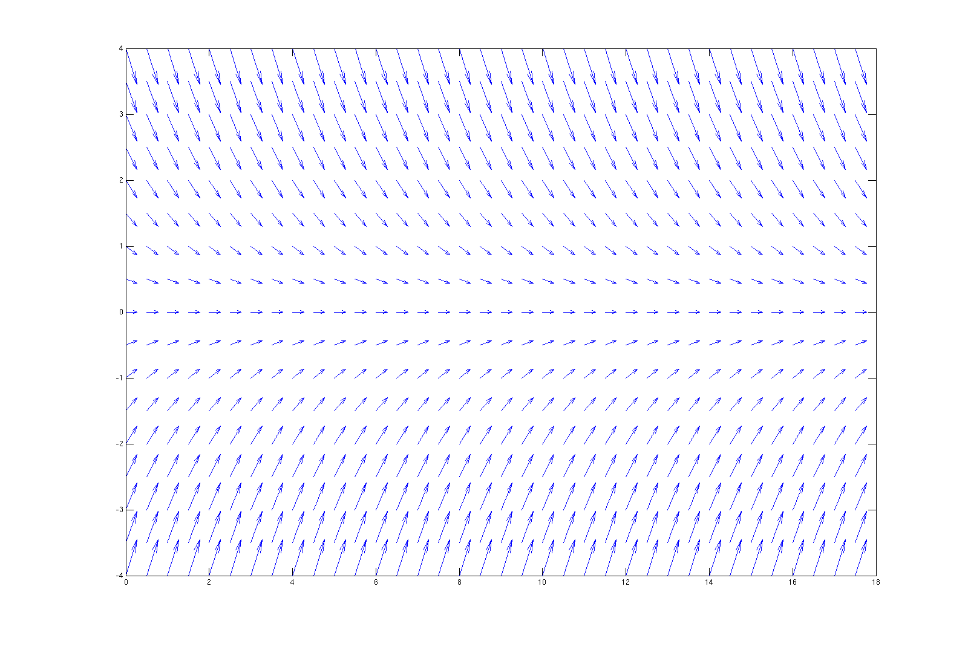
Instability
y
(
)=−
⋅
(
)
•
Vector field of ODE
˙
t
k
y
t

Slide 16
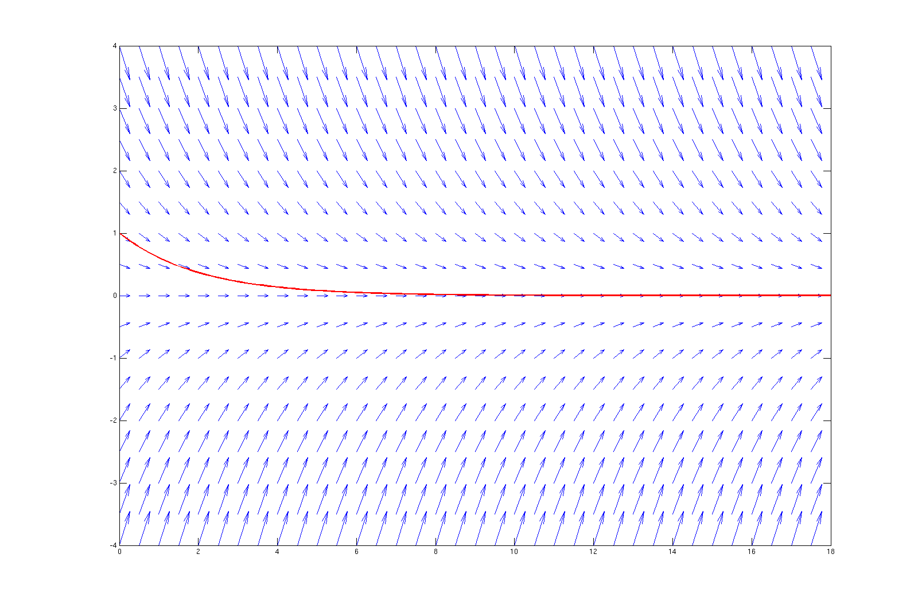
Instability
y
(
)=−
⋅
(
)
•
Vector field of ODE
˙
t
k
y
t

Slide 17
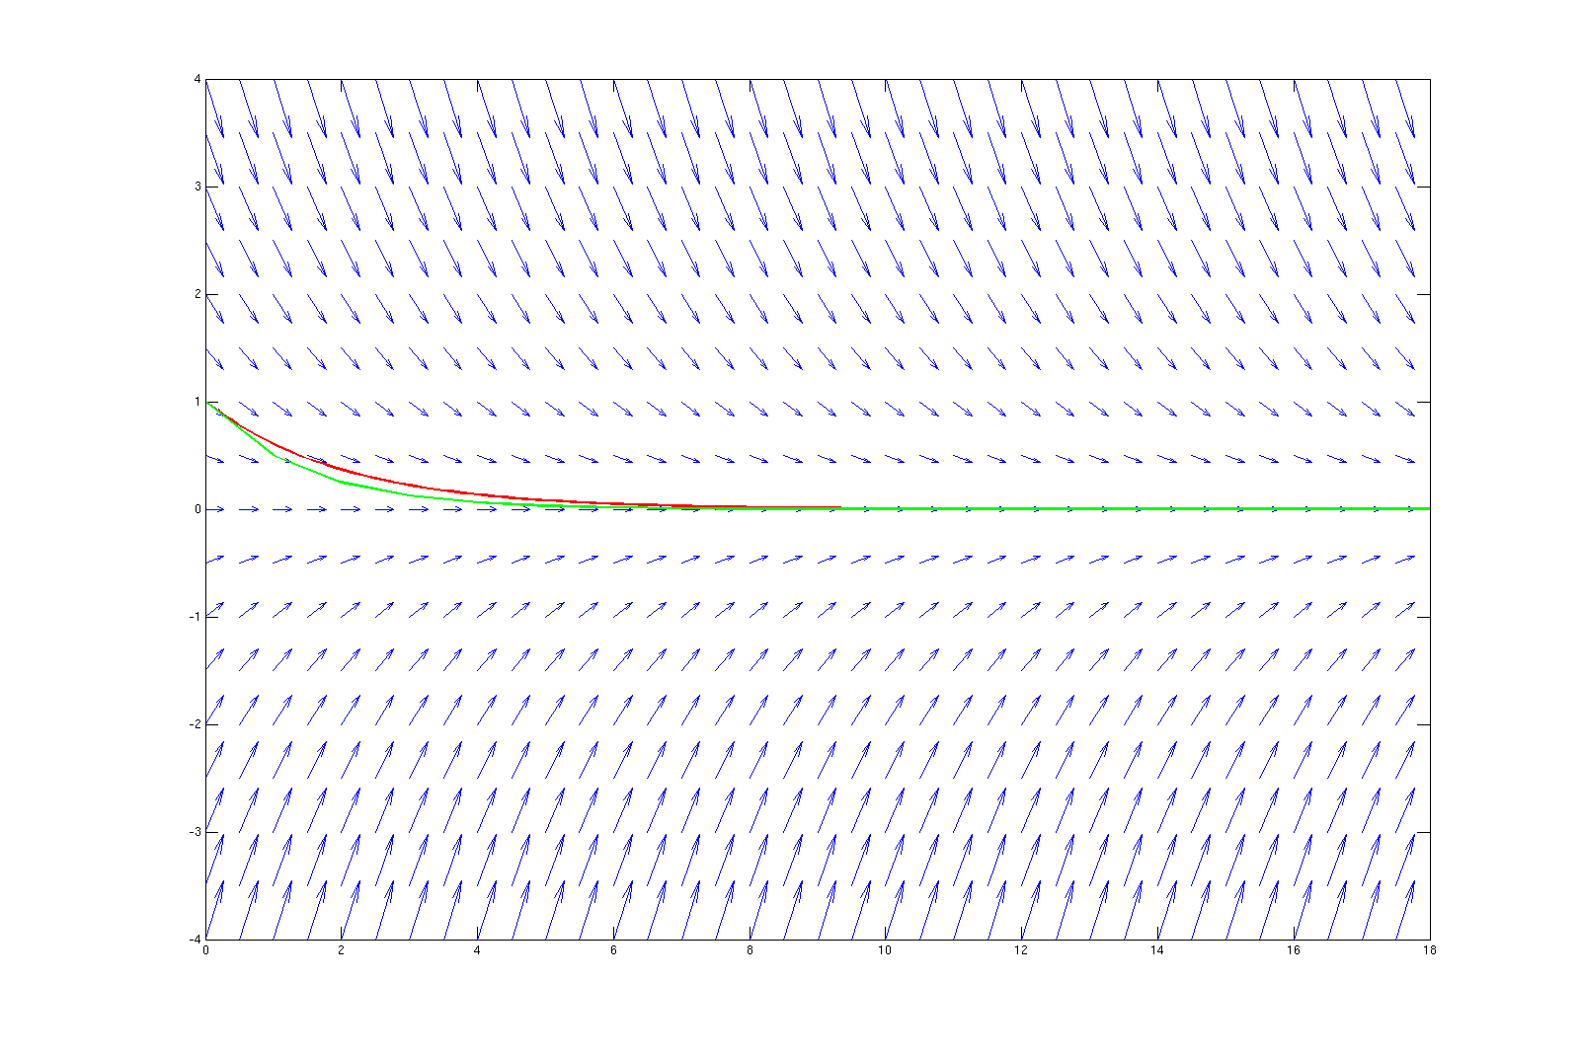
Instability
•
Explicit Euler, time step size: 1

Slide 18
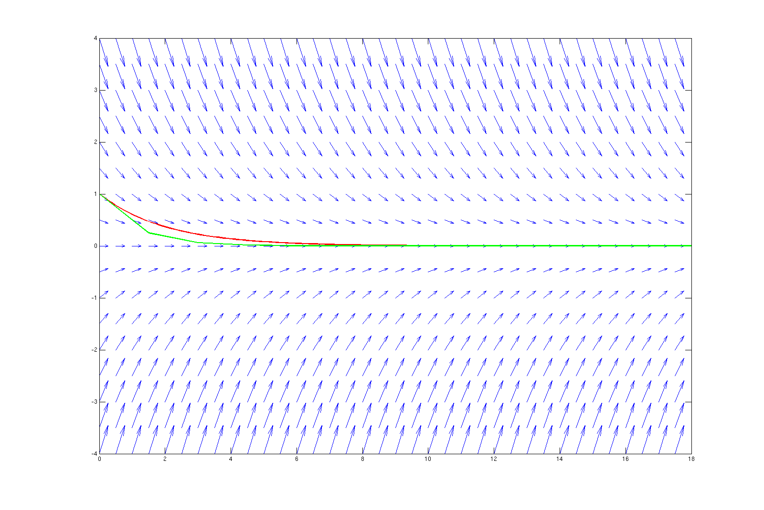
Instability
•
Explicit Euler, time step size: 1.5

Slide 19
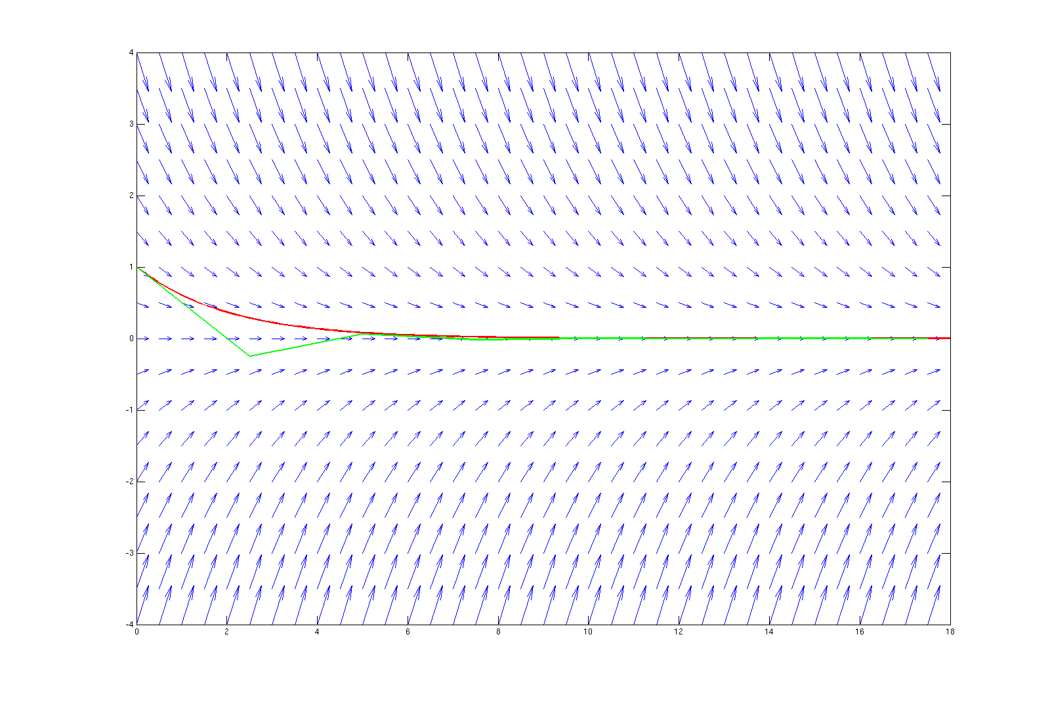
Instability
•
Explicit Euler, time step size: 2.5

Slide 20
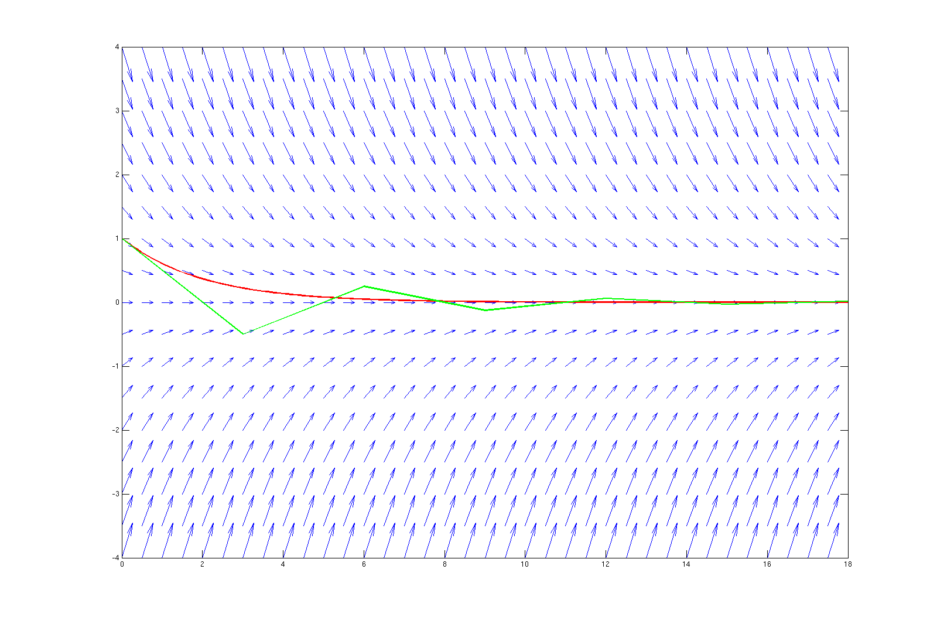
Instability
•
Explicit Euler, timestep-size: 3.0

Slide 21
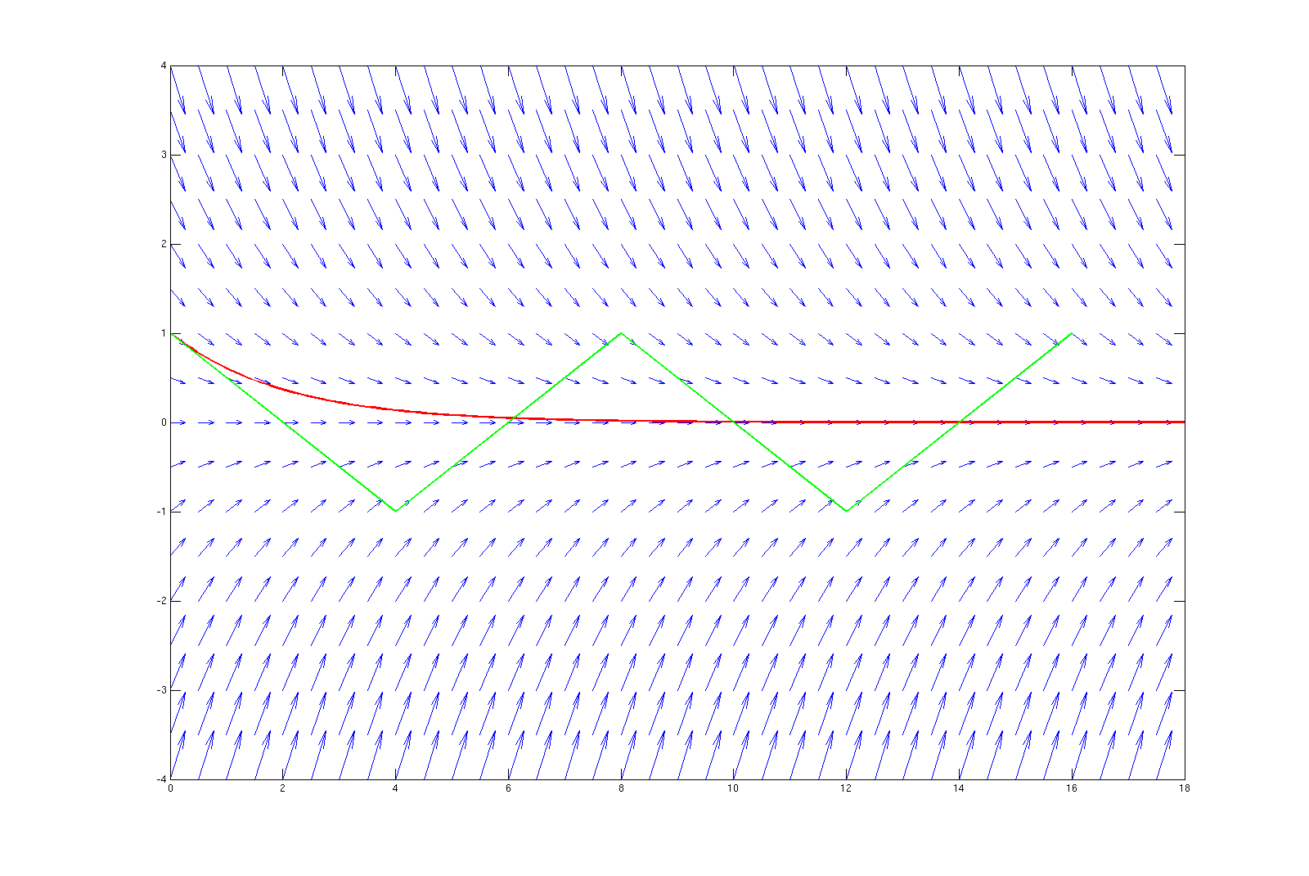
Instability
•
Explicit Euler, time step size: 4.0

Slide 22
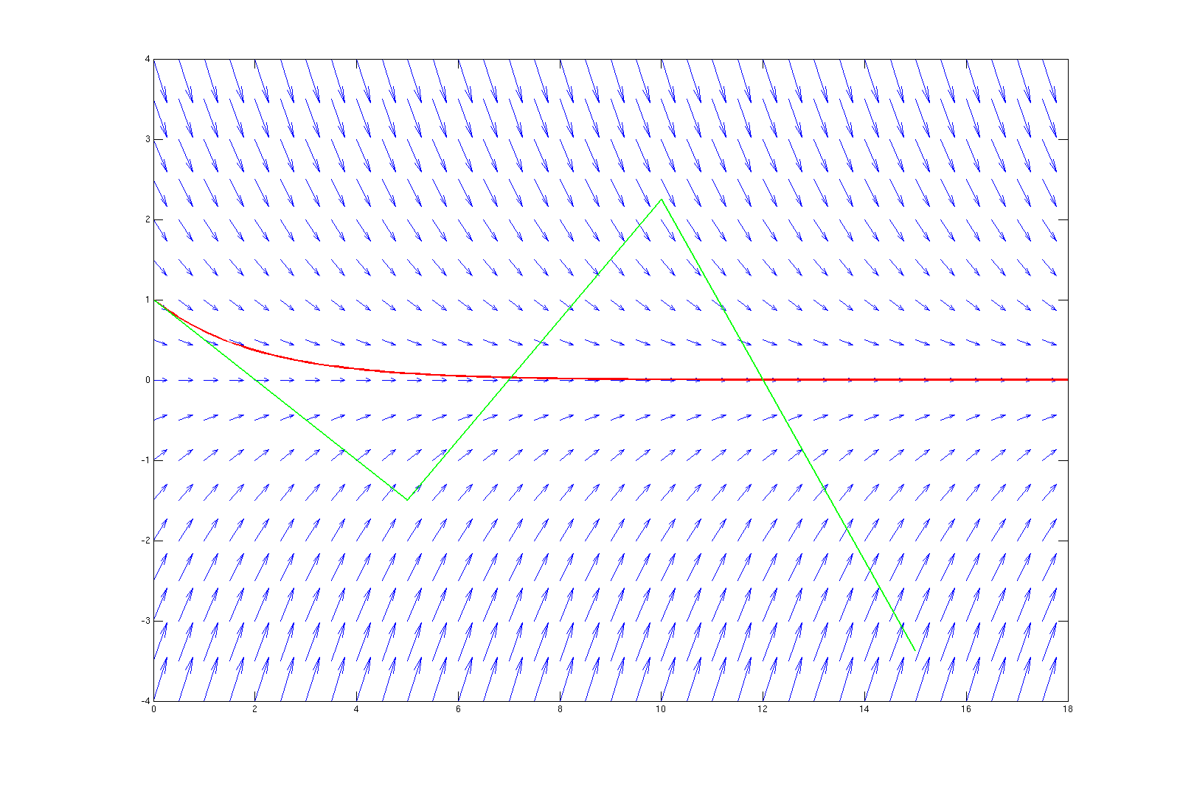
Instability
•
Explicit Euler, time step size: 5.0

Slide 23
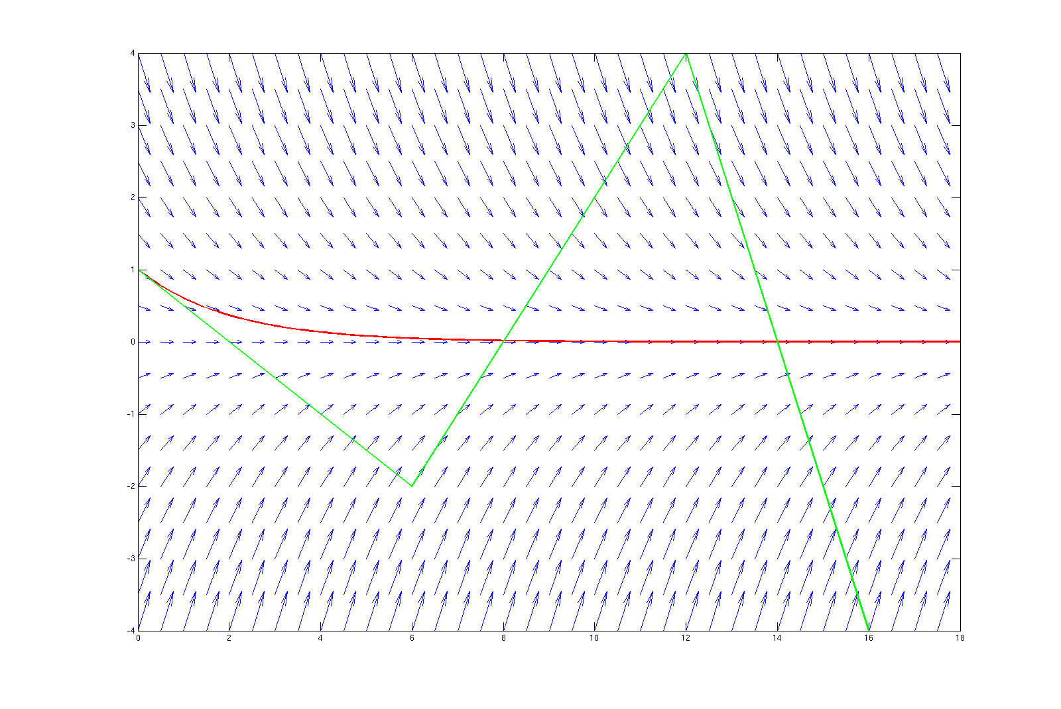
Instability
•
Explicit Euler, time step size: 6.0

Slide 24
Instability
•
stiff equations
–
instabilities if dt does not obey restrictions
–
„all explicit SSM with stable dt provide very small local errors”
–
examples: damped mech. systems, parabolic PDE, chem.
reaction kinetics
•
remedy: (special) implicit methods

Slide 25
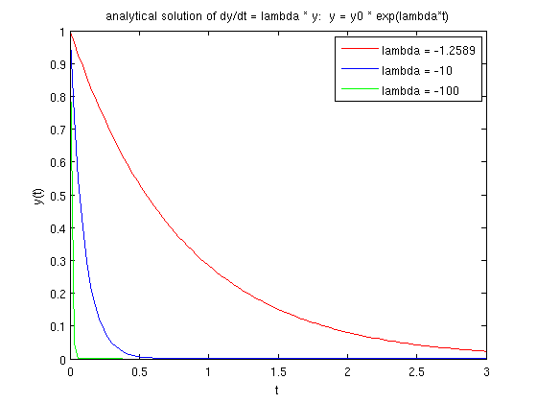
Stiff Equations
y
(
)=λ⋅
(
)
•
Example: Dahlquist's test equation:
˙
t
y
t
–
stable analyt. solution
–
explicit methods:
Δ
≤∣
/ λ∣
t
c
also in
steady phase
(c depending on the method)
transient phase
steady phase
Δ
t
Δ
t
limited by stability & accuracy
limited by stability only!

Slide 26
Implicit Methods
•
implicit Euler
•
2
-order Adams Moulton
nd
y
=
F
(
y
, t
Δ
)
➢
,
t
n
+
1
n
+
1
n

Slide 27
Implicit Methods
•
implicit Euler (1
st
-order method)
y
˙
+
t
n
1
y
=
y
+Δ
⋅
t
y
˙
n
+
1
n
n
+
1
y
+
n
1
=
y
+Δ
⋅
(
)
t
f
t
, y
n
n
+
1
n
+
1
t
Δ
t

Slide 28
Implicit Methods
•
2
-order Adams Moulton (Trapezoidal Rule)
nd
y
y
˙
˙
+
t
n
n
1
Δ
t
y
=
y
+
⋅(
y
+
y
)
˙
˙
y
n
+
1
n
2
n
n
+
1
n
+
1
Δ
t
=
y
+
⋅(
f
(
)+
(
))
t
, y
f
t
, y
n
2
n
n
n
+
1
n
+
1
t
Δ
t

Slide 29
Newton's Method
•
Implicit method may result in complex expressions:
ODE
f
(
(
))=−
(
(
))
t , y
t
log
y
t
implicit Euler:
y
=
y
+Δ
⋅
t
y
˙
n
+
1
n
n
+
1
=
y
+Δ
⋅
(
)
t
f
t
, y
n
n
+
1
n
+
1
=
y
−Δ
⋅
(
)
t
log
y
n
n
+
1

Slide 30
Newton's Method
•
Implicit method may result in complex expressions:
implicit Euler:
y
=
y
−Δ
⋅
(
)
t
log
y
n
+
1
n
n
+
1
needs to be solved:
y
+Δ
⋅
(
)−
=
t
log
y
y
0
n
+
1
n
+
1
n
Can (only) be solved numerically!

Slide 31
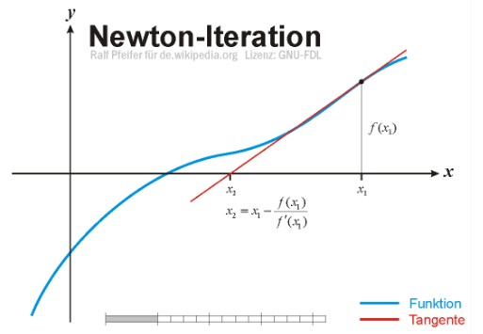
Newton's Method
•
Numerical approach to find roots of functions
G
(
)=
x
0
Ralf Pfeifer – http://upload.wikimedia.org/wikipedia/commons/e/e0/NewtonIteration_Ani.gif

Slide 32
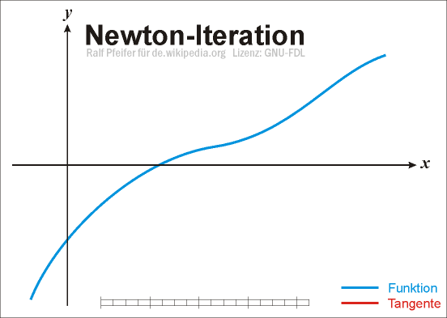
Newton's Method
•
Numerical approach to find roots of functions
G
(
)=
x
0
Ralf Pfeifer – http://upload.wikimedia.org/wikipedia/commons/e/e0/NewtonIteration_Ani.gif

Slide 33
Newton's Method
•
Numerical approach to find roots of functions
G
(
)=
x
0
G
(
)
x
x
=
x
−
i
+
i
1
i
G '
(
)
x
i
Ralf Pfeifer – http://upload.wikimedia.org/wikipedia/commons/e/e0/NewtonIteration_Ani.gif

Slide 34
Newton's Method
•
Numerical approach to find roots of functions
•
In our case we get
G
(
y
)=
0
n
+
1
•
Thus, we need
G '
(
y
)
n
+
1

Slide 35
Newton's Method
y
=
y
−Δ
⋅
(
)
•
Initial example:
t
log
y
n
+
1
n
n
+
1
G
(
y
)=
y
+Δ
⋅
(
)−
t
log
y
y
n
+
1
n
+
1
n
+
1
n
Δ
t
G '
(
y
)=
1
+
n
+
1
y
n
+
1

Slide 36
Explicit versus Implicit
•
explicit:
–
cheap time steps
–
many time steps
•
implicit:
–
expensive/impossible time steps
–
less time steps

Slide 37
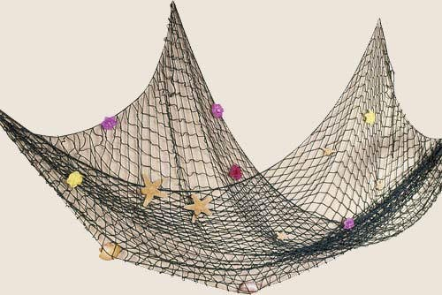
Stationary Partial Differential Equations
How to compute this?
http://orionwell.files.wordpress.com/2007/05/fish_net.jpg

Slide 38
Stationary Partial Differential Equations
What do we want to have?
http://orionwell.files.wordpress.com/2007/05/fish_net.jpg
Function f(x,y) that describes the
displacement for each joint (x,y).

Slide 39
Stationary Partial Differential Equations
F
g
Forces in initial state

Slide 40
Stationary Partial Differential Equations
F
g
Forces in equilibrium state

Slide 41
Stationary Partial Differential Equations
F
g
Forces in equilibrium state

Slide 42
Stationary Partial Differential Equations
f
−
f
−
x
1
x
f
−
f
x

1
x
F
g
F
=−
F

f
−
f

f
−
f
x
g
−

x
1
x
x
1
x
F
=−
F

f
−
⋅

2
f
f
x
g
−

x
1
x
x
1

Slide 43
Stationary Partial Differential Equations
1D:
F
=−
F

f
−
⋅

2
f
f
x
g
−

x
1
x
x
1
2D:
F
g
What is ? What is ?
F
f
x , y
x , y

Slide 44
Stationary Partial Differential Equations
2D:
F
g
What is ? What is ?
F
f
x , y
x , y

Slide 45
Stationary Partial Differential Equations
2D:
f
x , y

1
f
x
−
1, y
f
f
x

1, y
x , y
f
x , y
−
1
F
g
F
=−
F

f

f
−
⋅


4
f
f
f
x , y
g
x
−
1, y
x , y
−
1
x , y
x

1, y
x , y

1

Slide 46
Stationary Partial Differential Equations
What are Partial Differential Equations (PDEs)?
•
Dependent on several variables
•
Containing partial derivatives
•
boundary value problems
➢
no start and end (for stationary problems)

Slide 47
Discretization
What is discretization?
→
Solving the function just on some points
Why do we discretize?

Slide 48
Discretization
What is discretization?
→
Solving the function just on some points
Why do we discretize?
→
Continous form hard to store in the computer
→
Analytical solving often not possible

Slide 49
Discretization
•
space
grid
•
functions
finite difference/volume/element
•
operators

Slide 50
Discretization
•
space
grid
•
functions
finite difference/volume/element
•
operators
➢
How to solve this?
F
=−
F

f

f
−
⋅


➢
4
f
f
f
x , y
g
x
−
1, y
x , y
−
1
x , y
x

1, y
x , y

1
➢
In the equilibrium:
f

f
−
⋅


=
4
f
f
f
F
x
−
1, y
x , y
−
1
x , y
x

1, y
x , y

1
g
−
F

f

f
−
⋅


=
4
f
f
f
0
g
x
−
1, y
x , y
−
1
x , y
x

1, y
x , y

1

Slide 51
Discretization
f

f
−
⋅


=
4
f
f
f
F
x
−
1, y
x , y
−
1
x , y


x
1, y
x , y
1
g
How to transform this to the following form?






f
0,0
f
⋅
1,0
=
⋮
f
N , N

Slide 52
Discretization
f

f
−
⋅


=
4
f
f
f
F
x
−
1, y
x , y
−
1
x , y


x
1, y
x , y
1
g
Applied on each point (x,y) this gives






⋯
f
F
0,0
g
1
⋯
1
−
4
1
⋯
1
⋯
f
F
⋅
1,0
=
g
⋮
⋮
⋮
⋮
⋮
⋮
⋮
⋮
⋮
⋮
⋯
f
F
N , N
g
→
Linear System of Equations

Slide 53
Solvers for Systems of Linear Equations
What solving strategies do you know?
•
Direct solvers
–
Full matrix
–
Sparse matrix
•
Iterative solvers
–
Jacobi
–
Gauß-Seidel
–
...

Slide 54
Gauß-Seidel Solver
•
point-by-point processing
•
eliminate local residual
f

f
−
⋅


=
4
f
f
f
F
x
−
1, y
x , y
−
1
x , y


x
1, y
x , y
1
g

Slide 55
Gauß-Seidel Solver
•
point-by-point processing
•
eliminate local residual
f

f
−
⋅


=
4
f
f
f
F
x
−
1, y
x , y
−
1
x , y


x
1, y
x , y
1
g

Slide 56
Gauß-Seidel Solver
•
point-by-point processing
•
eliminate local residual
f

f
−
⋅


=
4
f
f
f
F
x
−
1, y
x , y
−
1
x , y


x
1, y
x , y
1
g

Slide 57
Gauß-Seidel Solver
•
point-by-point processing
•
eliminate local residual
f

f
−
⋅


=
4
f
f
f
F
x
−
1, y
x , y
−
1
x , y


x
1, y
x , y
1
g

Slide 58
Gauß-Seidel Solver
•
point-by-point processing
•
eliminate local residual
f

f
−
⋅


=
4
f
f
f
F
x
−
1, y
x , y
−
1
x , y


x
1, y
x , y
1
g

Slide 59
Gauß-Seidel Solver
•
point-by-point processing
•
eliminate local residual
f

f
−
⋅


=
4
f
f
f
F
x
−
1, y
x , y
−
1
x , y


x
1, y
x , y
1
g

Slide 60
Gauß-Seidel Solver
•
point-by-point processing
•
eliminate local residual
f

f
−
⋅


=
4
f
f
f
F
x
−
1, y
x , y
−
1
x , y


x
1, y
x , y
1
g

Slide 61
Gauß-Seidel Solver
•
point-by-point processing
•
eliminate local residual
f

f
−
⋅


=
4
f
f
f
F
x
−
1, y
x , y
−
1
x , y


x
1, y
x , y
1
g

Slide 62
Gauß-Seidel Solver
•
point-by-point processing
•
eliminate local residual
•
elimination for one point increases residual of
neighbouring points
→ Overall residual is smaller than before
→ Iterate until desired accuracy

Slide 63
Instationary PDEs
●
Stationary PDEs (time-independent):
●
Only spatial derivatives
2
2
∂
T
∂
T

=
rhs


x , y
∂
2
∂
2
x
y

Slide 64
Instationary PDEs
●
Stationary PDEs (time-independent):
●
Only spatial derivatives
2
2
∂
T
∂
T

=
rhs


x , y
∂
2
∂
2
x
y
●
Instationary PDEs (time-dependent):
●
Derivatives in space and time
∂
2
2
T
∂
T
∂
T
=

∂
t
∂
2
∂
2
x
y

Slide 65
Discretization
•
Spatial discretization
•
Time discretization

Slide 66
Explicit/Implicit
•
explicit time steps
➢
restricted time step sizes
➢
dependent on spatial step
➢
no equations to solve
•
implicit time step
➢
unrestricted time step sizes
➢
large systems of equations

Slide 67
Accuracy Issues
➢
Discretization error in time and space
=

e
e
e
space
time
➢
e
High-order space disc. → dominates
time
➢
e
High-order time disc. → dominates
space

Slide 68
Accuracy Issues
➢
Take into account:
–
Order of discretization
–
Region of stability
–
Maximum allowed timestep size

Slide 69
Accuracy Issues
➢
Take into account:
–
Order of discretization
–
Region of stability
–
Maximum allowed timestep size
➢
Higher-order methods do not harm (in terms of
accuracy; but be aware of comput. costs!)

Slide 70
Explicit/Implicit
•
Separation in space/time-discretization
–
Compute spatial derivatives
–
Consider function value on each grid-point as
an ODE

Slide 71
Thank You

