Slide 1
Integrated Business Intelligence Analysis
End-to-End Business Data Analysis Capstone Project
BY:
ABINAYA KN

Slide 2
Project Overview
This project presents a complete end-to-end business data analysis workflow.
The analysis was performed on three business datasets:
Sales performance data
Customer churn data
Housing market price data
The goal was to transform raw data into actionable business insights using structured analytical techniques.

Slide 3
Business Problem
Organizations face several operational challenges:
Uneven sales performance across regions
Customer attrition affecting revenue stability
Difficulty in determining accurate pricing strategies
Limited use of data for decision-making
This project aims to solve these challenges using data-driven analysis.

Slide 4
Project Objectives
The key objectives of this project were:
Perform data cleaning and preprocessing
Conduct exploratory data analysis (EDA)
Identify business trends and patterns
Calculate key performance indicators (KPIs)
Generate actionable business recommendations
Build a reproducible analytics workflow

Slide 5
Datasets Used
Three datasets were analyzed:
Sales Dataset
Product sales transactions
100 records
House Prices Dataset
Real estate property data
300 records
Customer Churn Dataset
Customer retention information
500 records
Total records analyzed: 900+

Slide 6
Methodology
The project followed a structured analytical workflow:
Raw Data ↓ Data Cleaning ↓ Exploratory Data Analysis ↓ Advanced Analysis ↓ Business Insights ↓ Recommendations
Python and Jupyter Notebook were used to ensure reproducibility.

Slide 7
Tools & Technologies
The following tools were used:
Python
Pandas
NumPy
Matplotlib
Jupyter Notebook
These tools enabled efficient data manipulation, visualization, and analysis.

Slide 8
Exploratory Data Analysis
During exploratory analysis:
Data distributions were examined
Relationships between variables were analyzed
Regional sales performance was compared
Pricing patterns were identified

Slide 9
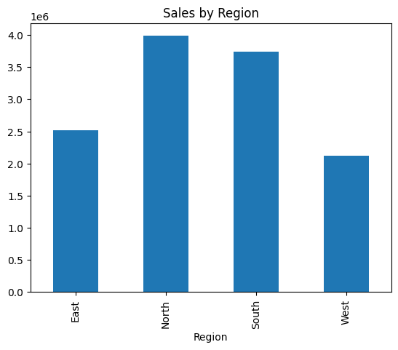
Sales Analysis Findings
Key observations from sales data:
Majority of transactions fall within mid-revenue ranges
Regional variations significantly affect revenue totals
Certain product categories contribute higher revenue
This indicates opportunities for targeted marketing.

Slide 10
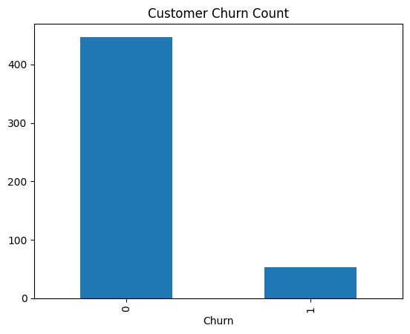
Customer Churn Findings
Key observations:
Overall churn rate approximately 10%
Customers with longer tenure show higher retention
Contract duration influences churn likelihood
This suggests retention strategies can reduce revenue loss.

Slide 11
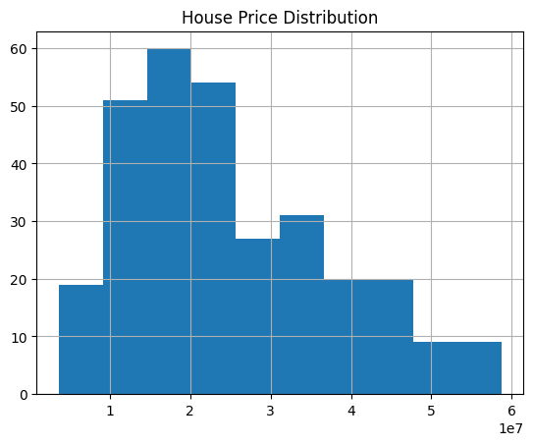
Housing Market Findings
Key observations:
Property area strongly correlates with price
Houses dominate market listings
Mid-price properties show higher frequency
This supports data-driven pricing decisions.

Slide 12
Key Performance Indicators
The following KPIs were calculated:
Total Sales Revenue
Average Property Price
Customer Churn Rate
These metrics provide measurable indicators of business performance.

Slide 13
Business Recommendations
Based on analysis:
Focus promotional campaigns on high-performing regions
Introduce loyalty incentives for long-term customers
Encourage extended subscription contracts
Apply data-driven pricing strategies in real estate decisions
Continuously monitor churn and revenue metrics

Slide 14
Conclusion
This project successfully demonstrated:
An end-to-end business analytics workflow
Practical application of data cleaning and EDA
Identification of meaningful business patterns
Generation of actionable recommendations
The project highlights how structured data analysis supports data-driven decision-making.

Slide 15
THANK YOU

