Slide 1
RESTAURANT FINDER AND RECOMMENDER
Applied DataScience Capstone Project
-by Abinaya S

Slide 2
INTRODUCTION
People in cities face difficulty in finding a restaurant of their choice within their locality due to very high number of restaurants in the city.
Using this restaurant finder people can find a restaurant according to
Cuisine that they want to try for the day
Find one near to them
Find rating for that restaurant
Will be of immense use to food lovers who take lot of pain in roaming around the city to find a restaurant of their choice of food and taste.

Slide 3
DATA USED TO SOLVE THE PROBLEM
The Foursquare API is the primary source of data for this project.
Foursquare API is used to find the list of locations within a radius range along with their lalitude,longitude,category and also filter data according to their category in this case, namely food.
Example:
{'id': '5b9e10ae1ffe97002cc752a7’,
'name': 'Starbucks’,
'location': {'address': 'Gopathi Narayanaswami Chetty Road, T Nagar’,
'crossStreet': 'Gronud Floor, PMG Complex’,
'labeledLatLngs': [{'label': 'display’,
'lat': 13.041685,
'lng': 80.23458}],
'distance': 6965…

Slide 4
METHODOLOGY
Filter out all the restaurants in their city which are within the given distance range specified by the user
Find out the cuisine that the user wants to try from the list of cuisines that are available within the city.
Find out all restaurants within the distance range which have cuisine specified by the user
Find out the ratings, price tier,distance of those restaurants filtered out in the previous step by using venueid
Recommend the places to the user according to their rating and their distance .

Slide 5
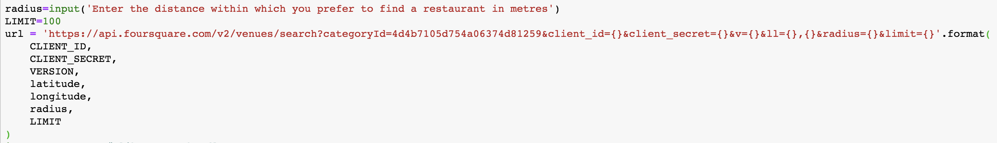
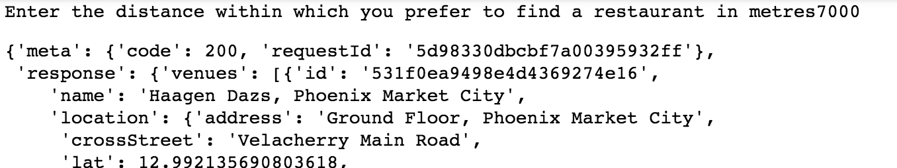
Results
User enters their location
User enters the distance range and Foursquare API is used to get the places within the distance range
Foursquare API returns response in JSON format containing list of restaurants within the required distance

Slide 6
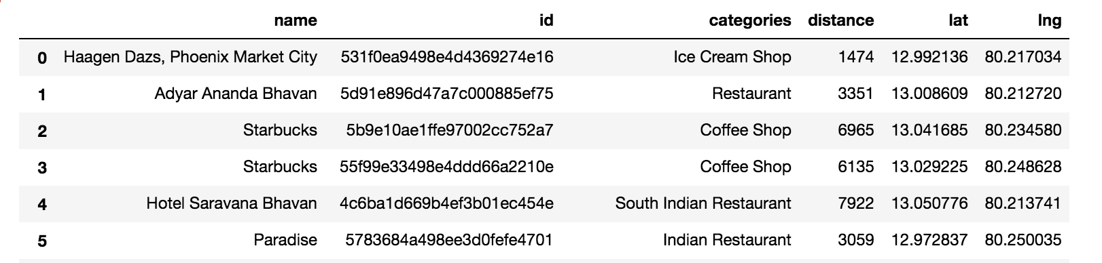
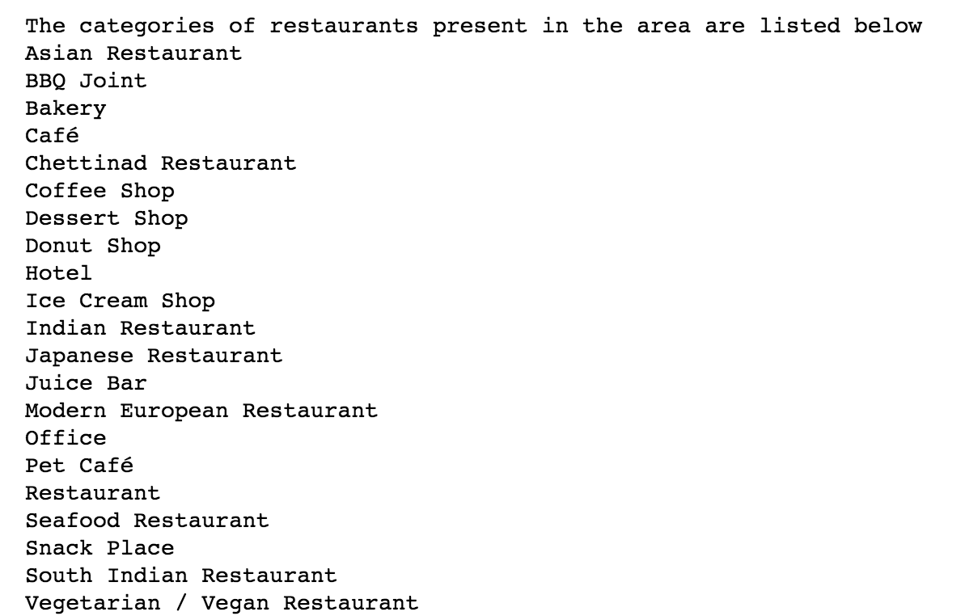
Cuisines/categories of restaurants present within the distance range

Slide 7
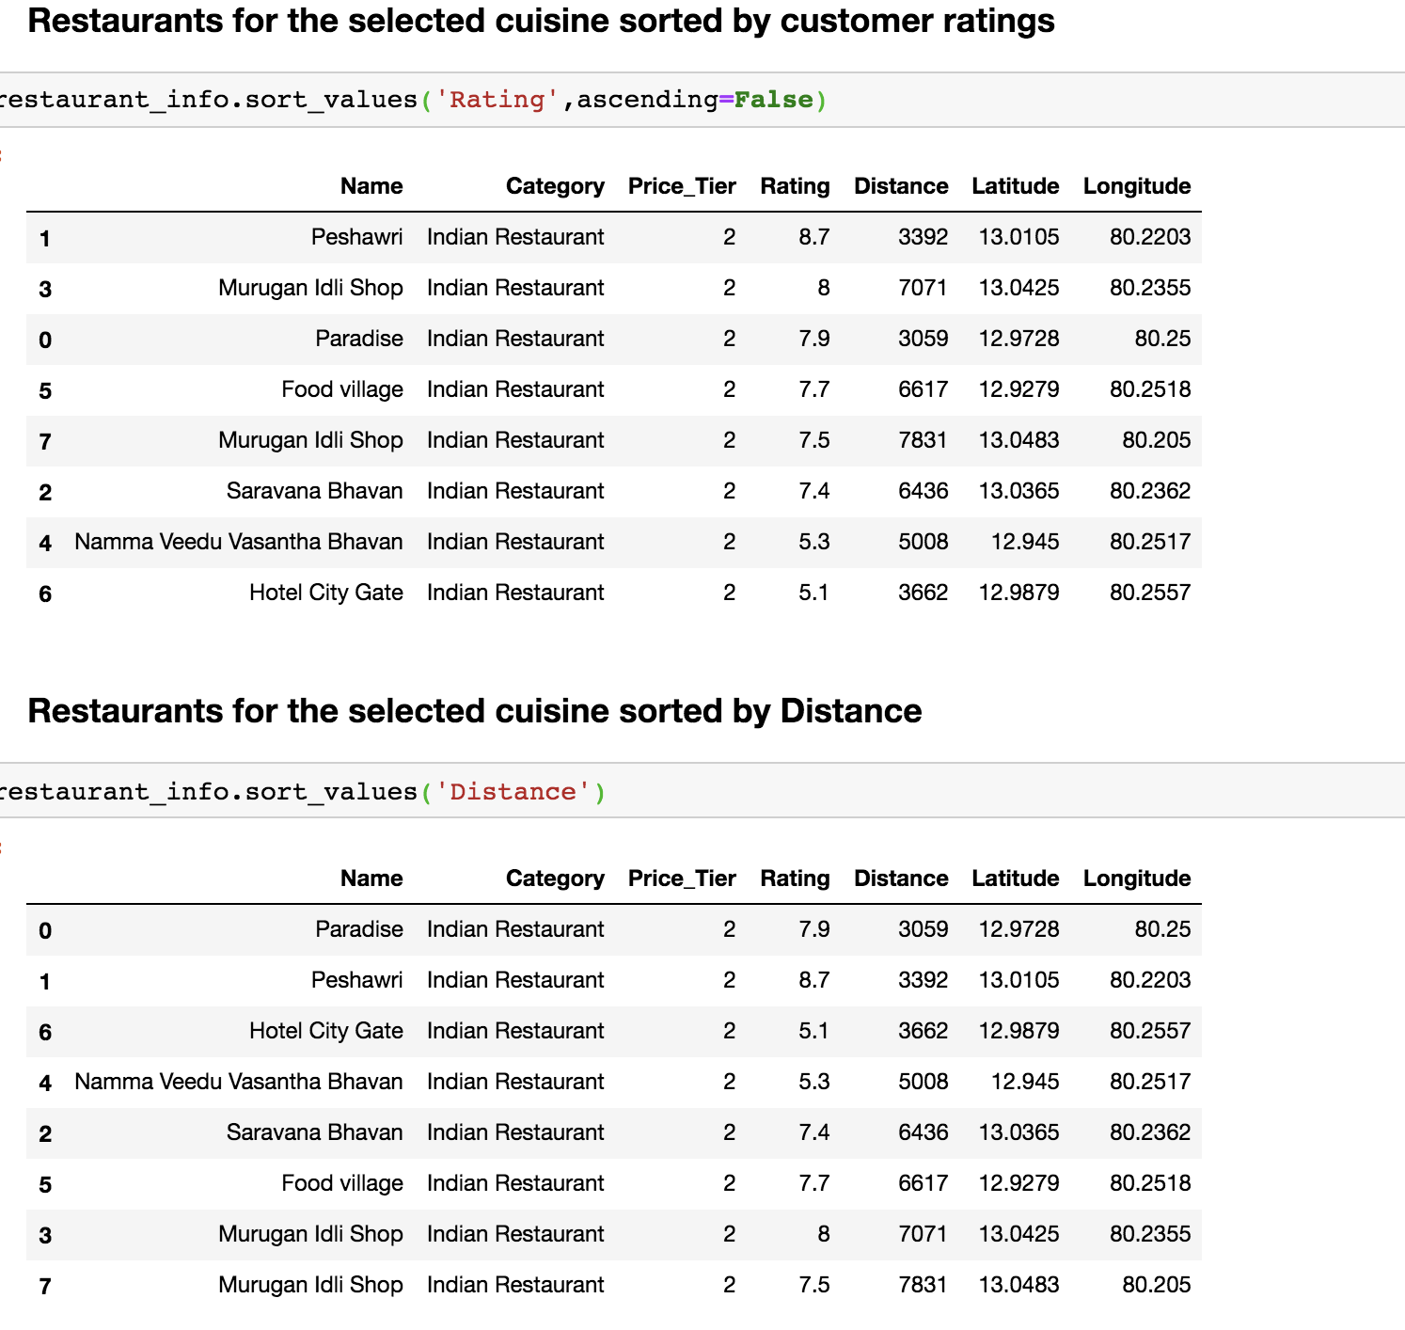
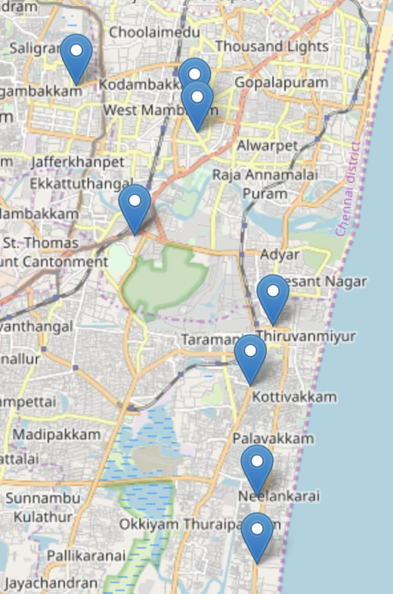
User enters the required cuisine that they want to try
Restaurants according to user’s choice are listed depending upon the ratings and distance which is obtained through another Foursquare API call
Listed places shown on map

Slide 8
CONCLUSION
The project finally delivers a list of restaurants according to
People choice of cuisine
Within the given distance range
Price tier
Rating
which makes the entire process of dine out simple and easy with minimizing time and efforts to search for a restaurant and maximise the time spent with our loved ones.

