Slide 1

Employee Data Analysis using Excel
STUDENT NAME: V ABINAYA
REGISTER NO: 312206350 (unm299bcom(g)1)
DEPARTMENT: Bcom(General)
COLLEGE: S.S.K.V. COLLEGE OF ARTS & SCIENCE FOR WOMEN
KANCHIPURAM.
1
Notes:
1

Slide 2

PROJECT TITLE
Employee Attendance Analysis using Excel
2

Slide 3



AGENDA
  Problem Statement
  Project Overview
  End Users
  Our Solution and Proposition
  Dataset Description
  Modelling Approach
  Results and Discussion
  Conclusion
3/21/2024 Annual Review
3

Slide 4

PROBLEM STATEMENT
Manual tracking and analysis of employee attendance are often error-prone and inefficient, limiting an organization’s ability to uncover valuable insights.
This project aims to develop a data-driven solution to accurately analyze attendance patterns, helping organizations optimize workforce management and improve overall productivity.
4

Slide 5

PROJECT OVERVIEW
Objective: Analyze employee attendance data to identify patterns, trends, and issues affecting productivity, and provide actionable insights for improvement.
5

Slide 6

WHO ARE THE END USERS?
1.Manager
2.Organization
3.Employee
4.Employer
5.IT Sectors
6

Slide 7

WHO ARE THE END USERS?
1.Manager
2.Organization
3.Employee
4.Employer
5.IT Sectors
6

Slide 8

OUR SOLUTION AND ITS VALUE PROPOSITION
. Pivot : Summary
. Graph: Data visualization
7

Slide 9
Dataset Description
→ Employee-kaggle
→ Employee ID-number
→ Week number-number
→ Absence type
→ Hours-hrs
→ Employee status-active/inactive
→ Attendance level – fullday/halfday/hourly absent

Slide 10

THE "WOW" IN OUR SOLUTION
. Attendance level : =IF(F2<2,"hourly absent",IF(F2<=4,"half day absent",IF(F2<=8,"fullday",)))
3/21/2024 Annual Review
9

Slide 11
MODELLING
→Data collection
  Kaggle
  Download the dataset
  →Attendance level
  Calculate the attendance
  Finalize the attendance
  Summary
  Pivot chart
  2) Data visualization
10

Slide 12
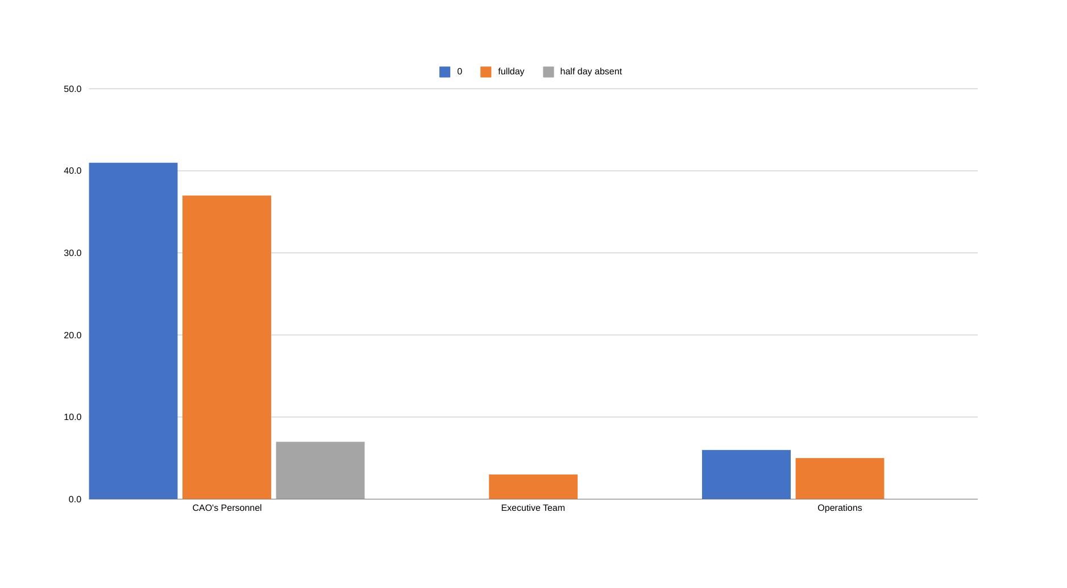
RESULTS
11

Slide 13
Conclusion
The analysis of the employee attendance dataset revealed key patterns and department-specific trends in absenteeism and overtime. These findings enable the organization to implement targeted strategies, such as flexible work policies and department-specific interventions, to improve attendance and productivity. The insights and predictive models (if developed) will help in ongoing monitoring and proactive management of attendance issues.

