Slide 1
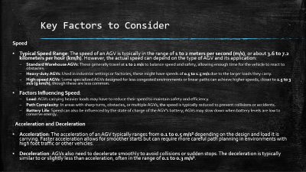
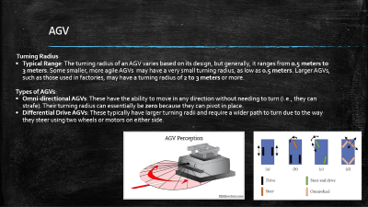


Problem definition
Automated Guided Vehicles (AGVs) are increasingly utilized in various industries for material handling and logistics. However, their operational efficiency is often hindered by suboptimal path planning, leading to excessive travel times and energy consumption.
In static environments, where obstacles and layout constraints are fixed, the challenge lies in developing a path planning solution that effectively navigates these constraints while minimizing both energy expenditure and travel duration

Slide 2
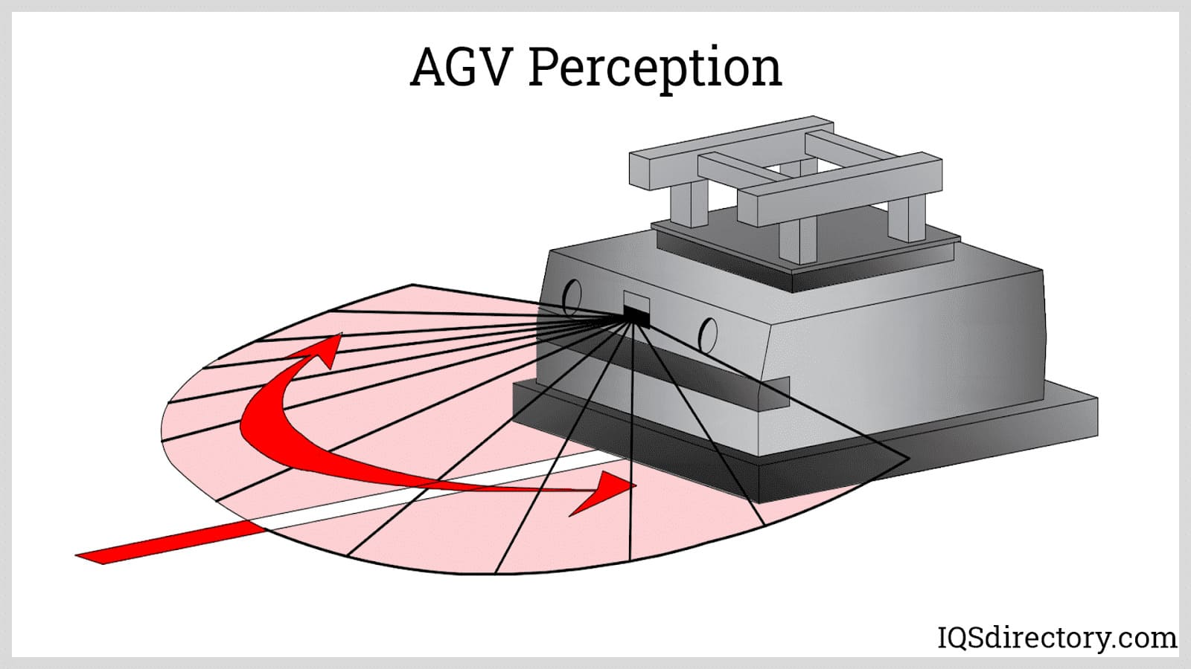
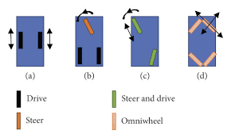
AGV
Turning Radius
Typical Range: The turning radius of an AGV varies based on its design, but generally, it ranges from 0.5 meters to 3 meters. Some smaller, more agile AGVs may have a very small turning radius, as low as 0.5 meters. Larger AGVs, such as those used in factories, may have a turning radius of 2 to 3 meters or more.
Types of AGVs:
Omni-directional AGVs: These have the ability to move in any direction without needing to turn (i.e., they can strafe). Their turning radius can essentially be zero because they can pivot in place.
Differential Drive AGVs: These typically have larger turning radii and require a wider path to turn due to the way they steer using two wheels or motors on either side.

Slide 3
Key Factors to Consider
Speed
Typical Speed Range: The speed of an AGV is typically in the range of 1 to 2 meters per second (m/s), or about 3.6 to 7.2 kilometers per hour (km/h). However, the actual speed can depend on the type of AGV and its application:
Standard Warehouse AGVs: These generally travel at 1 to 2 m/s to balance speed and safety, allowing enough time for the vehicle to react to obstacles.
Heavy-duty AGVs: Used in industrial settings or factories, these might have speeds of 0.5 to 1.5 m/s due to the larger loads they carry.
High-speed AGVs: Some specialized AGVs designed for less congested environments or linear paths can achieve higher speeds, closer to 2.5 to 3 m/s (9 km/h), though these are less common.
Factors Influencing Speed:
Load: AGVs carrying heavier loads may have to reduce their speed to maintain safety and efficiency.
Path Complexity: In areas with sharp turns, obstacles, or multiple AGVs, the speed is typically reduced to prevent collisions or accidents.
Battery Life: Speed can also be influenced by the state of charge of the AGV’s battery; AGVs may slow down when battery levels are low to conserve energy.
. Acceleration and Deceleration
Acceleration: The acceleration of an AGV typically ranges from 0.1 to 0.5 m/s² depending on the design and load it is carrying. Faster acceleration allows for smoother starts but can require more careful path planning in environments with high foot traffic or other vehicles.
Deceleration: AGVs also need to decelerate smoothly to avoid collisions or sudden stops. The deceleration is typically similar to or slightly less than acceleration, often in the range of 0.1 to 0.3 m/s².

Slide 4
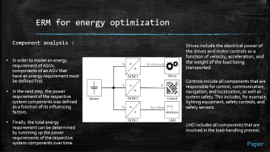
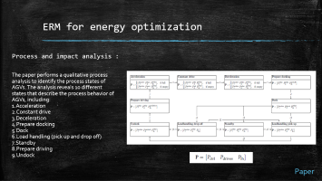
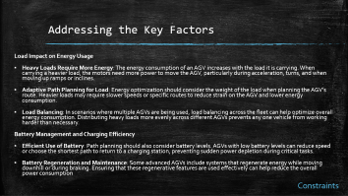
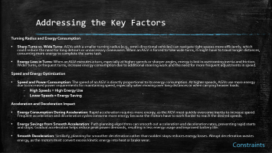
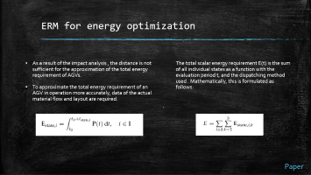

Understanding and Relevance

Slide 5
Addressing the Key Factors
Turning Radius and Energy Consumption
Sharp Turns vs. Wide Turns: AGVs with a smaller turning radius (e.g., omni-directional vehicles) can navigate tight spaces more efficiently, which could reduce the need for long detours or unnecessary maneuvers. When an AGV is forced to take wide turns, it might have to travel longer distances, consuming more energy to complete the same task.
Energy Loss in Turns: When an AGV executes a turn, especially at higher speeds or sharper angles, energy is lost in overcoming inertia and friction. Wider turns, or frequent turns, increase energy consumption due to additional steering work and the need for more frequent adjustments in speed.
Speed and Energy Optimization
Speed and Power Consumption: The speed of an AGV is directly proportional to its energy consumption. At higher speeds, AGVs use more energy due to increased power requirements for maintaining speed, especially when moving over long distances or when carrying heavier loads.
High Speeds = High Energy Use
Lower Speeds = Energy Saving
Acceleration and Deceleration Impact
Energy Consumption During Acceleration: Rapid acceleration requires more energy, as the AGV must quickly overcome inertia to increase speed. Frequent acceleration and deceleration cycles consume more energy because the motors have to work harder to reach the desired speeds.
Energy Savings from Smooth Acceleration: Path planning algorithms can smooth out acceleration and deceleration rates, preventing rapid starts and stops. Gradual acceleration helps reduce peak power demands, resulting in less energy usage and improved battery life.
Smooth Deceleration: Similarly, planning for smoother deceleration rather than sudden stops reduces energy losses. Abrupt deceleration wastes energy, as the motors must convert excess kinetic energy into heat or brake wear.
Constraints

Slide 6
Addressing the Key Factors
Load Impact on Energy Usage
Heavy Loads Require More Energy: The energy consumption of an AGV increases with the load it is carrying. When carrying a heavier load, the motors need more power to move the AGV, particularly during acceleration, turns, and when moving up ramps or inclines.
Adaptive Path Planning for Load: Energy optimization should consider the weight of the load when planning the AGV’s route. Heavier loads may require slower speeds or specific routes to reduce strain on the AGV and lower energy consumption.
Load Balancing: In scenarios where multiple AGVs are being used, load balancing across the fleet can help optimize overall energy consumption. Distributing heavy loads more evenly across different AGVs prevents any one vehicle from working harder than necessary.
Battery Management and Charging Efficiency
Efficient Use of Battery: Path planning should also consider battery levels. AGVs with low battery levels can reduce speed or choose the shortest path to return to a charging station, preventing sudden power depletion during critical tasks.
Battery Regeneration and Maintenance: Some advanced AGVs include systems that regenerate energy while moving downhill or during braking. Ensuring that these regenerative features are used effectively can help reduce the overall power consumption
Constraints

Slide 7
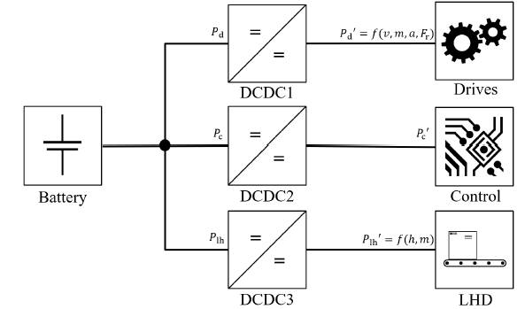
ERM for energy optimization
Component analysis :
Drives include the electrical power of the drives and motor controls as a function of velocity, acceleration, and the weight of the load being transported.
In order to model an energy requirement of AGVs, components of an AGV that have an energy requirement must be defined first.
In the next step, the power requirement of the respective system components was defined as a function of its influencing factors.
Finally, the total energy requirement can be determined by summing up the power requirements of the respective system components over time.
Controls include all components that are responsible for control, communication, navigation, and localization, as well as system safety. This includes, for example, lighting equipment, safety controls, and safety sensors.
LHD includes all components that are involved in the load-handling process.
Paper

Slide 8
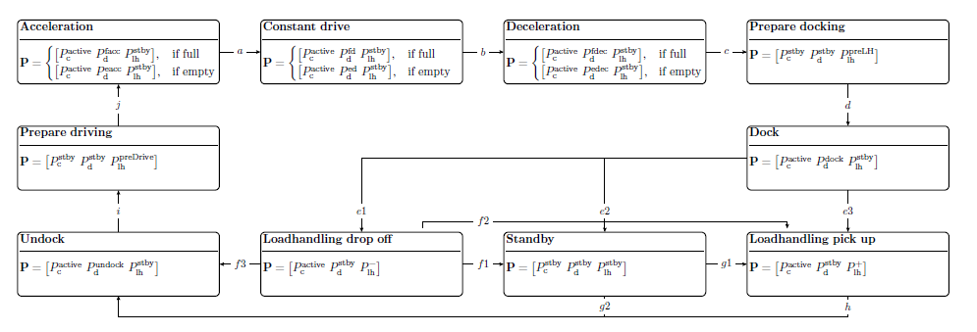

ERM for energy optimization
Process and impact analysis :
The paper performs a qualitative process analysis to identify the process states of AGVs. The analysis reveals 10 different states that describe the process behavior of AGVs, including:
Acceleration
Constant drive
Deceleration
Prepare docking
Dock
Load handling (pick up and drop off)
Standby
Prepare driving
Undock
Paper

Slide 9


ERM for energy optimization
As a result of the impact analysis , the distance is not sufficient for the approximation of the total energy requirement of AGVs.
To approximate the total energy requirement of an AGV in operation more accurately, data of the actual material flow and layout are required.
The total scalar energy requirement E(t) is the sum of all individual states as a function with the evaluation period t, and the dispatching method used . Mathematically, this is formulated as follows:
Paper

Slide 10
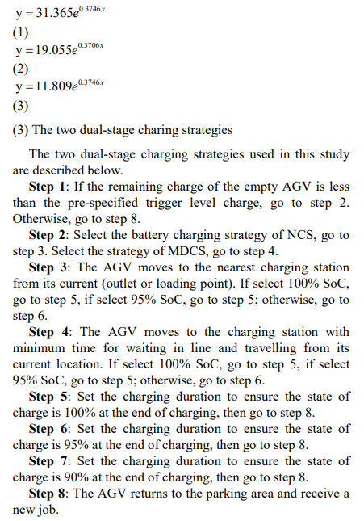

Study on AGVs battery charging strategy for improving utilization
The paper on Warehouse Robot Localization and Communication System prototype to optimize battery management and workflow in warehouses. Autonomous mobile robots equipped with advanced localization and wireless communication technologies coordinate to prevent downtime.
When the battery level of the robot drops below a certain threshold, it communicates with the main computer to request assistance. Another robot then takes over its task, allowing the low-battery robot to reach a charging station
Paper

Slide 11




Objectives:
(Multi-Objective Problem)
Minimize Distance Traveled (D) : finds the shortest path from the start point to the goal while navigating through the environment. This reduces travel time and increases efficiency.
Minimize Energy Consumption (E): Energy efficiency is crucial for operational cost savings

Slide 12
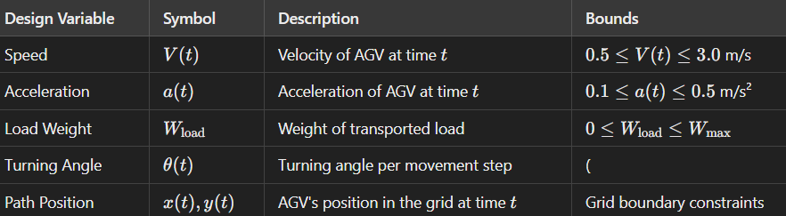







Design variables:
Inequality constraint:
Equality constraint:
Objective function

Slide 13
Approach

Slide 14
Creation of Grid
Grid Environment Variables
grid_size: Tuple (width, height) representing the dimensions of the grid
grid: 2D array representing the grid, where: 0 indicates a walkable cell, 1 indicates an obstacle.
start_position: Tuple (x, y) representing the starting position of the agent
goal_position: Tuple (x, y) representing the goal position of the agent
Design Variables

Slide 15
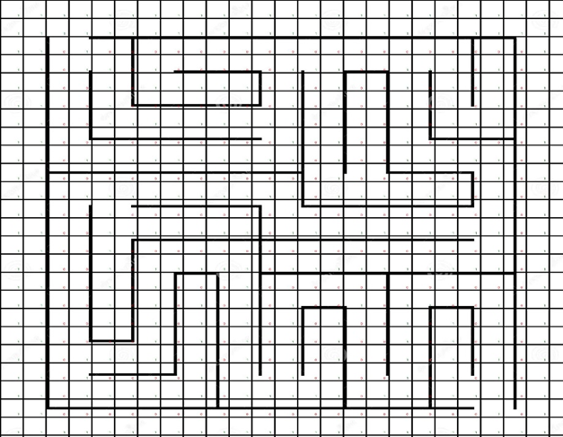
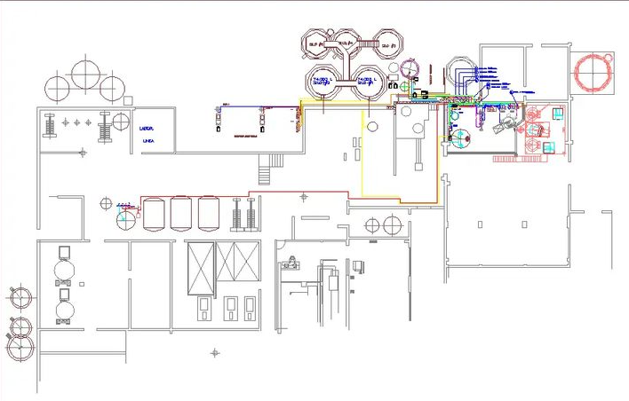
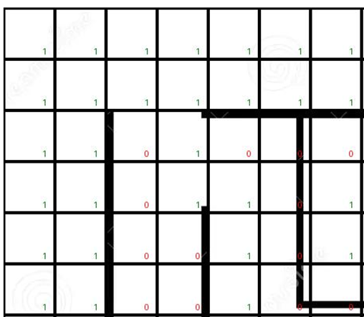
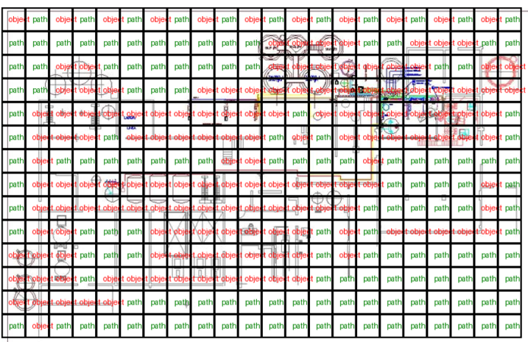
Factory level plan
Maze

Slide 16
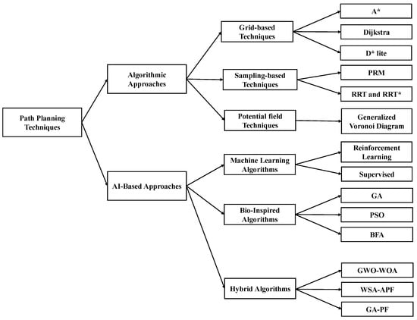
Path-Finding Algorithms
Algorithm Variables:
open_set: List or priority queue for nodes to be evaluated.
closed_set: Set for nodes that have already been evaluated.
came_from: Dictionary for tracking the best path.
g_score: Dictionary for storing the cost from the start to each node.
f_score: Dictionary for storing the estimated total cost to the goal.
Design Variable for A* algorithm

Slide 17
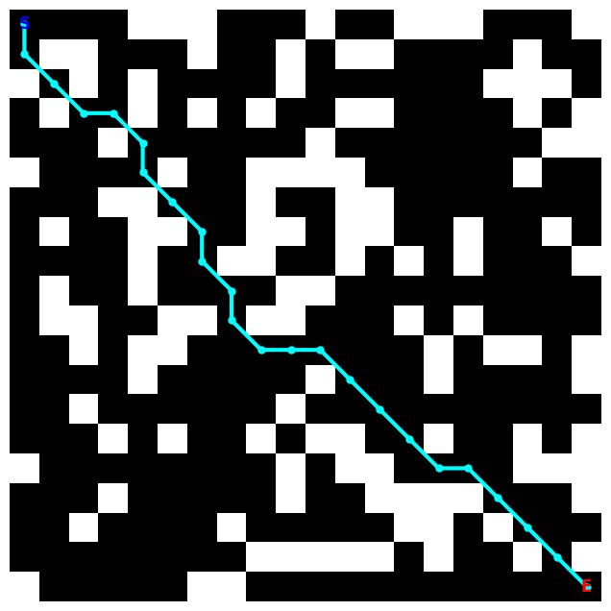
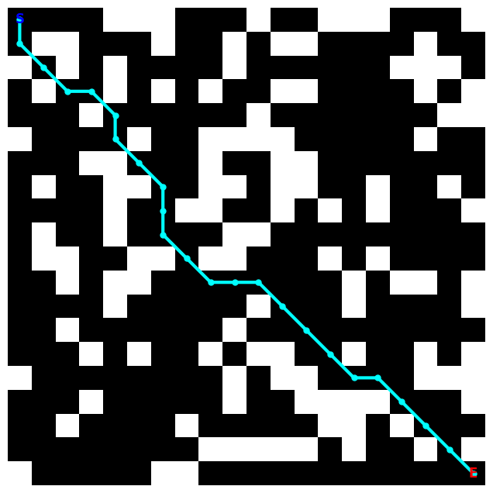

Grid based Algorithms
A* algorithm
Dijkstra's algorithm

Slide 18
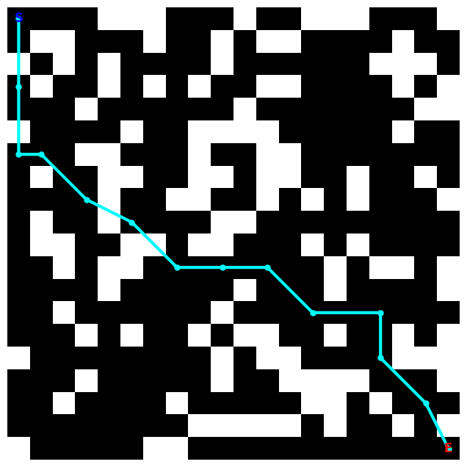


Sampling based Algorithms
PRM algorithm
RRT algorithm

Slide 19
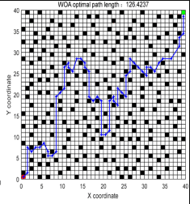
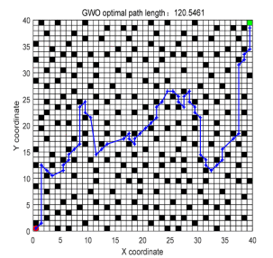
Bio inspired Algorithms
WOA (whale optimization)algorithm
GWO (grey wolf optimization)algorithm

Slide 20
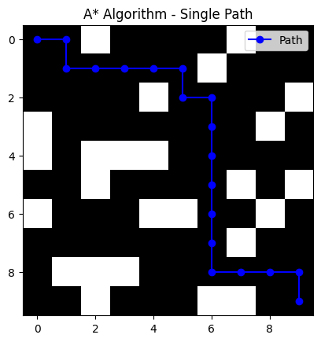
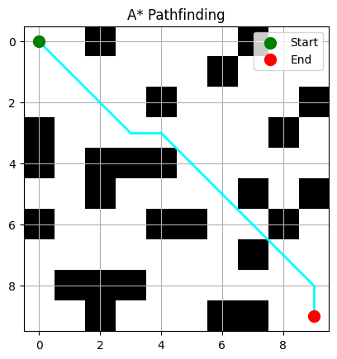
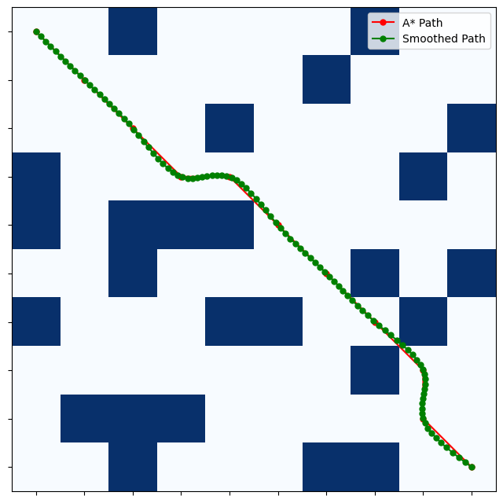
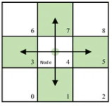
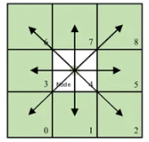



Improved A*

Slide 21
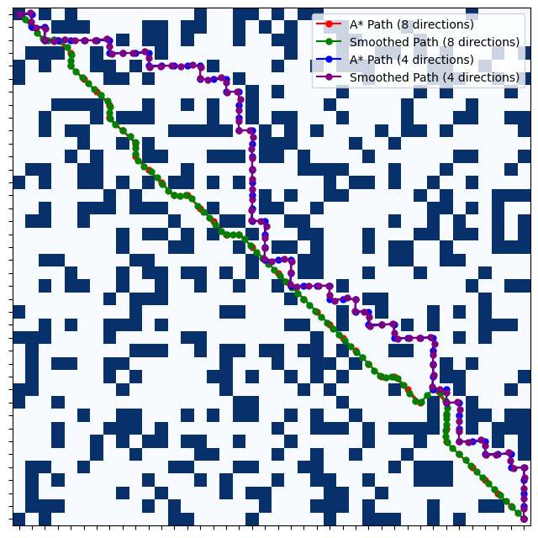
Comparison
metric | Traditional A* | Improved A*
Path length | 76.64 | 59.76
Time taken | 0.0039 | 0.0015
Number of turns | 32 | 2
A* vs Improved A*

Slide 22
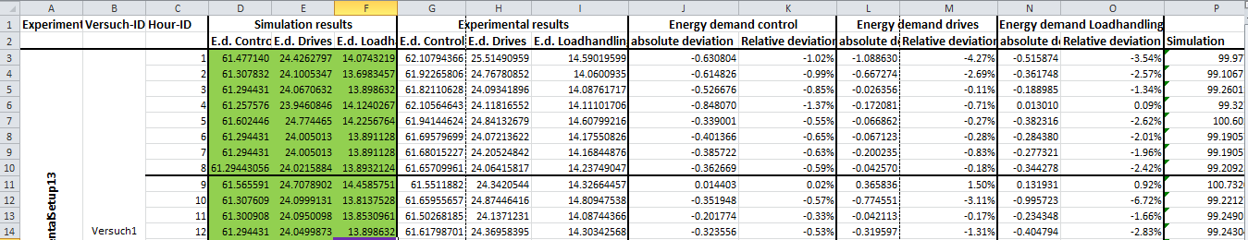
Combining improved A* with ERM
Define Energy Costs for Movements-
Instead of using distance-based weights, we assign energy consumption values from the dataset to different AGV actions.
Moving straight → Energy demand drives
Turning → Energy demand control
Waiting/standby →T standby data
Modifying the cost function in A*-
Instead of distance, use energy consumption.
Penalize high-speed acceleration to reduce Energy demand drives.
Prefer paths with lower control energy costs (Energy demand control).
Straight movement cost - default energy per step
Turning cost - higher energy for changing direction
Acceleration penalties
Standby energy cost- if AGV needs to wait
Turning cost - higher energy for changing direction
Acceleration penalties
Standby energy cost- if AGV needs to wait

Slide 23






Combining improved A* with ERM
Standard A* Cost Function:
g(n) = actual cost from start to node n
h(n) = heuristic estimated cost from n to the goal.
Energy-Based Cost Function (Modified g(n)):
E_{state,i}​ = energy cost in each state (acceleration, turning, standby)
K = the number of steps taken so far
Using the ERM equation from paper :
Driving energy : P_{drive} = power consumption of the AGV's motors.
Control system energy : P_{control} = control power usage.
Load-handling energy : P_{load} = power consumption for material handling.

Slide 24

Combining improved A* with ERM
Energy-Aware Heuristic h(n)-
d(n,goal) = estimated remaining distance.
E_{unit​} = average energy per unit distance (calculated from dataset).
Final A* -energy optimized model -
Objective Function

Slide 25
Methodology

Slide 26
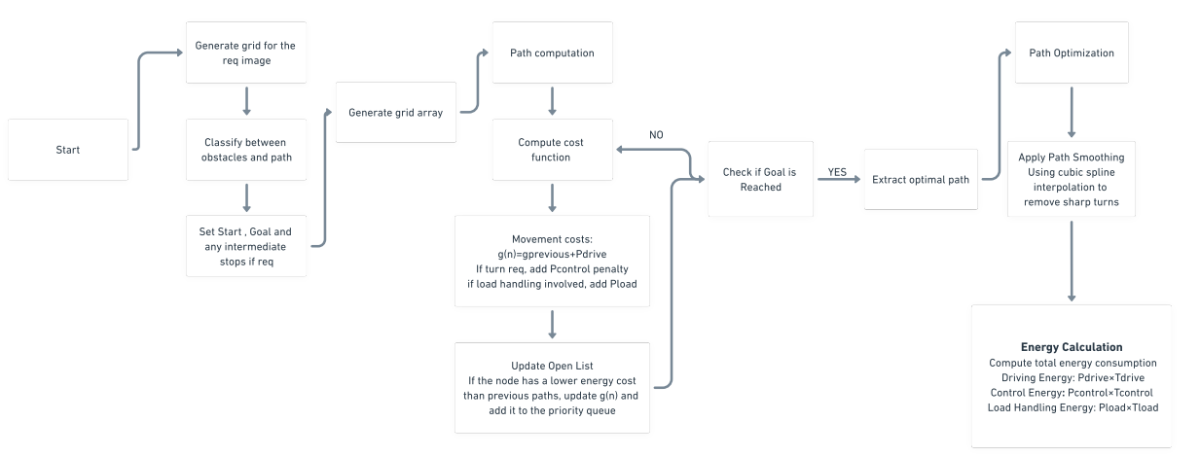
Summary

Slide 27



Implementation and testing​
We get the energy consumption values from the dataset
Driving Energy:
Mean Power: 37.90 W
Standard Deviation: 6.85 W
Mean Drive Time: 33.70 s
Control System Energy:
Standby Power: 55.15 W
Active Control Power: 63.19 W
Load Handling Energy:
Standby Power: 7.50 W
Active Load Power: 54.71 W
Mean Load Handling Time: 8.67 s

Slide 28
CODE

Slide 29
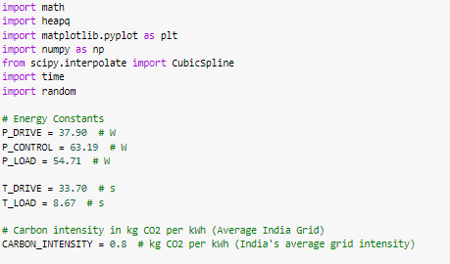
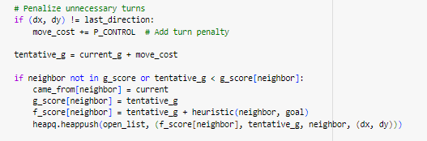
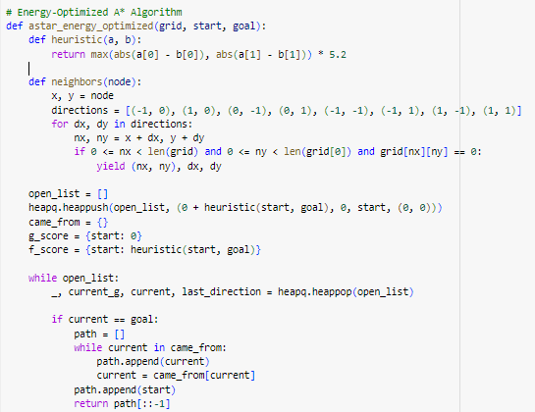
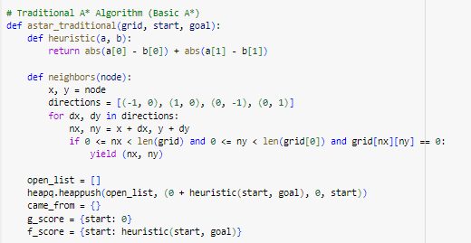
Traditional and Improved A*

Slide 30
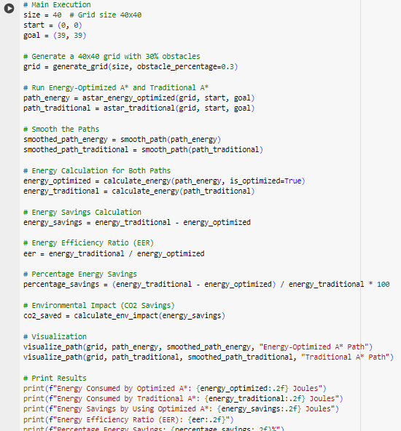
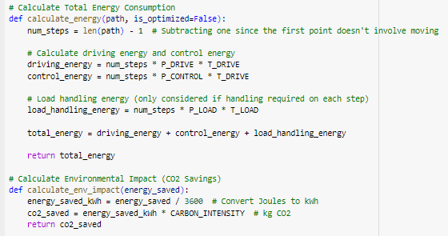
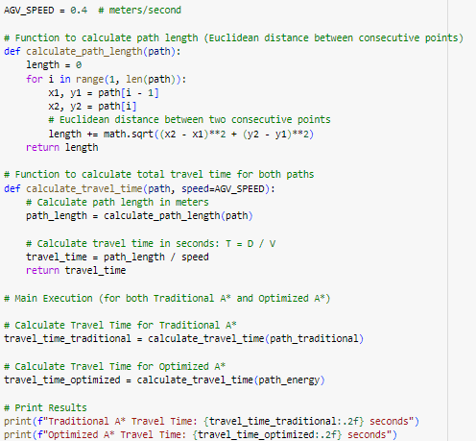
MAIN FUNCTION

Slide 31
Results and Analysis

Slide 32
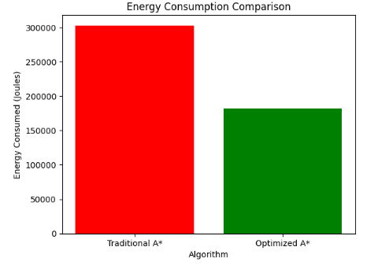
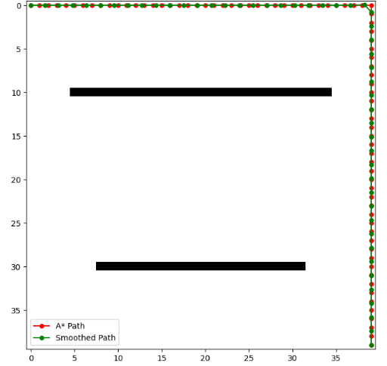
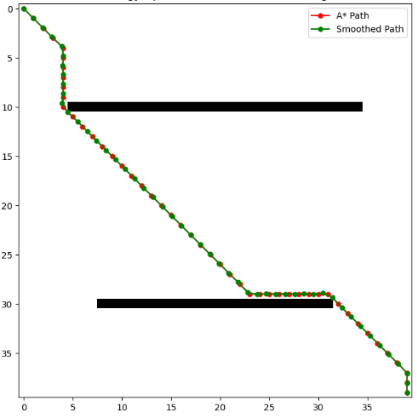

Traditional
Improved
Analysis:
The optimized algorithm enables faster pathfinding than the Traditional one

Slide 33

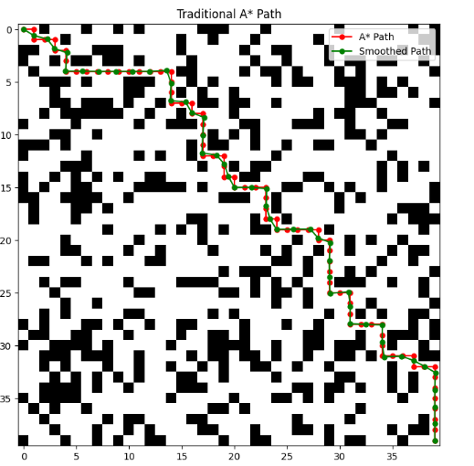
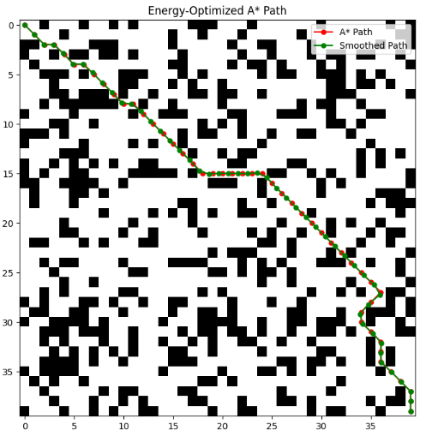
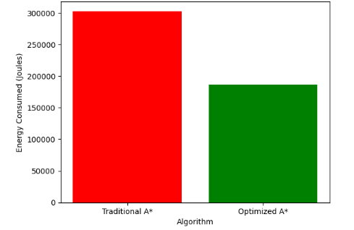
Analysis
Comparison
Energy consumed by the optimized algorithm is significantly lesser that the traditional one
The reduction in energy consumption contributes to a lower environmental impact.
Navigation is smoother and more stable with reduced sharp turns
This results in reduced wear and tear on the AGVs.
The optimized algorithm leads to increased productivity and responsiveness

