Slide 1


RESEARCH METHODOLOGY
AI-Enabled Acoustic Detection & Early Warning System
for Red Palm Weevil Infestation in Coconut Trees
ACOUSTIC
NON-INVASIVE
AI-BASED
EARLY DETECTION
CONTINUOUS MONITORING
Team 13

Slide 2



THE PROBLEM
A hidden pest that kills before you can see it
The Red Palm Weevil (Rhynchophorus ferrugineus) is the most destructive pest of coconut and palm trees worldwide.
WHY IT MATTERS
40%
of global crop production is affected annually by pests & diseases
Larvae feed INSIDE the trunk
Damage is completely hidden from view during early stages
26%
of global crop yield losses due to insects
Symptoms appear too late
Yellowing fronds and collapse show only in advanced stages — often irreversible
$70B+
attributed to invasive insect pests alone
Manual inspection is slow & unreliable
Curative treatment is easy — but only if the weevil is caught early. Early detection is the entire challenge.
Labour-intensive, error-prone, and impractical across large plantations
2

Slide 3








OUR SOLUTION
Listen to what the eye cannot see
Larvae feeding inside the trunk produce faint acoustic / vibrational signals. We capture them, clean them, and let a neural network decide.
SENSE
PROCESS
DECIDE
ACT
Acoustic / vibration sensor captures larval feeding sound
Noise removal, segmentation & feature extraction (MFCC + spectral contrast)
Feedforward neural network outputs an infestation probability
Threshold decision triggers alert & monitoring for the field operator
Non-Invasive
Early
Low-Cost & Lightweight
Continuous
Reduces Pesticide Use
3

Slide 4
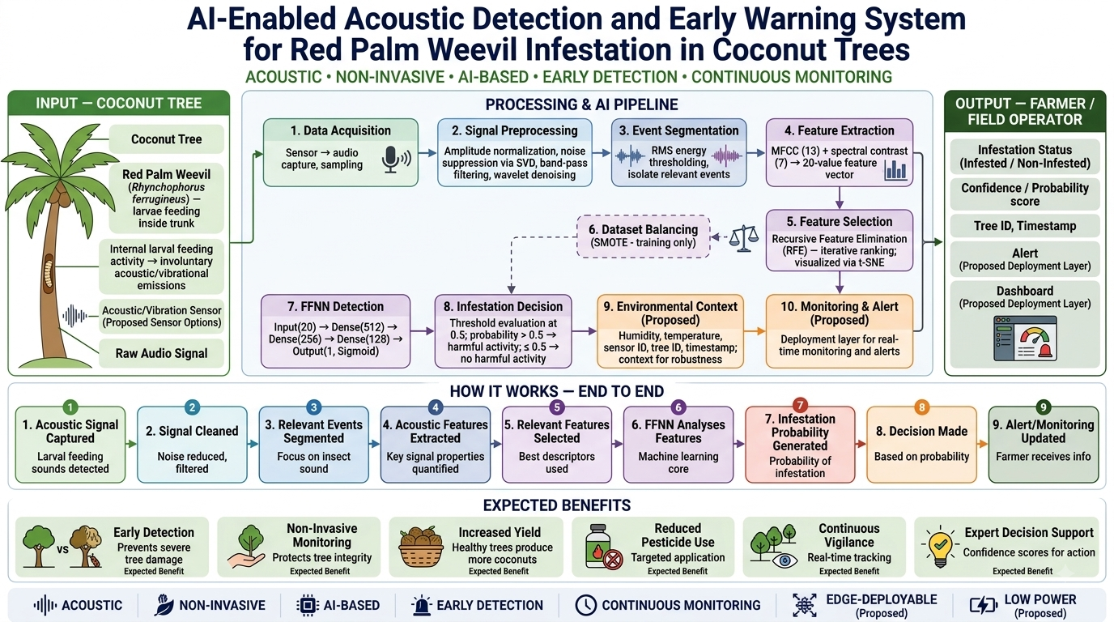
SYSTEM ARCHITECTURE
One story: from hidden larvae to farmer alert
4
Notes:
Walk through the architecture left to right: input (coconut tree + sensor) → processing pipeline (modules 1–10) → output (farmer/field operator). Emphasize that green=field, blue=signal processing, purple=AI, orange=decision/context. Point out that modules 9 & 10 and the edge/agentic pieces are proposed, not built.

Slide 5

TECHNICAL CORE
The AI signal-processing & classification pipeline
Every step below is grounded in the baseline paper — exact values preserved.
1
Preprocessing
2
Segmentation
3
Feature Extraction
Normalization • SVD noise removal • band-pass 1–8 kHz • wavelet denoising
RMS energy thresholding isolates relevant acoustic events
13 MFCC + 7 spectral contrast → 20-value feature vector
4
Feature Selection
5
FFNN
6
Decision
RFE ranking (training) • t-SNE visualization
512 → 256 → 128 → 1 (ReLU / Sigmoid)
Sigmoid probability vs 0.5 threshold → Infested / Non-Infested
Training-only step: SMOTE balances the infested / non-infested classes during training. It never runs in the real-time inference pipeline — a key academic distinction.
5
Notes:
This is the scientific heart. Stress that every value is taken directly from the baseline paper: 13 MFCC + 7 spectral contrast, 1-8 kHz band-pass, FFNN 512-256-128-1. SMOTE is training-only — this is the single most important academic distinction to state out loud.

Slide 6

BASELINE EVIDENCE
The model already works — and it is lightweight
85.6%
96.1%
0.72
29.4 ms
Testing Accuracy
Training Accuracy
F1-score (infested)
Inference Time
FFNN vs. ensemble models — accuracy (%)
WHY THE FFNN IS THE RIGHT CHOICE
Best macro F1-score of all models tested — statistically significant vs. XGBoost, LightGBM, CatBoost, AdaBoost (paired t-test, p < 0.05)
Only 176,129 parameters and 1.51 MB memory — real-time & field-ready
High recall matters most: missing an infestation (false negative) is far costlier than a false alarm
6
Notes:
85.6% test accuracy, F1=0.72, and only 176k parameters / 29.4 ms inference. The FFNN beat XGBoost/LightGBM/CatBoost/AdaBoost with statistical significance. Note VGGish shows higher raw accuracy but is less generalizable and heavier.

Slide 7





WHO IT SERVES
Stakeholder map
From the individual grower to national biosecurity — each stakeholder gains a different value from the same system.
Coconut Farmers & Growers
Plantation & Estate Managers
Agriculture Depts & Govt Bodies
Primary users — protect their trees and income with early, actionable alerts
Scale monitoring across thousands of trees; prioritise inspection & treatment
Regional pest surveillance, quarantine enforcement & outbreak containment
Researchers & Academia
AgriTech & Device Manufacturers
Agri-Extension & Advisory Services
Reproducible dataset + model baseline for further bioacoustic AI research
Edge / IoT hardware, sensors and dashboard commercialization partners
Data-driven guidance to farmers; reduced, targeted pesticide recommendations
7

Slide 8

MARKET LANDSCAPE
What already exists in the market
Acoustic RPW detection is a real, commercialized space. Our value is in the specific pipeline and integration — not the concept.
System
Approach
AI / Automation
Deployment
Agrint IoTree
Seismic sensor per tree
Signature detection + false-alarm filtering
Commercial • IoT + mobile app
AED2000 / LAAR WD-60
Piezoelectric acoustic probe
Human listener (headphones)
Commercial • handheld
KAUST Fiber-Optic DAS
Distributed acoustic sensing
CNN, ~97% accuracy
Research → field trials
Our Proposed System
MFCC + spectral contrast
FFNN + agentic layer (proposed)
Academic prototype → edge/IoT
Our differentiators: coconut in an Indian context • a specific MFCC + spectral-contrast + FFNN pipeline • a proposed agentic orchestration layer absent from every commercial product.
8
Notes:
Be honest here: acoustic RPW detection is already commercialized. Agrint IoTree is the flagship competitor. Our differentiators are the coconut/Indian focus, the specific MFCC+contrast+FFNN pipeline, and the proposed agentic layer.

Slide 9


SCOPE & INTEGRITY
What exists vs. what we will build
ESTABLISHED IN LITERATURE
OUR PROPOSED WORK
Acoustic detection of RPW larvae (since 2010)
Reproduce & evaluate the FFNN on our own field data
MFCC + spectral-contrast + FFNN methodology
Design & test our acoustic / vibration acquisition setup
RFE feature selection & SMOTE balancing
Confidence-aware (3-class) decision with review band
Reported baseline: 85.6% accuracy, F1 = 0.72
Edge / IoT deployment + monitoring dashboard & alerts
Feasibility of edge deployment (stated direction)
Environmental-context integration (humidity, temp.)
Agentic orchestration layer around the detector
9

Slide 10


CONTRIBUTION
Where our novelty honestly lies
We do NOT claim acoustic RPW detection as novel — it is established. Each element is classified by maturity.
Acoustic detection of RPW
MFCC + spectral-contrast + FFNN pipeline
ESTABLISHED IN LITERATURE
ESTABLISHED (THIS PAPER'S METHOD)
Reproducing on our own coconut field data
Edge / IoT deployment of this pipeline
EXTENSION OF EXISTING WORK
EXTENSION — REQUIRES VALIDATION
Confidence-aware 3-class decision
Agentic orchestration layer
PROPOSED CONTRIBUTION
PROPOSED CONTRIBUTION
10

Slide 11


PROPOSED EXTENSION
Agentic monitoring & decision layer
An optional orchestration wrapper around the trained detector. Marked PROPOSED — not part of the baseline paper.
Monitoring Agent
Signal Quality Agent
Detection Agent
Watches incoming sensor events across the plantation
Checks whether a captured segment is usable before analysis
Invokes the trained FFNN on the prepared feature vector
Decision Agent
Alert Agent
Model Improvement Agent
Applies the threshold and interprets the probability
Generates warnings & dashboard updates when needed
Logs uncertain cases for expert review & retraining
11

Slide 12

POSITIONING
Research gaps → architecture response
GAP: Environmental noise (wind, rain, birds)
GAP: Limited & imbalanced datasets
→ Preprocessing + signal-quality assessment
→ RFE + SMOTE (training) + feedback loop
GAP: No continuous monitoring in baseline
GAP: Real-time / low-power deployment
→ Sensor + monitoring/alert architecture
→ Lightweight FFNN + edge inference
GAP: Need for actionable output
GAP: Future model improvement
→ Decision + alert layer for field operators
→ Proposed feedback & data-collection layer
12

Slide 13
EXECUTION
Implementation roadmap
Data & Sensing
Model
Monitoring & Agents
Select sensor option, capture field samples, verify signal quality, build raw audio dataset
Reproduce baseline FFNN, train, tune, evaluate against ensembles
Build dashboard/alert prototype; implement agentic orchestration (proposed)
01
02
03
04
05
Signal & Features
Deployment
Implement normalization, filtering, wavelet denoising, RMS segmentation, MFCC + spectral contrast
Investigate edge hardware; prototype lightweight on-device inference
13

Slide 14


IMPACT
Expected benefits
Framed as expected outcomes — not yet experimentally proven by our team.
Earlier Detection
Non-Invasive
Higher Yield
Catch infestation before irreversible trunk damage
Protect tree integrity — no drilling or cutting
Healthier trees → more coconuts, less loss
Reduced Pesticide
Continuous Vigilance
Data-Driven Decisions
Targeted, data-driven application only where needed
Real-time tracking across whole plantations
Confidence scores support expert action
14

Slide 15
IN ONE SENTENCE
Coconut tree → hidden larval activity → acoustic signal → sensor → AI → decision → farmer alert.
A technically-grounded, reproducible acoustic-FFNN core, extended into an integrated edge / IoT / agentic early-warning system for coconut plantations.
Scientifically grounded
System-level integration
Field-ready & scalable
Thank you

