Slide 1
Hierarchical Optimization Technique for
Placement of Visual Landmarks for Robot
Navigation in Repetitive Structured Indoor
Environments
Abinaya S, Nivetha S, Kiruthik V,
Dr. Rakesh Kumar Sidharthan

Slide 2
Abstract
Autonomous indoor navigation poses significant challenges, particularly in visually repetitive GPS-denied environments, such as hotel corridors, hospital rooms, and shopping malls. Visual markers like ArUco (Augmented Reality University of Córdoba) tags can serve as reliable navigation beacons by providing unique landmarks for robot localization. However, determining the optimal placement of these markers is crucial, as excessive placement creates visual clutter while insufficient placement makes reliable robot navigation challenging.
To overcome this problem, the proposed work aims to develop a hierarchical optimization technique that automates the placement of visual markers in the given environment, enabling autonomous navigation. Three different types of markers, namely functional, junction, and corridor tags, are used to provide structural information to the robot. Mathematical feasibility analysis is carried out to select optimal marker parameters based on camera intrinsics and environmental constraints. Greedy search-based hierarchical placement logic is used to determine the optimal placement and density of markers.
Simulation study results in marker availability of 94.2%, while reducing the marker usage by 82% in structured environment. A reliable 100% marker availability is observed at junctions, where robot navigation is challenging. A mean visibility of 1.011 tags per frame is reported, thereby offering autonomous indoor navigation more accessible for real-world applications. Hardware validation is also carried out, which demonstrated the reliability of the proposed technique.

Slide 3
Introduction
Indoor navigation remains a challenging problem due to the absence of GPS and the unreliability of wireless signals such as Wi-Fi, which are affected by interference and multipath effects. This makes accurate and consistent localization difficult, especially in structured indoor environments like corridors.
Structured indoor environments such as corridors often contain repetitive features, leading to ambiguity in visual localization.
To address this, visual markers such as ArUco tags can be used as navigation beacons, providing unique reference points for the robot. These markers are low-cost, easy to detect, and suitable for real-time application
However, the effectiveness of such systems strongly depends on how these markers are placed within the environment.

Slide 4
Literature Survey
Sl. No. | Journal details | Findings | Methodology / Approach | Inferences
1 | Authors: Moteb Alghamdi, Ashraf Al-Marakeby, and Salah Abdel-Mageid Paper Title: Mobile Robot Navigation Based on Artificial Markers: A Systematic Mapping Study Year: 2025 | Artificial marker–based navigation systems (e.g., ArUco, AprilTag, QR) are widely used for indoor localization due to low cost and robustness, but performance strongly depends on marker type, placement strategy, visibility conditions, and environmental factors such as lighting and occlusion. | A systematic mapping study is conducted, reviewing and categorizing published research on artificial marker–based mobile robot navigation, analyzing trends, marker types, placement strategies, and evaluation metrics across the literature. | Marker placement strategy is repeatedly identified as a critical factor influencing localization accuracy and robustness, indicating that optimized, visibility-aware, and environment-specific tag placement is essential rather than arbitrary or uniform deployment.

Slide 5
Sl. No. | Journal details | Findings | Methodology / Approach | Inferences
2 | Authors: Hinderer S., Scheffler M., Yang B. Title: Investigation of ArUco Marker Placement for Planar Indoor Localization 2025 | Marker orientation and inter-marker spacing influence pose estimation accuracy. Poor placement causes localization instability. | Experimental evaluation of various planar ArUco marker layouts, analyzing spacing, orientation, and visibility effects on pose estimation. | Proper placement considering camera FOV and robot trajectory is more important than increasing marker count. Planar optimized layouts are effective for corridors.
3 | Authors: Kayhani N., Schoellig A., McCabe B. Title: Perception-aware Tag Placement Planning for Robust Localization of UAVs in Indoor Environments 2023 | Strategic placement of fiducial markers improves localization accuracy with fewer tags. Random or dense placement is inefficient. | Perception-aware optimization framework using Fisher Information Matrix (FIM). Genetic algorithm used to minimize number of tags while maximizing localization accuracy. | Fiducial marker placement should be optimized mathematically. Fewer well-placed tags reduce cost and improve robustness, applicable to indoor mobile robots.

Slide 6
Sl. No. | Journal details | Findings | Methodology / Approach | Inferences
4 | Authors: Bharadwaj R. K. Mantha and Borja García de Soto Title: Investigating the Fiducial Marker Network Characteristics for Autonomous Mobile Indoor Robot Navigation Using ROS and Gazebo Year: 2022 | Marker size, spacing, and placement height significantly affect indoor robot navigation performance, and optimal configurations improve success rates without requiring dense marker placement. | A mobile robot equipped with a camera navigated a virtual indoor environment where AprilTag markers were placed with varying sizes, spacing, and heights. Multiple simulation trials were conducted for each configuration, and navigation performance was assessed based on success rate and localization reliability. The results were then compared to determine optimal marker design parameters that balance navigation robustness and infrastructure requirements. | Marker placement should be designed based on spacing and visibility analysis rather than uniform distribution, and simulation-based testing can help determine optimal tag layouts.

Slide 7
Research gap and novelty
Existing approaches often rely on dense marker placement, leading to redundancy and increased cost.
Advanced optimization methods improve placement quality but require detailed modeling and are less practical for structured indoor environments
Limited focus on visibility constraints and robot-specific perception instructured indoor environments. Lack of a practical, scalable approach for efficient marker placement
A visibility-aware marker placement strategy considering robot field of view and environment structure
Hierarchical placement prioritizing critical areas such as junctions and functional points
Use of greedy optimization within a structured, environment-aware framework
A practical and scalable alternative to computationally intensive optimization methods

Slide 8
Objectives
To Calibrate of the onboard camera system to determine the size and ensure accurate ArUco markers.
To Configure of functionally specific markers and feasibility analysis for marker placement.
To Design of a hierarchical optimization technique for the placement of ArUco markers by analyzing spatial constraints, visibility requirements, and navigation performance.
To Validate of the proposed technique using simulation and in a real-time environment.

Slide 9
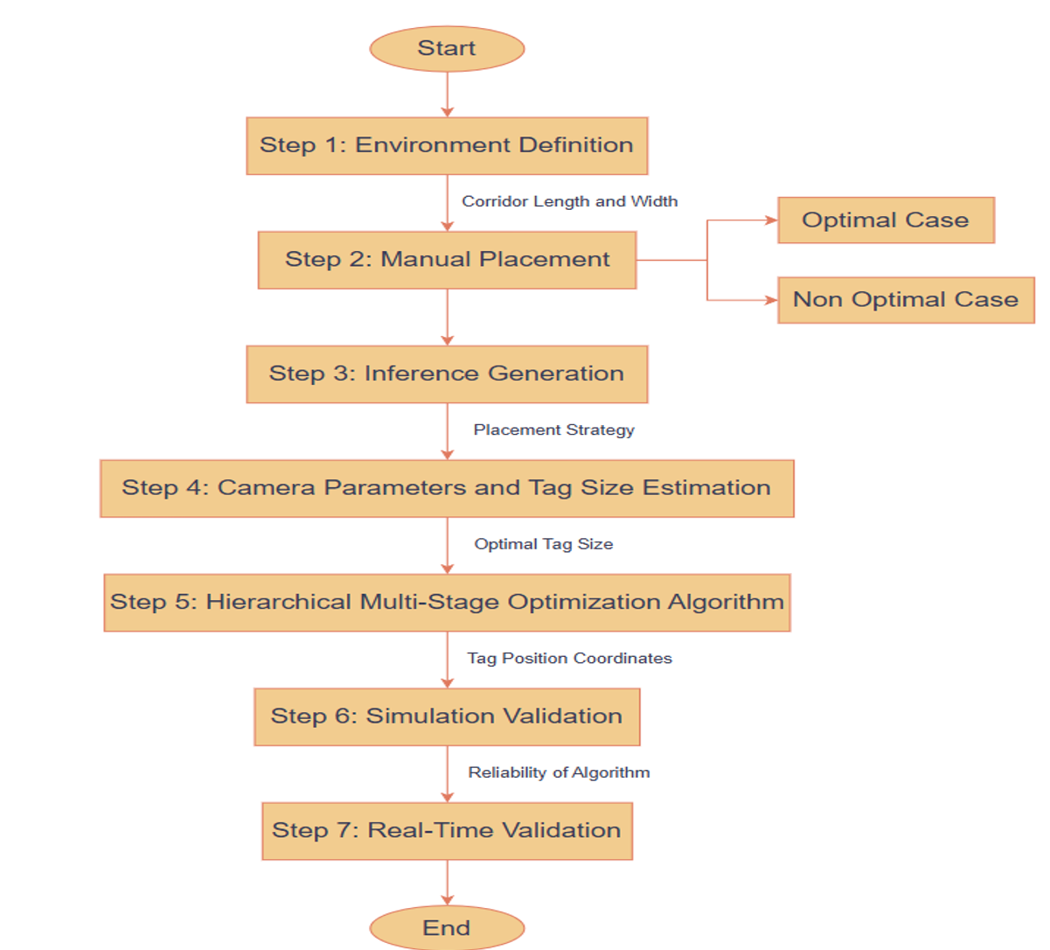
Methodology

Slide 10
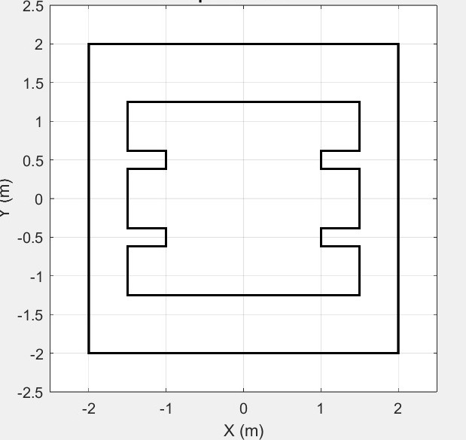
Methodology - Environment definition
A hotel-like indoor corridor environment characterized by repetitive structures is designed for the proposed study
The environment includes functional areas such as doors and junctions, which are prone to localization errors.
Corridor width is measured to define lateral visibility and the required bearing angles for detecting junctions before and after turns.
The beacons are categorized into three types based on placement locations as follows:
Functional Tags(F) – placed at doors or task areas
Junction Tags(J) – placed at intersections
Corridor Tags(C) – for straight-line navigation.
Structured, repetitive test environment

Slide 11
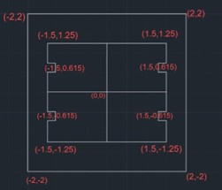
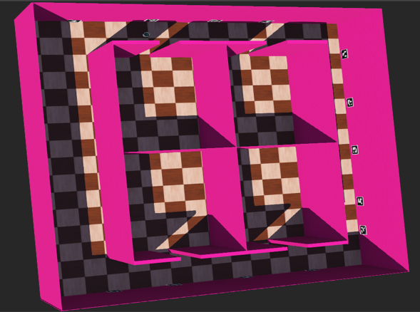
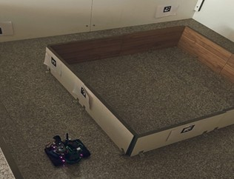
Methodology - Environment definition
The algorithm is deployed using MATLAB, and the results obtained are validated with Webots simulation software and real-world testing using physical hardware over evaluation metrics which includes
Localization availability,
Placement efficiency,
Blackout regions,
Junction availability, and
Redundancy
Environment in MATLAB
Structured repetitive environment
Simulation environment
Real-world environment

Slide 12
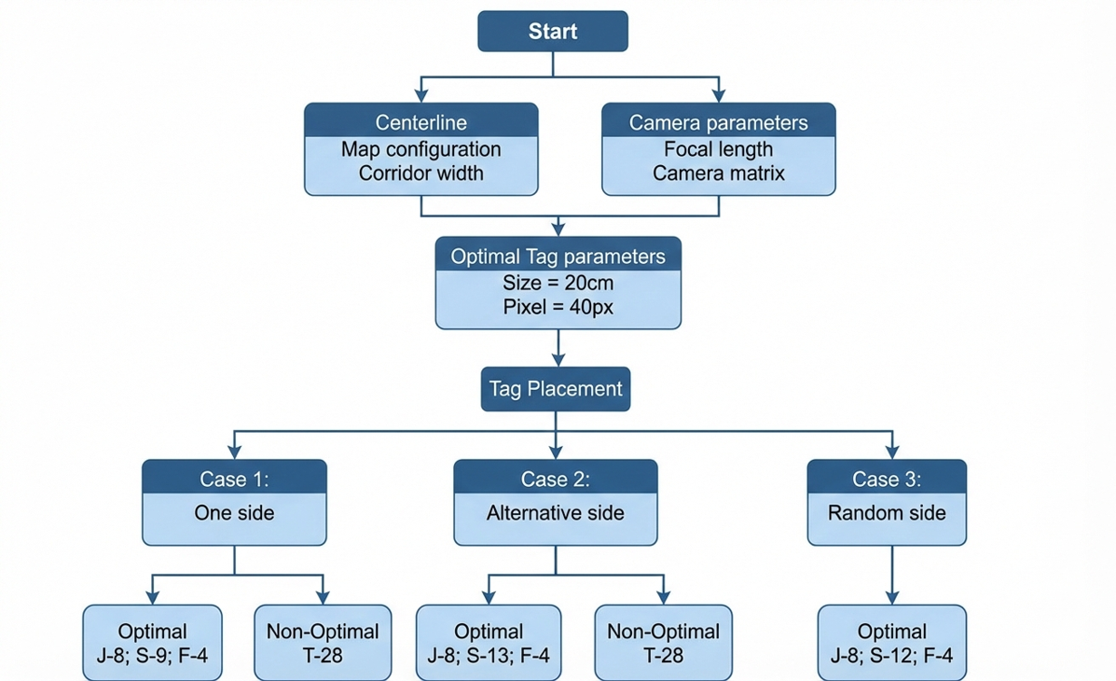
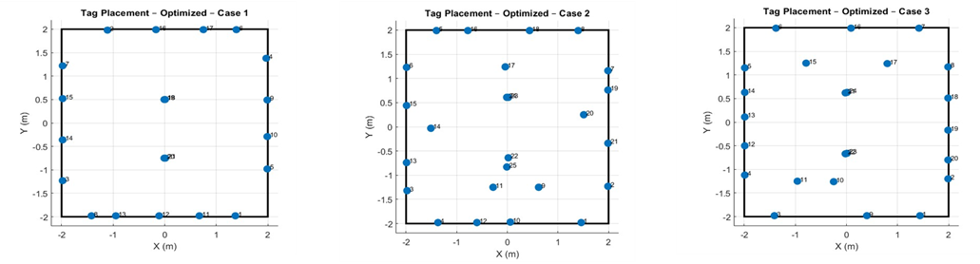
Methodology - Manual placement
Alternative
Single-sided
Methodology for optimizing tag placement in a robot's workspace to maximize localization availability across different corridor configurations
Random

Slide 13
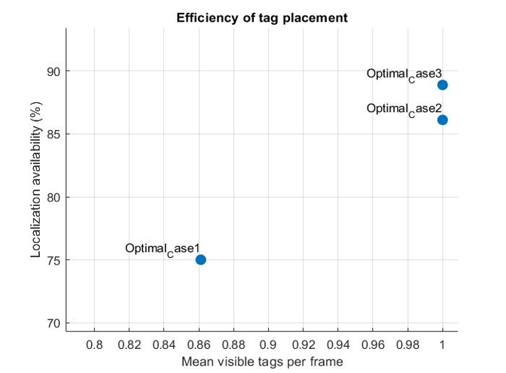
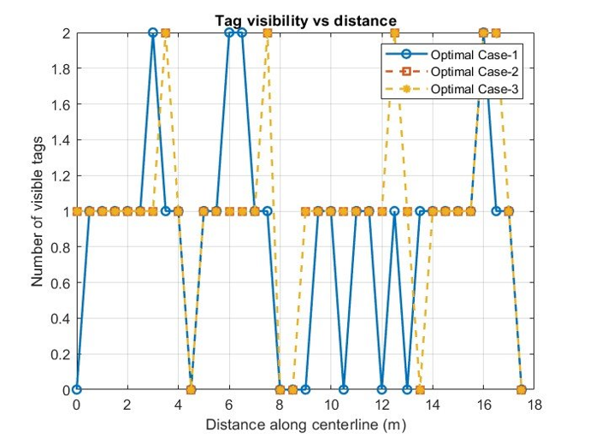
Manual placement – Setup
Non optimal uniform placement - Tags are placed manually at a uniform distance of 25cm for both single and alternate wall.
Optimal placement – Tags are placed following the visibility constraints of maximum detection distance, and maximum Horizontal field of view obtained from camera parameters
Efficiency of tag placement by comparing mean visible tags per frame against localization availability
Graph comparing visibility and a line plot tracking the number of visible tags over distance
Case | Availability | Junction Avail | Redundancy
Opt C1 | 75 | 56.25 | 11.11
Opt C2 | 86.11 | 68.75 | 13.88
Opt C3 | 88.88 | 75 | 11.11
Non-Opt C1 | 77.77 | 68.75 | 44.44
Non-Opt C2 | 77.77 | 68.75 | 30.55

Slide 14
Methodology – Inferences from manual placement
Placement Strategy
Uniform placement leads to high redundancy (>40%), improving robustness but also increasing cost and complexity
Strategic placement reduces redundancy while maintaining reliability
Alternating placement is effective for wide corridors
Single-side placement is sufficient for narrow corridors
Marker Design​
Very small tags reduce localization accuracy due to poor detection ​
Oversized tags overcrowd the camera field of view, reducing efficiency ​
Optimal tag size must balance detectability and field-of-view coverage​
Critical Locations
Marker placement at junctions and functional points is essential for reliable navigation
Pre- and post-junction markers improve re-localization and reduce navigation failures

Slide 15
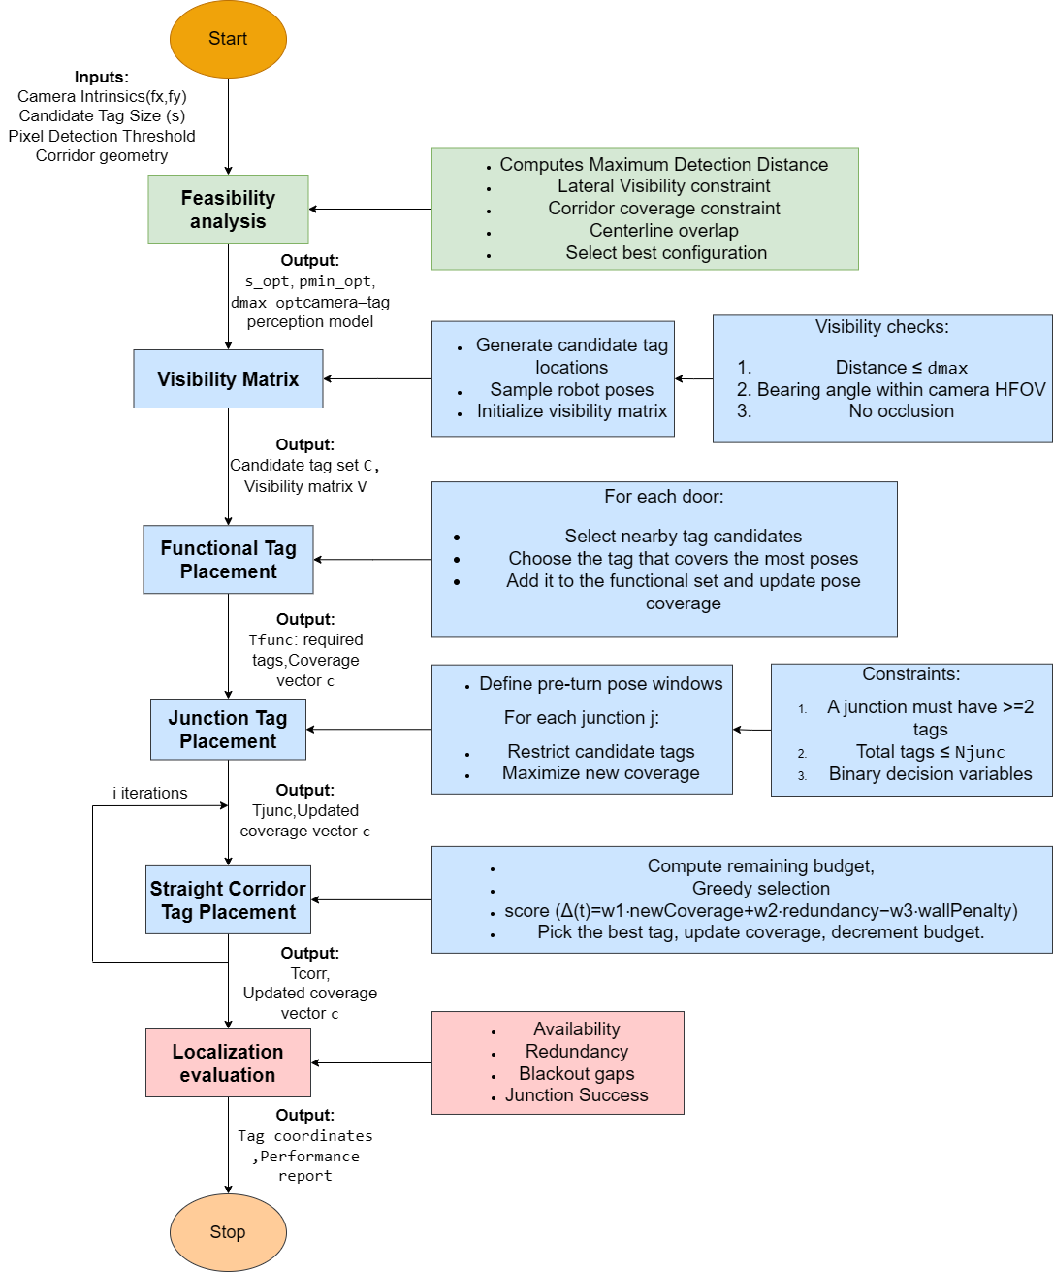
Methodology - Hierarchical Optimization Framework
A hierarchical multi-stage optimization algorithm is designed to optimize the placement and number of ArUco tags to ensure reliable indoor robot navigation with minimal infrastructure.
Minimal infrastructure refers to the trade-off between reduction of Aruco tags while increasing the localization availability.
Flow chart of the proposed hierarchical optimization technique for visual landmark placement

Slide 16
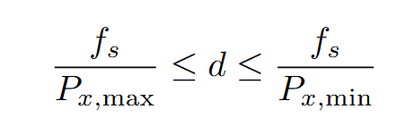
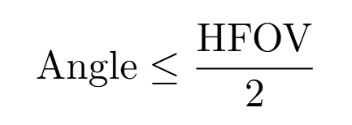

Hierarchical Optimization Framework – Feasibility analysis
The objective is to select a minimal subset of ArUco tags S from a candidate pool C, such that the robot’s path P achieves maximum localization availability
Feasibility analysis - The following are the constraints used
Detection feasibility
A tag is only selected if its distance d satisfies as shown in eq
Geometric visibility
The bearing angle relative to the robot must satisfy the​
constraint described in eq
Mandatory placement
Functional and junction tags to be selected, as shown
in condition eq

Slide 17
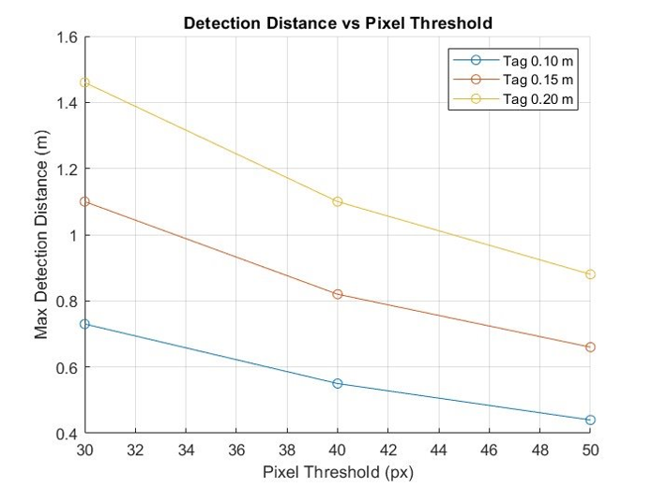
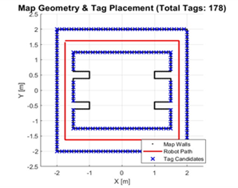
Feasibility Analysis -
The pixel threshold increases as the maximum detection distance decreases for ArUco tags. Hence, ArUco markers of different sizes (0.10m, 0.15m, and 0.20 m) are evaluated
The proposed feasibility analysis technique selects an optimal configuration of 0.2m tags with a 40px threshold, providing a maximum detection distance (dmax) of 1.1m.
Tag_m | PxThr | MaxDist_m
0.1 | 30 | 0.73
0.1 | 40 | 0.55
0.1 | 50 | 0.44
0.15 | 30 | 1.1
0.15 | 40 | 0.82
0.15 | 50 | 0.66
0.2 | 30 | 1.46
0.2 | 40 | 1.1
0.2 | 50 | 0.88
As the pixel threshold increases, the maximum detection distance decreases for ArUco tags of different sizes (0.10 m, 0.15 m, and 0.20 m).
Possible candidates for placement

Slide 18
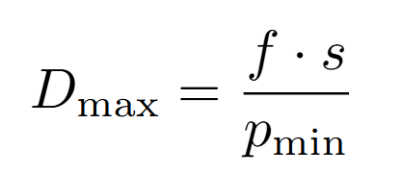
Hierarchical Optimization Framework – Visibility matrix
The algorithm utilizes camera intrinsics (fx, fy) and pixel thresholds (PxThr) to calculate the maximum detection distance (dmax), as shown in eq.
A visibility matrix(V) is derived by sampling potential robot poses along the centerline of the robot path and evaluated for distance, bearing angle and occlusion constraints.
1. Lateral visibility: Dmax must exceed the maximum wall offset to ensure the robot can visualize the side walls from the corridor centerline
2. Corridor coverage: Dmax must exceed the maximum corridor width to ensure continuous coverage.

Slide 19
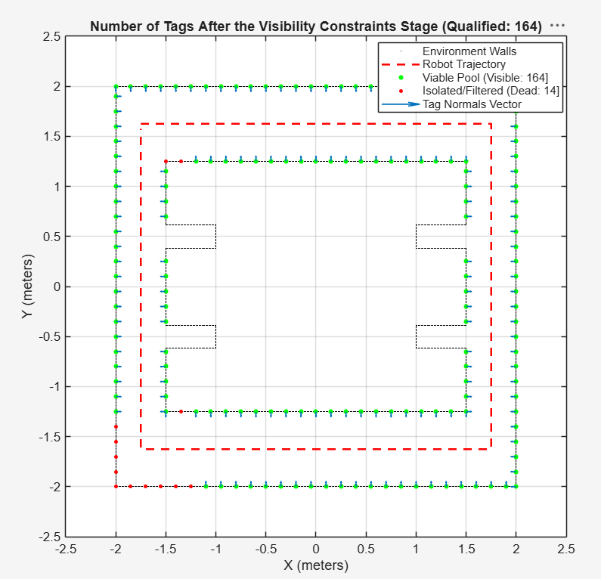
Visibility matrix
Candidate tags (Cj) are generated along all wall surfaces with a uniform spacing, enabling the set of tags to satisfy the visibility constraints
It is described as binary visibility state for every given robot pose (Pi)

Slide 20
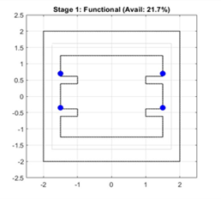
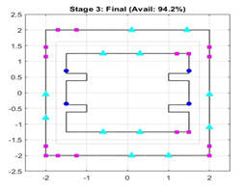
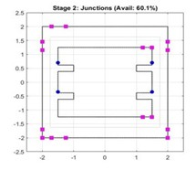
Hierarchical Optimization Framework – Multi-Stage Tag Placement
Stage 1 - Functional Tags
The algorithm initially prioritizes high-priority task areas. Candidate tags that are closest to the doorways are selected to ensure task-specific localization.
Stage 2 - Junction Tags
Tags are selected for placement at junctions in the corridor, where pre-turn and post-turn of robot leads to localization errors and reliable markers are re- quired. In our work, L- and T- based intersections are considered as junctions​
​
Stage 3 - Corridor Tags
The remaining straight corridors are filled using a greedy iterative algorithm that selects tags from the candidate pool based on a weighted objective function.
Score = New Coverage − Penalty

Slide 21
Multi-stage Placement – Iterative Optimization
The straight corridor stage minimizes coverage gaps and maximizes overall localization availability while strategically placing tags to eliminate redundancy and lower infrastructure costs.
The iterative greedy optimization loop, dynamically selects the candidate tag that maximizes new pose coverage at each step, penalizing close-range placements on the same wall.​
​
Iter | Coverage (%) | 0 tags Covered | Candidates | Total Tags
1 | 64.49 | 49 | 158 | 21
2 | 68.84 | 43 | 157 | 22
3 | 73.19 | 37 | 156 | 23
4 | 77.54 | 31 | 155 | 24
5 | 81.88 | 25 | 154 | 25
6 | 84.78 | 21 | 153 | 26
7 | 86.96 | 18 | 152 | 27
8 | 89.13 | 15 | 151 | 28
9 | 90.58 | 13 | 150 | 29
10 | 92.03 | 11 | 149 | 30
11 | 93.48 | 9 | 148 | 31
12 | 94.20 | 8 | 147 | 32

Slide 22
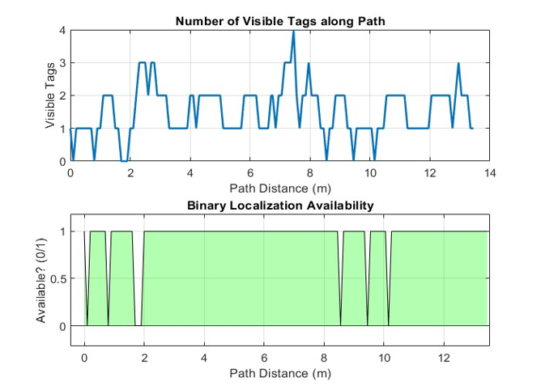
Result –Evaluation report generated
Stage | Tags Used(%) | No.Tags Used | Total Candidates | Reduction(%) | Localization Availability(%) | Total Blackout Length(m)
Functional Tags | 2.2 | 4 | 178 | 97.8 | 21.7 | 4.9
Junction Tags | 11.2 | 20 | 178 | 88.8 | 60.1 | 2.3
Straight | 18 | 32 | 178 | 82 | 94.2 | 0.3

Slide 23
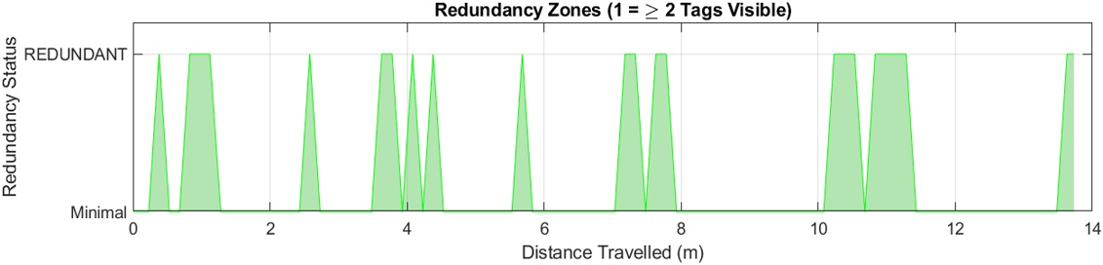
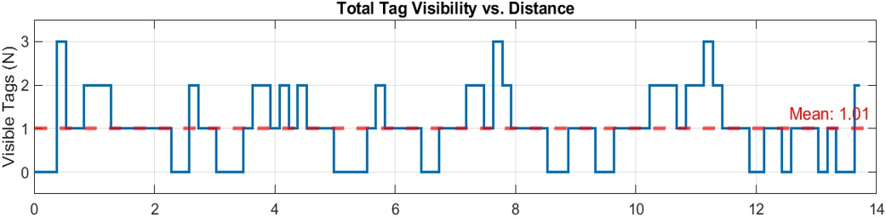
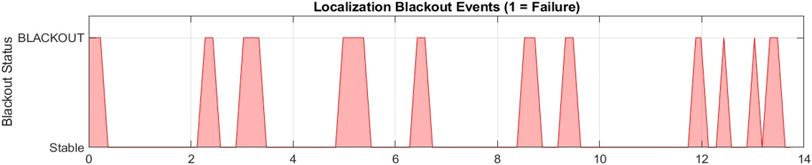
Result –Validation in Webots Simulation environment
The results obtained from the algorithm that was deployed in MATLAB is validated and tested in Webots environment with the same environment and Evaluation metrics to check the reliability of the algorithm.
Metric | Value
Total Distance Travelled | 13.73 m
Mean Tags Visible | 1.011
Max Tags Observed | 3
Localization Reliability (Path with ≥ 1 Tag) | 94.58%
Blackout Rate (Failure) (Path with 0 Tags) | 6.32%
Redundancy Rate (Optimal) (Path with ≥ 2 Tags) | 8.21%

Slide 24
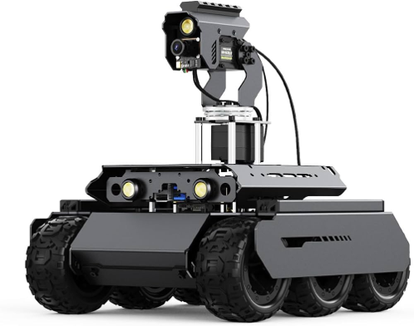
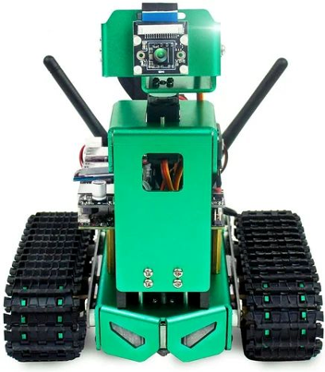
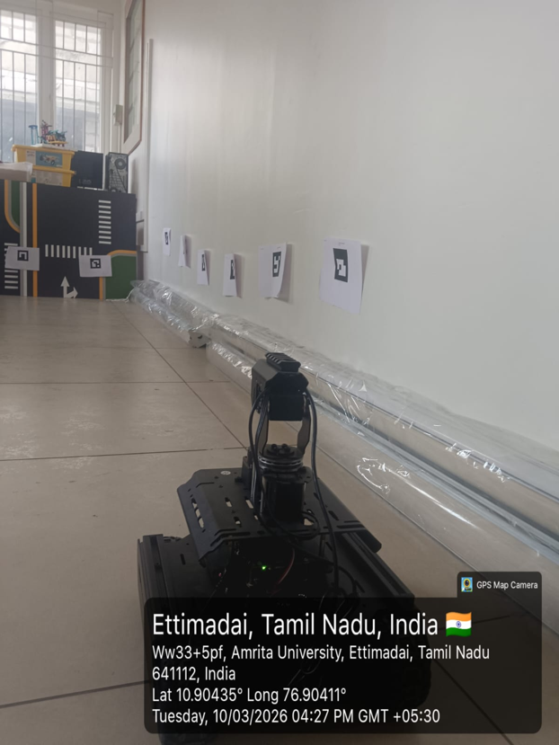
Hardware Utilized
Waveshare Rover
Jetbot
Sensor: OV5647 sensor
Resolution: 5 Megapixels (3280 x 2464 pixels).
Focal Length: 3.15 mm
Field of View (FOV): 160° ultra-wide angle.
Sensor: Sony IMX219
Resolution: 8 Megapixels (3280 x 2464 pixels).
Focal Length: 3.15 mm
Field of View (FOV): 160° ultra-wide angle.

Slide 25
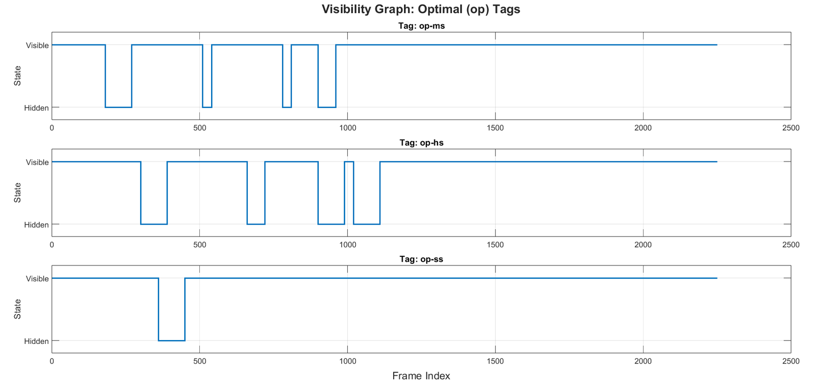
Result - Validation in Real world Environment
The robots are operated with three different speed type and the results are observed.
Speed types:
•slow speed – 5.54cm/s
•medium speed - 8.71cm/s
•high speed – 15.24cm/s
Metric | Value
Total Frames | 2666
Blackout Percentage | 8.18%
Availability Percentage | 91.82%
Redundancy | 8.21%

Slide 26
Conclusion
Visual landmarks like ArUco markers provide reliable beacons for robot naviga- tion in a structurally repetitive indoor environment. A hierarchical three-stage optimization algorithm is proposed to place the ArUco markers, enabling robot navigation. Inference generated from the manual placement provides insight into tag placement.
Visibility awareness and structure-specific deployment of tags are considered in this study. A greedy search algorithm is used to optimize the tag placement. Experimental analysis results in 94.2 % of tag availability. Validation in the simulation and real-world environment also results in a mean visibility of 1.011 tags per frame.
Development of an end-to-end automated strategy for automated marker placement using machine learning techniques will be the extension of the pro- posed work. Integration of sensor fusion techniques to combine visual markers information with IMU and wheel odometry will be investigated in the future.

Slide 27
References
[1] Alghamdi, M., Al-Marakeby, A. and Abdel-Mageid, S. (2025) ‘Mobile robot navigation based on artificial markers: A systematic mapping study’, Journal of Robotics and Mechatronics.
[2] Hinderer, S., Scheffler, M. and Yang, B. (2025) ‘Investigation of ArUco marker placement for planar indoor localization’, arXiv preprint, arXiv:2509.17345.
[3] Kayhani, N., Schoellig, A.P. and McCabe, B. (2023) ‘Perception-aware tag placement planning for robust localization of UAVs in indoor construction environments’, Journal of Computing in Civil Engineering, 37(2), pp. 1–14. doi: 10.1061/JCCEE5.CPENG-5068.
[4] Mantha, B.R.K. and García de Soto, B. (2022) ‘Investigating the fiducial marker network characteristics for autonomous mobile indoor robot navigation using ROS and Gazebo’, Journal of Construction Engineering and Management.

Slide 28
Thank You

