Slide 1
Abinaya S
3/21/2024 Annual Review

Slide 2
PROJECT TITLE
Music Recommendation System
3/21/2024 Annual Review

Slide 3

AGENDA
User Requirements: Understand user preferences and gather data on listening history and feedback.
Data Collection: Collect and preprocess music metadata, including genre, tempo, and artist information.
ML Algorithm: Choose ML algorithms like collaborative filtering or content-based filtering for personalized music recommendations based on user preferences and historical data.
Evaluation Metrics: Use metrics such as precision, recall, and mean average precision to measure the accuracy and effectiveness of the music recommendation system in providing relevant suggestions to users.
UI and Experience: Design an intuitive user interface with features like search, filters, and playlists to enhance user engagement and provide a seamless music discovery experience.
3/21/2024 Annual Review

Slide 4

PROBLEM STATEMENT
Design and implement a music recommendation system that leverages machine learning algorithms to provide personalized music recommendations based on user preferences, listening history, and music characteristics. The system should aim to improve user satisfaction by suggesting relevant and diverse music tracks, taking into account factors such as genre, tempo, mood, artist preferences, and user feedback. The goal is to create an engaging and enjoyable music discovery experience for users while maximizing the accuracy and relevance of recommendations.
3/21/2024 Annual Review

Slide 5

PROJECT OVERVIEW
Develop a personalized music recommendation system using machine learning algorithms to enhance user engagement and satisfaction on music streaming platforms, focusing on user preferences, data collection, feature engineering, ML algorithms (Collaborative Filtering, Content-Based Filtering), evaluation metrics (Precision, Recall, MAP), user interface design (Search, Filters, Playlists), testing, deployment, and ongoing monitoring and maintenance.
3/21/2024 Annual Review

Slide 6

WHO ARE THE END USERS?
Music Enthusiasts: These users are passionate about discovering new music and seek personalized recommendations based on their tastes, favorite genres, and mood preferences.
Casual Listeners: These users enjoy music for leisure and appreciate recommendations that cater to their diverse interests, making their listening experience enjoyable and engaging.
3/21/2024 Annual Review

Slide 7
YOUR SOLUTION AND ITS VALUE PROPOSITION
Our music recommendation system utilizes advanced machine learning algorithms to analyze user preferences, listening history, and music characteristics, delivering personalized recommendations for an engaging music discovery experience.
Value Proposition:
Personalization: Tailored music suggestions based on individual preferences for an enjoyable listening experience.
Accuracy: Precise recommendations enhance user trust and satisfaction with the platform.
Engagement: Interactive features encourage exploration and increase user interaction.
Time-Saving: Instant access to curated playlists and suggestions saves time and effort.
Continuous Improvement: Feedback-driven refinement ensures ongoing value and relevance for users.
3/21/2024 Annual Review

Slide 8
THE WOW IN YOUR SOLUTION
Cutting-edge Machine Learning: Our music recommendation system leverages state-of-the-art machine learning algorithms to deeply analyze user preferences, music attributes, and historical data, enabling precise and personalized recommendations that resonate with each user's unique tastes and preferences. Swift Discovery: With lightning-fast processing capabilities, our system swiftly generates recommendations in real-time, ensuring users have immediate access to relevant and engaging music suggestions, thereby enhancing their overall listening experience. Adaptive Customization: Our solution is highly adaptable and customizable, allowing organizations to tailor the recommendation algorithms to specific genres, moods, or user segments, ensuring a seamless integration into existing platforms and maximizing user satisfaction and engagement.
3/21/2024 Annual Review

Slide 9
MODELLING
Data Preparation:
Collect and preprocess music metadata, ensuring data quality and feature extraction.
Model Training:
Split the dataset into training, validation, and test sets.
Train the selected models using appropriate techniques, including regularization, dropout, and batch normalization. Model Selection:
Explore recommendation algorithms and train models using techniques like matrix factorization and deep learning. Model Evaluation:
Assess model performance with metrics like accuracy and diversity, and continuously improve based on user feedback.
3/21/2024 Annual Review

Slide 10
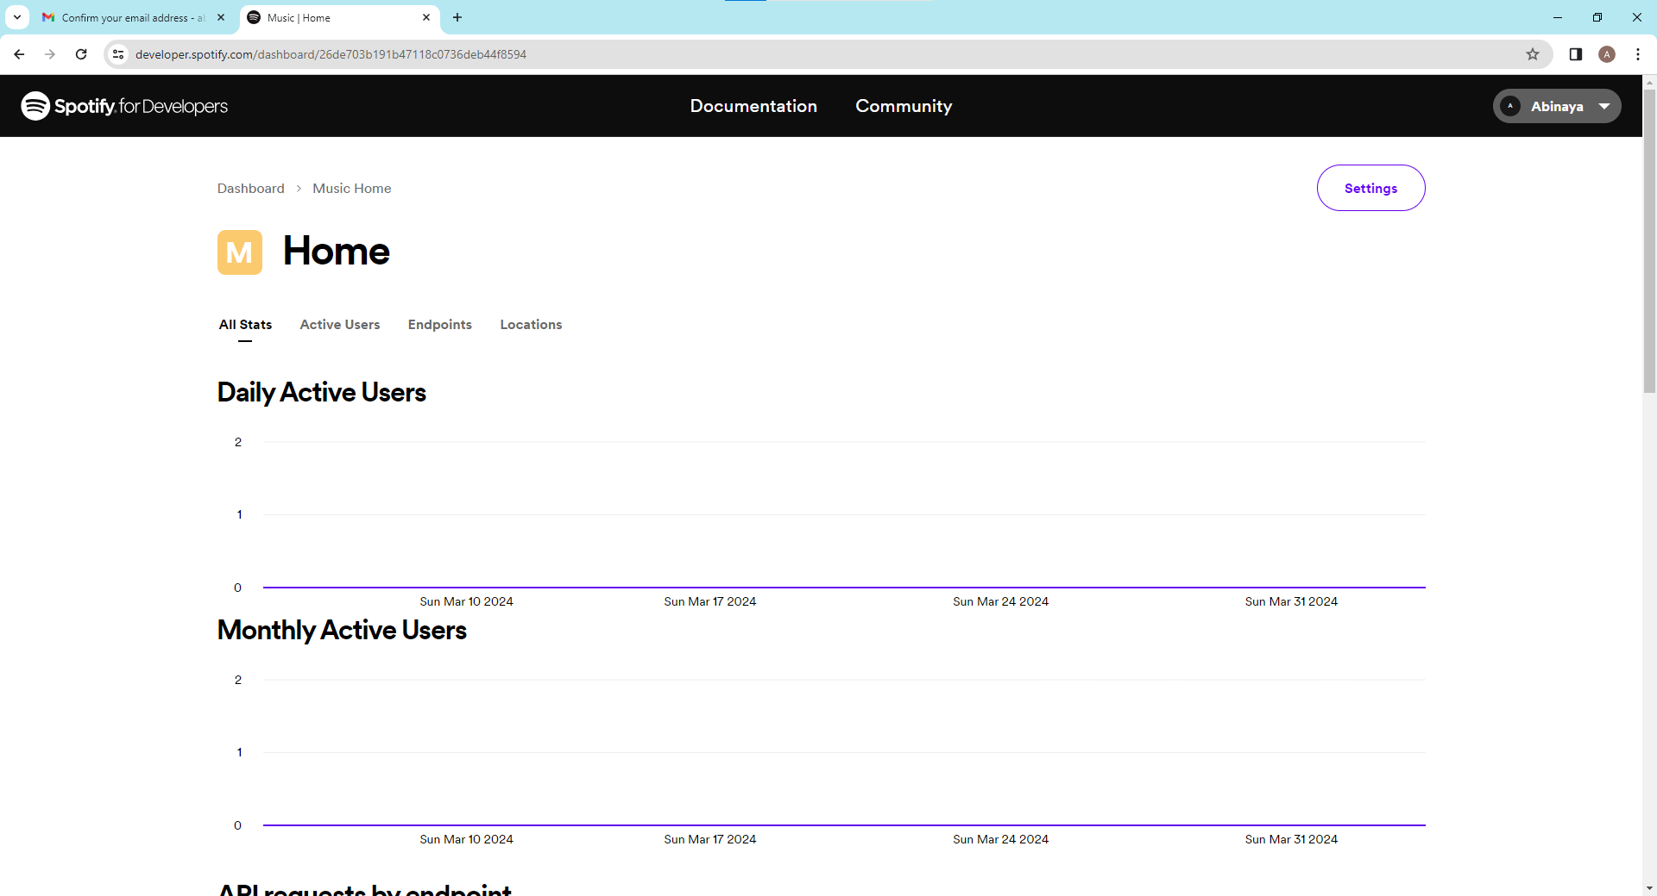
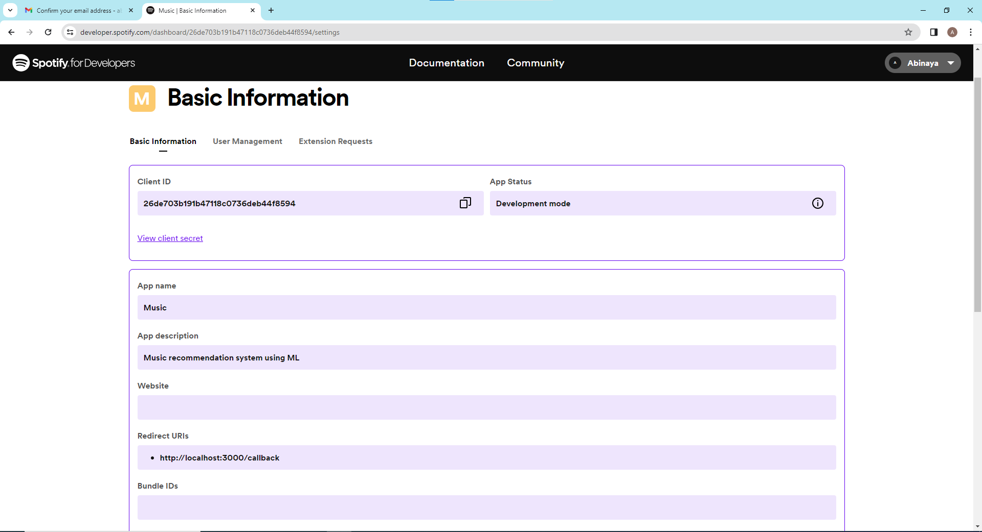
RESULTS
The result of our music recommendation system is highly accurate and personalized recommendations, leading to increased user satisfaction and engagement with the platform.
https://github.com/Abinaya1606/TNSDC-Generative-AI
3/21/2024 Annual Review

