Slide 1


Print custom marketing materials today
Advanced Computing Concepts - COMP8547
FINAL PROJECT - FALL 2021
Printinglia
Sales Proposal
Building a Search Engine
Instructor : Dr. Abedalrhman Alkhateeb
Prepared for Green Aero Tours

Slide 2
Get to Know Our Team
Abinaya Elanchezhian - 110061220
Lakshmi Narayanan Shankar - 110070078
Shruthi Paka - 110062738
Vishal Jayaraman - 110067134

Slide 3

Roles & Responsibilitites
The team equally divided the roles and collaborated with eachother for the development of the Search engine.
Abinaya Elanchezhian - Keyword Search, Powerpoint presentation
Lakshminarayanan Shankar - Ranking, Project Research
Shruthi Paka - Spell Checker, Video editing
Vishal Jayaraman - Web crawler, Testing

Slide 4




Tools Used
Github - For maintaining the code structure
Eclipse - Running the java code
Canva - For designing the presentation
Microsoft Teams, Whatsapp - Communication within the team
Outlook - For all official communication
Lucidchart - Flow Diagram designing

Slide 5
Project Overview
Basic idea :
To develop a web search engine that is designed for accessing the information available on the internet regarding a specific field of interest.
Algorithms used:
Boyer - Moore Algorithm for Keyword searching
Merge sort - Webpage ranking, Frequency counter
Edit- Distance Algorithm - Spell checker

Slide 6

Features Implemented
Web Crawler
Keyword Search
Ranking webpags
Spell checking
Scrape and parse of HTML files

Slide 7






What is a Search Engine?
Customer Testimonial
Search engine is a software program that allows users to find the information they are looking for online by using keywords or phrases. The user can literally search anything and everything on the internet using a search engine.
Printinglia has helped clients level up their marketing and stand out from their competitors
Some common search engines are :

Slide 8
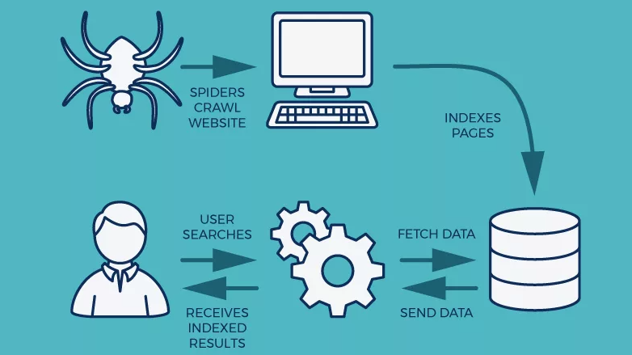

The figure below depicts the process of Web crawling.
WEB CRAWLER
A web crawler often called as spiderbot is an Internet bot that systematically browses the world Wide Web inorder to index pages for search engines.
For example, Google's major web crawler is called as 'GoogleBot' which is used for both mobile and desktop crawling.
Yahoo's crawler is named as Yahoo!Slurp while DuckDuckGo's crawler is termed as DuckDuckGo Bot.

Slide 9
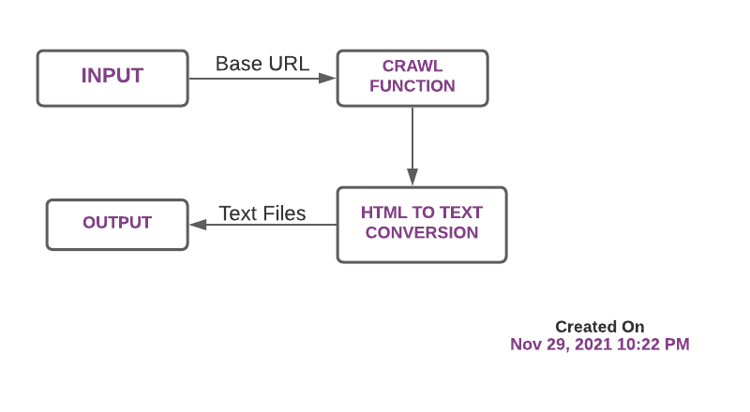
Crawler Using JSoup

Slide 10
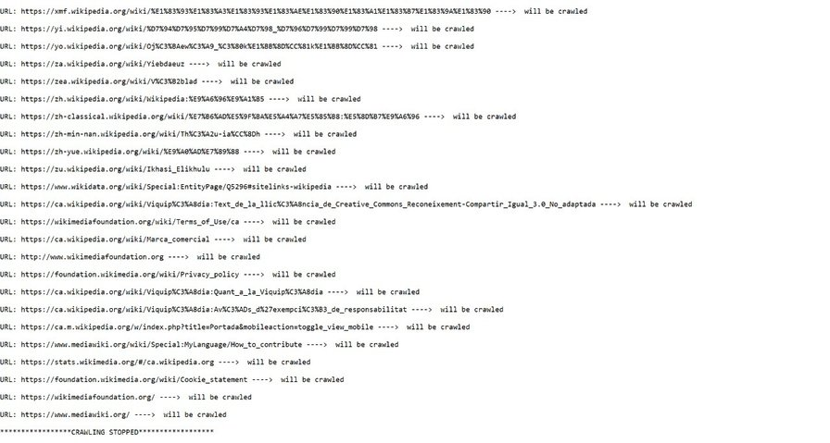
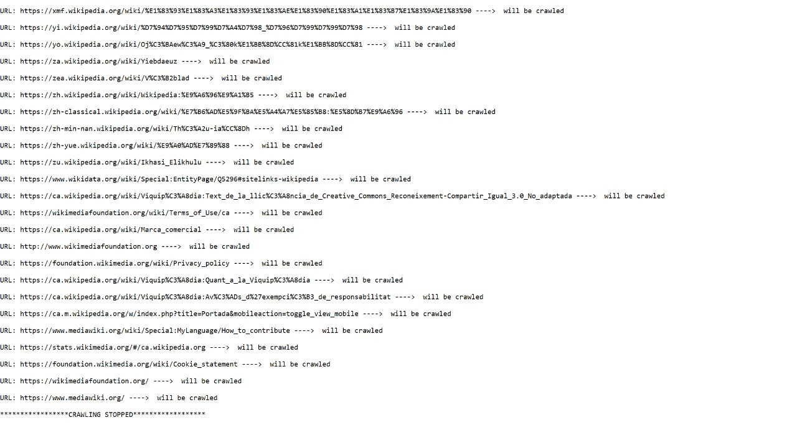
Web crawler output

Slide 11
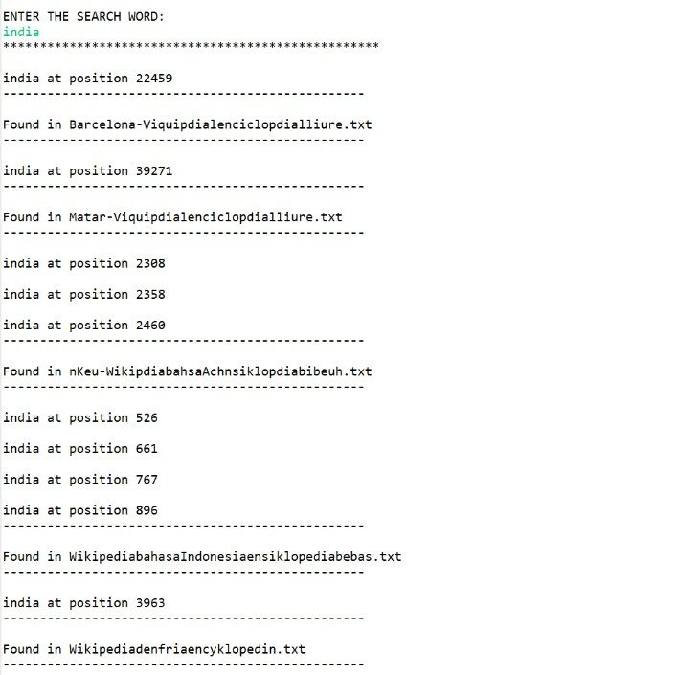
KEYWORD SEARCH
The main concept involved is searching for specific keywords or topics in the GeeksForGeeks website. Boyer Moore Algorithm was used for searching.
Boyer Moore algorithm was developed by Robert S. Boyer and J. Strother Moore.

Slide 12
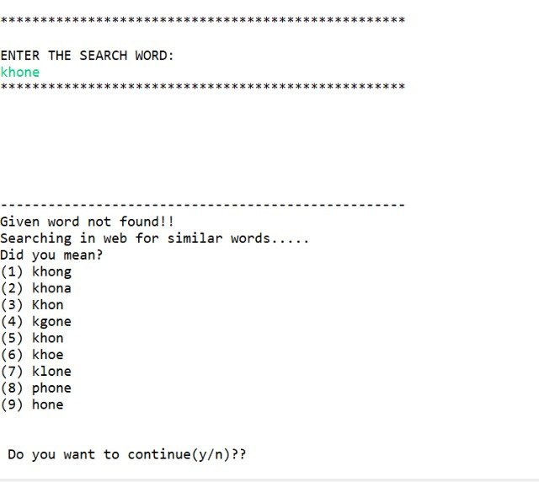
Spell Checker
This feature checks for the various characters and words for similar patterns by using the edit distance algorithm.
This Edit distance algorithm calculates the length of two strings and compares the length for performing spell checking function.

Slide 13
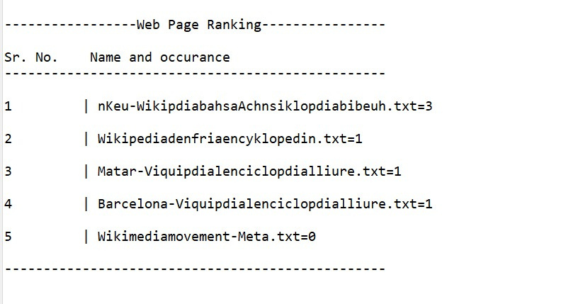
Ranking Webpages
The project displays the url of the webpages in which the keyword appears the maximum number of times and displays them in descending order.

Slide 14
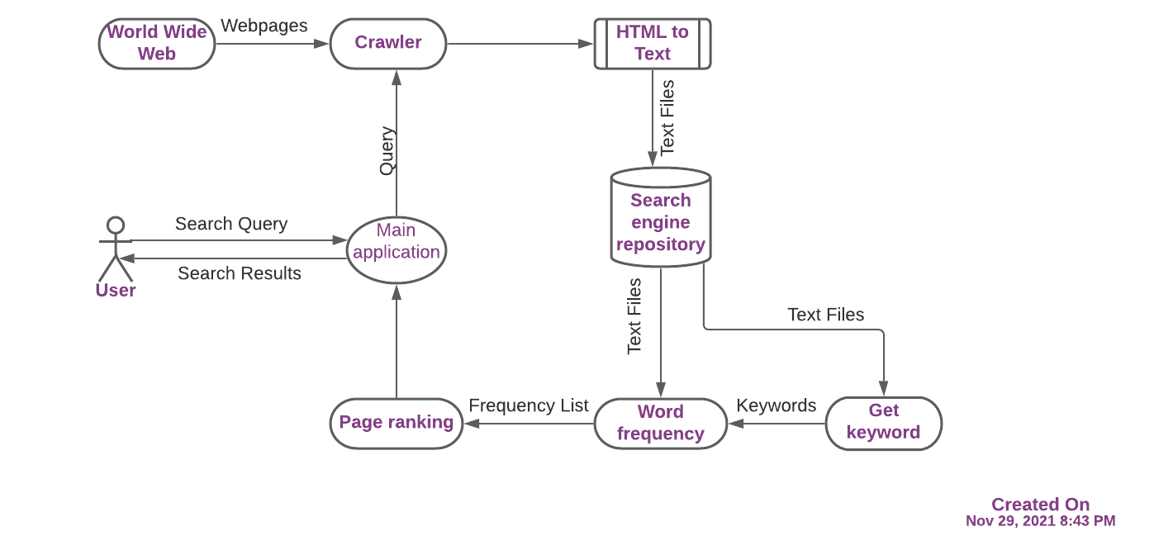
Flow Diagram

Slide 15
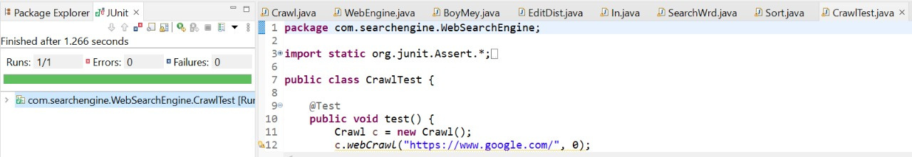
TESTING
Unit testing was done in order to verify that each individual units of the source code executed without any issues.
JUnit is a Unit Testing Framework used to implement unit testing in Java, which speeds up development and increases code quality.

Slide 16
Future Scope
Further add-ons can be implemented in the search engine in order to build a full fledged web search engine similar to that of Google or Bing.
This engine will be different to Google or other existing search engines as it will give access to only students of a specific university. This can be further implemented by integrating the project with the university database server giving access to students.
This will allow students to view and refer previous projects, assignments and research works affiliated with that university.

Slide 17
Summary
The basic idea of the project is to search for various unique URL links in a specific website. It then converts the HTML files to text files where the actual word is searched. So the project displays the frequency and position of the keyword along with ranking the most frequently parsed sites having the keyword. In addition to this, the search engine identifies or performs spell checking function. The project was successfuly executed using the Eclipse IDE.

Slide 18
Thank You

