Slide 1


BLOODLINK
BloodLink – Blood Donor & Blood Bank Platform
Team 13 - faith force
NAME | REGISTER NUMBER
Shroff Akhil | 99230040232
Kummara Niranjan | 99230040979
S R Abhinaya | 99230040232
Harini Sri K | 99230040232
One centralized emergency workflow.
Notes:
BloodLink connects donors, blood banks, hospitals, and patients through one centralized emergency workflow. This presentation reviews the problem, the platform objectives, the protected architecture, the role-based experiences, and the current scope of the BTech final-year project.

Slide 2
THE PROBLEM
Disconnected processes create avoidable delay
Finding a suitable donor can be manual and location-dependent.
Emergency communication is fragmented across calls and messages.
Blood bank information and request progress are difficult to track centrally.
BloodLink brings donor discovery, requests, inventory, and tracking together.
Notes:
The core problem is fragmentation. Donor discovery can depend on manual, location-dependent work. Emergency communication moves across calls and messages, while blood bank information and request progress lack one central view. BloodLink addresses that gap by bringing discovery, requests, inventory, and tracking together.

Slide 3
PLATFORM DESIGN
Six objectives shape the platform
Centralize
Control access
Track requests
Centralize blood donation operations.
Provide multi-role authentication and access control.
Submit and track emergency blood requests.
Manage inventory
Discover donors
Monitor the platform
Manage inventory across all eight blood groups.
Discover available donors by blood group and city.
Give administrators platform-level monitoring.
Notes:
These six objectives define the platform boundary. BloodLink centralizes operations, controls access across roles, supports emergency request tracking, manages all eight blood groups, narrows donor discovery by blood group and city, and gives administrators platform-level monitoring.

Slide 4
ARCHITECTURE
React to MongoDB through a protected API layer
Users interact with the React frontend. Axios sends requests to Express REST APIs; JWT and middleware protect access; controllers read and write MongoDB through Mongoose.
Client | User → React 19 + Vite + React Router v7 → Axios
Protected API | Node.js + Express.js 5 REST API → JWT / bcryptjs / authorization middleware → controllers
Data + return | MongoDB Atlas + Mongoose → API response → React UI
Notes:
Walk left to right through the request path. Users begin in the React 19 frontend with Vite and React Router v7. Axios reaches the Node.js and Express.js 5 REST API. JWT, bcryptjs, and authorization middleware protect access before controllers read and write MongoDB Atlas through Mongoose. The API response returns to the React UI.

Slide 5
ROLE-BASED WORKFLOW
One platform, three controlled experiences
SHARED AUTHENTICATION
One protected entry point, with permitted capabilities by role
BLOOD DONOR
BLOOD BANK
ADMINISTRATOR
Register, manage profile, toggle availability, submit requests, and track them.
Manage inventory, review requests, and approve, reject, or fulfill them.
Inspect users, donors, blood banks, requests, and platform analytics.
PERMITTED CAPABILITIES
PERMITTED CAPABILITIES
PERMITTED CAPABILITIES
Notes:
The platform presents three controlled experiences after shared authentication. Donors manage their profile, availability, requests, and tracking. Blood banks manage inventory and request decisions. Administrators inspect the broader platform, including users, donors, blood banks, requests, and analytics.

Slide 6

REQUEST MANAGEMENT
Emergency requests have a visible lifecycle
REQUEST DATA
Blood group, hospital, city, units needed, and medical reason.
Pending
SUPPORTED GROUPS
Approved
A+, A-, B+, B-, AB+, AB-, O+, O-.
CONTROL
Fulfilled
Pending requests can be tracked and cancelled; approved requests can move to fulfilled.
Notes:
An emergency request begins with structured information: blood group, hospital, city, units needed, and medical reason. The lifecycle makes progress visible from Pending to Approved to Fulfilled, while Rejected and Cancelled remain clear alternate outcomes. The platform supports all eight blood groups.

Slide 7
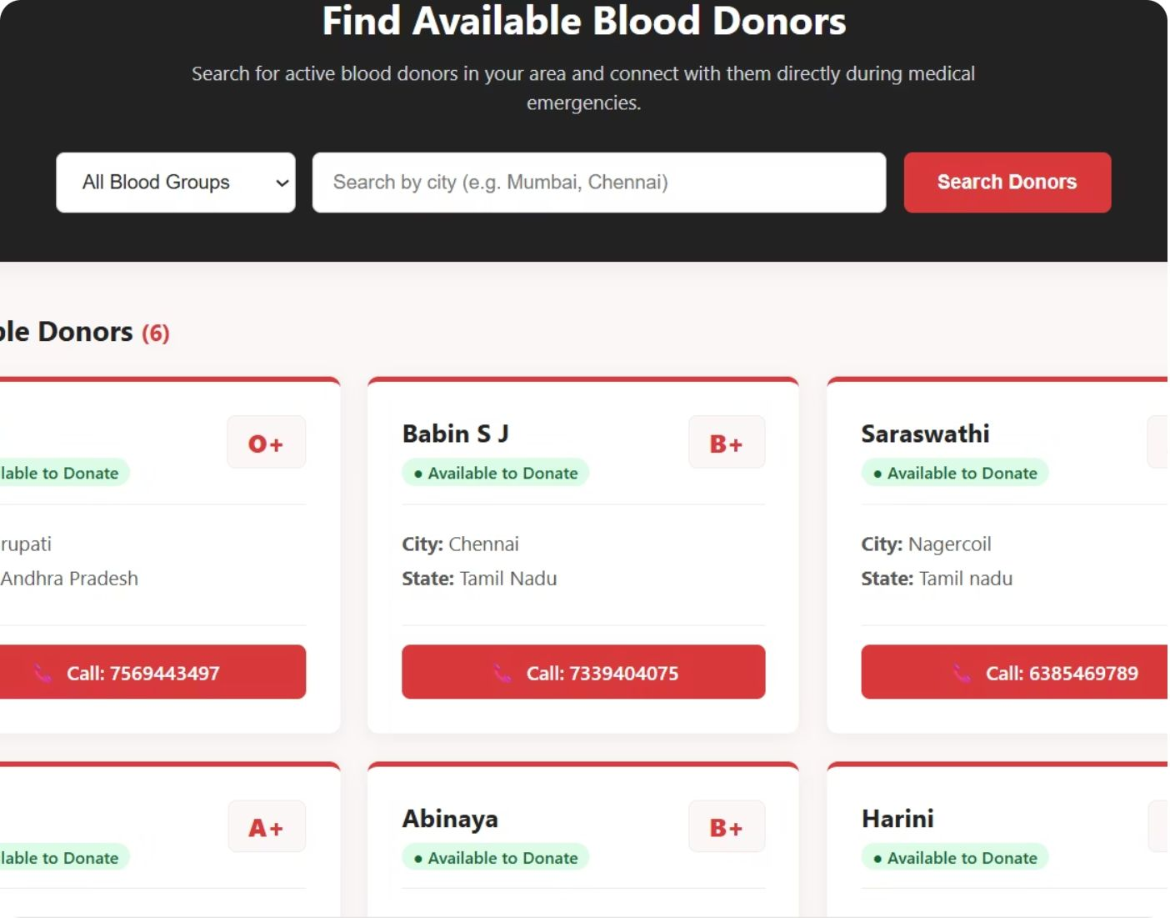
DONOR DISCOVERY
Donor discovery narrows the search quickly
1
Choose a blood group and search by city.
2
Review available donor details and location.
Supplied platform evidence: search, donor details, and contact action.
3
Use the contact action to call a donor during an emergency.
Notes:
The donor search is designed to reduce the search space quickly. A user chooses a blood group, searches by city, reviews available donor details and location, and uses the contact action to call a donor during an emergency. The supplied screenshot shows the platform evidence.

Slide 8
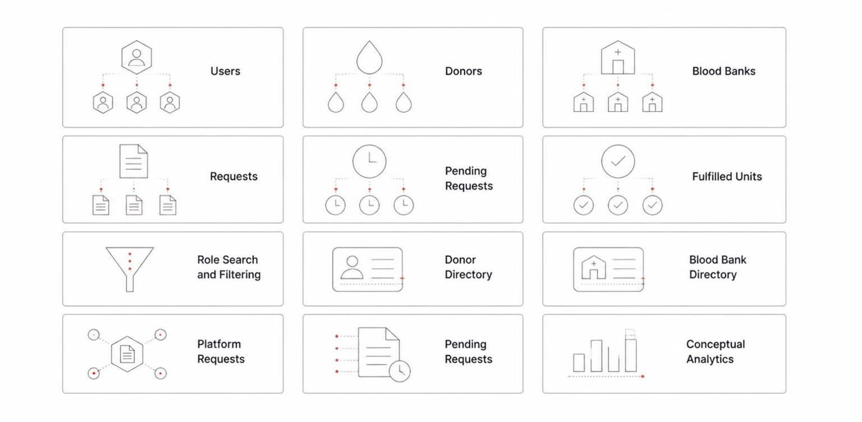
ADMINISTRATION
The administrator sees the system as a whole
SYSTEM VIEW
Monitor users, donors, blood banks, requests, pending requests, and fulfilled units.
Search and filter accounts by role.
Inspect donor and blood bank directories and platform requests.
Analytics are conceptual only. No project results are implied.
Notes:
The administrator view brings the system together. It supports monitoring users, donors, blood banks, requests, pending requests, and fulfilled units. Accounts can be searched and filtered by role, while directories and platform requests can be inspected. Any analytics shown here are conceptual, not invented project results.

Slide 9
SCOPE
Future enhancements extend the current scope
IMPLEMENTED
PLANNED
Current strengths
Future work
Centralized workflows
Donor discovery
Blood bank management
Digital tracking
Role-based access
Responsive interface
SMS/email alerts
GPS-based discovery
Mobile app
Stock forecasting
Donor verification
Stronger security
Planned enhancements are clearly distinguished from implemented functionality.
Notes:
The current scope is clear: centralized workflows, donor discovery, blood bank management, digital tracking, role-based access, and a responsive interface. Planned enhancements include alerts, GPS-based discovery, a mobile app, stock forecasting, donor verification, and stronger security. These are future work, not implemented functionality.

Slide 10
THANK YOU
Every Drop Counts. Every Life Matters.
BloodLink · https://bloodlink-frontend-44lx.onrender.com/
Notes:
Thank the review panel and invite questions. Close by returning to the central purpose of BloodLink: coordinating donors, blood banks, hospitals, and patients when blood is urgent.

