Slide 1
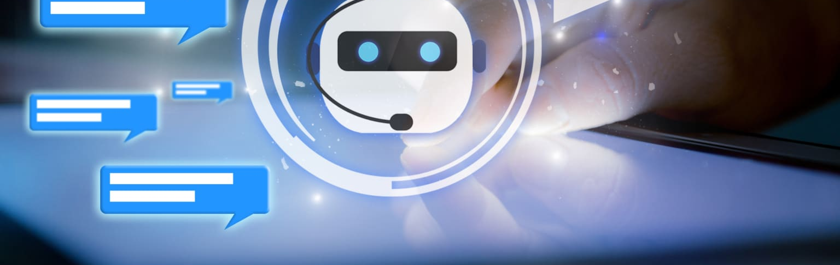
GovGuideBot – Exploring Government Schemes
BY:
S. Abinaya – 2021115004
D. Cheran – 2021115022
P. Saravana Kumar - 2021115319

Slide 2
Problem statement
In today's digital age, government schemes play a crucial role in providing assistance and benefits to citizens across various sectors.
However, accessing information about these schemes can often be challenging due to the complexity of government websites and the lack of user-friendly interfaces.
The aim of this project is to address this issue by developing an intelligent chatbot that can efficiently provide information about government schemes to users in a conversational manner.

Slide 3
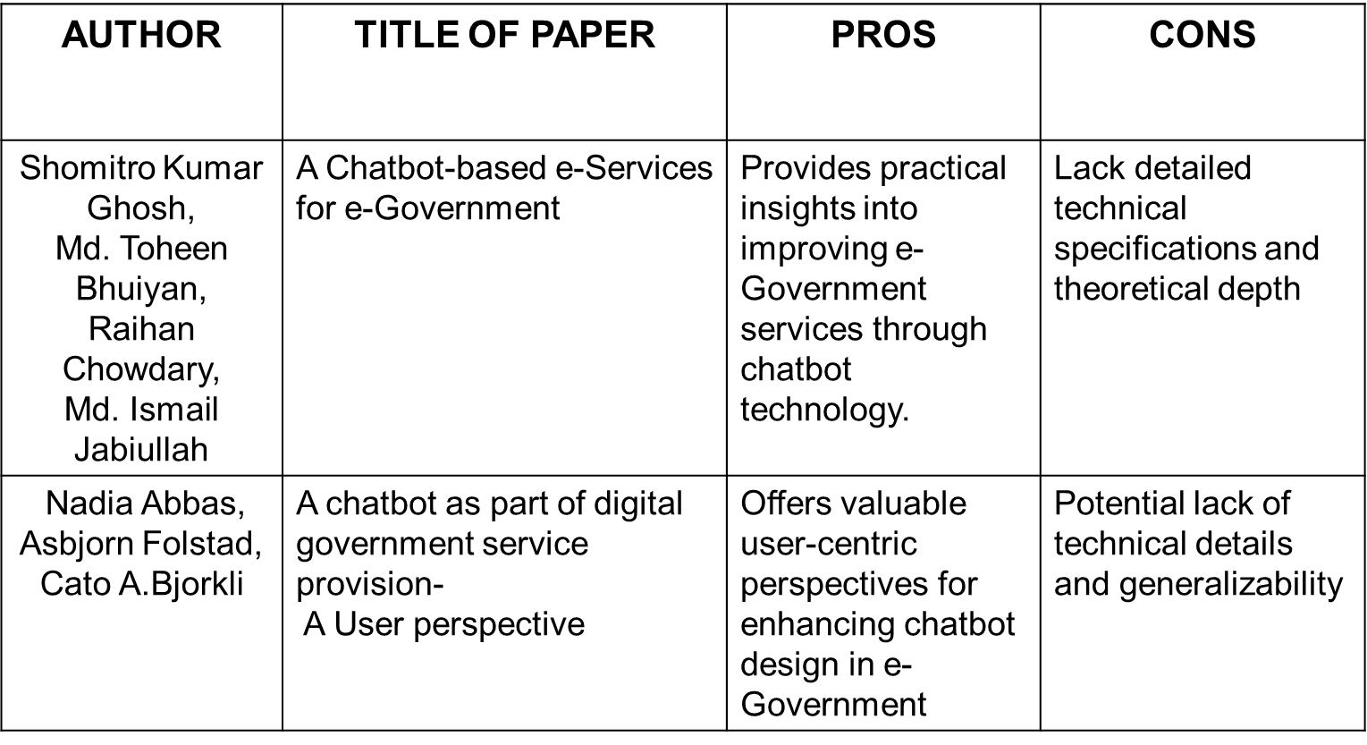
Literature Survey

Slide 4
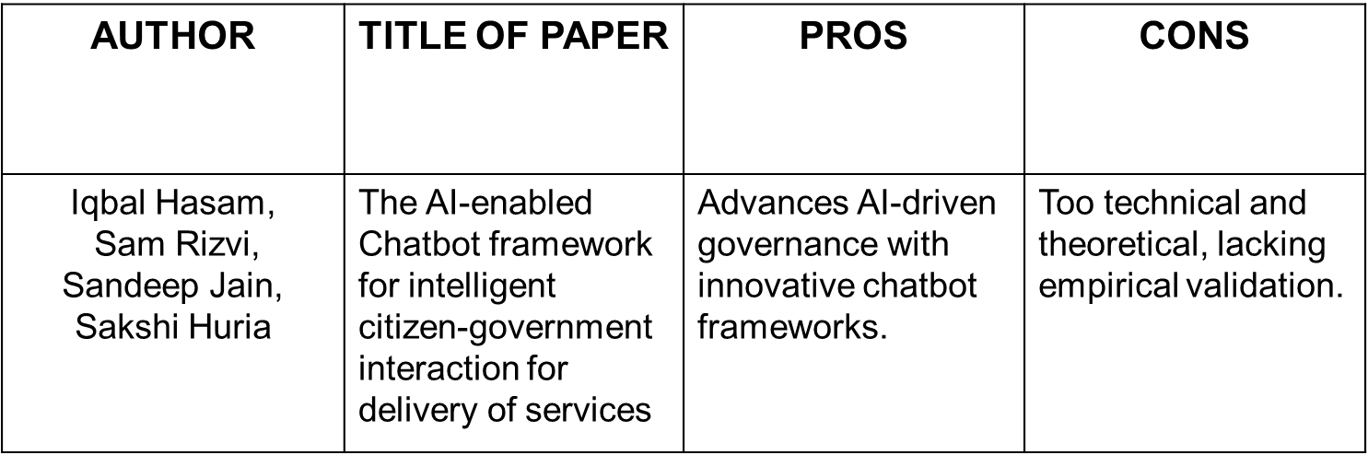
Literature Survey

Slide 5
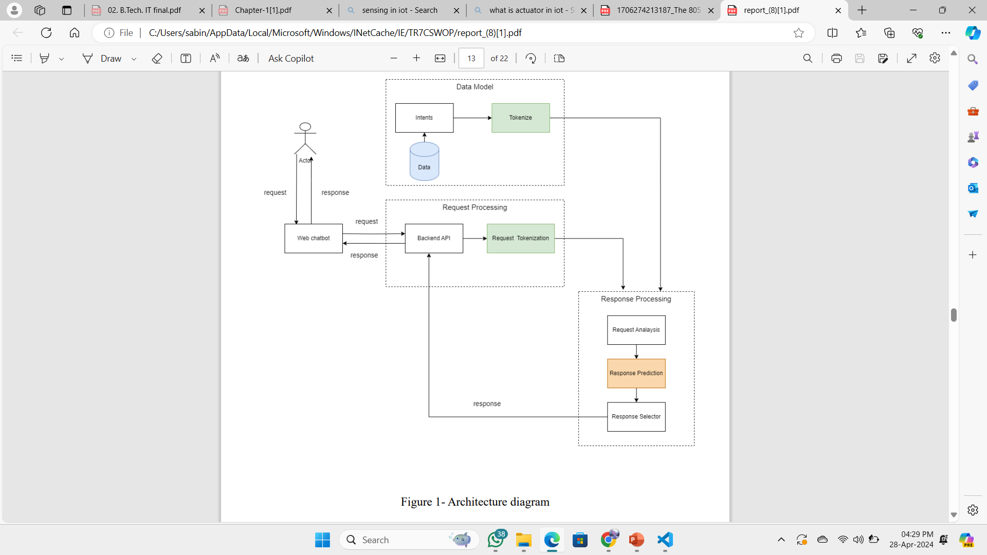
Architecture Diagram

Slide 6
Module Description and algorithms planned to use
The approach we used doesn't explicitly mention a specific algorithm but it outlines a series of steps and methods commonly here:
1. Bag-of-Words Model:
Description:
The bag-of-words model is a fundamental technique used in natural language processing for text classification and analysis.
It represents text data as numerical feature vectors, ignoring the sequence and structure of words.
Implementation:
Utilizing the nltk_utils.py module, the chatbot tokenizes user input and builds a bag-of-words representation.
The bag-of-words is constructed using a predefined vocabulary (all_words) obtained from the training data.

Slide 7
Module Description and algorithms planned to use
2. Intent Classification:
Description:
Intent classification determines the purpose or meaning behind a user's input.
It assigns a predefined tag to the user's query, indicating the intended action or information sought.
Implementation:
The chatbot employs a pre-trained machine learning model (loaded from "Model V1.pkl") for intent classification.
The model predicts the intent tag based on the bag-of-words features extracted from the user input.

Slide 8
Module Description and algorithms planned to use
3. Context Management:
Description:
Context management enables the chatbot to maintain awareness of the conversation's state and history.
It facilitates the handling of follow-up queries and ensures relevant responses.
Implementation:
The chatbot stores contextual information, such as the last queried scheme, using a Python dictionary (context).
Context is updated based on user interactions, allowing for tailored responses and seamless conversation flow.

Slide 9
Module Description and algorithms planned to use
4. Response Generation:
Description:
Response generation involves crafting appropriate replies based on the user's intent and context.
It retrieves relevant information from the intents.json file and formats responses for user consumption.
Implementation:
The chatbot scans the intents.json file to find matching patterns for the user's intent.
Responses are randomly selected from the corresponding intent's response options, ensuring variety and naturalness in interactions

Slide 10
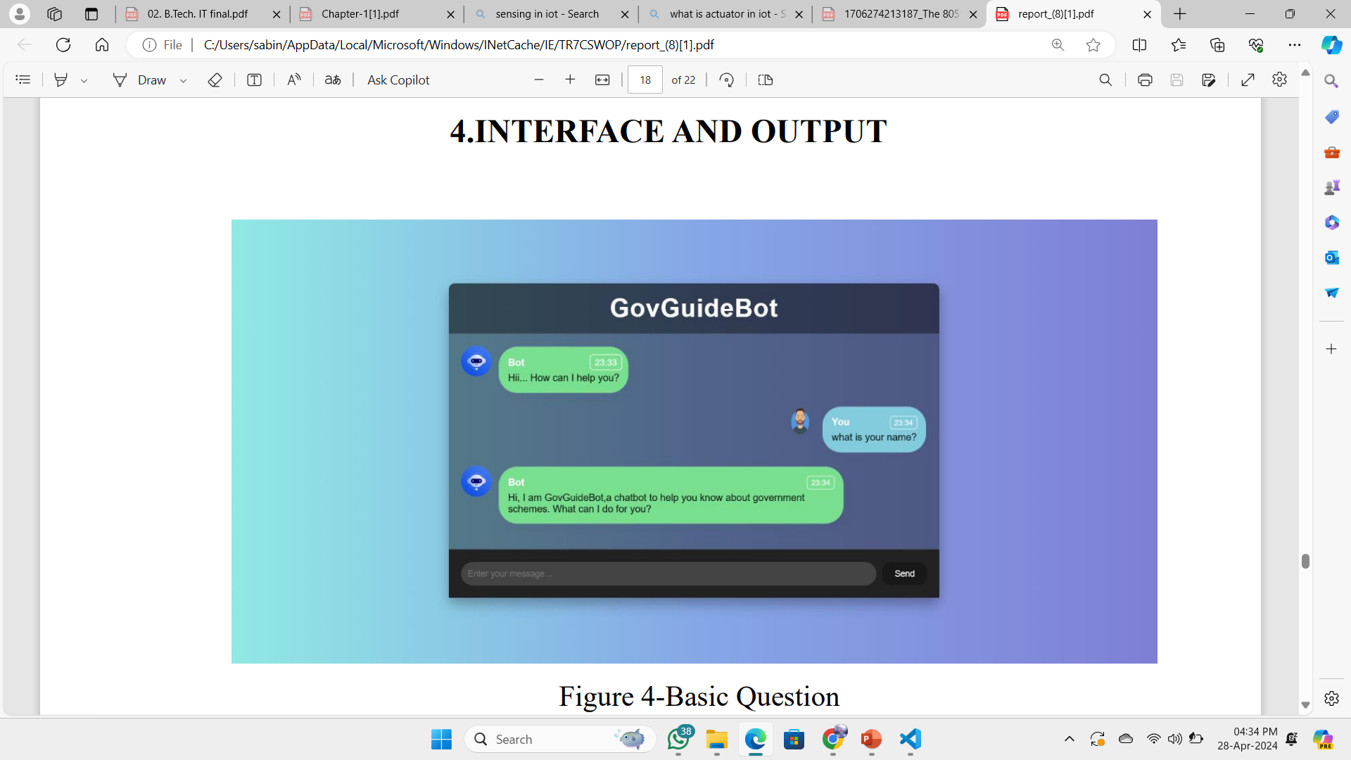
Sample Screenshot 1.Basic questions
Basic question such has “what is your name ? ’, ’who are
you?’ etc.. gives response .All introduction queries has been responded properly
by chat.

Slide 11
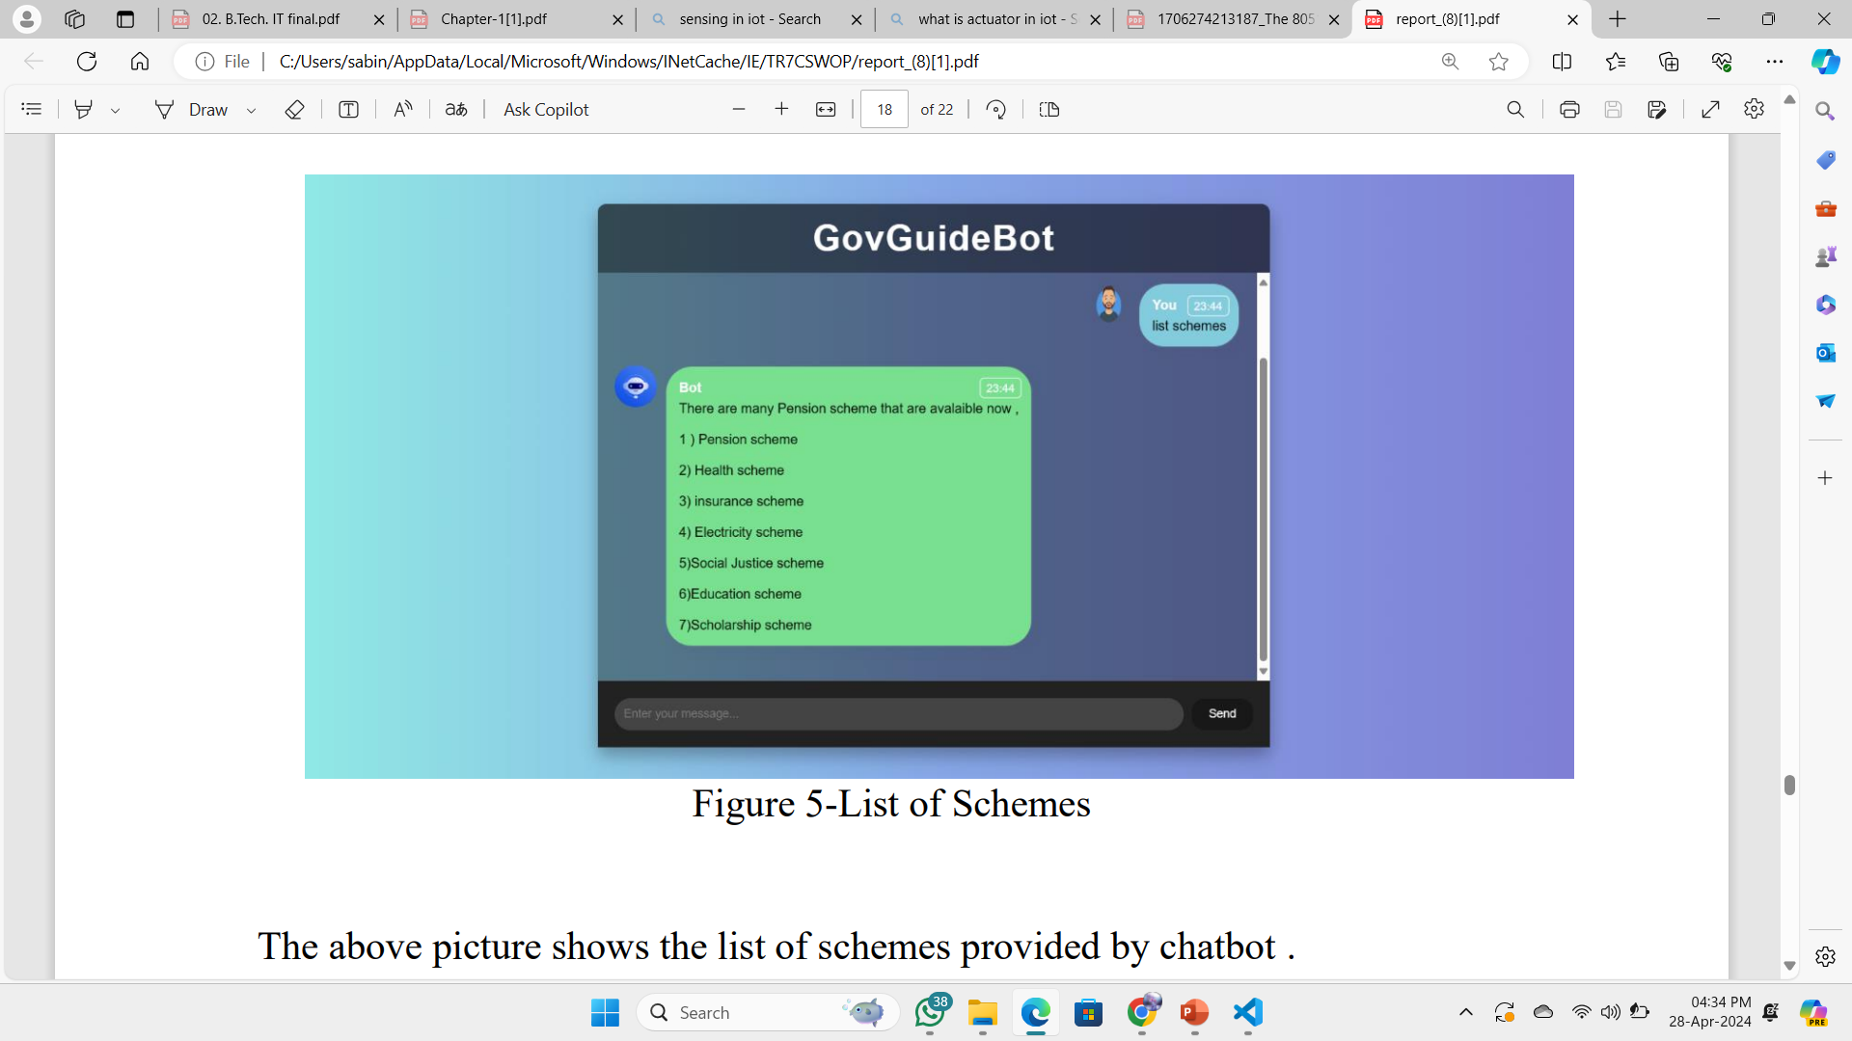
2.List of Schemes
Shows the list of schemes provided by chatbot

Slide 12
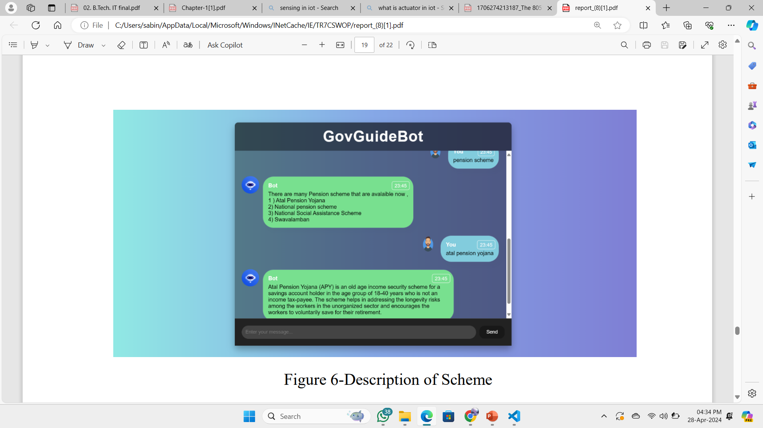
3.Description of Schemes
Shows the description of scheme which was asked by user. Chatbot
provide the complete description of each scheme which was asked by user.

Slide 13
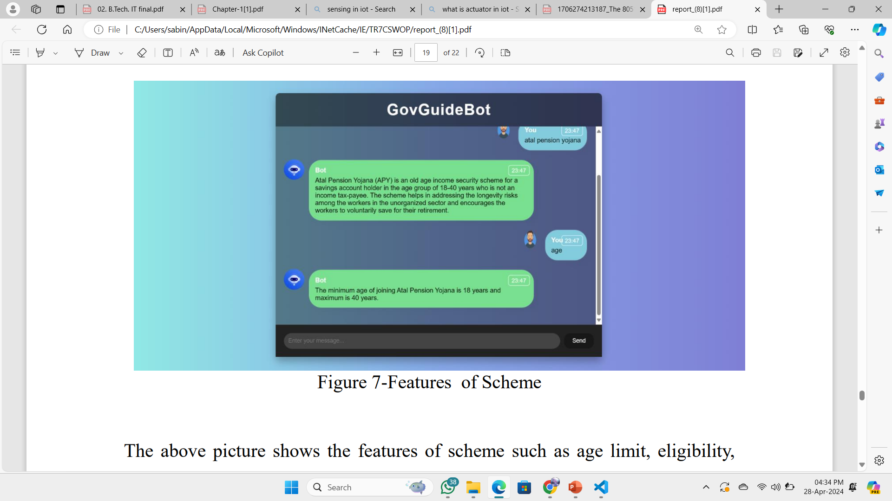
4.Scheme details
Shows the features of scheme such as age limit, eligibility, required
documents , application process of scheme which was provided by chatbot
without including that particular scheme name

Slide 14
Tools and Technologies
Python: The backend logic of the chatbot is written in Python.
NLTK (Natural Language Toolkit): Used for natural language processing tasks such as tokenization and bag-of-words generation.
Pickle: A Python module used for serializing and deserializing Python objects, used here to load the machine learning model and word list.
JSON: Used to store and manage the intents and responses of the chatbot.
Machine Learning Model (Model V1.pkl): Trained model used for intent classification, presumably created using libraries like scikit-learn.

Slide 15
References
1. Shomitro Kumar Ghosh, Md. Toheen Bhuiyan, Raihan Chowdhury, Md. Ismail Jabiullah, "A Chatbot-based e-Services for e-Government" .
2. Nadia Abbas, Asbjorn Folstad, Cato A. Bjorkl , "Chatbots as Part of Digital Government Service Provision – A User Perspective”
3. Iqbal Hasan, Sam Rizvi, Sandeep Jain, Sakshi Huria, "The AI-enabled Chatbot Framework for Intelligent Citizen-Government Interaction for Delivery of Services".

Slide 16
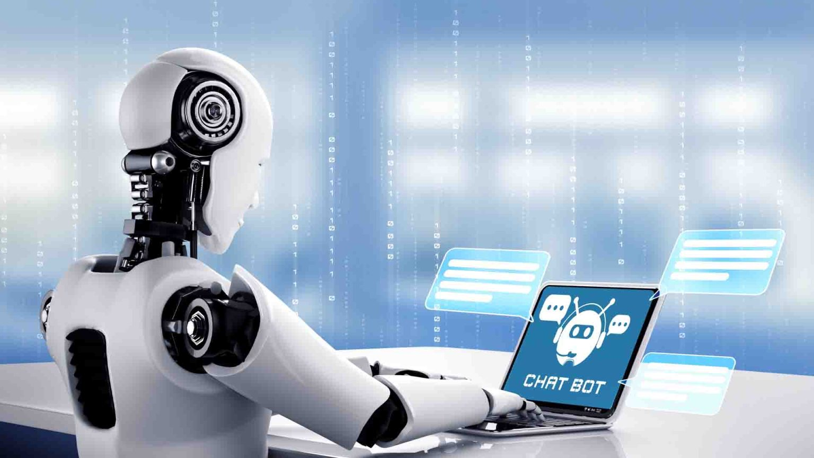
THANK YOU!

