Slide 1
Excel Final Assessment
Name: Abinaya Anbuchezhian Emp ID : 4347

Slide 2
Understanding data
Data columns
WO
District
LeadTech
Service
Rush
ReqDate
WorkDate
Techs
WtyLbr
WtyParts
LbrHrs
PartsCost
Payment
Wait
LbrRate
LbrCost
LbrFee
PartsFee
TotalCost
TotalFee
ReqDay
WorkDay
Days
workdays without balnk
rush without balnk
Wrt without blank

Slide 3

Q1
Steps
I have created an days column with the two date but it has some blanks and so, I used an column which I handled it with today() function
Formulas used:=IF(ISBLANK(G2),TODAY(),G2),datedif() function
Inference
Avg lead time between req date and completion date is 167.704 , this might be used to the today() function I used for handling blacks

Slide 4
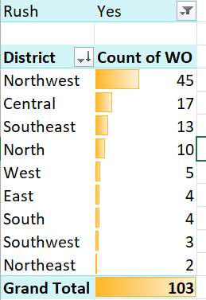
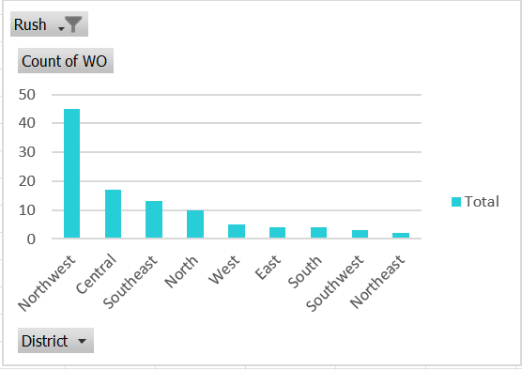
Q2
Steps
Used pivot to analyse , rush as an filter and count of wo on values, district on row
Inference
From the pivot North west has the highest part of wo
Least is north east

Slide 5
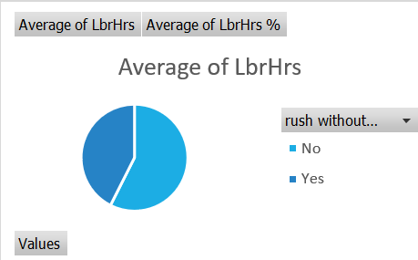
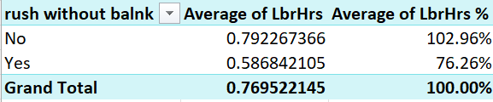
Q3
Steps
Used pivot , handled blanks on rush using if
Formula:=IF(ISBLANK(E2),"No",E2)
Inference
Without rush jobs has the highest avrage labour work hours, with 102.96%

Slide 6
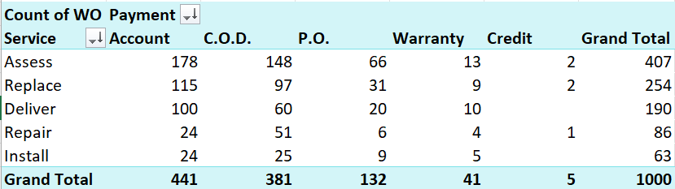
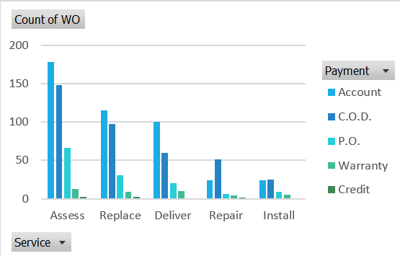
Q4

Slide 7
Q4
Steps
Used the pivot table , column chart for analyses
Inference
Assess service used the account payment type the most
Except in repair on all services account payment toped

Slide 8
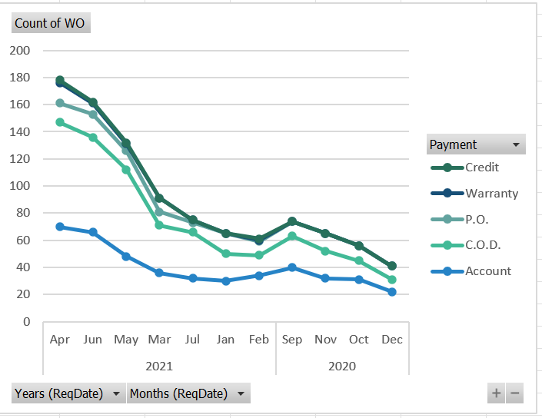
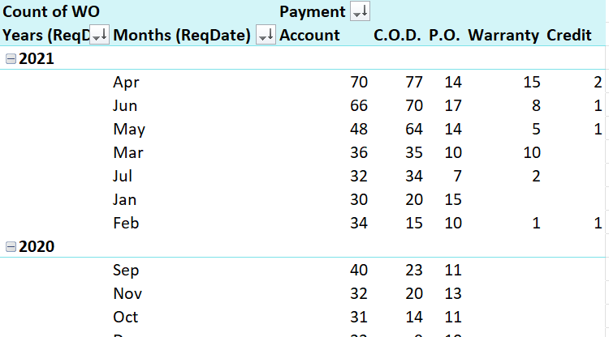
Q5

Slide 9
Q5
Steps
Used pivot chart and line chart to find the trend in payment methods
Inference
There is an increase in all payment method over the year as the graph goes up from 2020 to 2021
Compared to others account payment method has the less increase graph in trajectory

Slide 10
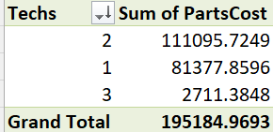
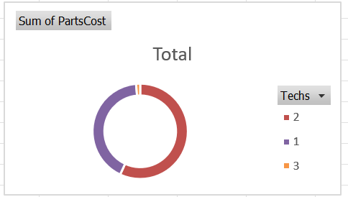
Q6
Steps
Used pivot table and the chart
Inference
2 hold the highest part cost than all

Slide 11
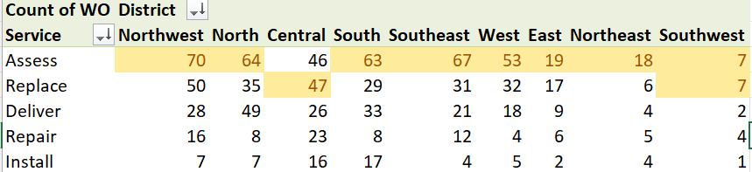
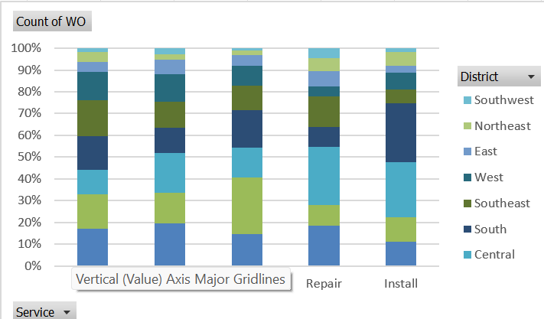
Q7

Slide 12
Q7
Steps
Used pivot table and used conditional formatting to highlight the top ones
Inference
Assess and north west hold the most wo

Slide 13
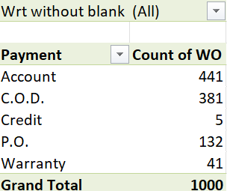
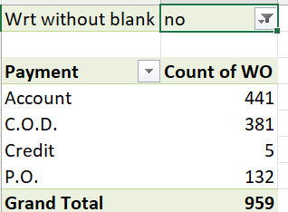
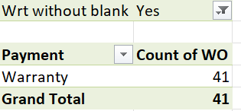
Q8
Inference
Used pivot and used filter to find distribution of payment type with warrenty

Slide 14
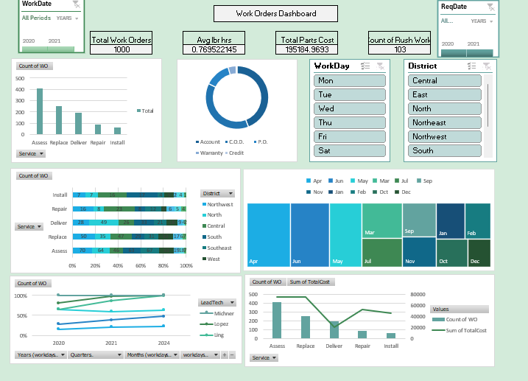
Dashboard

Slide 15
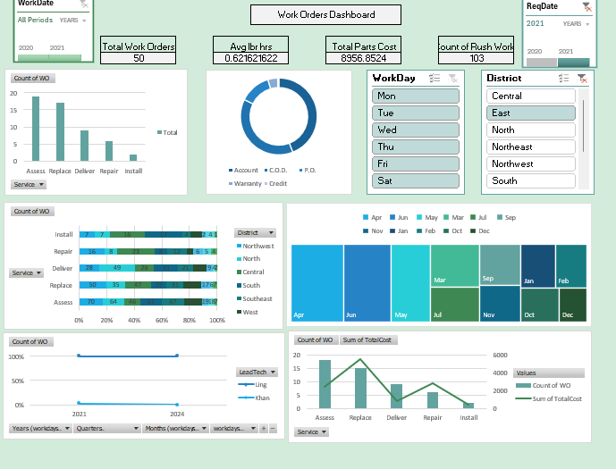
Dashboard

Slide 16
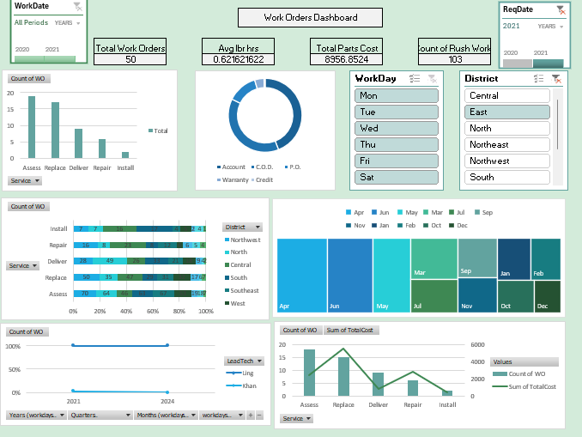
Dashboard

Slide 17
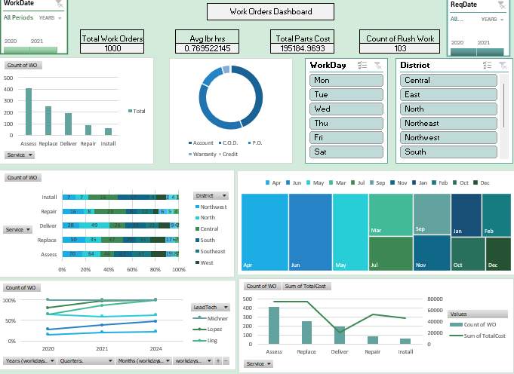
Dashboard

