Slide 1
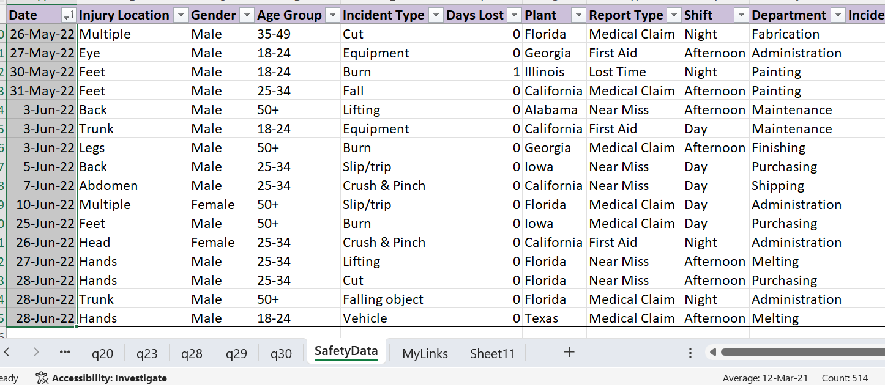
1.What is the total number of safety incidents recorded in the dataset?
By selecting all the rows and finding the count of records on the right corner we can see the total number of safety incidents recorded in the dataset is 514

Slide 2
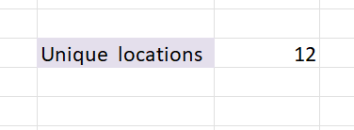
2.How many unique injury locations are there in the dataset?
By using the formula → =COUNTA(UNIQUE(SafetyData[Injury Location]))
found that count of unique location are 12

Slide 3
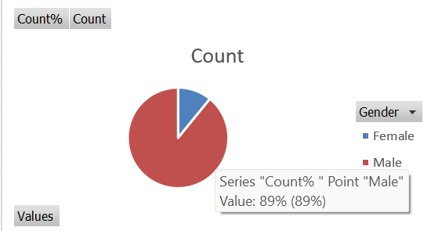
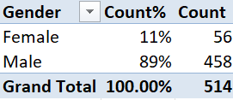
3.What is the distribution of gender among employees involved in safety incidents?
It is an distribution of appx only 10% of female and 90% of male

Slide 4
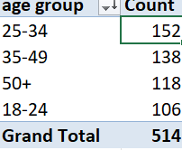
4.Which age group has the highest number of safety incidents?
25- 34 is the age which has the highest number of safety incidents

Slide 5
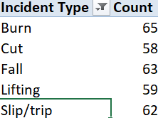
5.What is the most common type of safety incident?
Top 5 most occurring incident type are listed above using pivot table and filtered on top 5

Slide 6

Formula used to find the average number of days lost per safety incident→ =AVERAGE(SafetyData[Days Lost])
6.What is the average number of days lost per safety incident?

Slide 7
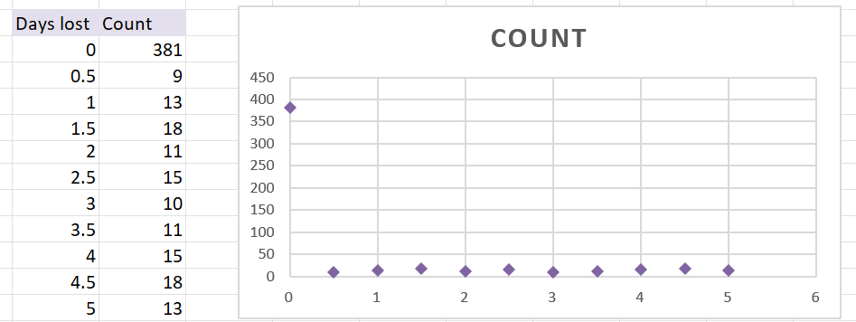
26. Are there any outliers in the number of days lost for safety incidents?
0 days lost is an outlier has highest number(381) of incidents happening which can be seen using an scatter chart

Slide 8
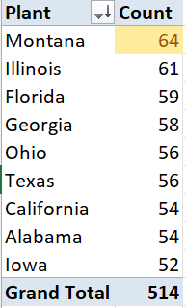
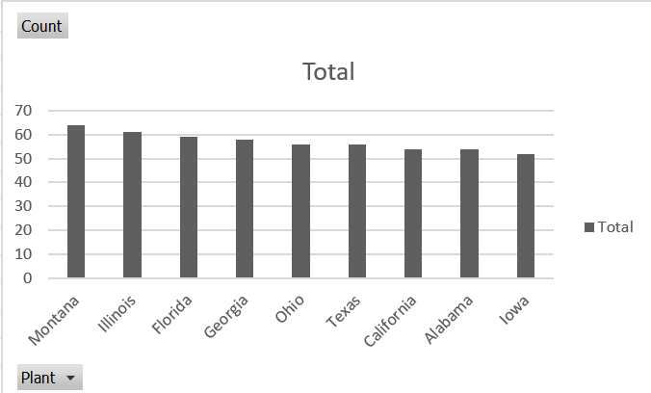
7. Which plant has the highest number of safety incidents?
Montana plant has the highest number of safety incidents

Slide 9
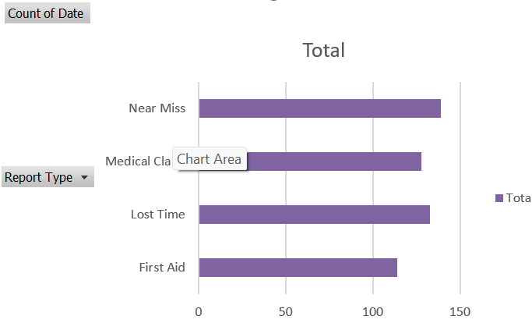
8. What is the distribution of report types filed for safety incidents?

Slide 10
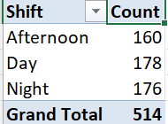
9. During which shift do most safety incidents occur?
Most incident occurs on Day still there is no major difference in the count

Slide 11
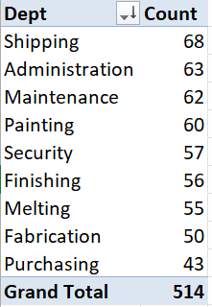
10. Which department has the highest number of safety incidents?
Shipping department has the highest number of safety incidents

Slide 12

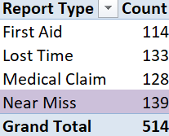
11. What is the total cost of safety incidents recorded in the dataset?
Using the formula → =SUM(SafetyData[Incident Cost])
12. How many safety incidents were reported as "Near Miss"?
139 incidence were recorded as near miss

Slide 13
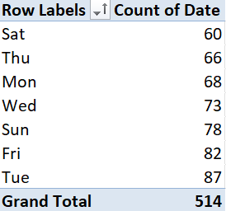
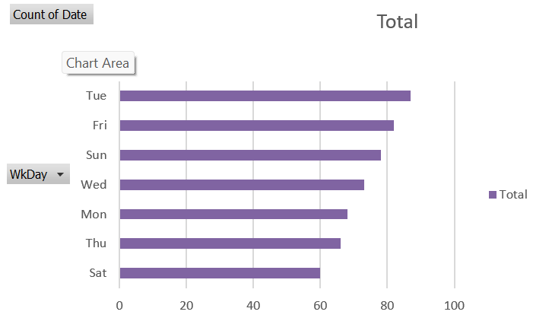
13. What is the distribution of safety incidents across different days of the week?
24. Is there any correlation between the day of the week and the number of safety incidents?

Slide 14
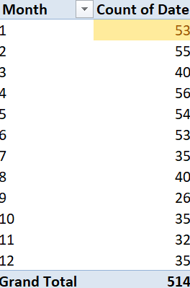
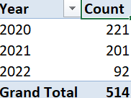
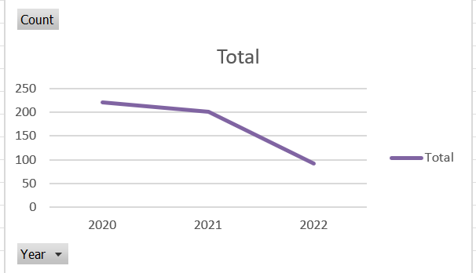
14. How many safety incidents occurred in each month?
15. What is the trend of safety incidents over the years?
Is seems to be decreasing over time

Slide 15
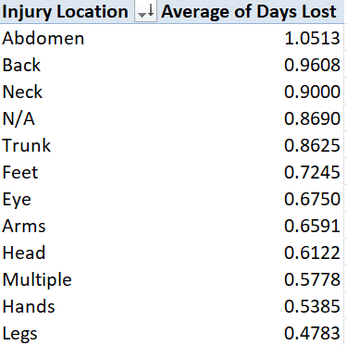
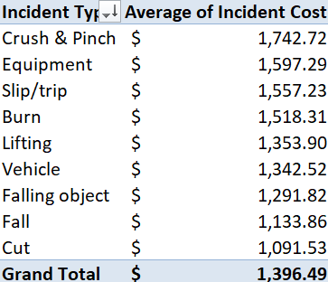
16. Which injury location results in the highest number of days lost on average?
Abdomen has the highest avg days lost
17. What is the average incident cost for each type of safety incident?

Slide 16
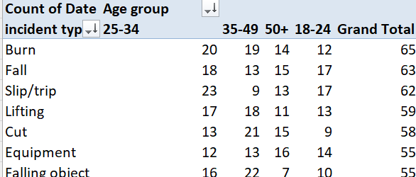
18. Is there any correlation between age group and incident type?
18-24 and 35-49 has less number of crush and pinch events happening , it seems they are more caution about the objects
Burn event have no connection they are also 20 count a each divided equally
For lifting , even we lift till 34 it wont be any issue our body can take it , but after 34 . Body might act another way as that might cause people above 50+ to avoid lifting .

Slide 17
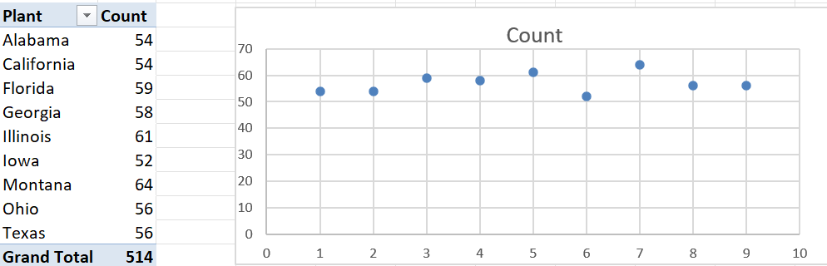
19. How does the distribution of safety incidents vary across different plants?

Slide 18
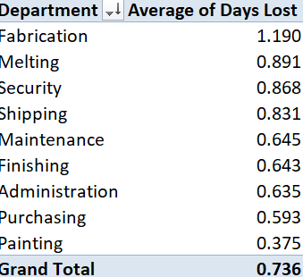
20. What is the average number of days lost for safety incidents in each department?
21. Are there any noticeable patterns in safety incidents based on the day of the week?
Yes , It follows an peak and valley pattern, fluctuation pattern

Slide 19
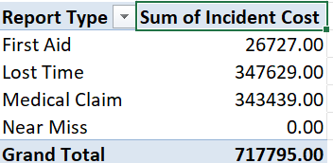
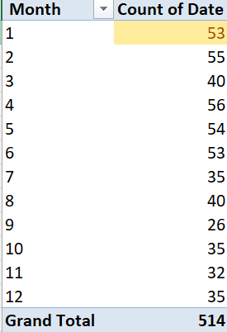
22. Is there a difference in incident costs between different report types?
Lost time and medical claims incur the highest expenses, while it near miss situation result in zero funds
23. Which month has the highest number of safety incidents reported?
January is the month with highest number of safety incidents occurred

Slide 20
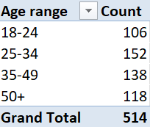
25. What is the average age of employees involved in safety incidents?

Slide 21
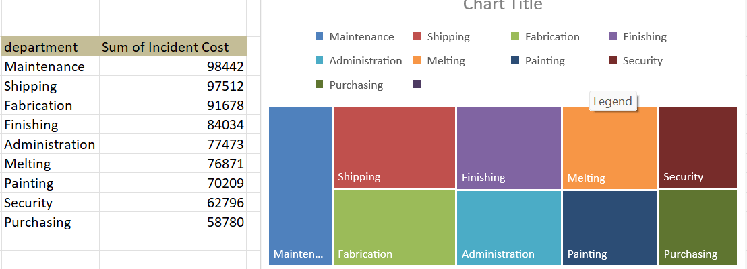
27. How does the distribution of safety incidents vary across different shifts?
Its all around 30% each.
28. Is there a relationship between incident cost and the department where the incident occurred?

Slide 22
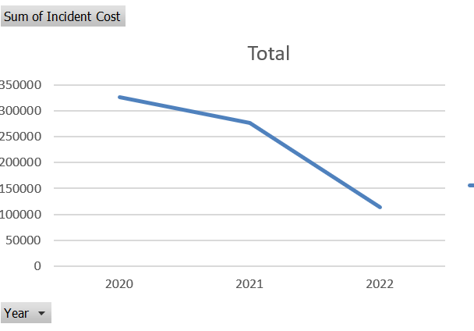
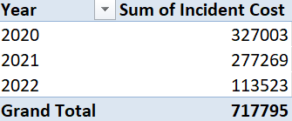
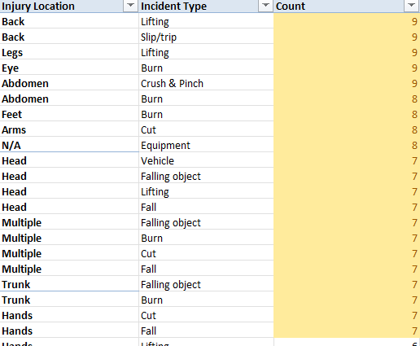
29. Are there any trends in incident costs over the years?
As the safety incidents decreased over the year the cost for those also might be decreased
30. What is the most common combination of injury location and incident type?
Back injury due to lifting the most common occurring issue

