Slide 1
Excel Internal Assessment
Name: Abinaya Anbuchezhian Emp ID : 4347

Slide 2
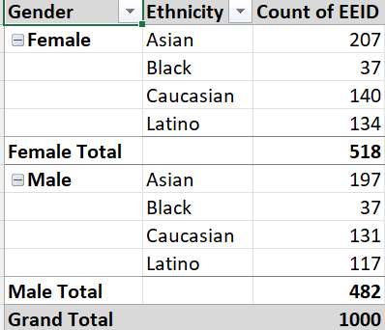
Q1
Outcomes
Company has more female count than male
Asain’s dominating in both gender

Slide 3
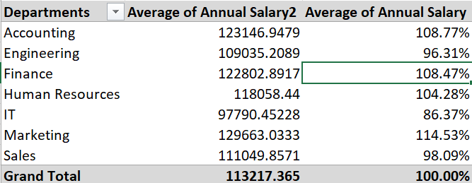
Q3
Outcomes
There is no significant difference in average salary based on departments
Finance and account people has higher salary percentage

Slide 4
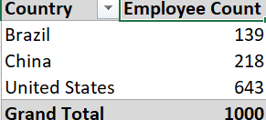
Q4
Outcomes
Us has the highest number of employees
Where China and Brazil count diff is not significant

Slide 5
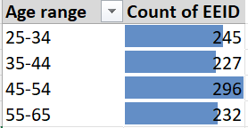
Q5
Outcomes
Age range with highest count of employee is 45-54 second comes the 25-34

Slide 6
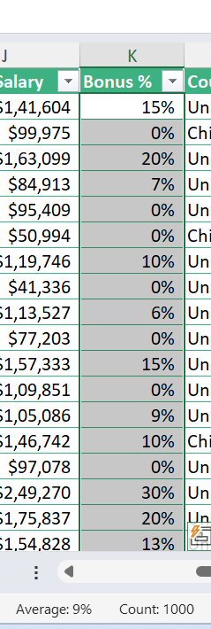
Q6
Outcomes
Average bonus percentage is 9%

Slide 7
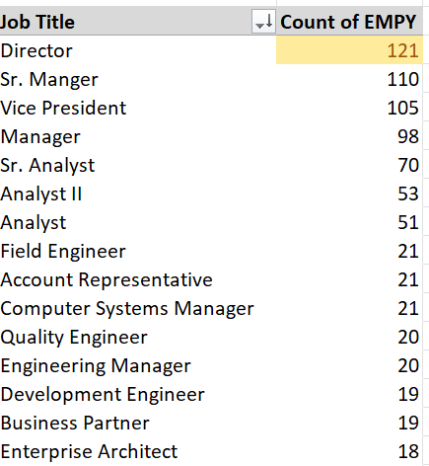
Q7
Outcomes
The highest job title occurred the most is directors

Slide 8
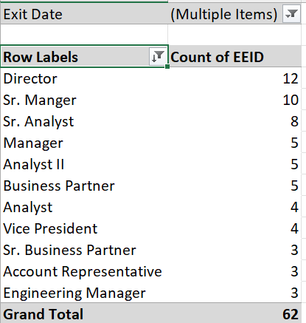
Q8
Outcomes
Used exit date column as a filter filtered down the blacks and white space
More people are exiting on director role ,Close to 20%

Slide 9
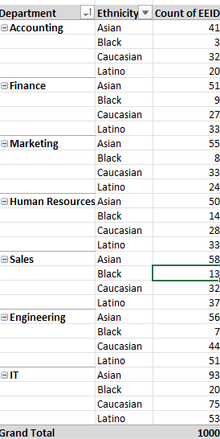
Q9
Outcomes
Compared to other departments black’s percentage in HR, sales and IT are high

Slide 10
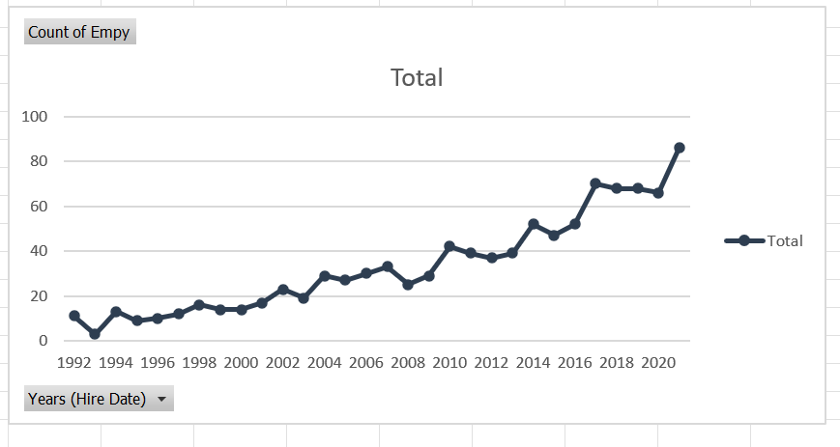
Q10
Outcomes
Its an overall increase in number of employee hiring over years

Slide 11
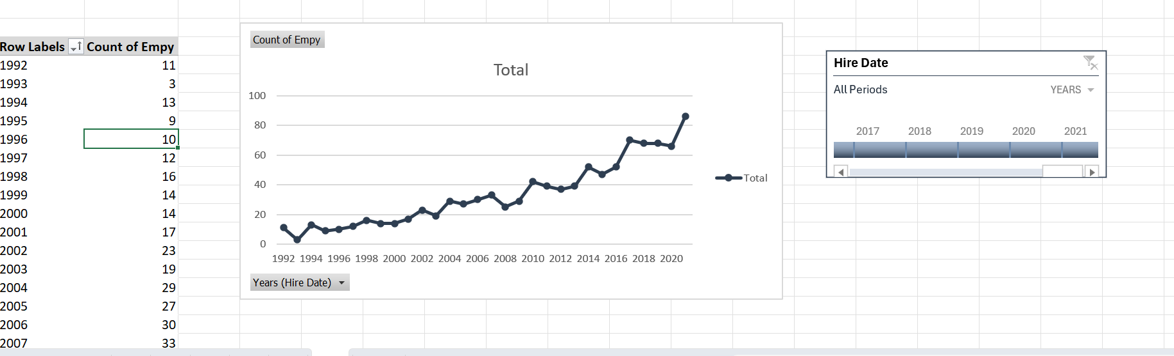

Slide 12
Q2
Outcomes
Create an column to find the years the employee stayed in a company by taking an difference between hire and exit date

