Slide 1

ByteCode Squad
Student Management Program
A complete Java console application — input marks, calculate grades, and find the topper.
PRESENTED BY:
Abinaya S
Priyanka
Gokul M
Manoharan
JAVA · BEGINNER FRIENDLY

Slide 2
What This Program Does
Input
Calculate
Roll No, Name & 3 subject marks per student
Total, Average & Letter Grade automatically
Display
Topper
Full details for every student in the class
Identifies and displays the highest-scoring student

Slide 3

Program Structure
calculateGrade()
displayTopper()
Main loop
Two helper functions keep the main() method clean and focused on program flow.

Slide 4

FUNCTION 1
calculateGrade()
Takes an average, returns a letter grade.
A
≥ 90
B
≥ 75
C
≥ 50
F
< 50

Slide 5


Storing Student Data
Parallel arrays hold each student's data, indexed by position.
int[] rollNo
String[] name
int[] total
double[] average
char[] grade
All arrays share size n — same index = same student.

Slide 6
The Input Loop
01
02
Read Roll No & Name
Read 3 Subject Marks
sc.nextInt() then sc.nextLine() to clear the buffer
Three separate nextInt() calls
03
04
Compute & Store
Track Topper
Total, average, and grade saved to arrays
Update highest and topperIndex if current total is greater

Slide 7


KEY LOGIC
Finding the Topper
Inside the input loop, compare each student's total to the running maximum.
if (total[i] > highest) {
highest = total[i];
topperIndex = i;
}
Store the index, not the value — needed to look up all topper details later.

Slide 8

Displaying Results
Student List
Topper Call
Loop through all arrays, printing each student's full record
displayTopper() receives all five values via topperIndex
Clean Exit
sc.close() releases the Scanner resource properly

Slide 9
Sample Output
--- Student Details --- Roll No: 101 Name: Alice Total: 285 Average: 95.0 Grade: A

Slide 10




Key Takeaways
Modular Design
Parallel Arrays
Running Maximum
Scanner Best Practice
Helper functions isolate logic — cleaner, testable code
Same index across arrays = same student's data
Track the topper during input — no second pass needed
Clear buffer with nextLine() after nextInt(); always close

Slide 11
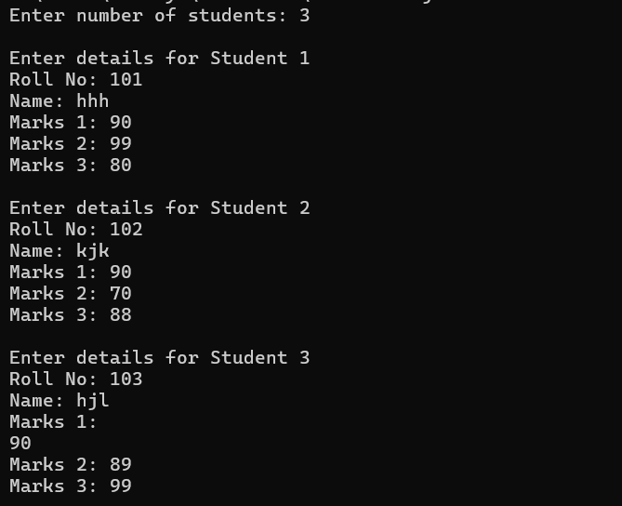
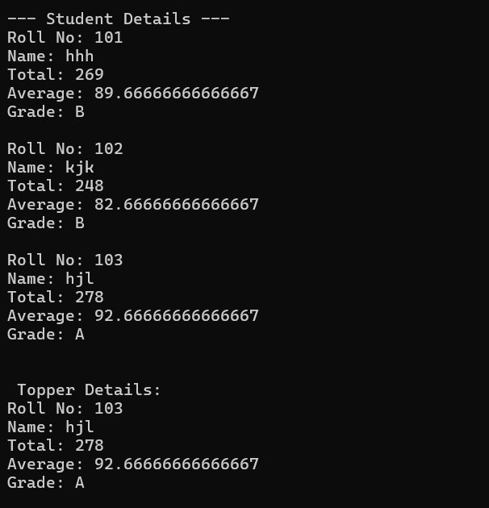
OUTPUT:
THANK YOU

