Slide 1
Tableau Products
Product | Connectivity | Distribution | Automation | Best For
Reader | .twbx files only | Offline | NA | View Workbooks
Public | Excel, text files | Cloud(Public) | NA | Sharing public data
Desktop: Personal | Excel, text files, Access, Tableau files | Offline, Tableau Public | NA | flat data files
Desktop: Professional | All possible connections in Tableau | Offline, Tableau Server, or Tableau Public | NA | Professional level report creation
Server | WB published to Tableau Server | Cloud | Available via data refresh schedules | Permission,Automation,Managing Workbooks

Slide 2
Chapter 1 : Connecting to Data
Connect to flat files, Access, Databases, Cloud platform.
Cross Join is accepted
Metadata management
Datasource filters

Slide 3
Exercise 1
Left Join Orders sheet and Returns sheet
Split the Order ID column with ‘-’ as split condition.
Filter the data by state ‘Texas’
Perform a inner join with text file. (Create a .txt file for returns data)

Slide 4
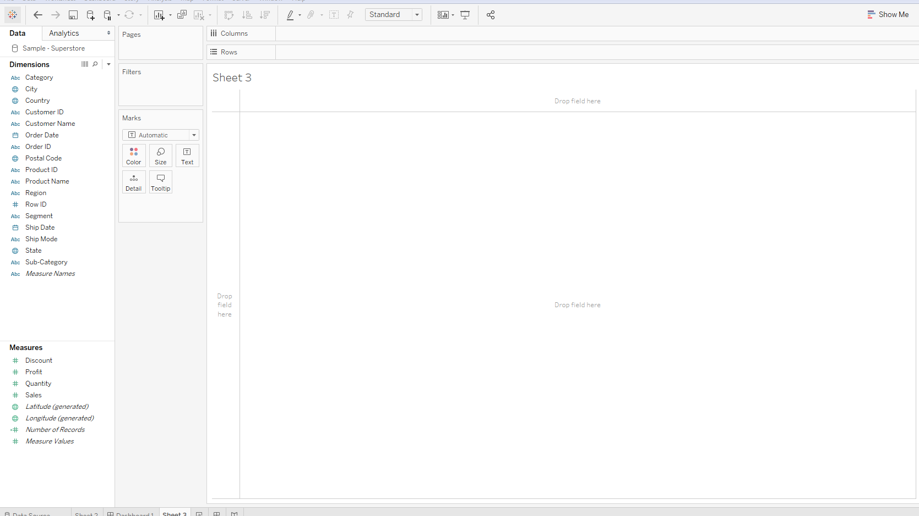
Column Shelf
Pages Shelf
Row Shelf
Filters Shelf
Dimension Shelf
Marks Shelf
Legend
View
Measure Shelf

Slide 5
Chapter 2 : Understanding Differences
Dimension Vs Measure
field containing qualitative, categorical information as a Dimension.
field containing numeric (quantitative) information as a Measure.

Slide 6
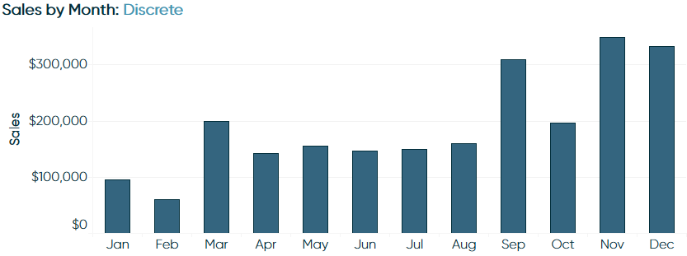
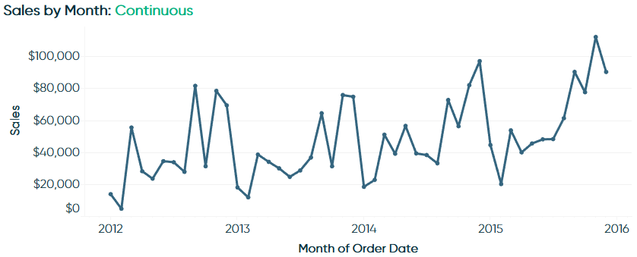
Discrete vs Continuous
Discrete fields draw headers
continuous fields draw axes
Discrete
Continuous

Slide 7
Exercise 2
Find which region has the least average sales in 2017?
Find the second most purchased product in 2017?
Which product has the maximum profit of all time ?
Note: Create view in different worksheets.

Slide 8
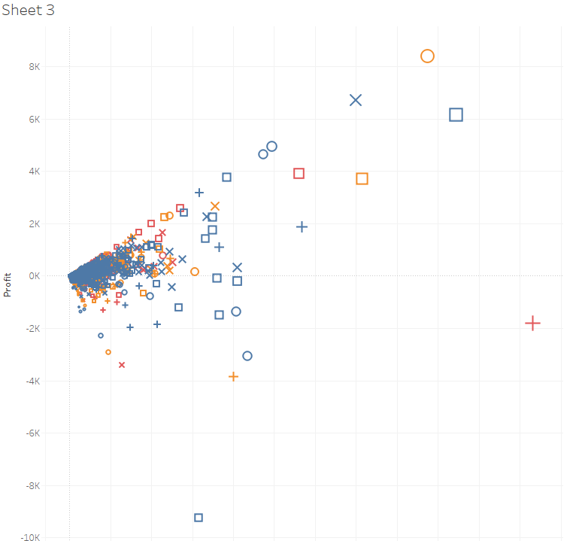
Chapter 3 :Marks Cards, Encoding, and Level of Detail
Color: Assigns color
Size: Decides shape
Label: Assign value
Detail: Level of Detail
Tooltip: Values on point
Shape: Mark shapes.

Slide 9
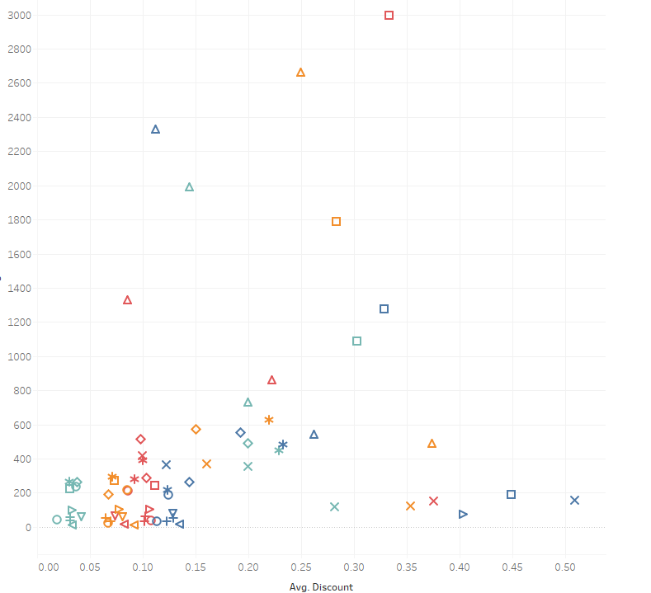
Exercise 3
Create a view with
-Average Discount on X-axis, Average Sales on Y-axis
-Region Identified by Color
-Sub-category by Shape
-Sum of quantity on hover over mark.
And find out which sub-category has
highest average discount?

Slide 10
Chapter 4: Introduction to Filters
Extract Filters
Datasource Filters
Dimension filters
Measure Filters
Context filters

Slide 11
Context Filters
Dependent filters.
Applied before dimension and measure filters.

Slide 12
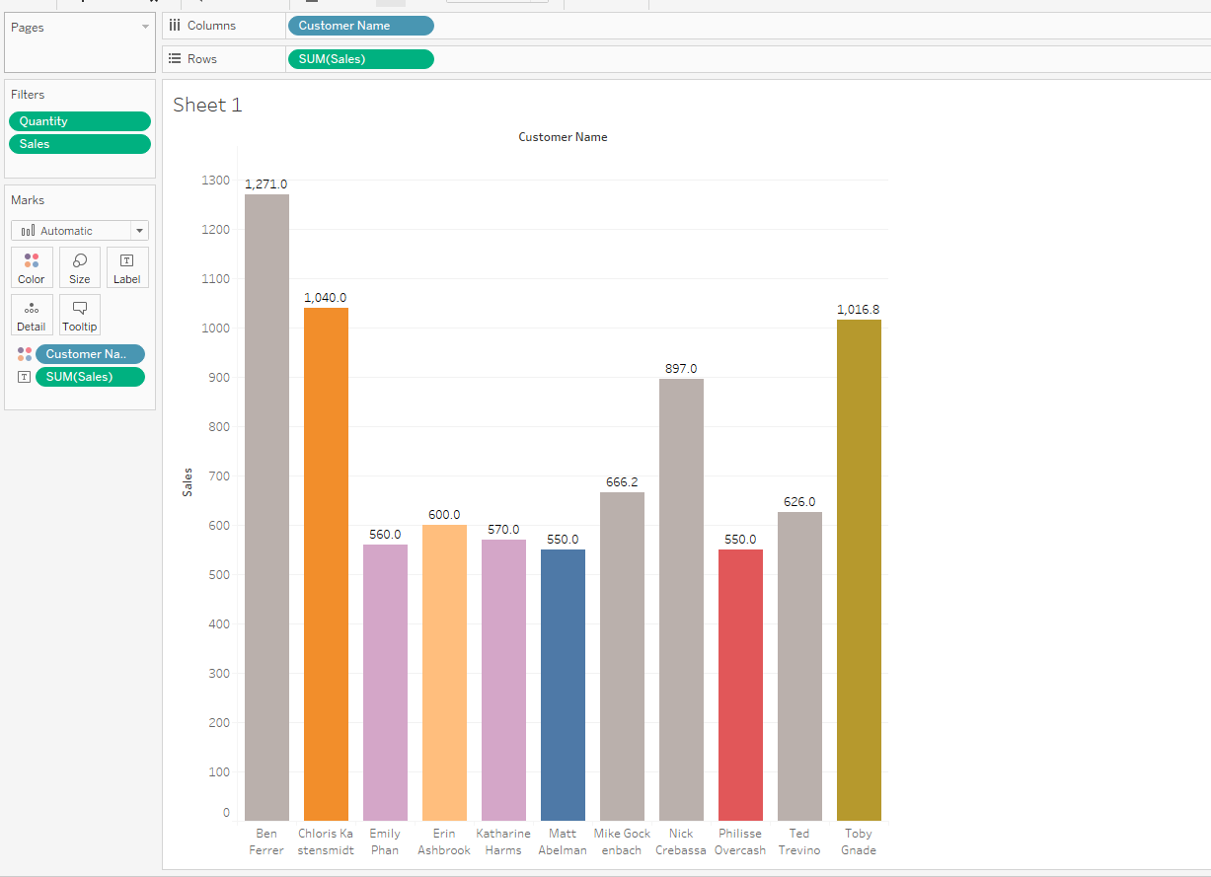
Exercise 4
Find the list of customer names who bought one quantity in all sub-category where sum of sales value is greater than $500?

Slide 13
Chapter 5: Introduction to Calculated Fields
used to create new dimensions or measures
Useful for on-the-fly calculations

Slide 14
Exercise 5
Find the list of customer names whose profit value is negative.
Note:Use SIGN
Which sub-category has the highest Average Order Value(AVO) in 2017?
Note: Formula=sum of sales/Number of Orders

Slide 15
Chapter 6: Introduction to Table Calculations.
create advanced calculations even without knowing the underlying syntax
Running Total
Difference & Percent Difference.
Percent of total
Rank & Percentile
Moving Average
Year over year Growth

Slide 16
Exercise 6
Generate a report that shows Sum of sales for each category and each month regardless of year. While doing so, present the data by percentage difference (month over month) compared to previous month in “Text tables”.
Generate Dual axis – one with sum(sales) without table calculation and another sum(sales) with table calculation based on “Running Total” against Month of all years where month being continuous dimension.

Slide 17
Chapter 7 – An Introduction to Parameters
transferring control from the author to the end user
Instructions through Calculated fields.

Slide 18
Exercise 7
Create a parameter to hold values for all sub-category
Use this parameter control to allow the user to change the values and plot against sum of sales.
Note: Show the sum(sales) vs subcategory based on parameter values. Show ONLY for TRUE case.

Slide 19
Chapter 8 – An Introduction to sets and bins
Sets can be thought of as custom segments.
They are binary – either set or not.
Bins are buckets for measure.
Stores measure value and apply against dimension.
Usage:
As a filter
To encode marks
In calculated fields
As dimension fields – in/out

Slide 20
Exercise 8
Worksheet1:
Create a set for top 20 customer names by sum of sales .
Use it in calculated field (if top 20 then “top20” else “others”) and plot this against Order_id dimension.
Worksheet2:
Create a bin for quantity and set the size of the bucket to 1. Use this bin against “state” and “sales”.
Find the state which has highest sales for quantity of 5?

Slide 21
Chapter 9 – An introduction to Dashboards and distribution
Combining worksheets
Analyze in context of each other
Distribution
Packaged workbook
Tableau public
Tableau server

Slide 22
Exercise : 9
Create a dashboard with one being sum of sales in map and sum of profit in map – both against state dimension.
Add a filter action to filter based on the selection of state.
Export this workbook to tableau public.

Slide 23
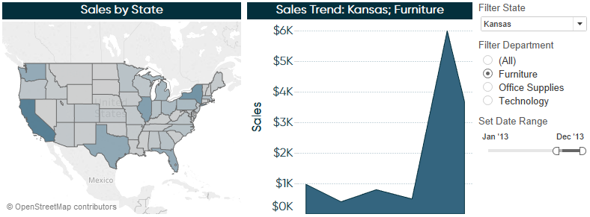
Best Practices
Tip 1: Drill Down, Filters,Actions in dashboard.

Slide 24
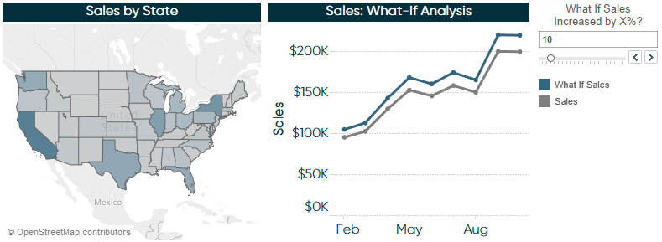
Tip 2 : What if Analysis through parameter

Slide 25
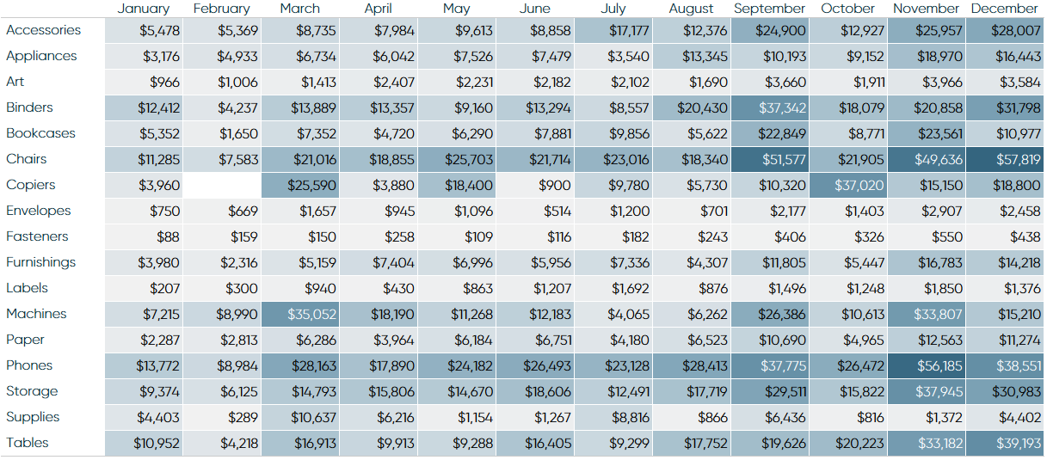
Tip 3 : Using Highlight tables
Quickly identifying highs and lows or other points of interest in your data.
A means of enhancing a crosstab.

Slide 26
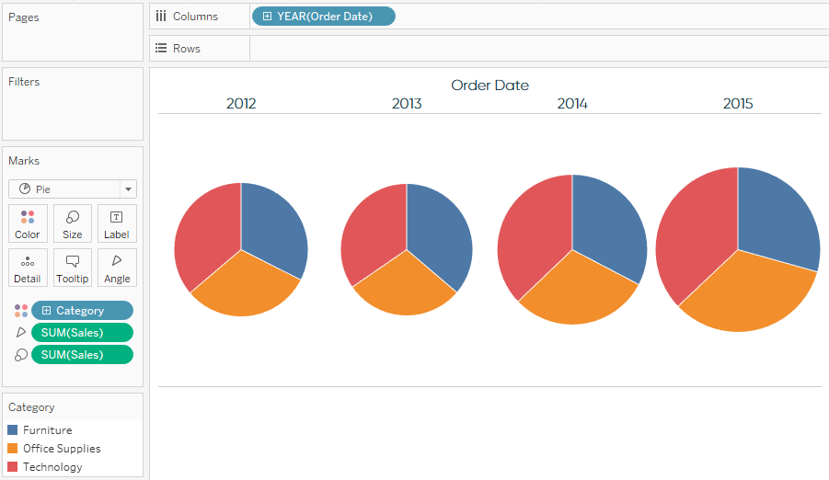
Tip 4 : Don’t Use Pie Chart

Slide 27
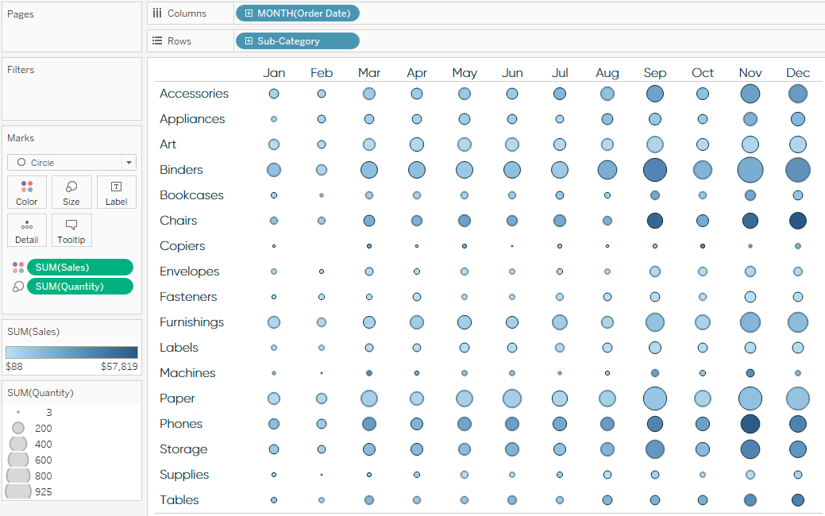
Tip5: Heat maps excels
Helps analyzing chunk of data faster.

Slide 28
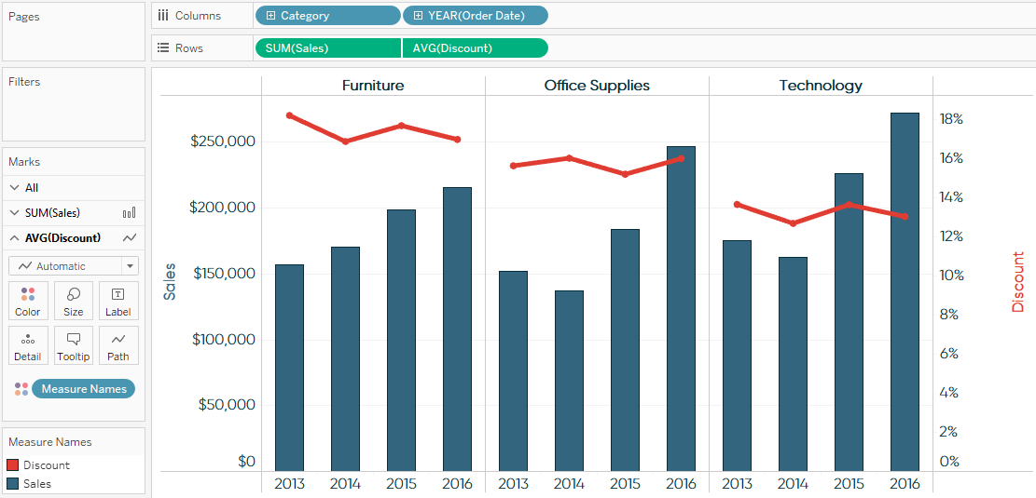
Tip 6 : Leveraging Dual Axis
For comparing two items in same axis.

