Slide 1

Final Project
ABINAYA V
3rd year B.E. CSE Government College of Technology,
Coimbatore

Slide 2
Enhancing Retail Efficiency:
People Counting in Grocery Shops

Slide 3


Agenda
Problem Statement
Project Overview
End Users 4.Solution
5.Wow Factor 6.Modelling 7.Results

Slide 4

Problem Statement
The retail industry grapples with eectively managing customer traic and optimizing store eiciency. Accurate people counting is crucial for staing and inventory management decisions. Traditional counting methods often prove inadequate, necessitating innovative solutions. There is a need for reliable real-time counting systems tailored to retail environments. The absence of such solutions hinders retailers' ability to manage customer ﬂow and streamline operations. Thus, the problem statement focuses on developing precise and eicient people counting methods suited for retail, enabling beer staing, inventory management, and overall store eiciency.

Slide 5

Project Overview
This project aims to develop a real-time people counting system tailored to the needs of the retail industry. Leveraging advanced computer vision techniques, such as YOLO and OpenCV, the system will accurately count customers entering and exiting retail stores. By providing precise data on customer traic, the system will enable retailers to optimize staing levels, improve inventory management, and enhance overall store eiciency. The project’s goal is to address the shortcomings of traditional counting methods and provide retailers with a reliable tool to beer manage customer ﬂow and streamline operations, ultimately improving the retail experience for both customers and sta.

Slide 6
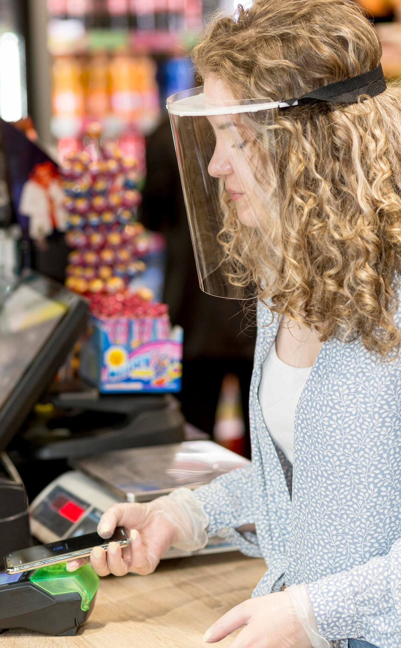
End Users
The primary end users of this real-time people counting system are retail store managers and sta. They will utilize the system to monitor and analyze customer traic within their stores, enabling informed decisions on staing levels, inventory management, and overall store operations to enhance eiciency and customer satisfaction.

Slide 7

Solution
Real-Time People Counting: The solution utilizes advanced computer vision techniques like YOLO (You Only Look Once) and OpenCV (Open Source Computer Vision Library) to accurately count individuals entering and exiting retail stores in real-time.
Data Analysis and Insights: The system provides store managers with detailed insights into
customer traic paerns, enabling them to make informed decisions regarding staing, inventory management, and resource allocation.
Optimization of Store Eiciency: By leveraging precise people counting data, the solution enables retailers to optimize staing levels, improve customer service, minimize wait times, and enhance overall store eiciency, thereby improving the shopping experience and increasing customer satisfaction.

Slide 8
Wow Factor
Seamless Integration: The solution seamlessly integrates with existing retail infrastructure, requiring minimal setup and ensuring a smooth transition for store managers and sta.
Real-Time Alerts: It oers real-time alerts to notify store managers of ﬂuctuations in customer traic, enabling proactive adjustments to staing and resource allocation.
Customizable Analytics: The solution provides customizable analytics dashboards, allowing store managers to tailor insights to their speciﬁc needs and objectives.
Scalability: With its scalable architecture, the solution can accommodate the needs of retail stores of varying sizes, from small boutiques to large department stores.
AI-driven Accuracy: Leveraging advanced artiﬁcial intelligence algorithms, the solution delivers unparalleled accuracy in people counting, minimizing errors and maximizing operational eiciency.

Slide 9
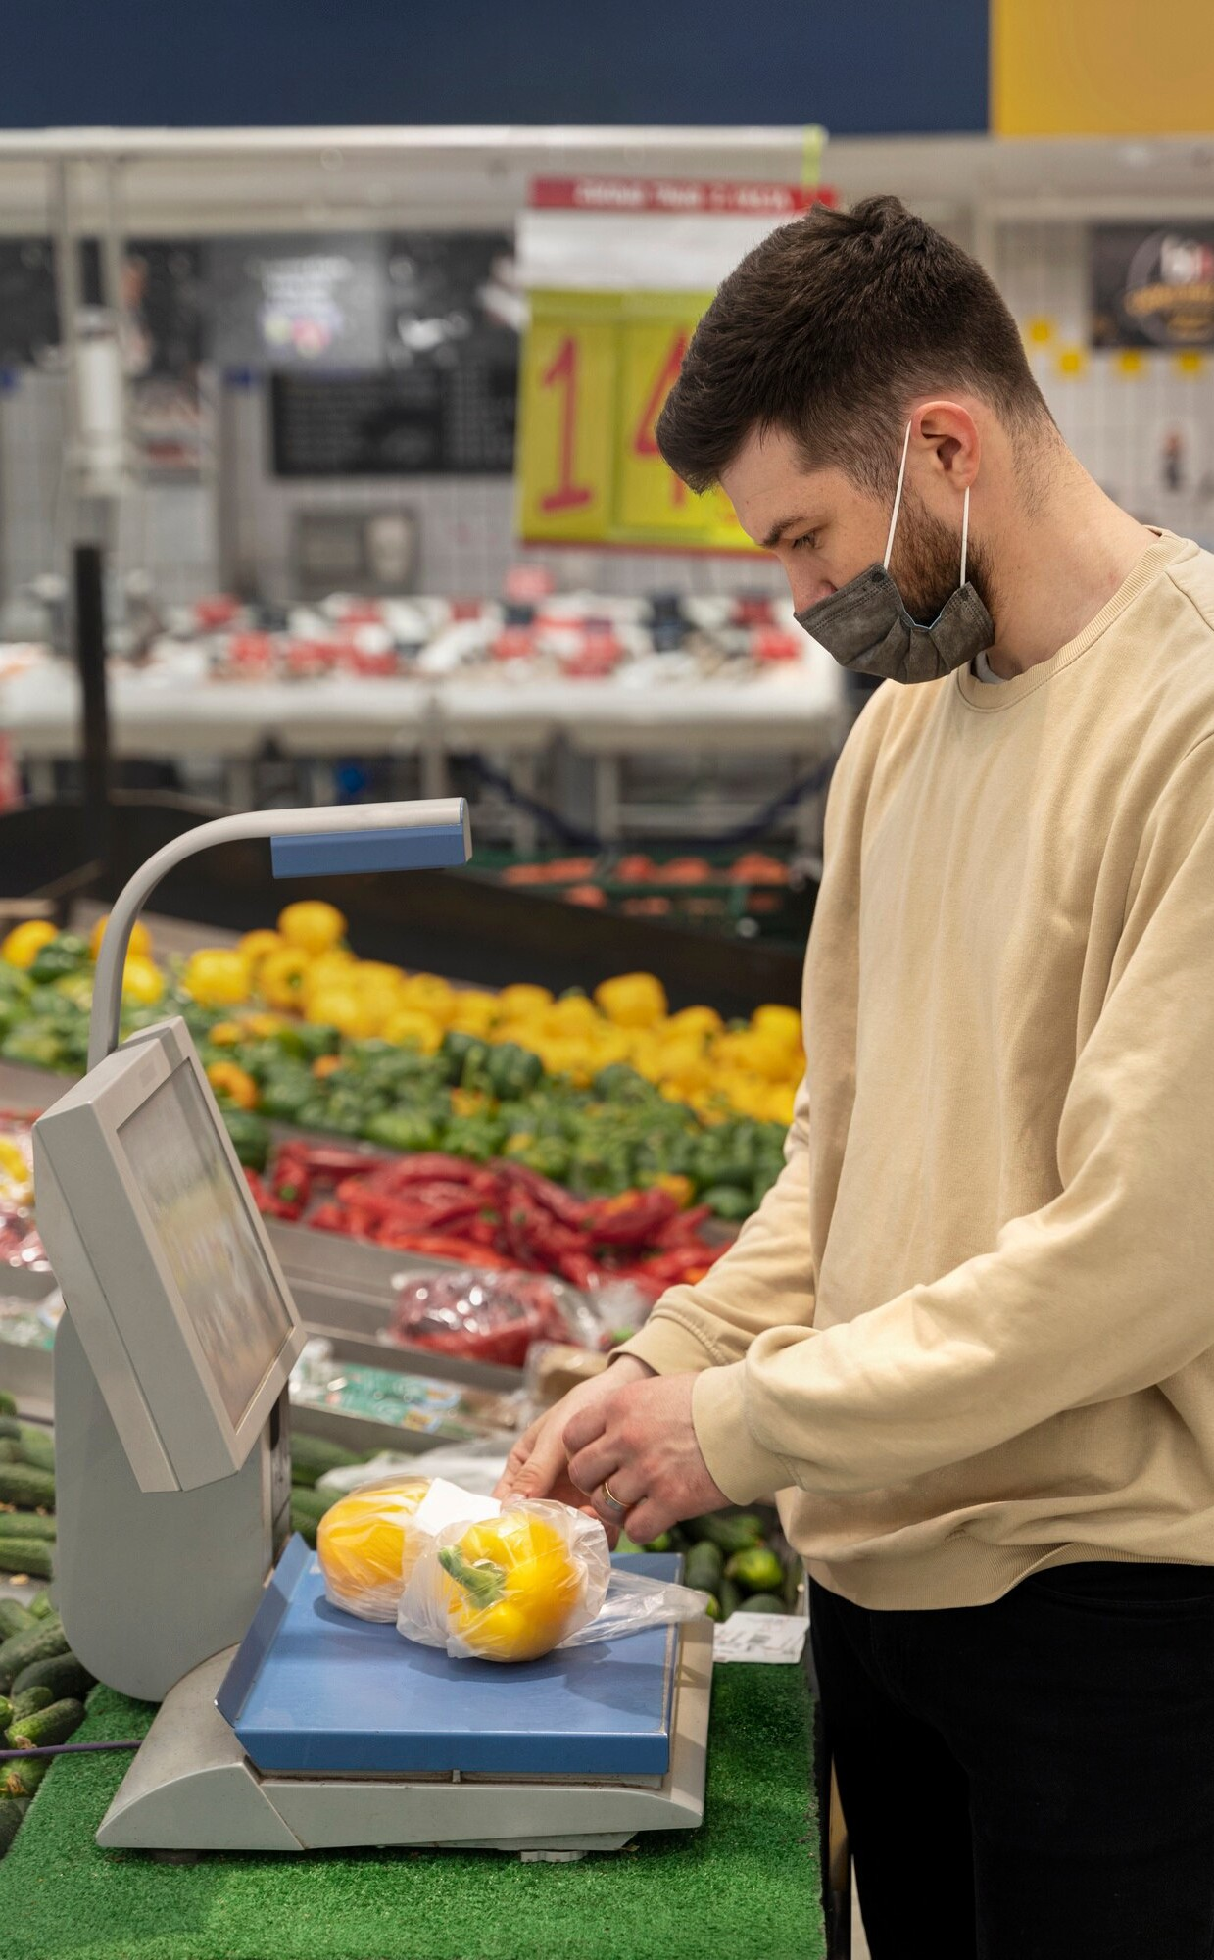
Modelling
Customer Flow Modeling: Creating simulations to predict how customers move through the store, optimizing layouts for eiciency.
Staing Optimization: Using data to determine the right
number of sta needed at dierent times, minimizing wait times.
Inventory Management: Developing models to forecast
demand and optimize stock levels, reducing overstocking and stockouts.
Predictive Analytics: Using historical data to anticipate future trends and make proactive decisions.
Machine Learning Algorithms: Incorporating algorithms to continuously improve predictions and optimize operations.

Slide 10
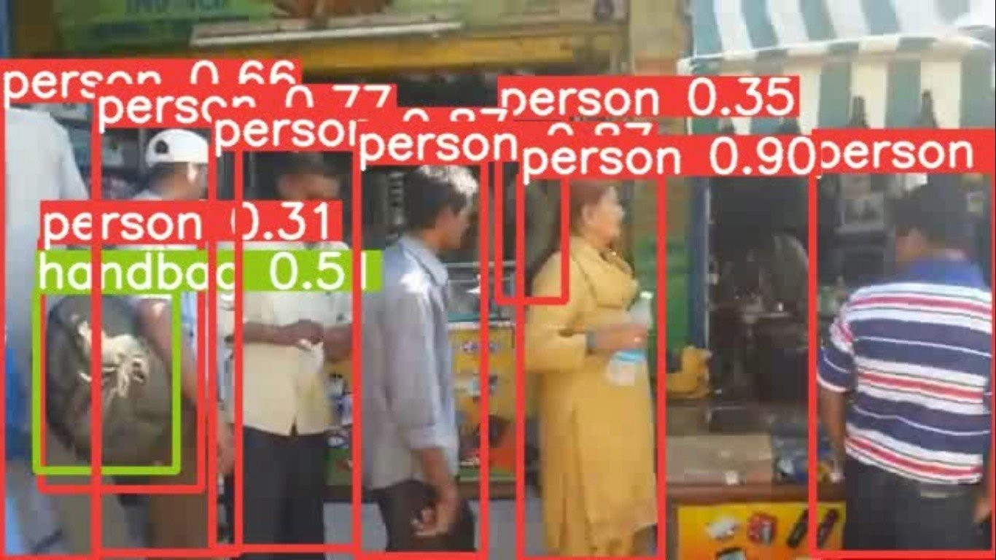
Result
Demo Link

