Slide 1

Exploratory Data Analysis – Facebook Data
INSAID JUNE COHORT 2019
Prepared by Abiniu Chawang

Slide 2
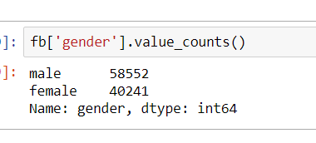
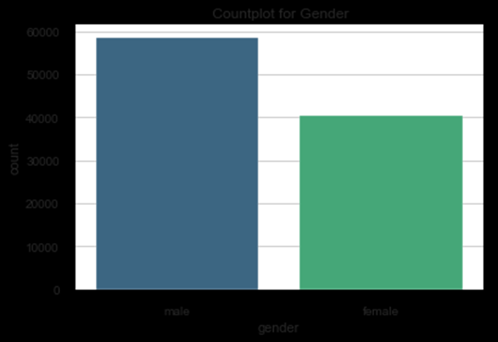
User Count –Gender Wise
Males user count are more than female
58552 user belongs to male
40241 user belongs to female

Slide 3
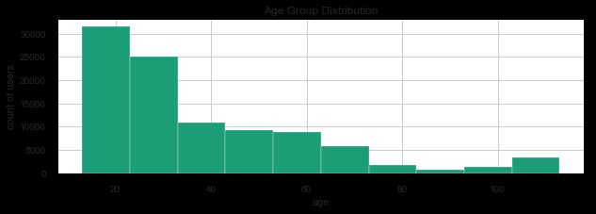
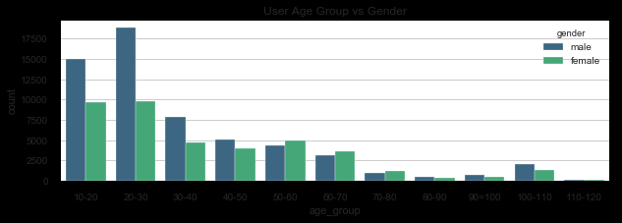
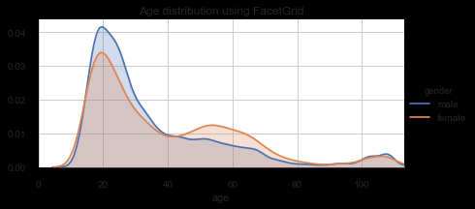
Age Distribution
Age Group vs Gender
Most of the user belongs to 20-30 age group.
Male users are more in most of the age group however female users belonging to age group 50-70 are slightly more than male.
There are declining trend in user after age 30.
Minimum user age is 13.
Maximum user age is 113

Slide 4
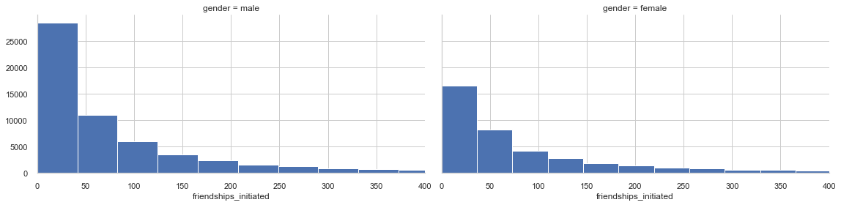
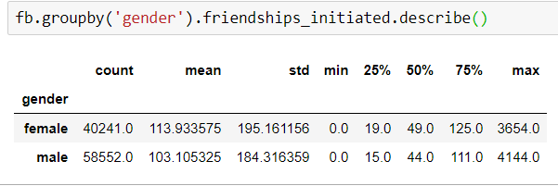
Who Initiated Friendship more?
Males seems to be more open and initiated friendship more than female. It could be because male user count are more than female as well.

Slide 5
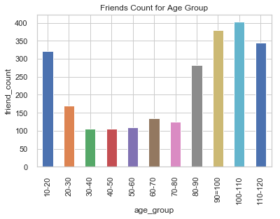
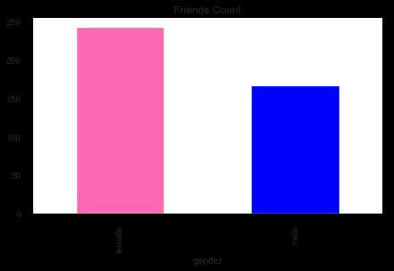
Friends Count
Friends Count Female has more friends than male Age group 10-20 has more friends and there’s steep declined from age 20-80 Age group 100-110 has maximum friends.

Slide 6
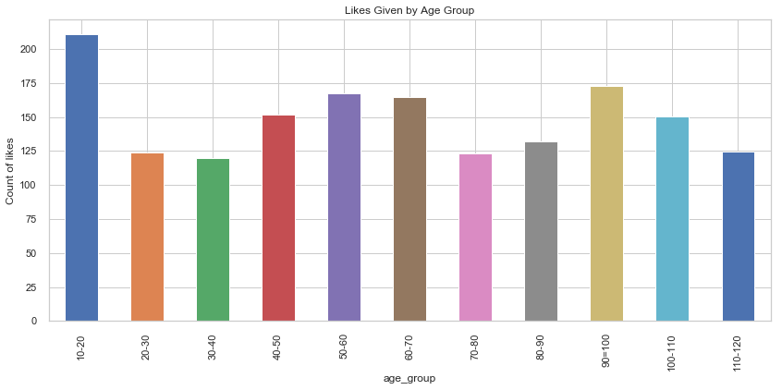
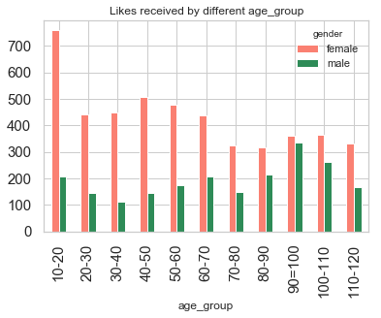
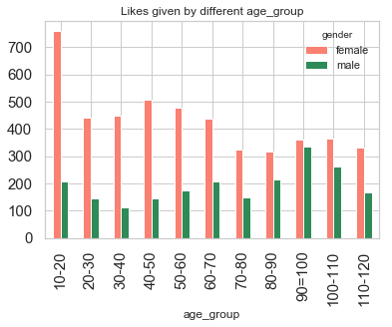
Activity
Activities
This plot shows the activity for different age group vs gender
Maximum likes is given by age group 10-20
There's slight decline in activity for age group between 20-40
Female user gave more likes, this shows female user are more active than male
Female user received more likes than male across all the age groups

Slide 7
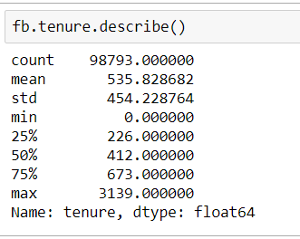
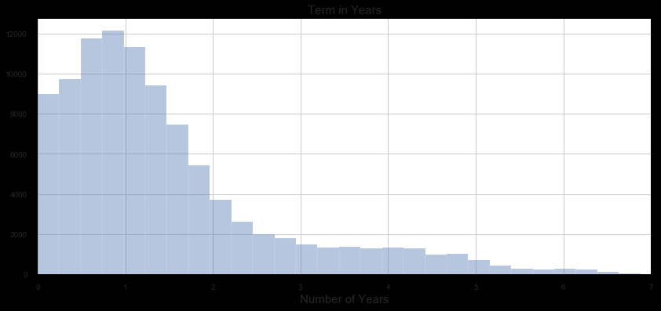
Tenure
This plot shows user mostly are active for 1-2yrs. New user are more active than old user. There’s steep decline in activity as time goes

Slide 8
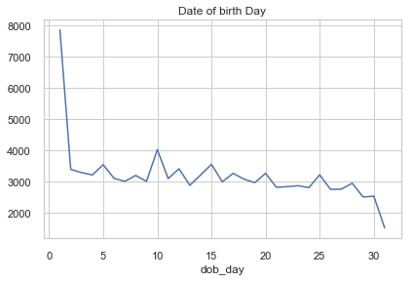
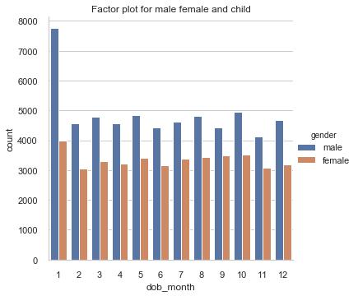
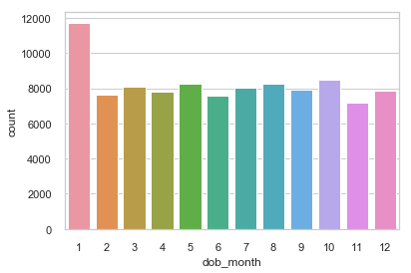
Which day has maximum birthday
This plot shows most of the users registered their birthday as 1st Jan both for male & female
Count for rest of the month are fairly the same

Slide 9
Thank you

