Slide 1

ResUnet-Steel: Enhancing Steel Defect Detection with Residual Networks and Localized U-NET Architecture
PRESENTED BY
ABINESH 23MDT1005
UNDER THE GUIDANCE OF
DR . DAVID MICHAEL RAJ
DEPARTMENT OFMATHEMATICS
VELLORE INSTITUTE OFTECHNOLOGY,
CHENNAI

Slide 2
ABSTRACT:
Developed a ResNet classifier and U-Net segmentation model for early steel defect detection, aiming to boost manufacturing quality and reduce waste Key
Achieved high accuracy in defect classification and precise defect boundary delineation, highlighting the system's potential for real-time application.
Enables manufacturers to integrate automated defect detection for timely corrections, improving efficiency and product quality, with adaptability to other industries.

Slide 3
PROBLEM STATEMENT:
Traditional inspection in steel manufacturing is manual, time-consuming, and prone to human error, impacting product quality and efficiency.
Late identification of defects leads to higher waste and increased costs, underscoring the need for early, accurate defect detection.
An automated, real-time defect detection solution is essential to streamline production, reduce scrap, and enhance overall manufacturing quality.

Slide 4
INTRODUCTION:
Leveraging ResNet and U-Net architectures, deep learning offers a powerful, automated alternative for defect detection and localization.
Develop a system that not only identifies defects but precisely locates them, enhancing both the quality and efficiency of steel manufacturing.

Slide 5
DATASET:
Collected 12,600 high-resolution images from steel manufacturing lines, labeled to identify four main defect types.
Images include variations in lighting, angle, and background to ensure model generalization in real-world scenarios.
Pixel-level labels provide precise defect locations, supporting both classification and segmentation tasks.

Slide 6
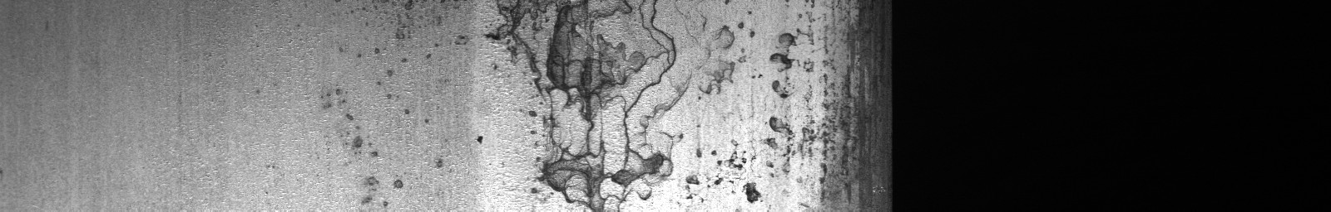
LAYERED DEEP LEARNING PIPELINE TO PERFORM CLASSIFICATION & SEGMENTATION
RESUNET SEGMENTATION MODEL
DEFECT DETECTED
INPUT IMAGES
FROM MANUFACTURING LINE OR MAINTENANCE DEPARTMENT
DETECT DEFECT LOCATION ON THE PIXEL LEVEL
RESNET DEEP LEARNING CLASSIFIER MODEL
END
DEFECT FREE

Slide 7
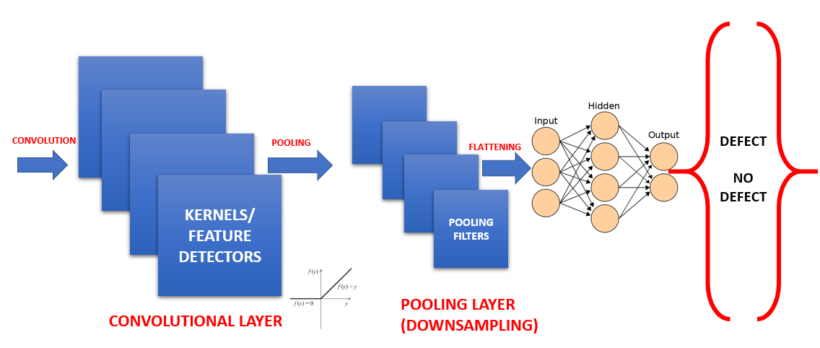
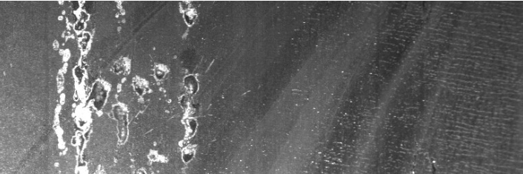
CONVOLUTIONAL NEURAL NETWORKS(CNN)
The first CNN layers are used to extract high level general features.
The last couple of layers are used to perform classification (on a specific task).

Slide 8
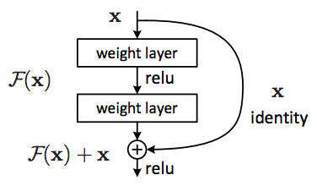
RESNET (RESIDUAL NETWORK)
Residual Neural Network includes “skip connection” feature which enables training of 152 layers without vanishing gradient issues.
Resnet works by adding “identity mappings” on top of the CNN.
ImageNet contains 11 million images and 11,000 categories.
ImageNet is used to train ResNet deep network.

Slide 9
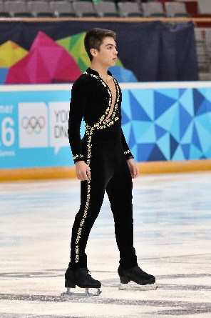
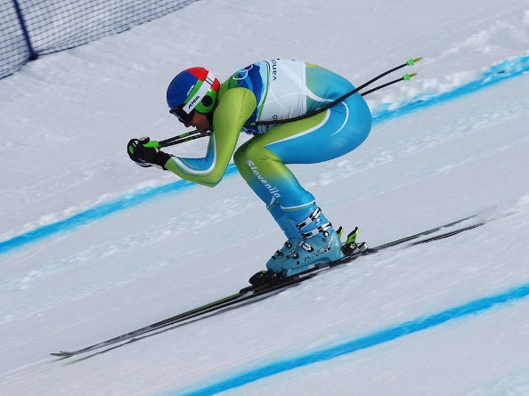
TRANSFER LEARNING:
Transfer learning is a machine learning technique in which a network that has been trained to perform a specific task is being reused (repurposed) as a starting point for another similar task.
KNOWLEDGE TRANSFER
.

Slide 10
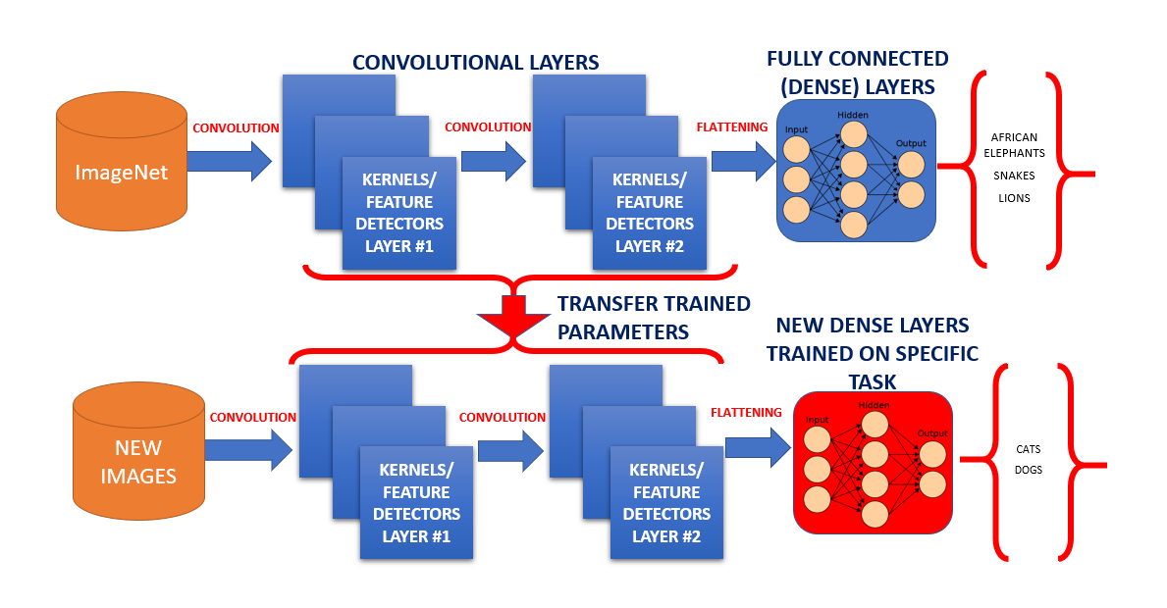
TRANSFER LEARNING (MODEL ARCHITECTURE):

Slide 11


IMAGE SEGMENTATION:
The goal of image segmentation is to understand and extract information from images at the pixel-level.
The goal of image segmentation is to train a neural network to produce pixel-wise mask of the image.
I will be using ResUNet architecture to solve the current task.
ResUNet

Slide 12
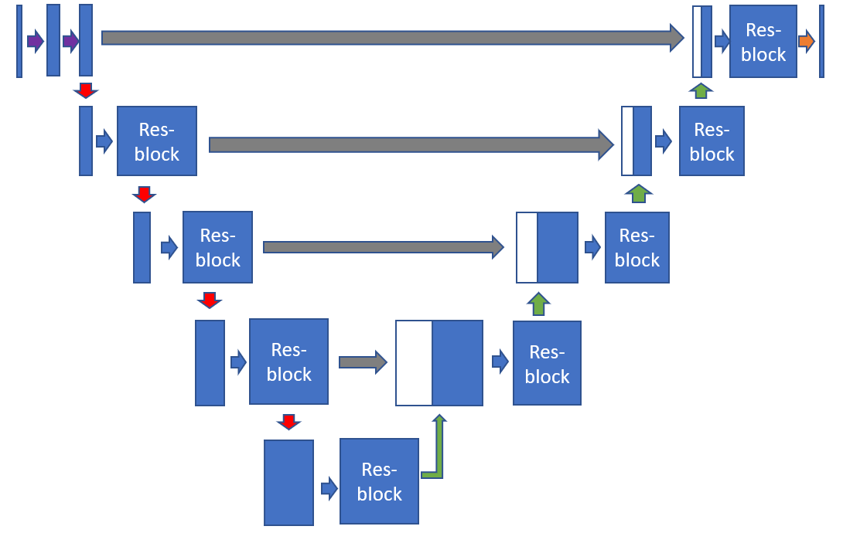
RESUNET :
ResUNet architecture combines UNet backbone architecture with residual blocks to overcome the vanishing gradients problems present in deep architectures.
Resunet consists of three parts:
(1) Encoder or contracting path
(2) Bottleneck
(3) Decoder or expansive path
INPUT IMAGE
SEGMENTATION MASK

Slide 13
RESUNET ARCHITECTURE:
1. Encoder or contracting path consist of 4 blocks:
First block consists of 3x3 convolution layer + Relu + Batch-Normalization
Remaining three blocks consist of Res-blocks followed by Max-pooling 2x2.
2. Bottleneck:
It is in-between the contracting and expanding path.
It consist of Res-block followed by up sampling conv layer 2x2.
3. Expanding or Decoder path consist of 4 blocks:
3 blocks following bottleneck consist of Res-blocks followed by up-sampling conv layer 2 x 2
Final block consist of Res-block followed by 1x1 conv layer.

Slide 14
RESUNET MODEL ARCHITECTURE:
Res-block
Res-block
Res-block
Res-block
Res-block
copy
Max-pooling 2 x 2
Res-block
Res-block
Crop and concat
Up-conv 2x2
Res-block
Conv 1x1
Conv 3x3,BN,Relu

Slide 15
MASK:
The goal of image segmentation is to understand the image at the pixel level. It associates each pixel with a certain class. The output produce by image segmentation model is called a “mask” of the image.
Masks can be represented by associating pixel values with their coordinates. For example if we have a black image of shape (2,2), this can be represented as:
[[ 0, 0],
[0, 0]]
If our output mask is as follows:
[[255, 0],
[0,255]]
To represent this mask we have to first flatten the image into a 1-D array. This would result in something like [255,0,0,255] for mask. Then, we can use the index to create the mask. Finally we would have something like [1,0,0,1] as our mask.

Slide 16
THANKYOU

