Slide 1
BELLOMASSI
From customer order to confirmed delivery
Prototype review and A–Z project documentation package
Draft for client review · 12 November 2026 · Not approved
Notes:
Purpose: present what the prototype does, what is documented, what is still simulated, and the decisions we need from you.

Slide 2
Where we are today
A working prototype validates the whole order-to-delivery flow — production work starts after your scope decisions
35
179
292
234
modules documented
functional requirements
test cases written (not executed)
documents in the package
Prototype: React web app with office, driver and customer layouts; data stays in the browser (LocalStorage).
GPS, OTP messages, email, WhatsApp, OCR and AI are simulated and labelled in the UI.
No client approval, UAT, production deployment or SAP integration exists yet.
Notes:
Counts: 179 FRs from the FRD set; 228 functional + 64 cross-cutting test cases, all "Not run".

Slide 3
One record from order to delivery note
1
2
3
4
5
6
Capture
Approve
Consolidate
Dispatch
Deliver (OTP + POD)
Delivery note
Salesman / customer app
Sales Manager (credit checks)
Customer Service
Dispatcher (zone, driver, vehicle)
Driver
Customer
Stock is deducted when the Dispatcher confirms loading. The driver cannot complete a stop without the customer's 6-digit OTP. Failed or partial stops return to the Dispatcher for review.

Slide 4
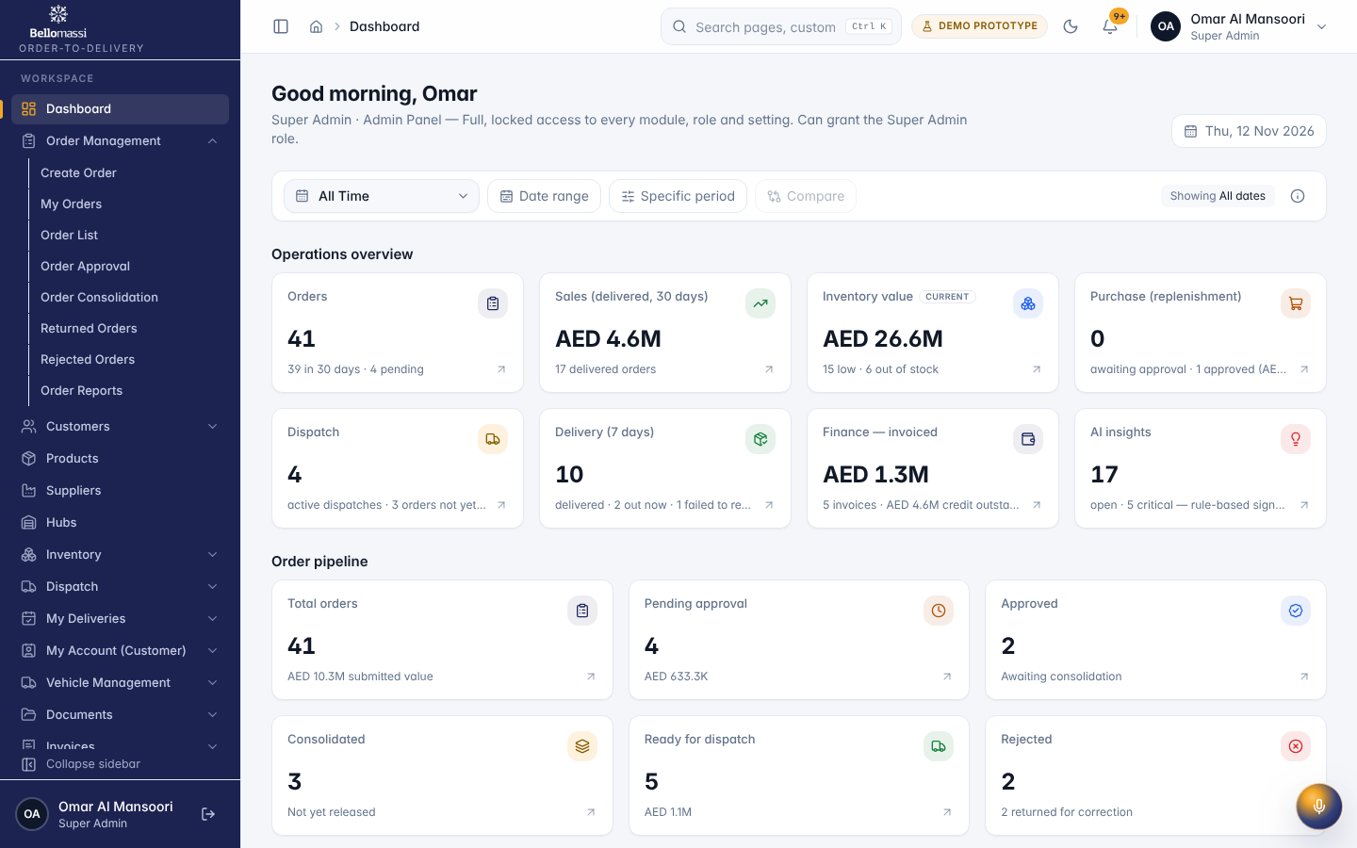
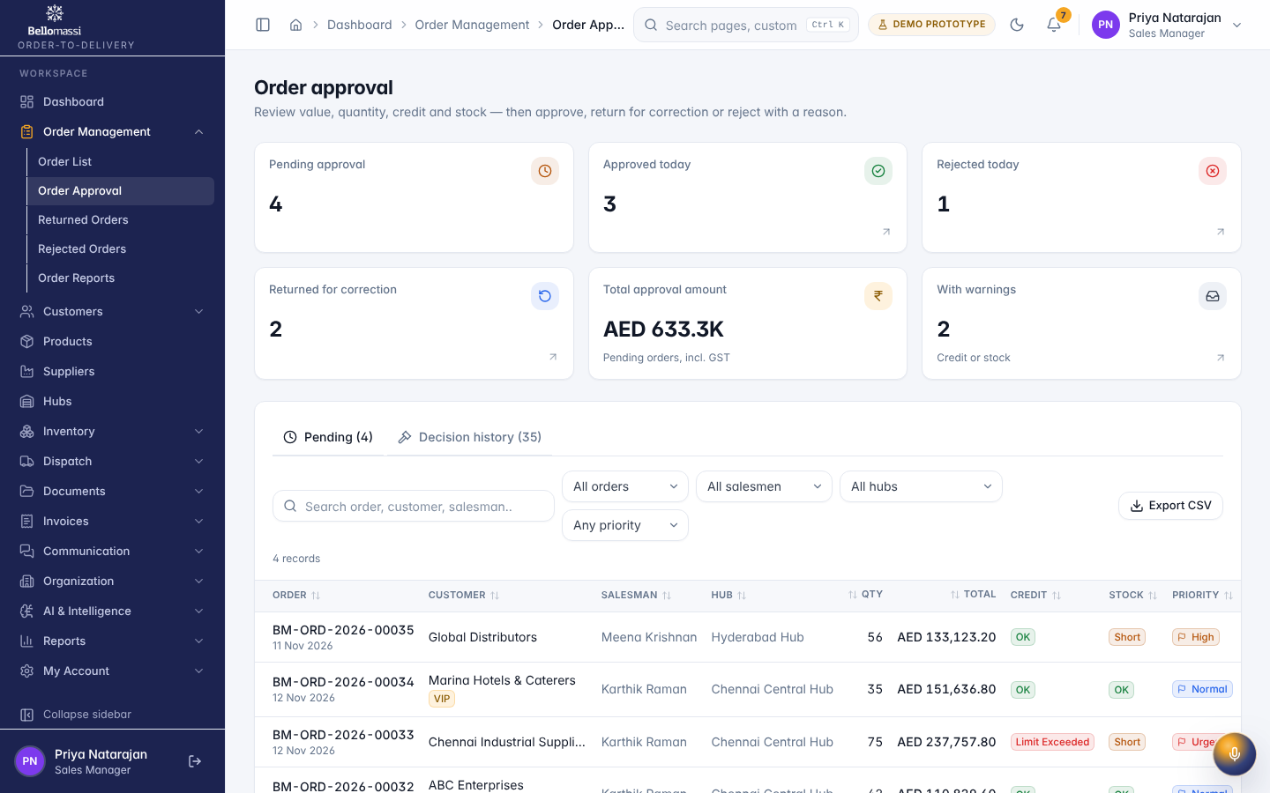
The office web app
Real screenshots of the prototype with demo data
Role dashboards with period filter · approval queue with automatic checks · 13 roles, 110 permissions

Slide 5
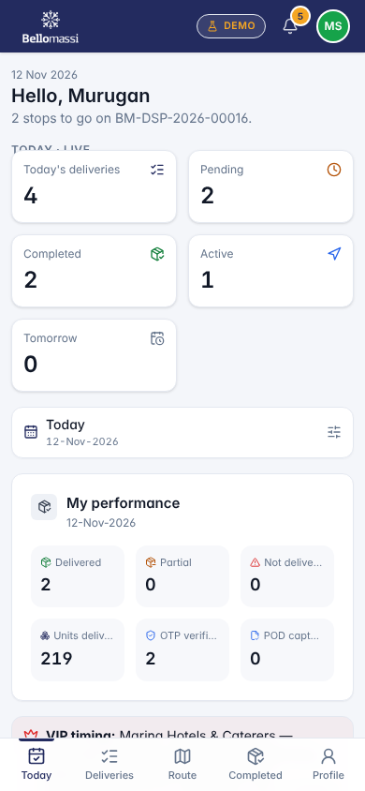
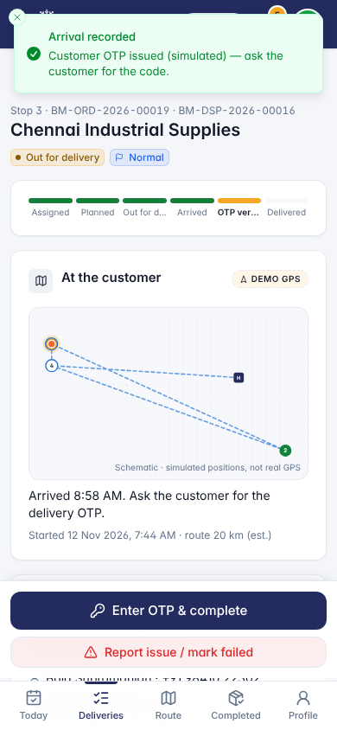
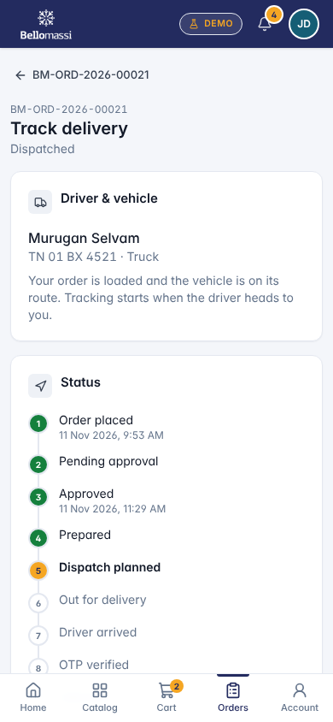
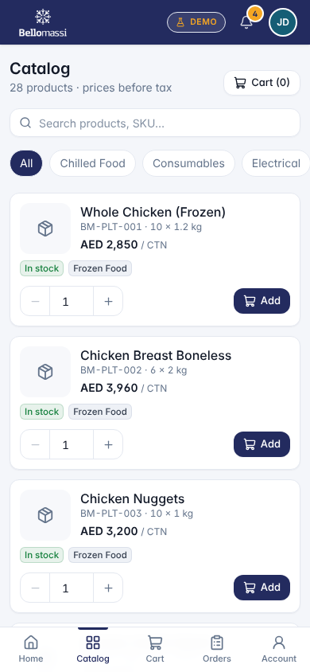
Driver and customer apps
Driver: stops in sequence, reach location, OTP, POD, delivery note
Customer: catalog, cart, order tracking, OTP display, documents
Mobile web today; native driver app proposed

Slide 6
Most modules work — integrations are simulated
Simulated today
DEMO GPS tracking, OTP / delivery-note sending, email and WhatsApp, OCR, AI
Not built
Backend, database, server security, SAP integration, native mobile app

Slide 7
Gaps against the Scope of Work
G-01
Approved value / quantity change
G-03
Zone drag-and-drop board
G-04 / 05
Fastest route, turn-by-turn
G-06 / 07
OTP and delivery note by SMS / WhatsApp
G-08
Native iOS / Android driver app
G-10
Items from SAP (stage 2)
G-12
Order channel captured
G-13
Real authentication
Full list: BM-DOC-003 Gap Analysis and BM-HND-012 Pending Requirements

Slide 8
The prototype goes beyond the SOW
Eleven extensions need a scope decision before production (X-01 … X-11)
Likely keep
Decide
Phase 5 or retire
Inventory check at dispatch
VMS document compliance
Messaging needed for OTP
Customer self-service app
Reports Center (choose go-live set)
Extra roles
Invoicing (SOW: outside)
Scrap, OCR, call history
AI, forecasting, supplier portal
Effort ranges per extension: BM-RSK-004 (estimates)

Slide 9
Indicative path to production (estimate)
Phase 1
Phase 2
Phase 3
Phase 4
Phase 5
Prototype
Backend
Mobile + integrations
Deployment, UAT, go-live
SAP + enhancements
Done
12–14 weeks
~9 weeks, overlapping
6–8 weeks
To be estimated
Durations are estimates; the assumed start (4 Jan 2027) is not agreed. Target stack: Django + PostgreSQL, React web, React Native driver app.

Slide 10
Decisions we need from you
Scope: which extensions stay (X-01 … X-11)
Country, currency and tax model (UAE / AED vs India data)
1
2
Order status model: 8 (SOW) or 13 (prototype)
Credit exceeded: warn or block
3
4
Hosting provider and region
Messaging provider for OTP and delivery notes
5
6
SAP interface and timing
UAT users and pilot hub
7
8
Business approval form: BM-HND-005 (blank)

Slide 11
What the documentation package contains
Business
Requirements
Design
Security & infra
Overview, BRD, SOW, phase plan
SRS, 35 FRDs, NFRs, rules, RTM
HLD / LLD, database, API + OpenAPI, 23 diagrams
Policies, RBAC matrix, hosting, cost estimate
Quality
Users
Delivery
Handover
Strategy, plans, 292 test cases, UAT plan
Driver, customer, office and 14 role manuals
Deployment, release, rollback, checklists
Known issues, limitations, blank sign-offs
Index: 25_DOCUMENTATION_INDEX/BELLOMASSI_DOCUMENTATION_INDEX.xlsx

Slide 12
Next step
Review the package and take the scope decisions at gate G0
Then: hosting and providers (G1) → Phase 2 kick-off

