Slide 1



DEEP LEARNING (CNN, RNN AND LSTM)
Internship 2023
Abinivesh M

Slide 2
CONVOLUTIONAL Neural networks

Slide 3
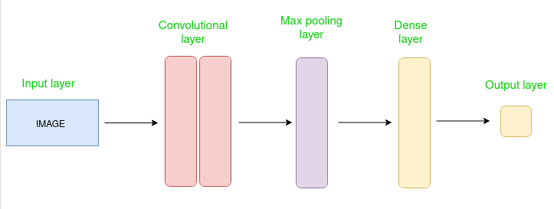
Introduction
A Convolutional Neural Network (CNN) is a type of deep learning algorithm that specializes in processing data that has a grid-like topology, such as images.

Slide 4
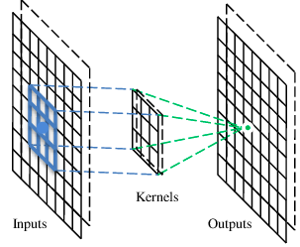
A Convolutional layer
A CNN is a neural network with some convolutional layers (and some other layers).
A convolutional layer has a number of filters that does convolutional operation.

Slide 5
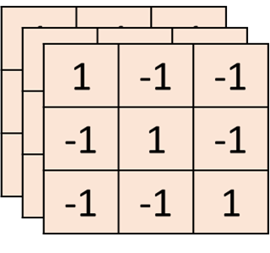
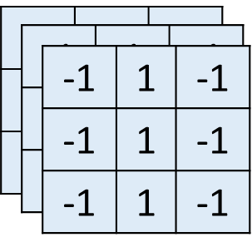
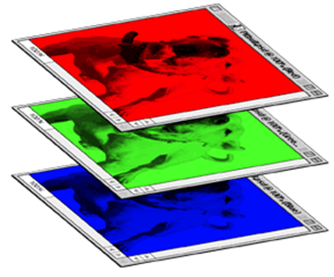
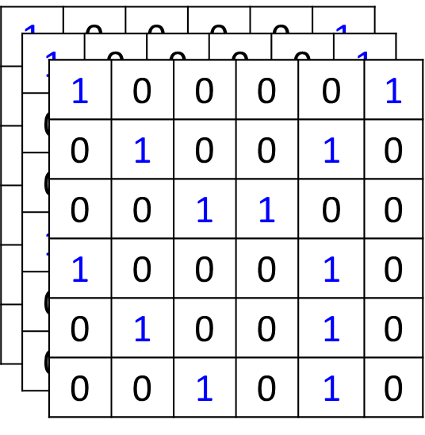

Color image: rgb 3 channels
Filter 1
Filter 2
Color image

Slide 6
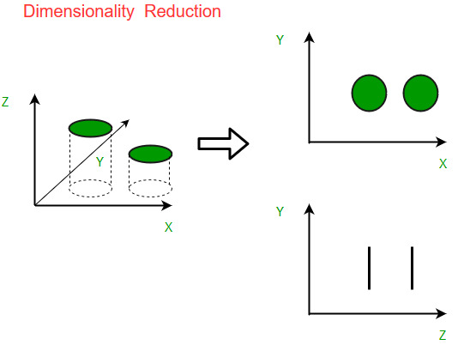
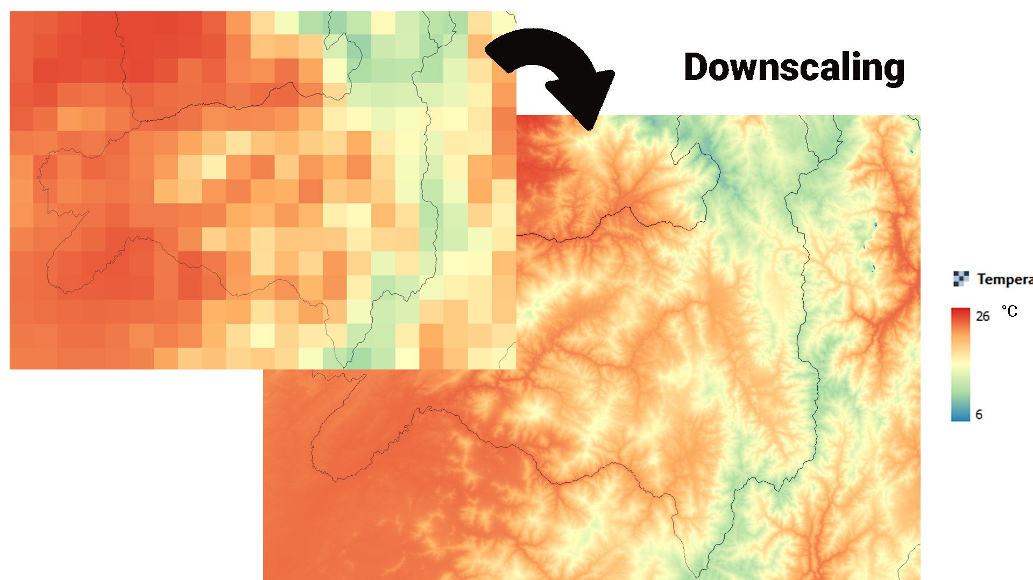
Pooling
Spatial downscaling
Dimensionality reduction

Slide 7
Types of Pooling
Max Pooling
Average Pooling

Slide 8
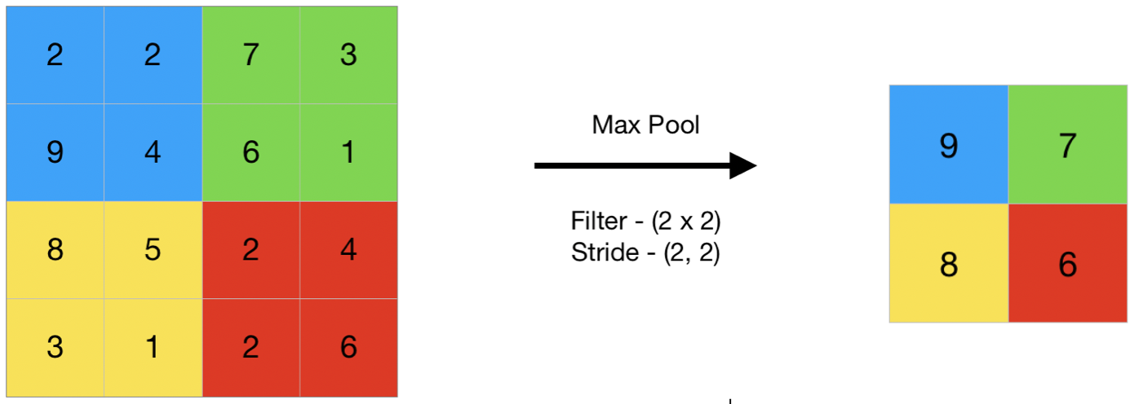
Max Pooling
Max pooling is a pooling operation that selects the maximum element from the region of the feature map covered by the filter.

Slide 9
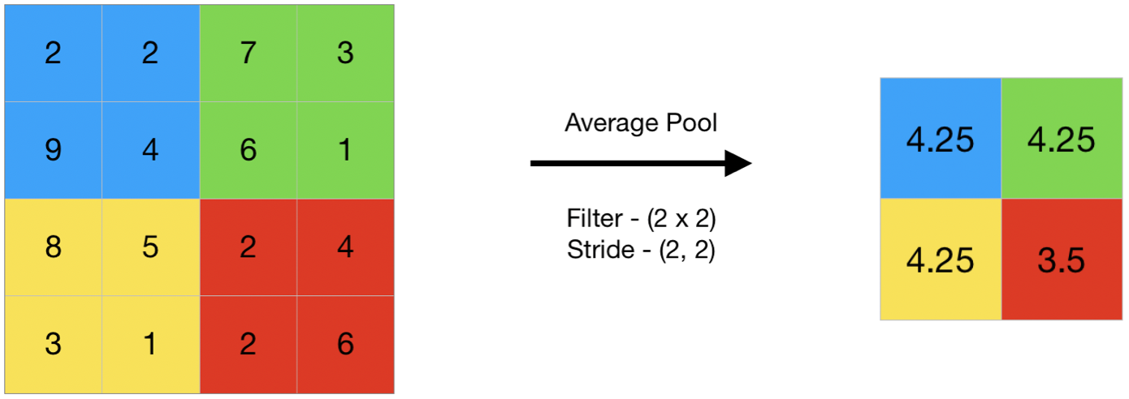
Average Pooling
Average pooling computes the average of the elements present in the region of feature map covered by the filter.
Thus, while max pooling gives the most prominent feature in a particular patch of the feature map, average pooling gives the average of features present in a patch.

Slide 10
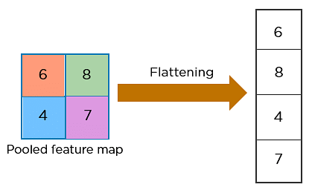
Flattening
Flattening is used to convert all the resultant 2-Dimensional arrays from pooled feature maps into a single long continuous linear vector.

Slide 11

– Rectified Linear Unit
The most common of such functions is the Rectified Linear function, and a neuron that uses it is called Rectified Linear Unit (ReLU)
The usage of ReLU helps to prevent the exponential growth in the computation required to operate the neural network.

Slide 12
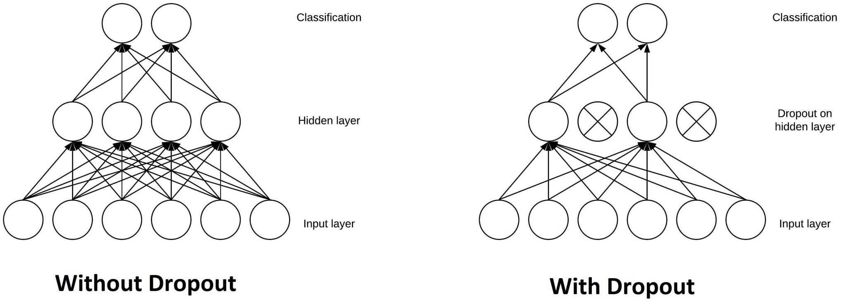
The Dropout Layer
The Dropout layer is a mask that nullifies the contribution of some neurons towards the next layer and leaves unmodified all others.

Slide 13
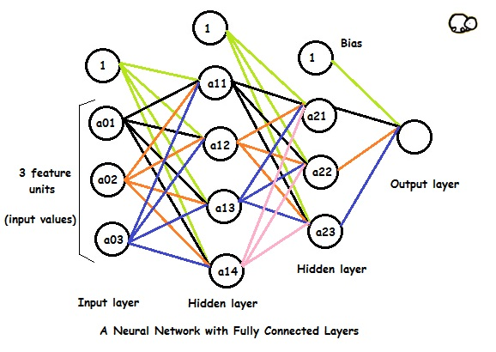
Fully Connected Layers
Fully Connected layers in a neural networks are those layers where all the inputs from one layer are connected to every activation unit of the next layer
compiles the data extracted by previous layers to form the final output
It is the second most time consuming layer second to Convolution Layer.

Slide 14
Output Layer
Last layer of neurons that produces given outputs for the program
Simple feedforward neural networks with three individual layers provide basic easy-to-understand models
More sophisticated, innovative neural networks may have more than one of any type of layer – and as mentioned, each type of layer may be built differently

Slide 15
CNN Architecture
VGG
Xception
ResNet
DenseNet
InceptionV3
InceptionResnet
MobileNet
NasNet
EfficientNet
ConvNeXt

Slide 16
Applications
Image Classification
Object Detection
Sematic Segmentation
Image Generation
Video Analysis

Slide 17
Recurrent neural network

Slide 18
recurrent neural network
Recurrent Neural Network(RNN) is a type of Neural Network where the output from the previous step is fed as input to the current step.
In some cases when it is required to predict the next word of a sentence, the previous words are required and hence there is a need to remember the previous words
Here RNN is used
It comes up with the Hidden State to solve this issue
This reduces the complexity of parameters, unlike other neural networks.

Slide 19
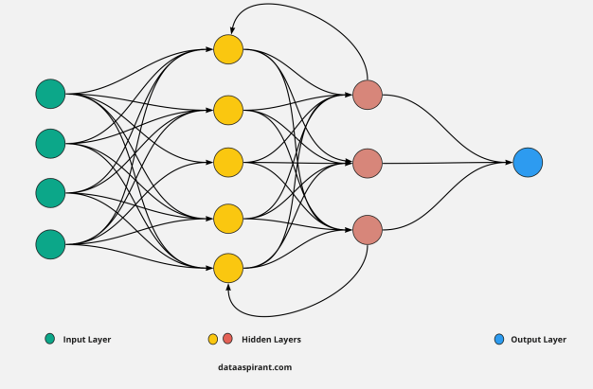
recurrent neural network

Slide 20
TYPES OF RNN
One to One
One to Many
Many to One
Many to Many

Slide 21
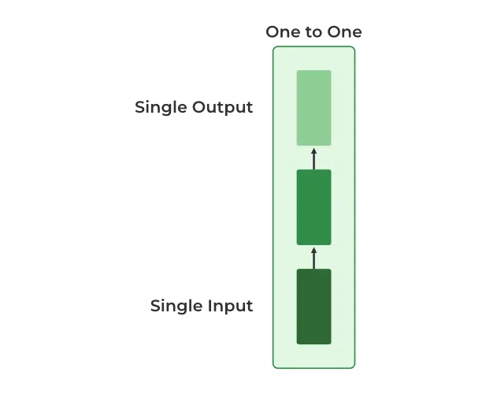
One to one
This type of RNN behaves the same as any simple Neural network it is also known as Vanilla Neural Network. In this Neural network, there is only one input and one output.

Slide 22
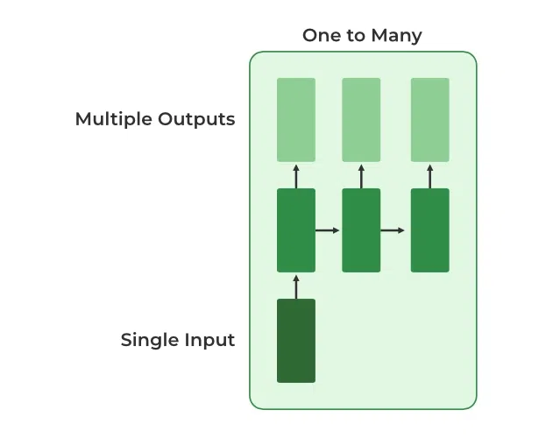
One to Many
One input and many outputs associated with it. One of the most used examples of this network is Image captioning where given an image we predict a sentence having Multiple words.

Slide 23
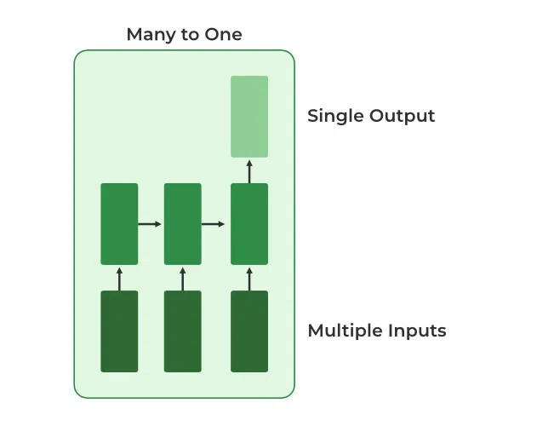
Many to one
Many inputs are fed to the network at several states of the network generating only one output. Where we give multiple words as input and predict only the sentiment of the sentence as output. Used in Sentiment Analysis

Slide 24
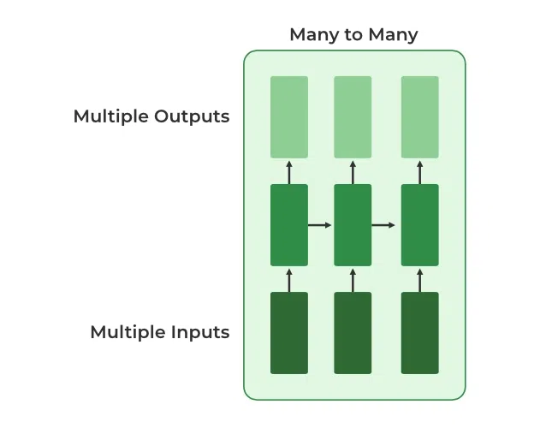
Many to many
Multiple inputs and multiple outputs corresponding to a problem. In language translation, we provide multiple words from one language as input and predict multiple words from the second language as output. Used in Language Translation

Slide 25
VARIATION OF RECURRENT NEURAL NETWORK (RNN)
Bidirectional Neural Network (BiNN)
Long Short-Term Memory (LSTM)

Slide 26
LONG SHORT-TERM MEMORY

Slide 27
LONG SHORT-TERM MEMORY
Long Short-Term Memory Networks is a deep learning, sequential neural network that allows information to persist.
LSTM resolves the problem caused by traditional RNNS

Slide 28
LSTM ARCHITECTURE
Forget Gate
Input Gate
New Information
Output Gate

Slide 29
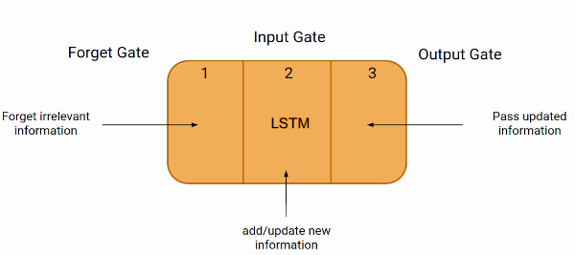
LONG SHORT-TERM MEMORY

Slide 30
How it works ?
Raju eats samosa almost everyday, it shouldn’t be hard to guess that his favourite cuisine is Indian. His Brother Jajju however is a lover of pasta and cheese that means his favourite cuisine is Italian.

Slide 31
APPLICATIONS
Language modelling or text generation
Image processing
Speech and Handwriting Recognition
Music generation
Language Translation

Slide 32
Rnn vs lstm
RNN | LSTM
It can be difficult to train standard RNNs to solve problems that require learning long-term temporal dependencies. | LSTM units include a ‘memory cell’ that can maintain information in memory for long periods of time.
The gradient of the loss function decays exponentially with time (called the vanishing gradient problem). | LSTMs deal with vanishing and exploding gradient problem by introducing new gates, such as input and forget gates

Slide 33
THANKYOU

