Slide 1


CONVOLUTIONAL NEURAL NETWORKS
ABINIVESH M
INTERNSHIP JUNE-2023

Slide 2
Contents
Introduction
Convolutional Layer
Pooling
Types of Pooling
Flattening
ReLU
Dropout
Fully Connected Layer
CNN Architecture
Applications

Slide 3
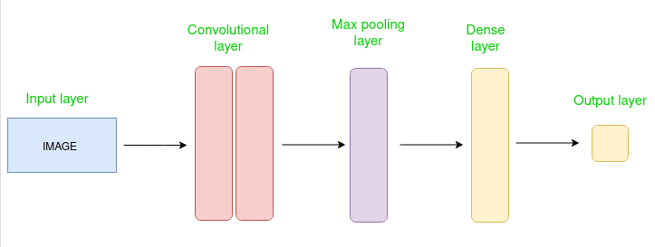


Introduction
A Convolutional Neural Network (CNN) is a type of deep learning algorithm that specializes in processing data that has a grid-like topology, such as images.

Slide 4
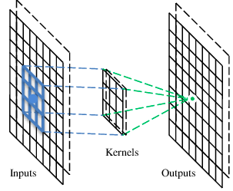
A Convolutional layer
A CNN is a neural network with some convolutional layers
(and some other layers). A convolutional layer has a number
of filters that does convolutional operation.

Slide 5
Convolution
1 | -1 | -1
-1 | 1 | -1
-1 | -1 | 1
1 | 0 | 0 | 0 | 0 | 1
0 | 1 | 0 | 0 | 1 | 0
0 | 0 | 1 | 1 | 0 | 0
1 | 0 | 0 | 0 | 1 | 0
0 | 1 | 0 | 0 | 1 | 0
0 | 0 | 1 | 0 | 1 | 0
Filter 1
These are the network parameters to be learned.
-1 | 1 | -1
-1 | 1 | -1
-1 | 1 | -1
Filter 2
……
6 x 6 image
Each filter detects a small pattern (3 x 3).

Slide 6
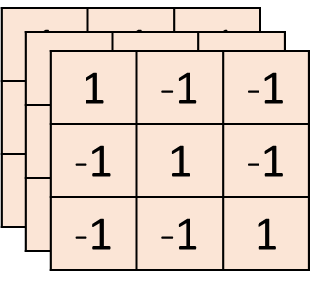
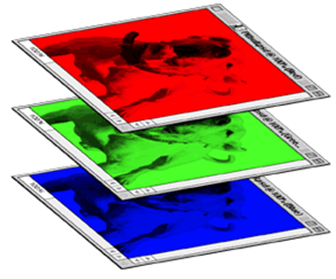
Color image: RGB 3 channels
-1 | 1 | -1
-1 | 1 | -1
-1 | 1 | -1
-1 | 1 | -1
-1 | 1 | -1
-1 | 1 | -1
-1 | 1 | -1
-1 | 1 | -1
-1 | 1 | -1
Filter 1
Filter 2
Color image
1 | 0 | 0 | 0 | 0 | 1
0 | 1 | 0 | 0 | 1 | 0
0 | 0 | 1 | 1 | 0 | 0
1 | 0 | 0 | 0 | 1 | 0
0 | 1 | 0 | 0 | 1 | 0
0 | 0 | 1 | 0 | 1 | 0
1 | 0 | 0 | 0 | 0 | 1
0 | 1 | 0 | 0 | 1 | 0
0 | 0 | 1 | 1 | 0 | 0
1 | 0 | 0 | 0 | 1 | 0
0 | 1 | 0 | 0 | 1 | 0
0 | 0 | 1 | 0 | 1 | 0
1 | 0 | 0 | 0 | 0 | 1
0 | 1 | 0 | 0 | 1 | 0
0 | 0 | 1 | 1 | 0 | 0
1 | 0 | 0 | 0 | 1 | 0
0 | 1 | 0 | 0 | 1 | 0
0 | 0 | 1 | 0 | 1 | 0

Slide 7
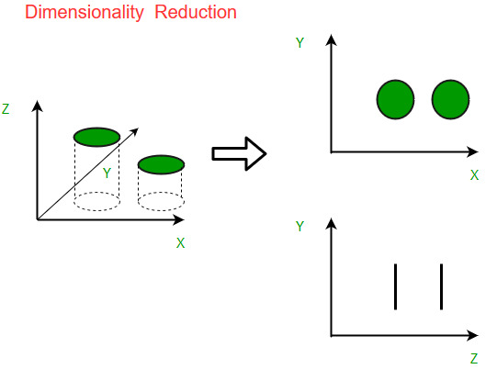
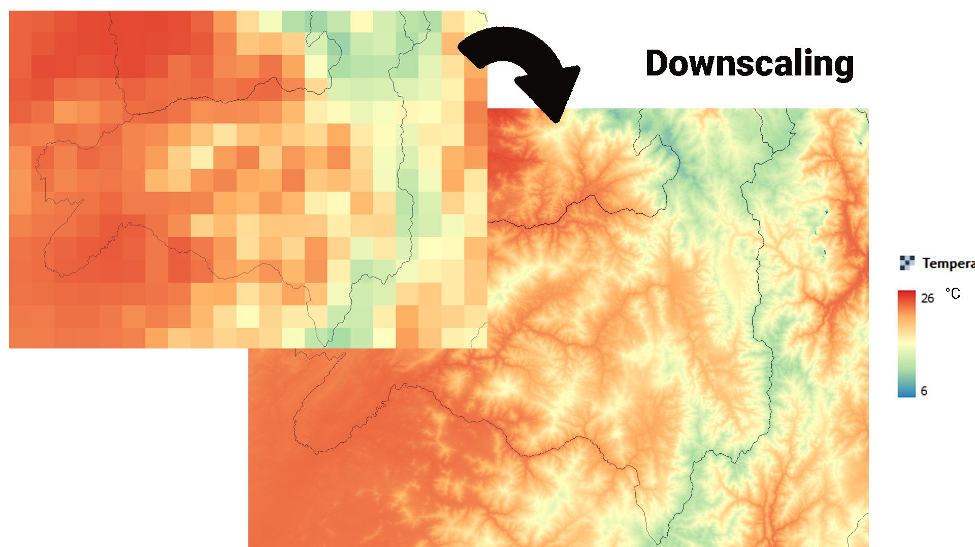
Pooling
Spatial downscaling
Dimensionality reduction

Slide 8
Types of Pooling
Max Pooling
Average Pooling

Slide 9
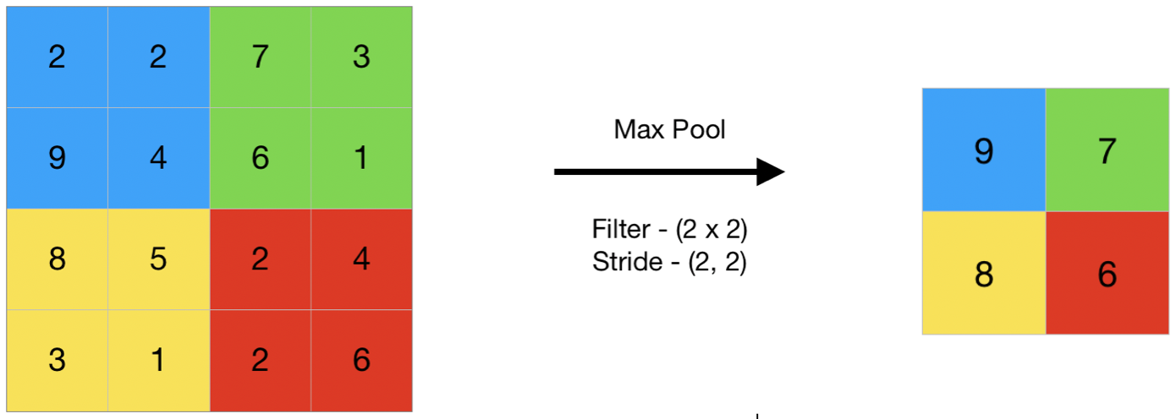
Max Pooling
Max pooling is a pooling operation that selects the maximum element from the region of the feature map covered by the filter.

Slide 10
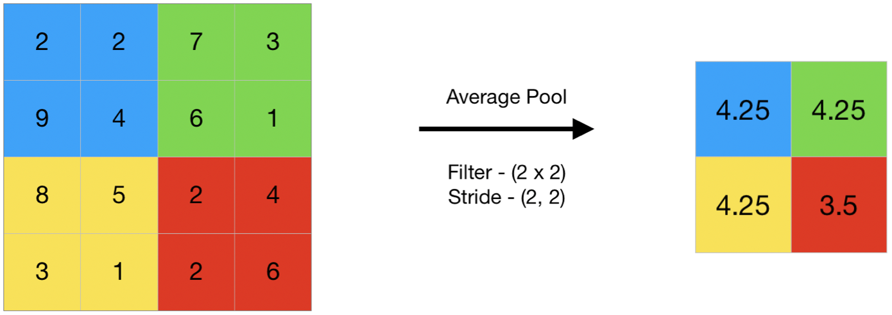
Average Pooling
Average pooling computes the average of the elements present in the region of feature map covered by the filter.
Thus, while max pooling gives the most prominent feature in a particular patch of the feature map, average pooling gives the average of features present in a patch.

Slide 11
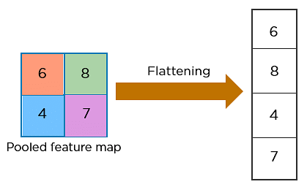
Flattening
Flattening is used to convert all the resultant 2-Dimensional arrays from pooled feature maps into a single long continuous linear vector.

Slide 12
ReLU – Rectified Linear Unit
The most common of such functions is the Rectified Linear function, and a neuron that uses it is called Rectified Linear Unit (ReLU)
The usage of ReLU helps to prevent the exponential growth in the computation required to operate the neural network.

Slide 13
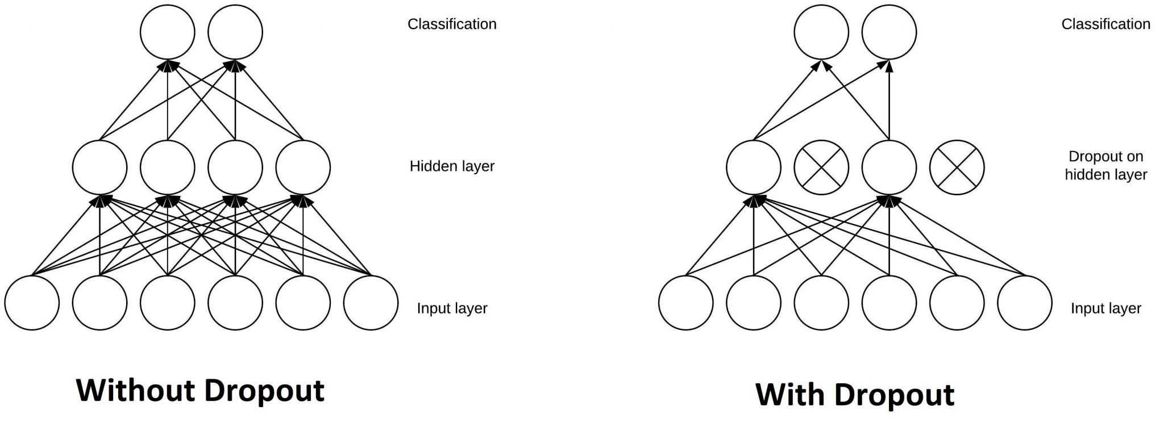
The Dropout Layer
The Dropout layer is a mask that nullifies the contribution of some neurons towards the next layer and leaves unmodified all others.

Slide 14
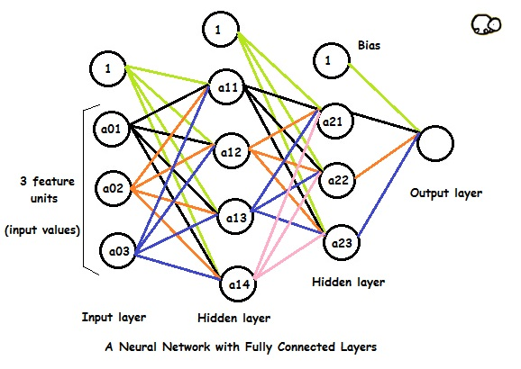
Fully Connected Layers
Fully Connected layers in a neural networks are those layers where all the inputs from one layer are connected to every activation unit of the next layer
compiles the data extracted by previous layers to form the final output
It is the second most time consuming layer second to Convolution Layer.

Slide 15
Output Layer
Last layer of neurons that produces given outputs for the program
Simple feedforward neural networks with three individual layers provide basic easy-to-understand models
More sophisticated, innovative neural networks may have more than one of any type of layer – and as mentioned, each type of layer may be built differently

Slide 16
CNN Architecture
VGG
Xception
ResNet
DenseNet
InceptionV3
InceptionResnet
MobileNet
NasNet
EfficientNet
ConvNeXt

Slide 17
Applications
Image Classification
Object Detection
Sematic Segmentation
Image Generation
Video Analysis

Slide 18
Thank you

