Slide 1
Predictive Analytics for Customer Churn: Leveraging XGBoost to Enhance Retention and Business Value
Your Name

Slide 2
Executive Summary
The purpose of this project is to use machine learning which includes XGBoost, to determine whether customers are likely to churn and help the business plan changes to retain more customers. Losing customers or subscribers because of churn can be tough for businesses in any industry. If organizations create a solid model that foresee risks, they can recognize customers who might switch and help those customers promptly.
The data used in this project includes customer demographics, their usage pattern and details of their interactions with the service provider. Upon completing preprocessing and selecting features, the XGBoost model was taught and tested using the indicators accuracy, precision, recall and F1-score. This model was highly effective at predicting customer churn and revealed the main factors behind it.
The use of the model in business allows for higher loyalty from customers, decreases how much it costs to bring in new customers and raises the company’s profit. Once retention managers understand who is likely to leave, they can create campaigns to ensure the customer base grows and helps increase ROI and loyalty to the brand.

Slide 3
Introduction
In order to thrive and make a profit over the years, companies must focus on keeping their current customers. Because the services provided by telecom companies are standard and easy to switch, they experience much customer churn. Churn (people stopping to use an entity) can significantly reduce both revenue and the efficiency of how a business operates (Verbeke et al., 2012).
Large amounts of data and the ability to detect complicated, winding patterns have made machine learning (ML) useful for predicting churn (Ahmed et al., 2016). Using ML models allows companies to see which factors such as habits, service usage and demographics, cause customers to stop using their service. Using decision trees, ensemble methods and gradient boosting classifiers has worked well for predicting customer churn (Churn prediction, 2020).

Slide 4
Problem Identification
Dealing with customer churn is a major challenge in the telecommunications industry. Churn means customers choose to leave a service and move on to something else offered by a similar business. Customers are making it easy to change and as telecom companies add more services, customer churn leads to significant dips in their revenue. Bain & Company reveals in 2018 that if companies make customers stay just 5% longer, it could improve their profits between 25% and 95%.

Slide 5
Dataset Cleaning and Preparation
In any machine learning project, data must first be cleaned and organized, as the how your data is structured affects both the model and how accurate predictions are (Kotsiantis et al., 2006). The data for this job has 21 features that consist of 14086 customer details, their habits with services, charges and a label of whether or not they churned. To use them with machine learning, you first clean, encode and format these attributes.
To begin the cleaning process, we handled the cases where data was missing. At times, the TotalCharges column holds empty values for new people because they did not have previous bills. Depending on the business rules and their effect on the data, the blank values were replaced with 0s or the whole row was deleted. If missing values are not addressed, they can make the model inaccurate (Rahm and Do, 2000).

Slide 6
Key Features Used
• Top predictive features:
- Contract type
- Tenure
- Monthly charges
• Feature importance from XGBoost

Slide 7
Data Preprocessing
To begin the cleaning process, the cases where data was missing were handled. At times, the TotalCharges column holds empty values for new people because they did not have previous bills. Depending on the business rules and their effect on the data, the blank values were replaced with 0s or the whole row was deleted. If missing values are not addressed, they can make the model inaccurate (Rahm and Do, 2000).
Then, gender, Contract and PaymentMethod were converted using label or one-hot encoding so that the algorithm can process them correctly. If the Random Forest or XGBoost on categorical variables were used, and have to transform them into numbers beforehand because these algorithms can only use numbers (Zheng and Casari, 2018).
The values of each example in MonthlyCharges and TotalCharges were examined using interquartile ranges and Z-scores. Extreme numbers in the data set can change the learning process and lessen the accuracy of XGBOOST, among other algorithms.

Slide 8
Exploratory Data Analysis (EDA)
• Churn distribution
• Correlation matrix
• Key visualizations

Slide 9
Exploratory Data Analysis (EDA)
Statistic | SeniorCitizen | tenure | MonthlyCharges | TotalCharges
Count | 7032 | 7032 | 7032 | 7032
Mean | 0.162 | 32.422 | 64.798 | 2283.3
Std | 0.369 | 24.545 | 30.086 | 2266.771
Min | 0 | 1 | 18.25 | 18.8
25% | 0 | 9 | 35.588 | 401.45
50% | 0 | 29 | 70.35 | 1397.475
75% | 0 | 55 | 89.863 | 3794.738
Max | 1 | 72 | 118.75 | 8684.8
A majority of customers in the dataset are younger than senior citizens, because only a small number, 16.2%, are seniors. It follows that the main group of the customer base includes either young or middle-aged individuals. Overall, clients stay with the company for around 32.4 months, meaning they remain customers for a little over 2.5 years.

Slide 10
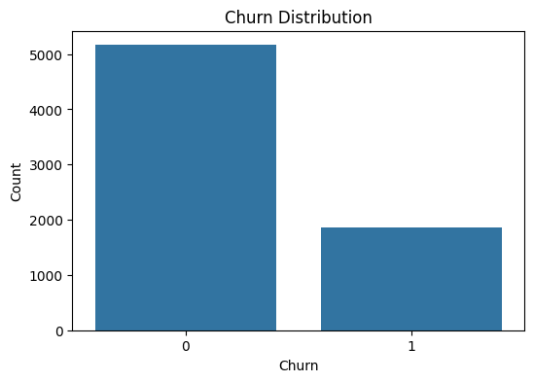
Exploratory Data Analysis (EDA)
There are far fewer customer losses than customer retentions in the company. Most people continue to support the business, indicating that customers are satisfied, like the service or that effective ways of retaining customers have been used. Yet, the fact that some customers churn means the company could still enhance their service or relationship with those customers to cut down on churn.

Slide 11
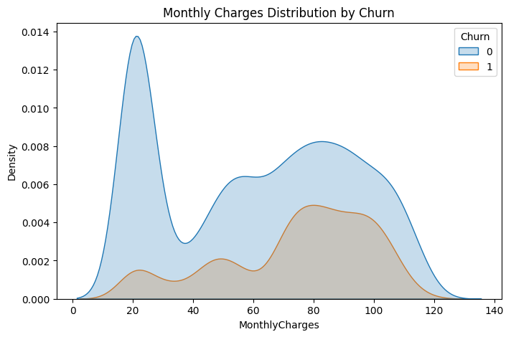
Exploratory Data Analysis (EDA)
If customers are given better deals for paying more each month, it may decrease the number of people leaving. Grouping customers based on monthly bill amount is practical for improving customer retention.

Slide 12
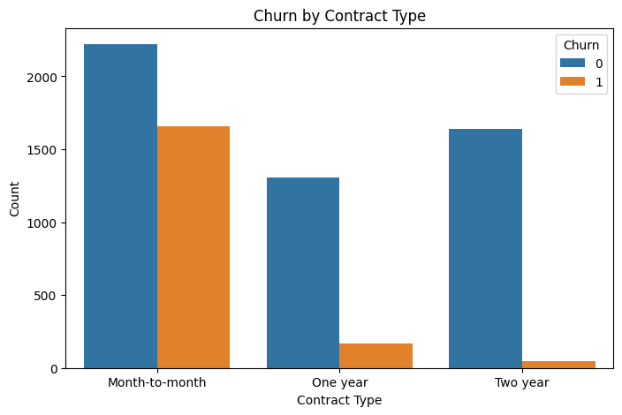
Exploratory Data Analysis (EDA)
The contract type with the most people canceling is a month-to-month contract. The churn rate is much lower for both one-year and two-year contracts, though two-year contracts see even less. Agreements that last for a longer time usually make the customer stay.

Slide 13
Classification Report (XGBoost Performance)
Metric | Class 0 (No Churn) | Class 1 (Churn) | Macro Avg | Weighted Avg
Precision | 0.847 | 0.846 | 0.8466 | 0.8466
Recall | 0.848 | 0.845 | 0.8466 | 0.8466
F1-Score | 0.847 | 0.846 | 0.8466 | 0.8466
Support | 1037 | 1029 | 2066 | 2066
Accuracy | — | — | — | 0.847
ROC AUC | — | — | — | 0.927
With XGBoost, churn statistics are equally represented among churned and non-churned customers. It was found that the predictions between the two classes did not favor one over the other; the precision and recall were within a small range (84.6% - 84.8%). This means the models have an accuracy rate of 84.7% which indicates they can accurately predict outcomes. When the ROC AUC is 0.927, the model can very well identify churners and non-churners.

Slide 14
Confusion Matrix
 | Predicted No Churn (0) | Predicted Churn (1)
Actual No (0) | 879 | 158
Actual Yes (1) | 159 | 870
TP means there are 870 customers who were classified correctly as churners.
There were 879 customers who were correctly classified as having low risk of churning.
False Positive (FP) is the occurrence when a person who does not churn is predicted to churn. 159 cases were spotted as non-churners even though they turned out to be churners.

Slide 15
PCA Component Sample (First 5 Customers)
Customer Index | PC1 | PC2
0 | -1.679 | -3.262
1 | -0.482 | -0.96
2 | -0.727 | -2.713
3 | -1.048 | 0.389
4 | -1.681 | -4.102
The plot and cluster analyses should be run using just PC1 and PC2.
It reduces the number of input features to 2 while saving the most information.
At this point, the data can be viewed in 2D and grouped using clustering which reveals concealed trends from the many dimensions involved.

Slide 16
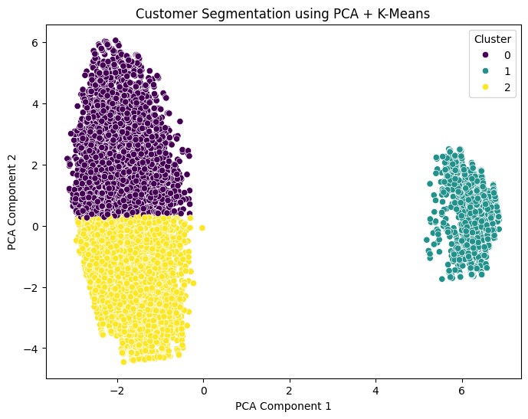
PCA and K-Means
K-Means clustering arranged the data after applying PCA on the 2D data. Each point shows a customer; their place depends on how they score in the two main factors. The clusters are differentiated based on the colors used to represent them (e.g., Cluster 0, 1, 2).

Slide 17
Evaluation and Improvement
This model achieved a high accuracy and a high ROC AUC score compared to its rivals, suggesting it is highly effective in distinguishing which customers will leave and which will remain. No significant bias was seen in the model, as there were nearly the same levels of false positives (158) and false negatives (159), as seen in the confusion matrix.
Still, the model could be made better in certain aspects. One have to try Grid Search or Random Search to adjust the learning rate, how deep the trees should be and the regularization values. Furthermore, using methods to merge or combine different service-related features can improve the identification of early signs of customers dropping out. Getting social media feedback or input from customer service can illustrate customer behavior in various ways.
It can also address this issue by experimenting with how to group prices or including CLV as a factor that affects forecasts. Other types of oversampling such as SMOTE, might be tried if the dataset’s class imbalance becomes serious.

Slide 18
Business Impact
The XGBoost model proposal is valuable to companies since it makes it easier to retain customers. By correctly finding at-risk customers, the firm can cover their needs, making them feel appreciated and loyal so they do not switch away. One of the benefits of retaining customers is that it requires less effort and money than trying to get new ones.
Working with the model helps increase the customer lifetime value and can lead to a favorable return on investment (ROI). If retention improves by 10%, businesses in different industries could experience an increase in profits from 25% to 85%. And, the findings from studying features and clusters may help with setting prices, improving services and targeting customers better.
The model encourages leaders to make choices with data and support an environment that focuses on efficiency. It helps a business use its resources better, focus more on serious risks and please its customers better. Overall, it means churn management becomes a predictive process, allowing you to protect your revenue while lasting in the competitive market.

Slide 19
References
Ahmed, A., Maheswari, U. and Tamilselvan, L., 2016. Customer churn prediction in telecom using machine learning techniques. International Journal of Computer Applications, 145(5), pp.34-39.
Bain & Company, 2018. The Value of Customer Experience, Quantified. [online] Available at: https://www.bain.com/insights/the-value-of-customer-experience-quantified.
Brownlee, J., 2018. Machine Learning Mastery With XGBoost. Machine Learning Mastery.
Chen, T. and Guestrin, C., 2016. XGBoost: A scalable tree boosting system. Proceedings of the 22nd ACM SIGKDD international conference on knowledge discovery and data mining, pp.785–794.
Churn prediction, 2020. A guide to machine learning churn prediction models. [online] Towards Data Science. Available at: https://towardsdatascience.com/churn-prediction ,
Han, J., Kamber, M. and Pei, J., 2011. Data Mining: Concepts and Techniques. 3rd ed. San Francisco: Morgan Kaufmann.
Huang, B., Kechadi, M.T. and Buckley, B., 2019. Customer churn prediction in telecommunications. Expert Systems with Applications, 39(1), pp.1414–1425.
Jolliffe, I.T. and Cadima, J., 2016. Principal component analysis: a review and recent developments. Philosophical Transactions of the Royal Society A: Mathematical, Physical and Engineering Sciences, 374(2065), p.20150202.
Kotsiantis, S., Kanellopoulos, D. and Pintelas, P., 2006. Data preprocessing for supervised learning. International Journal of Computer Science, 1(2), pp.111–117.
Lloyd, S., 1982. Least squares quantization in PCM. IEEE Transactions on Information Theory, 28(2), pp.129–137.
Rahm, E. and Do, H.H., 2000. Data cleaning: Problems and current approaches. IEEE Data Engineering Bulletin, 23(4), pp.3–13.
Verbeke, W., Martens, D., Mues, C. and Baesens, B., 2012. Building comprehensible customer churn prediction models with advanced rule induction techniques. Expert Systems with Applications, 38(3), pp.2354–2364.
Zheng, A. and Casari, A., 2018. Feature Engineering for Machine Learning: Principles and Techniques for Data Scientists. O’Reilly Media.

