Slide 1




KPMG DATA ANALYSISVIRTUAL INTERNSHIP

Slide 2
Prepare a detailed examination of the tasks carried out throughout the project, encompassing completion tasks, and deliver your discoveries to the management in a PowerPoint presentation. Please develop a dashboard that we can present to the client showing the below as segments:
Which profit patterns or trends may be identified in the available data?
Which customer segment exhibits the most significant value in terms of customer and products engagement?
Considering the market segment being pursued, which customers should the marketing team prioritize their efforts on?

Slide 3
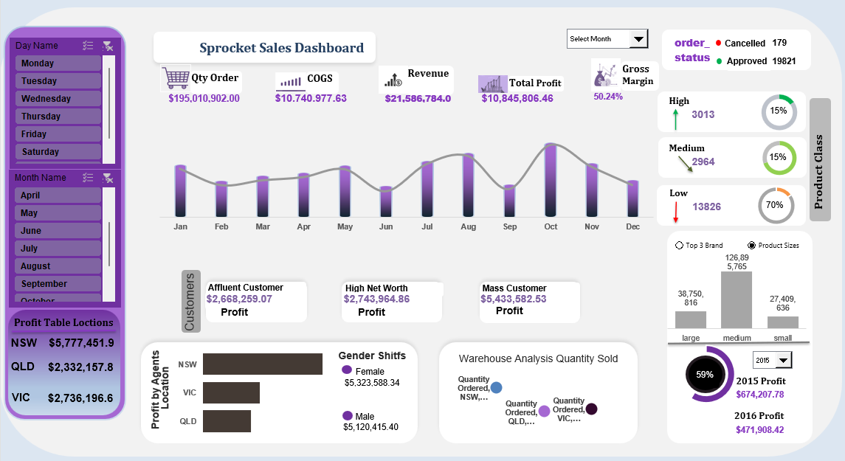

Slide 4
As a Business Analyst, the task I performed was to prepare a detailed examination of the tasks carried out throughout the project and deliver the findings to the management in a PowerPoint presentation.
To provide an in-depth analysis, I conducted an extensive review of the project tasks, identifying the completion tasks and their associated deliverables. This involved collecting useful data and analyzing it to understand the patterns and trends. During the process of completing the project, certain skills were necessary, and other skills were acquired. The required skills included Data Quality Analysis, Data Cleaning, Creating Analytical Dashboards, Data Analytics, and Customer Segmentation, Presenting Data-driven insights, Developing Data Dashboards, Creating Data Visualizations, and Delivering Presentations.
Action - To accomplish this task, I collected and analyzed sales and financial data. Then, I conducted a thorough analysis of the data, looking for patterns and trends to identify any profit patterns and collaborated with the marketing team to understand their objectives and the specific market segment they were pursuing. I then conducted an analysis of customer data, including demographics, purchase behaviours, and product trends, to determine which customers were most likely to respond positively to the marketing efforts. By considering the market segment being pursued, I provided recommendations on the specific customers that the marketing team should prioritize their efforts on.
Result - By using the available data, I discovered certain profit patterns or trends. The presentation highlighted the profit patterns identified in the data, providing a comprehensive understanding of the project's financial performance. Through this analysis, I also determined the customer segment that exhibited the most significant value in terms of customer engagement. These insights were then incorporated into the PowerPoint presentation, which was shared with the management.
Recommendations: Considering the market segment being pursued, I recommend that the marketing team prioritize their efforts on customers within ‘Mass Customer.' This segment has already shown a strong level of engagement and profitability, making them an ideal target for further marketing initiatives. By focusing resources on this segment, the marketing team can maximize their efforts and potentially drive even higher profits. Additionally, it is essential to continuously monitor and measure customer engagement and profitability to adapt and fine-tune marketing strategies as needed. Regular data analysis and customer feedback should inform future initiatives and help maintain a customer-centric approach.

Slide 5
Thank you for staying till the end
To receive more updates, make sure hit the follow button TO LIKE AND COMMENT: linkedin.Com/in/abiodun-o

