Slide 1


Lumen Lyceum
EdTech Learning Analytics: Reconciling Completion
Analytics Engineering Fellowship
CAPSTONE CASE STUDY
ABIOLA OGUNBAJO
Notes:
1

Slide 2
Background
TWO TEAMS, TWO DASHBOARDS, ONE PLATFORM
Curriculum Team
Measures completion by lesson progress: did the learner get through all the material.
Lumen Lyceum is an online learning platform selling self-paced courses. A learner enrols, works through lessons, and sits a final exam. The unit of analysis is the enrolment, not the student, since one person can enrol in multiple courses or re-enrol in the same one.
Credentialing Team
Measures completion by exam outcome: did the learner pass the final assessment.
Two teams each run their own dashboard to track how well learners finish their courses, and the dashboards have never agreed.
2

Slide 3


The Problem
CURRICULUM TEAM
45.0%
COMPLETION, MEASURED AS % OF LESSONS FINISHED
Two teams, two dashboards, two different numbers
Same enrolments. Same platform.
A 15-point gap that neither dashboard explains.
CREDENTIALING TEAM
29.9%
COMPLETION, MEASURED AS % WHO PASSED THE FINAL EXAM
3

Slide 4
THE APPROACH
MODEL BOTH DEFINITIONS: DON'T PICK A WINNER
1
Stage raw data
Clean and deduplicate the 4 raw tables (students, courses, lessons, assessments) without imposing business logic yet.
2
Model both definitions explicitly
int_lesson_completion (Curriculum's view) and int_assessment_outcome (Credentialing's view), kept as separate, named signals.
3
Build one enrolment-grain mart
fct_enrollments carries both flags side by side, plus a reconciliation bucket, never collapsed into a single 'completion' column.
4
Reconcile, don't resolve
A dedicated model explains the gap instead of silently picking one number as the truth.
4
Notes:
4

Slide 5
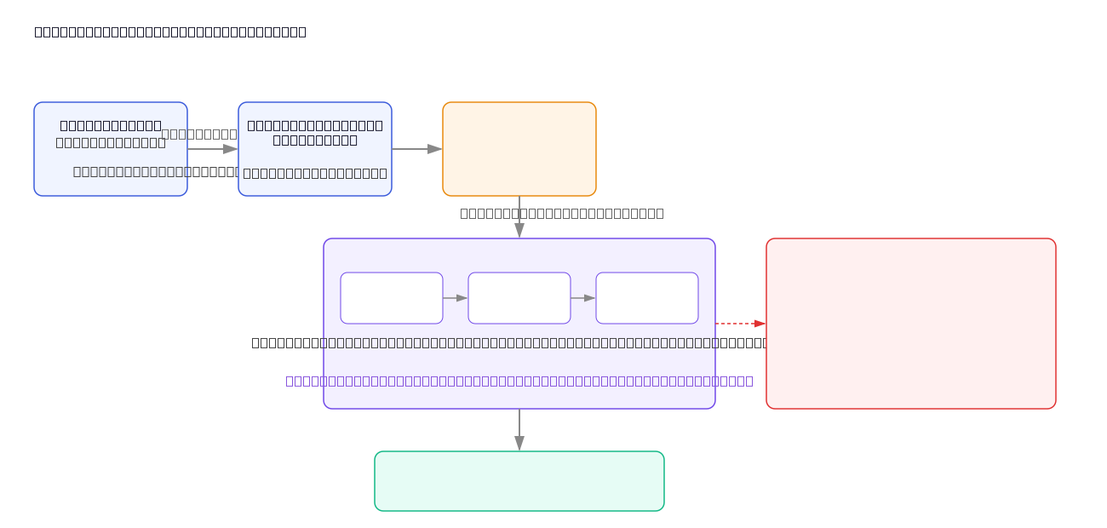
ARCHITECTURE - Source to dashboard, orchestrated daily
5
Notes:
5

Slide 6
DELIVERABLE 3
BRIDGING THE 45.0% TO 29.9% GAP
Incomplete on both definitions
50.4%
Finished lessons and passed the exam
25.2%
Finished lessons, never sat or failed the exam
19.8%
Tested out: passed without finishing every lesson
4.6%
Bridge: 45.0% finished every lesson (25.2 + 19.8). Of those, 25.2 points also passed. 19.8 points finished lessons but never sat or failed the exam, the largest driver of the gap. A further 4.6% tested out. Net: 25.2 + 4.6 ≈ 29.9%.
6
Platform status disagreement: 162 enrolments marked "completed" never passed the exam. 2,068 "tested out" enrolments are NOT marked "completed" at all.
Notes:
6

Slide 7
DELIVERABLE 4
PIPELINE MONITORING AND TEST SEVERITY
severity: error
severity: warn
  unique / not_null on primary keys (4 raw sources + mart)
  relationships: course_id to stg_courses
  accepted_range on pct_lessons_completed
  Build fails; downstream models skipped
  Data engineer paged via Slack/email
  Last-good data served during the outage
  accepted_values on completion_reconciled
  Unexpected-but-not-catastrophic anomalies
  Logged in run_results.json
  Build continues normally
  Surfaced in a daily digest, not paged
  23 tests passing total across the pipeline
7
Notes:
7

Slide 8
DELIVERABLE 5
DAILY ORCHESTRATION DAG DESIGN
Check source
freshness
Run staging
models
Run intermediate
models
Run mart
models
Run
tests
Generate
docs
Schedule
Alerting
Idempotency
Daily around 3 AM, after the overnight export; freshness check is the real gate, not the clock.
Freshness/test failures alert the data team; run errors get 1 retry (5 min) before paging.
Every dbt run is safe to re-run, required given retries and manual reruns.
Design and reasoning is the required deliverable. A running DAG (Airflow/Dagster/Prefect) is a stretch goal for a later iteration.
8
Notes:
8

Slide 9
KNOWN ISSUES
A SOURCE-LEVEL BUG, FOUND AND DIAGNOSED
Corrupted raw timestamps (enrolled_at, last_active_at)
Loaded into Snowflake as nonsensical values (e.g. year -1,688,798,502) via the data generator's write_pandas upload step. Diagnosed down to the upload itself: Python's own date logic is correct; the corruption happens specifically during the write to Snowflake. Flagged upstream with the diagnostic detail.
Impact
Unaffected
Next step
active_within_28_days, days_active_span, and median_days_to_complete are unreliable until resolved.
Completion rates, reconciliation buckets, and all other metrics do not depend on these columns and are confirmed correct.
Fix at the source, reload raw tables, re-run dbt build, and update these two metrics.
9
Notes:
9

Slide 10
Recommendations
REPORT BOTH DEFINITIONS, LABELED CLEARLY
1
2
3
4
5
  Report both completion rates side by side, permanently. Do not collapse them into one number.
  Ship fct_enrollments and mart_completion_reconciliation as the shared source of truth both teams query directly.
  Use the reconciliation bucket breakdown as the standing reference whenever the two numbers are questioned.
  Fix the platform's overnight status job separately. It disagrees with both definitions and misses the entire 'tested out' population.
  Resolve the source timestamp bug before relying on the active-learner or time-to-complete metrics operationally.
10

