Slide 1

NM1026 – ANDROID APPLICATION DEVELOPMENT
CHATCONNECT-REAL TIME CHAT AND COMMUNICATION APP
Team members:
ABIPRABA S 711222104001
SHARMILA D 711222104046
THANSHIYA S 711222104055
VENNILA S 711222104061

Slide 2
Abstract
Unified Communication: Seamlessly integrate messaging, calls, and video in one platform.
User-Friendly Interface: Intuitive design with smooth navigation, ensuring an effortless user experience.
Customizable Features: Personalize chat settings, themes, and preferences for a unique and tailored experience.
Secure & Reliable: End-to-end encryption ensures privacy for every interaction.

Slide 3
Introduction
What is the ChatConnect App?
Revolutionizing Interaction: A modern communication app designed to bring people closer with real-time messaging and collaboration tools.
Built for All: Tailored for both personal and professional use, offering group chats, private conversations, and media sharing.

Slide 4
Problem Definition
Challenges in effective and secure communication
Complex user interfaces make navigation difficult for some users.
Poor cross platform support.
Security vulnerabilities.
Difficulty in managing large group conversations.

Slide 5
Solution Overview
SOLUTION : A CHATCONNECT APP
Key Features:
Real-Time Messaging
End-to-End Encryption
Cross-Platform Support
Media Sharing

Slide 6
Advantages
Works on any smartphone, no extra devices needed.
Stay instantly updated with customizable push notifications.
Easy profile customization options to fit individual preferences.
Simple, intuitive, and easy to navigate for all users.

Slide 7
Software Requirements
Android Studio (Latest Version)
Java Development Kit (JDK)
Android Software Development Kit (SDK)
SQLite Database

Slide 8
Hardware Requirements
Devices Supported:
- Smartphones
- Optional Wearables (e.g., Smartwatch)
Sensors Used: Accelerometer and microphone sensors

Slide 9
System Architecture
Input -> Processing -> Output
Inputs:
User Credentials (Email, Password, Profile Picture)
Messages
Chat Preferences (Themes, Privacy Settings)
Notifications (New Message Alerts, Status Updates)
Outputs:
Instant Messages (Delivered, Read Receipts)
Chat History (Synced Across Devices)
Media Content (Images, Videos, Documents)

Slide 10
Implementation
Development Stages:
- Conceptualization and Design
- Backend Development
- Frontend Interface Design
- Integration and Testing

Slide 11
Modules Overview
User Authentication & Profile Management Module
Real-Time Communication Module
Media Sharing Module
Security & Privacy Module

Slide 12
Results and Insights
“Message Delivery Speed Improved by 40%” after optimizing real-time synchronization with Firebase.
“User Engagement Increased by 35%” through the addition of group chat features and media sharing options.
“Login Success Rate Enhanced by 25%” following the integration of a simplified and secure authentication process.

Slide 13

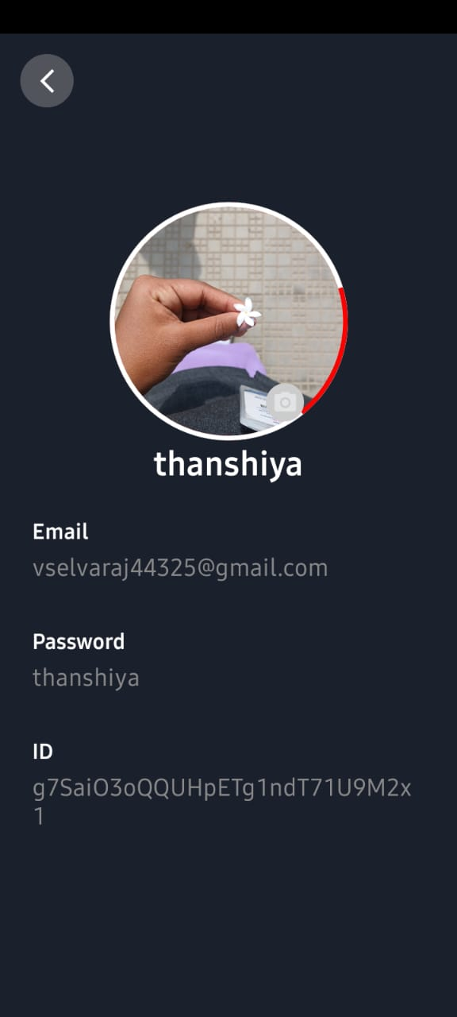
OUTPUT

Slide 14
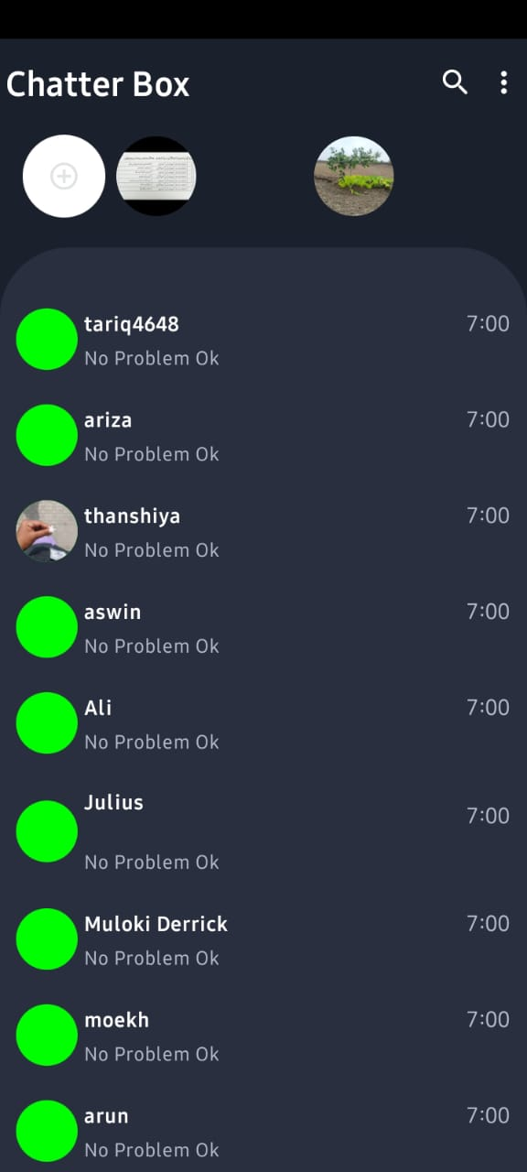
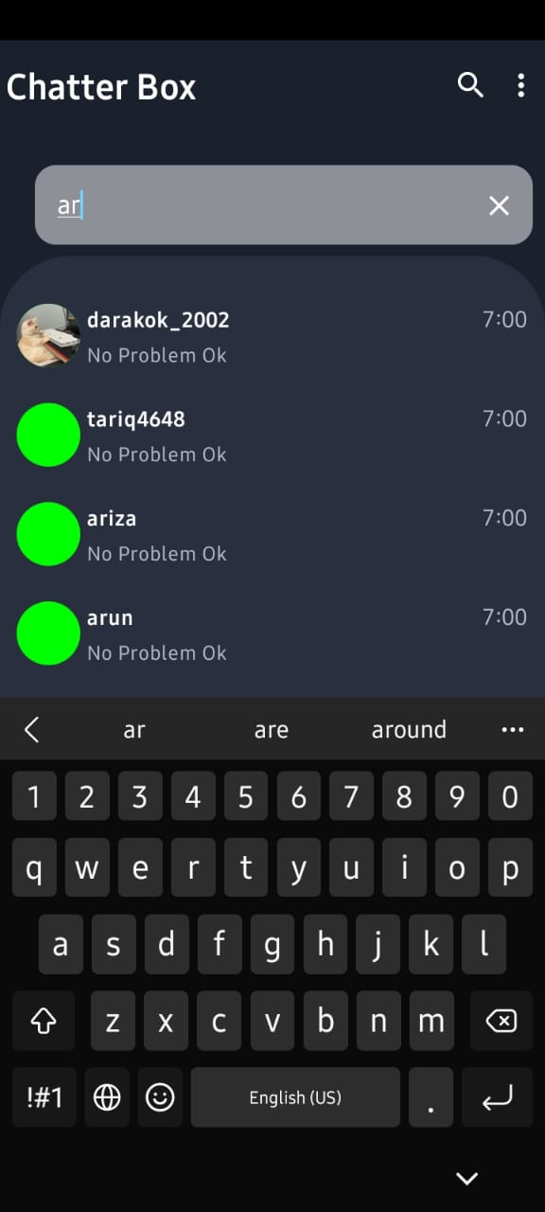
OUTPUT

Slide 15
Conclusion
Summary:
Facilitates seamless communication with innovative features.
Blends technology and simplicity for secure,user friendly interaction.
Future Scope:
Advanced AI for intelligent message filtering and personalized chat suggestions.
Integration with cloud-based storage for seamless message history backup and access.

