Slide 1
Concrete Cracks Detection Using Convolutional Neural Network Based on Transfer Learning
Group 1 (A2)
Roll: 1706034-37

Slide 2
Methods Of Detecting Cracks
The current method
Using image processing
Detection involves a specified technician or engineer working with related field to detect related problems.
Costly
time consuming
The use of instruments can bring about further problems or hazards.
Human neuron like neural networks can efficiently detect cracks using machine learning and image processing.
Cheaper
Smoother
Hassle free
Super Fast

Slide 3
Deep Learning
Deep learning is an artificial intelligence (AI) function that imitates the workings of the human brain in processing data and creating patterns for use in decision making. ... Also known as deep neural learning or deep neural network.
Types of Deep Learning Networks
Feedforward neural network. ...
Radial basis function neural networks. ...
Multi-layer perceptron. ...
Convolution neural network (CNN) ... (We will use this network for image Processing)
Recurrent neural network. ...
Modular neural network. ...
Sequence to sequence models.

Slide 4
CNN
A convolutional neural network (CNN) is a type of artificial neural network used in image recognition and processing that is specifically designed to process pixel data.
CNN is a Deep Learning algorithm which can take in an input image, assign importance (learnable weights and biases) to various aspects/objects in the image and be able to differentiate one from the other.
It is made up of neurons with learnable weights and biases.
A CNN typically has three layers: a convolutional layer, a pooling layer, and a fully connected layer.
The main advantage of CNN compared to its predecessors is that it automatically detects the important features without any human supervision .

Slide 5
EfficientNetB0
EfficientNet is a convolutional neural network architecture and scaling method that uniformly scales all dimensions of depth/width/resolution using a compound coefficient.
EfficientNet uses a compound coefficient to uniformly scales network width, depth, and resolution in a principled way.
The EfficientNetB0 is a network that uses the smoothened, ReLU like Swish activation function. The function basically is defined as
f(x) = x.sigmoid(x)

Slide 6
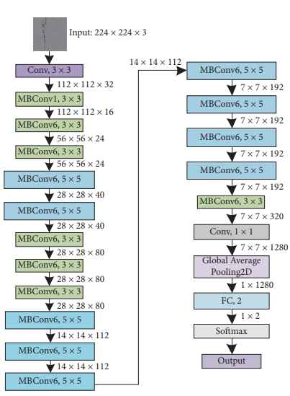
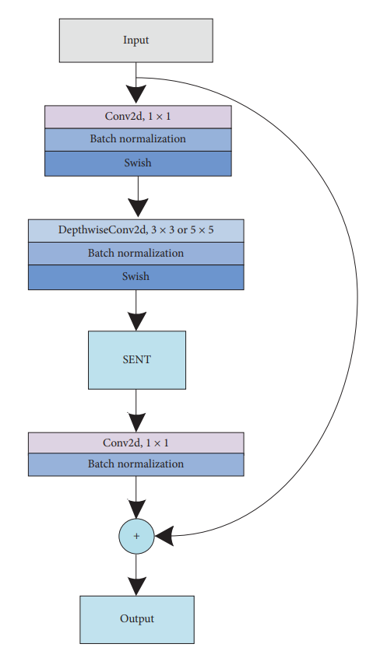
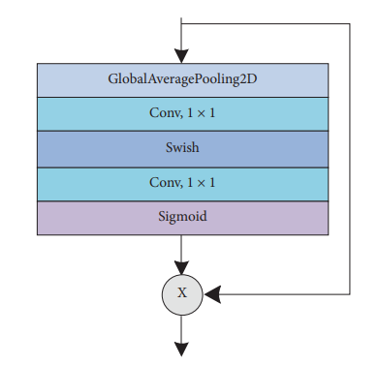
EfficientNet Architecture (left), MBconv framework (middle) and Squeeze and excitation block (right).

Slide 7
Processes we followed and some background regarding them:
Dataset
Assigning hyperparameters and data augmentations
Freezing layers and preprocessing
Dropout rates, pooling, and Optimizer
Fine tuning as an incremental step
Performance testing

Slide 8
Dataset
We collected data from mainly two sources.
The first dataset (mendeley) contains 40000 images(227x227 pixels)
The 2nd dataset(SDnet) contains 7700 images (224x224 pixels)
We formulate our data into training, validation and test set in ratio of 6:2:2
We add our 2nd dataset to the initial dataset to make the mendeleySDnetadded dataset.
To handle our datasets and perform analysis by Google Colaboratory, tensorflow built in codes and google drive.

Slide 9



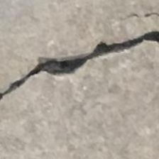
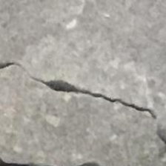
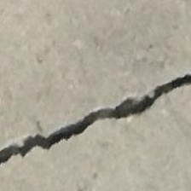





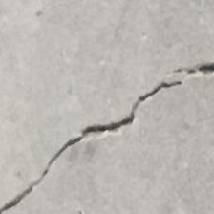



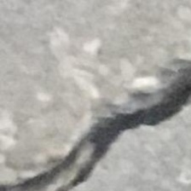
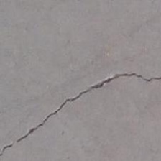
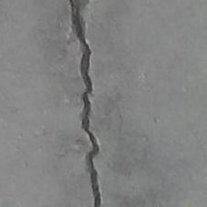
Samples(Mendeley dataset ) 1.Negative 2. Positive

Slide 10
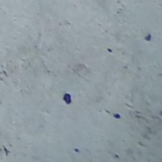










Samples(mendeleySDnetadded Dataset) 1.Negative 2. Positive

Slide 11
Assigning hyperparameters and data augmentations
We import the necessary libraries, like keras and tensorflow to enjoy the privilege of built in codes.
Learning rate, is set as 0.0001
Batch size of the images are taken to be 32.
Preprocessing and augmentation of the data includes random horizontal and vertical flipping and we use 0.3 rotaion.
We visualize some data before and after augmentation.
Afterwards, auto tuning helps us to efficiently use the input pipeline and model pipeline.

Slide 12
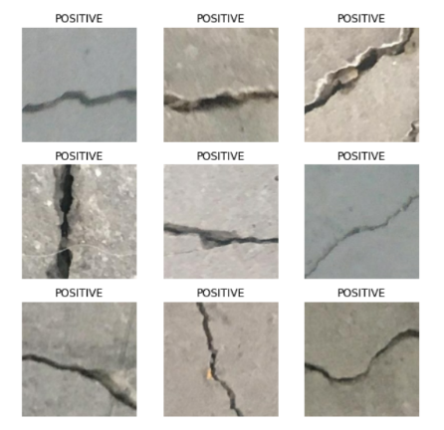
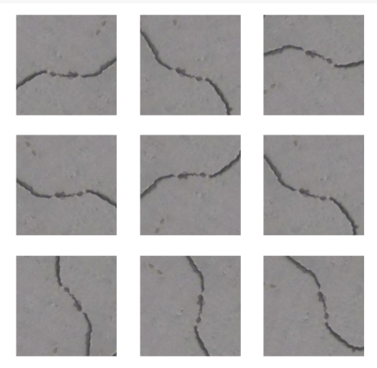
Some data before and after augmentation. 1.Before 2. After

Slide 13
Freezing layers and preprocessing
We issue the model.trainable false command to freeze up the pre-trained EfficientNet model layers.
The prediction layer, has been assigned an activation of the sigmoid function nature.
The preprocessing commands that we apply is EfficientNet.

Slide 14
Dropout rates, pooling, and Optimizer
During training, some number of layer outputs are randomly ignored or dropped out. We added a dropout rate of 0.3 for our modelling purposes.
We also implement global average pooling 2d.
we implement the Adam optimizer. Optimizers optimize the learning rates and weights in layers to minimize the loss.
After all the settings are complete, we initiate the training.

Slide 15
Fine tuning as an incremental step
We had thought of 30 epochs for our training.
After 15 epochs, until which the model has trained to convergence safely, we decide to change the model a little bit, that is, unfreeze the layers and run the last 15 epochs with unfrozen layers. This is the fine tuning step.

Slide 16
Performance testing
The training is allowed to complete, once for the initial dataset, and once for the mixed dataset. The model evaluation command does evaluation on the test dataset and finds out related parameters.
The parameters we are finding out are:
Accuracy: (TP+TN)/(TP+FP+TN+FN)
Precision: TP/(TP+FP)
Recall : TP/(TP+FN)
F 1-score: 2 x precision x recall/ (precision+reca­­ll)
( Where TP and TN mean correctly classified images with crack and without crack )

Slide 17




Results: For EfficientNetB0
For mendeley dataset
For mendeleySDnetadded dataset:

Slide 18

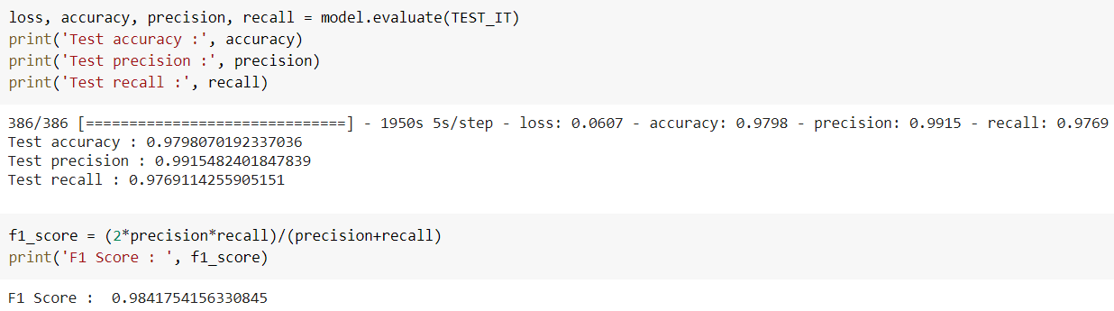
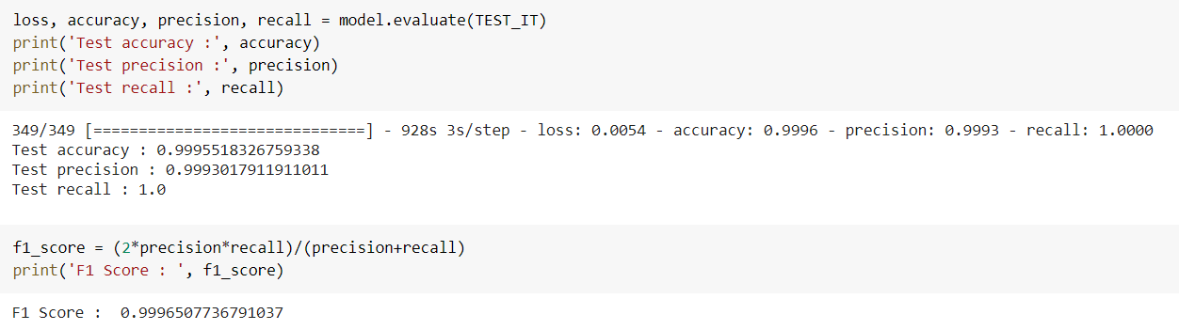
Results: For MobilenetV2
For mendeley dataset
For mendeleySDnetadded dataset:

Slide 19




Results: For InceptionV3
For mendeley dataset
For mendeleySDnetadded dataset:

Slide 20
Comparison in the results
For mendeley dataset
(Low dataset difficulty and easier discernible recognition possible)
For mendeleySDnetadded dataset
(A more difficult batch has been mixed into initial dataset)
Recognition model | Accuracy | Precision | Recall | F1 score
EfficientNetB0 | 0.99955 | 0.99944 | 0.99986 | 0.98706
MobileNetV2 | 0.99955 | 0.99930 | 0.99999 | 0.99965
InceptionV3 | 0.99982 | 0.99986 | 0.99986 | 0.99986
Recognition model | Accuracy | Precision | Recall | F1 score
EfficientNetB0 | 0.98393 | 0.99285 | 0.98133 | 0.98706
MobileNetV2 | 0.98220 | 0.99334 | 0.97805 | 0.98563
InceptionV3 | 0.98165 | 0.99219 | 0.97830 | 0.98519

Slide 21
Conclusion
The paper we were following accuracy on mixed dataset testing of 97.37%.
Our use of the same model yielded an accuracy of 98.4%, more than a 1% rise.
In mendeley datasets (easy) EfficientNet is not the best in terms of parameters as the Inception and MobileNet beat it largely.
But the finensse of the EfficientNet is spectacled when it comes to varieties of data(mendeleySDnetadded data), and it shines out more accurately than other models. It also holds a good balance between precision, recall and the F1 scores.

