Slide 1

Rock, Paper, Scissors: A C Program
This presentation dives into the development of a classic game, Rock, Paper, Scissors, implemented in the C programming language. We will explore its implementation, logic, and functionalities.

Slide 2
Introduction to the Game
Gameplay
Objective
Two players choose between rock, paper, or scissors. Rock beats scissors, scissors beats paper, and paper beats rock.
The player who makes the winning choice defeats the opponent and earns a point. The game typically continues until one player reaches a predetermined number of points.

Slide 3
Program Structure
#include <stdio.h>
#include <stdlib.h>
#include <time.h>
void print_choice(int choice) {
switch(choice) {
case 0:
printf(" ___\n---' _)\n ()\n ()\n ()\n---.()\n");
break;
case 1:
printf(" ______\n---' ___)\n ______)\n _______)\n _______)\n---.)\n");
break;
case 2:
printf(" ______\n---' ___)\n _____)\n __________)\n ()\n---.()\n");
break;
}
}
int main() {
int user_choice, computer_choice;
printf("Type 0 for rock, 1 for paper, 2 for scissors\n");
printf("What do you choose?: ");
scanf("%d", &user_choice);
if (user_choice >= 0 && user_choice <= 2) {
print_choice(user_choice);
} else {
printf("Invalid input. You lose!\n");
return 1;
}
srand(time(NULL));
computer_choice = rand() % 3;
printf("Computer chose: \n");
print_choice(computer_choice);
if (user_choice == 0 && computer_choice == 2) {
printf("You win!\n");
} else if (user_choice == 2 && computer_choice == 0) {
printf("You lose!\n");
} else if (computer_choice > user_choice) {
printf("You lose!\n");
} else if (user_choice > computer_choice) {
printf("You win!\n");
} else {
printf("It's a draw!\n");
}
return 0;
}

Slide 4
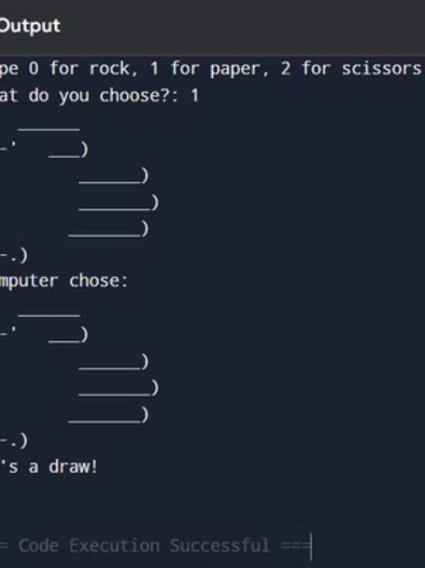
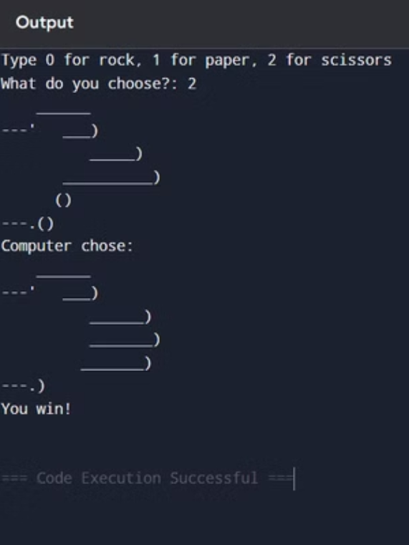
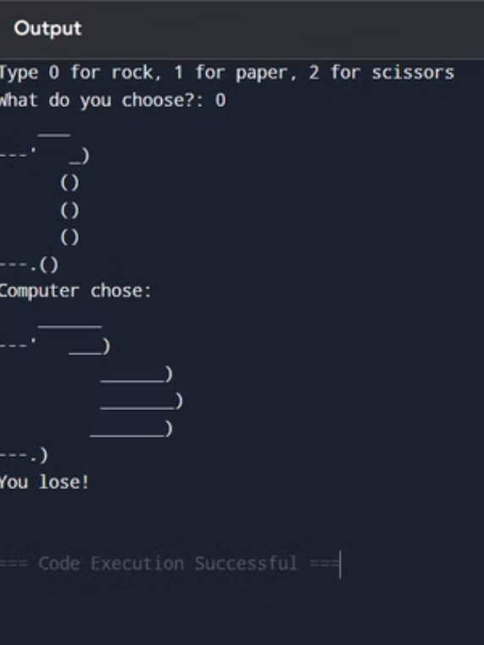
Sample Output

Slide 5
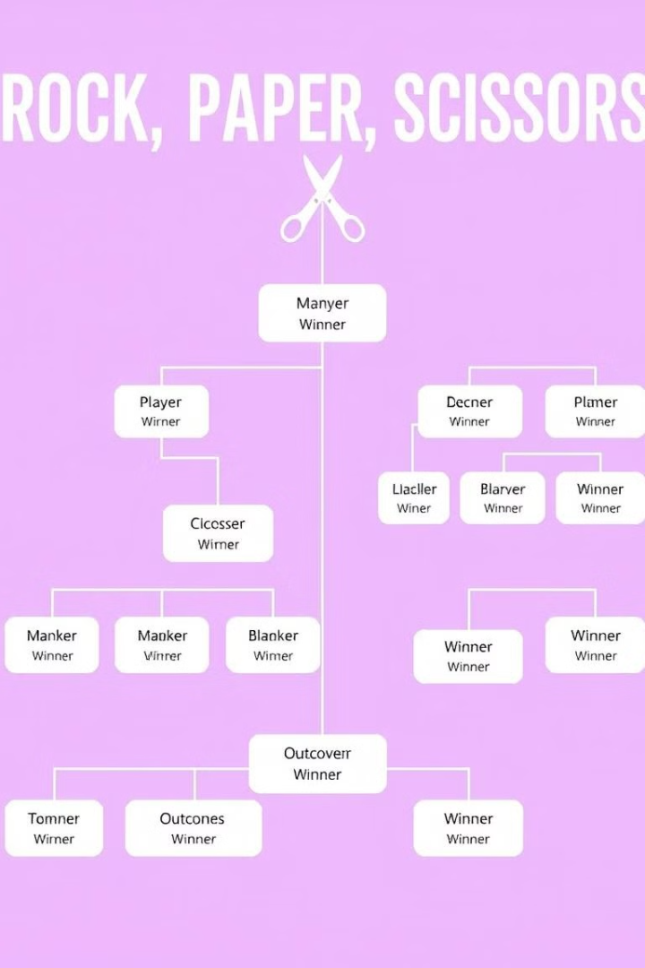
Game Logic
// Determine winner if (playerChoice == computerChoice) { printf("It's a tie!\n"); } else if (playerChoice == 1 && computerChoice == 3 || playerChoice == 2 && computerChoice == 1 || playerChoice == 3 && computerChoice == 2) { printf("You win!\n"); } else { printf("Computer wins!\n"); }

Slide 6

Handling User Input
Input Validation
Error Handling
The program should ensure the user inputs a valid choice, either 1 (rock), 2 (paper), or 3 (scissors).
Implement error messages for invalid input to guide the user towards making correct selections.

Slide 7



Conclusion and Key Takeaways
1
Simple Logic
2
User Interaction
3
C Fundamentals
Presented by: Abir Dubey(RA2412707010025), Arnab Kar(RA2412707010022), Abhinav R(2412703010031)

