Slide 1
CSE 583 Term Project Proposal
Gender-Based Age Estimation using Quantified Brain Asymmetry
Bodhisatwa Chatterjee(bxc583)

Slide 2
Salient Points of this Project
Revisit the problem of age-estimation using quantified brain asymmetry
Include the factor of gender in age-estimation
Seek answer to the question whether the gender of a subject influences the estimation of age?
Also seek answer to whether male and female have different asymmetry of brain

Slide 3

Why should gender matter in age-estimation?
According to neuroscience community, male and female brains have distinct anatomical structure.
Our hypothesis is that differences in anatomical structure should also cause difference in brain asymmetry.
As a result, the features for regression model for age estimation might change depending on gender.

Slide 4
How do we (in)validate our hypothesis?
Train a classifier model which would first learn to categorize subjects into male and female
Build separate linear regression models for each category of subjects for the age-estimation.
Check whether the results in each category differ to that of the original result. (Can compare MSE)

Slide 5
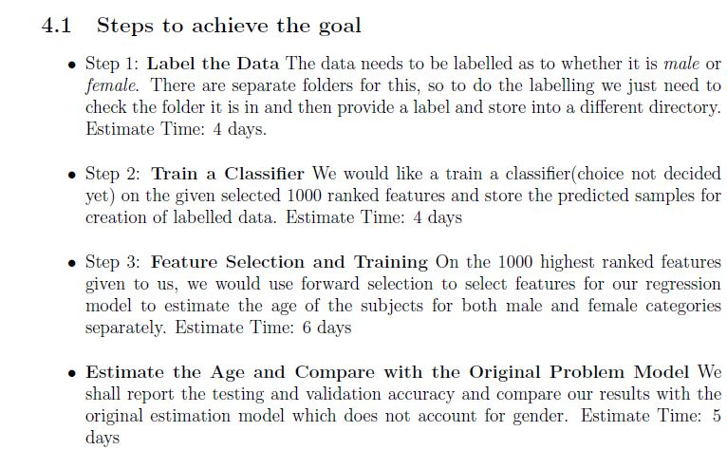
Specific Plan of Action

Slide 6
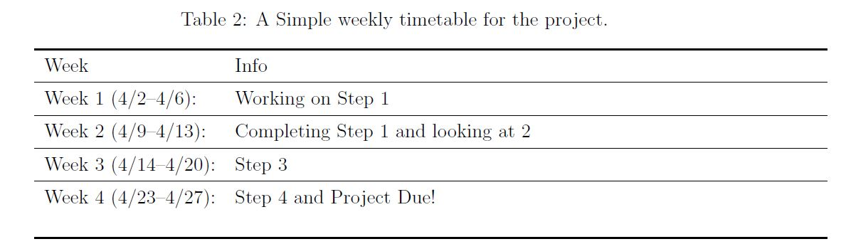
Project Timeline

Slide 7
What are the implications of this project?
If everything goes as planned, then we can shed light to the following questions.
Does the factor of gender affects the age-estimation by brain asymmetry?
Are the instances of neuro degenerative diseases(AD/PD) more prevalent in male or female subjects? (need more data for a stronger claim)(will use the normal aging dataset)

Slide 8
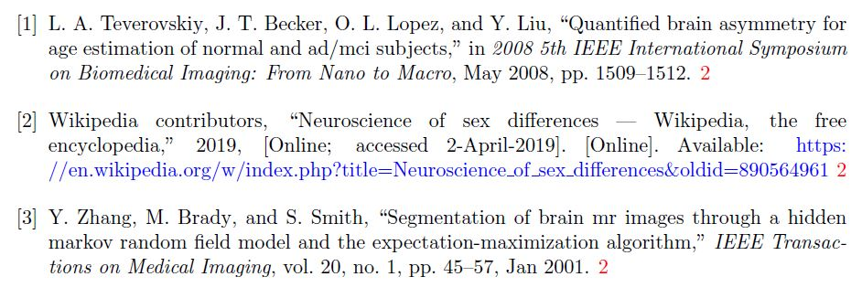
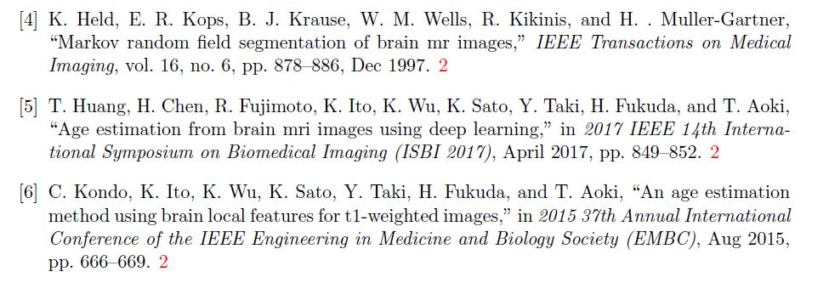
References

