Slide 1
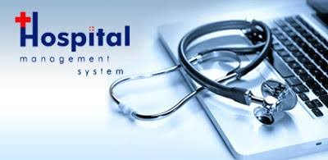
Hospital Management System
176144 Riddhi Pawar
176127 Neha Kothawade
176135 Ashlesha Narkhede
176130 Ritu Mahajan
YouTube link: https://youtu.be/SwE4mxQxhEI
GitHub Link: https://github.com/rid17pawar/HospitalManagement.git

Slide 2
Contents
Introduction
System Need
Software & Database Requirement Specification
Modules (Entity Relationship Diagram)
Project Screenshots.
Advantages & Disadvantages
Conclusion

Slide 3
Existing System Issues
Features of Proposed System
-paper based
-inappropriate data keeping
-time wastage in storage, retrieval
-patients were unable to understand
the prescription
-Separate user account for doctors
and other staff.
-Keeps each patient’s data separate,
easy to track
-Easy user interface
-PDF of doctor prescription

Slide 4
System Needs
To keep track of hospitals day-to-day activities & records of its patients, doctors that keep the hospital running smoothly & successfully there is need of Hospital management System.
To digitalize all the version of the manual system.
To provide a paper-less hospital up to 90%, i.e. To provide low-cost reliable digitalization of the existing systems
To digitalize, the process of day-to-day activities like Registering New Patient, Assigning a Doctor to new patient, Adding new staff members, and finally compute the bill etc.
To provide excellent security of data at every level of user-system interaction and also to provide robust & reliable storage facility.

Slide 5

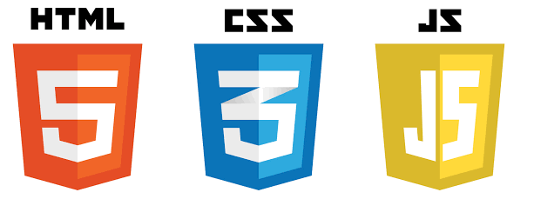
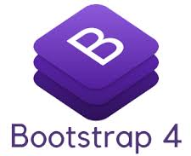





Technologies Used

Slide 6
Software Requirement Specifications
Content | Description
Processors | i3,i5,i7
Hard Drive | 1GB(minimum) , 2GB(Recommended)
RAM | 512MB(minimum), 1GB(Recommended)
Operating System | Windows 10,Windows 7,Windows 8

Slide 7
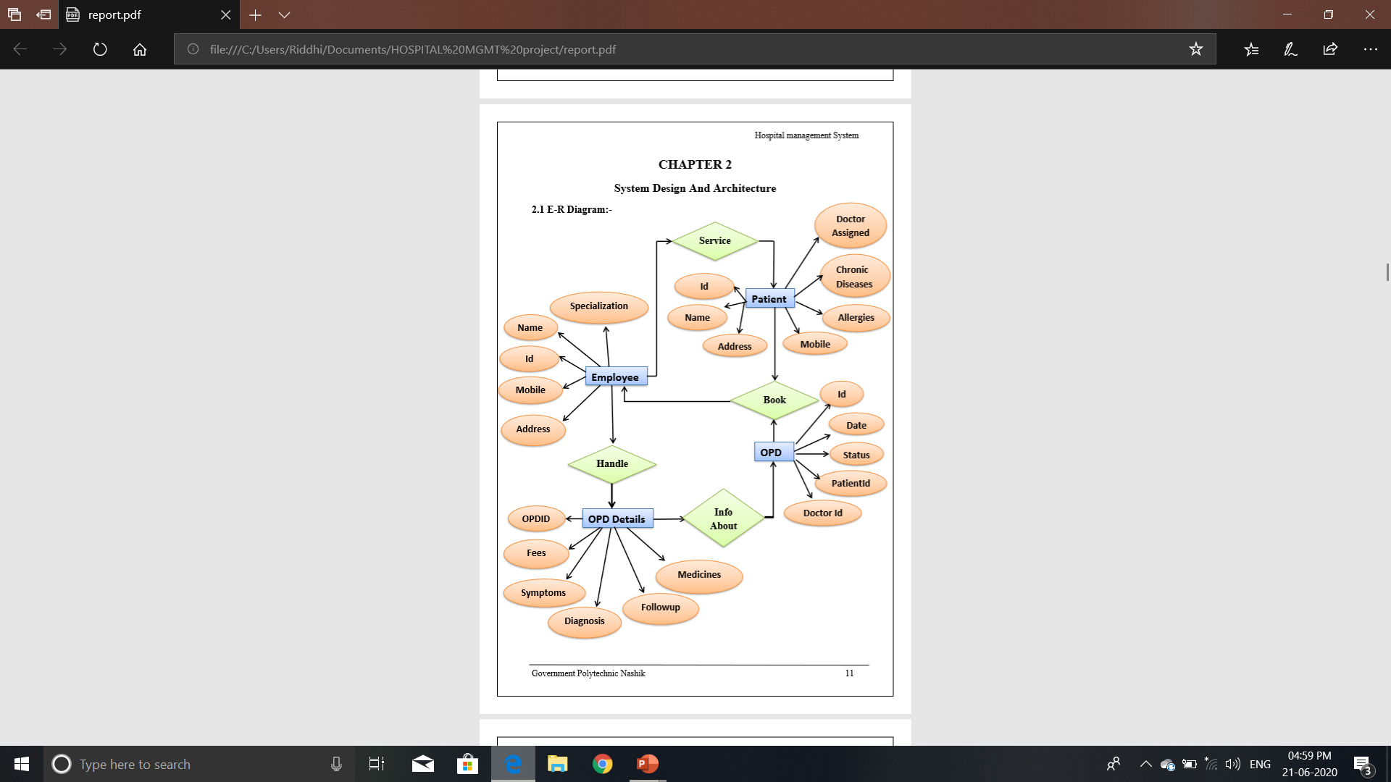
ER Diagram

Slide 8
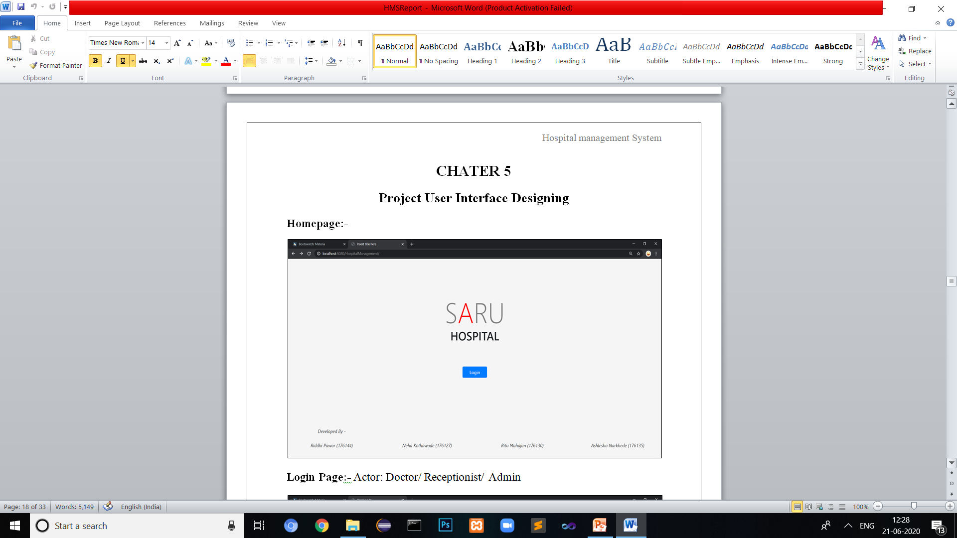
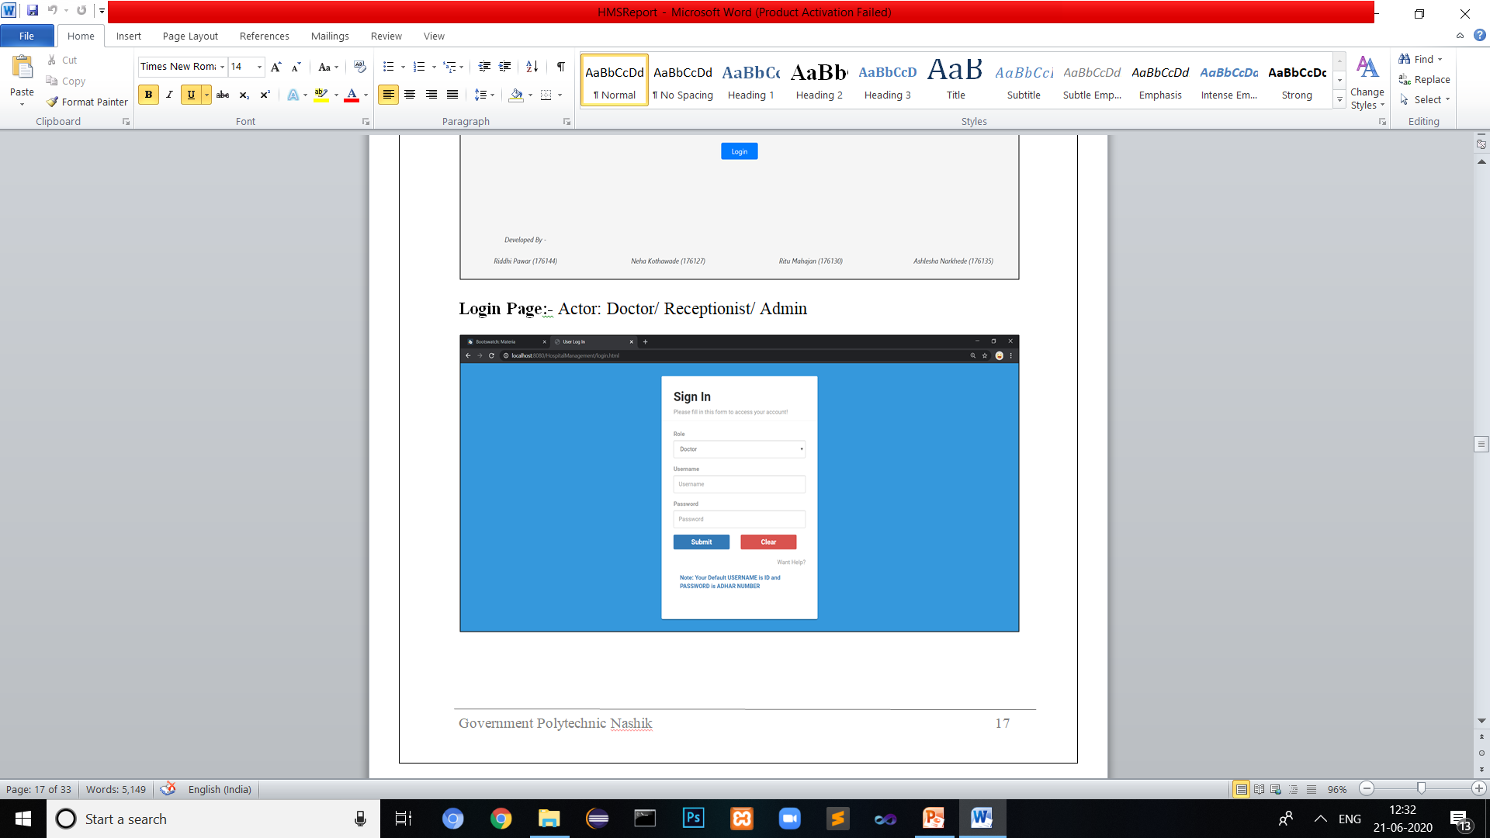
Project Screenshots
Home Page
Login Page

Slide 9
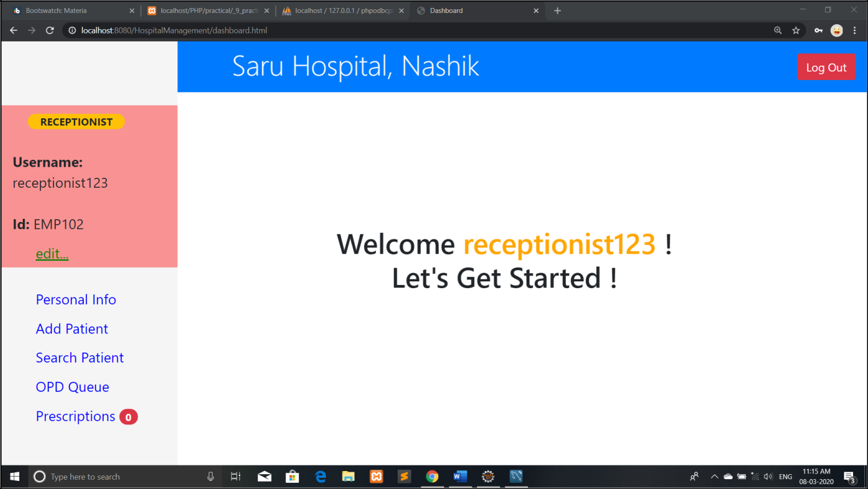
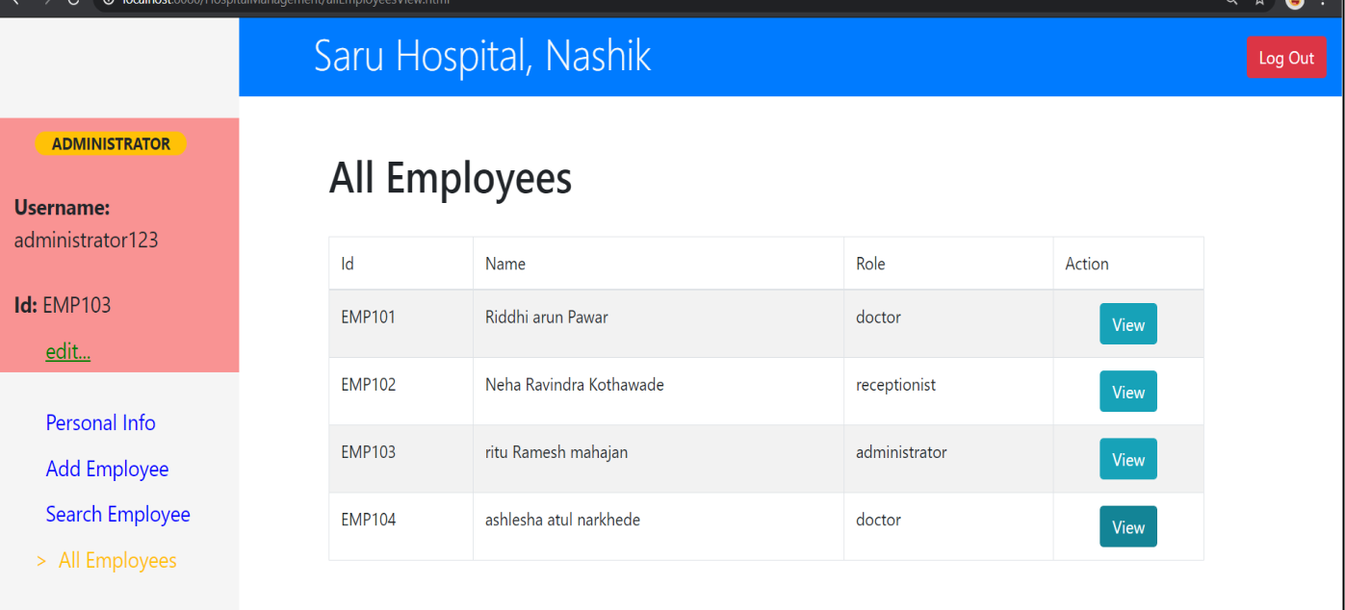
Receptionist Dashboard:-
Admin Dashboard:-

Slide 10
Advantages and Disadvantages
Advantages:
Makes prescription readable and understandable to patients.
Eliminate redundancy in term of data storage.
Reduce the time wasted in retrieving data i.e. in finding a past health records.
Increase Efficiency and Interactivity in any area of specialization in the hospital.
Able to quickly collect and edit data ,summerize results.
Disadvantages:
Patients don’t have any role.
No Live Queue feature.

Slide 11
Conclusion
This project helps in making paperless activities. It reduces the workload from Doctor and Receptionist.
It provides more ease and flexibility to from Doctor, Administrator and Receptionist.
This digitalization has reduce costs of Hospital.
This work has created a little awareness and promotes the idea that the concept of paperless office is reality.

Slide 12
Thank You !

