Slide 1
CPU Lite
5-Stage Pipelined RISC Core with Write-Back Cache

Slide 2

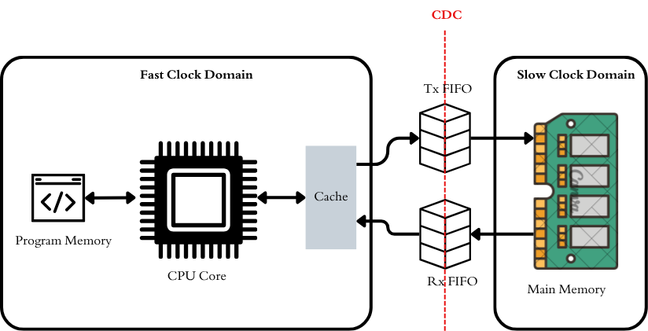


Overview
A 32-bit single-issue RISC CPU with a cached memory system spanning two asynchronous clock domains, designed in synthesizable Verilog.
Objective
Design a RISC CPU that fetches from program memory and accesses data memory only through an L1 cache
Safely connect a fast CPU domain to a slow memory domain
Top mem

Slide 3
Key Specification
Item | Detail
Datapath | 32-bit, 16 registers (R0–R15), 12-bit PC, 4-bit PSR (Z, N, C, V)
ISA | Fixed 32-bit instructions, about 38 instructions (ALU, load/store, branches, shifts)
Fast domain (150 MHz) | CPU core, L1 data cache, program memory (4K × 32)
Slow domain (70 MHz) | Data memory (16K × 32)
Cache | Direct-mapped, write-back with dirty bit, write-allocate
CDC bridge | Async FIFOs, Gray-coded pointers, 2-flop synchronizers (the only domain crossing)

Slide 4
Micro Architecture

Slide 5
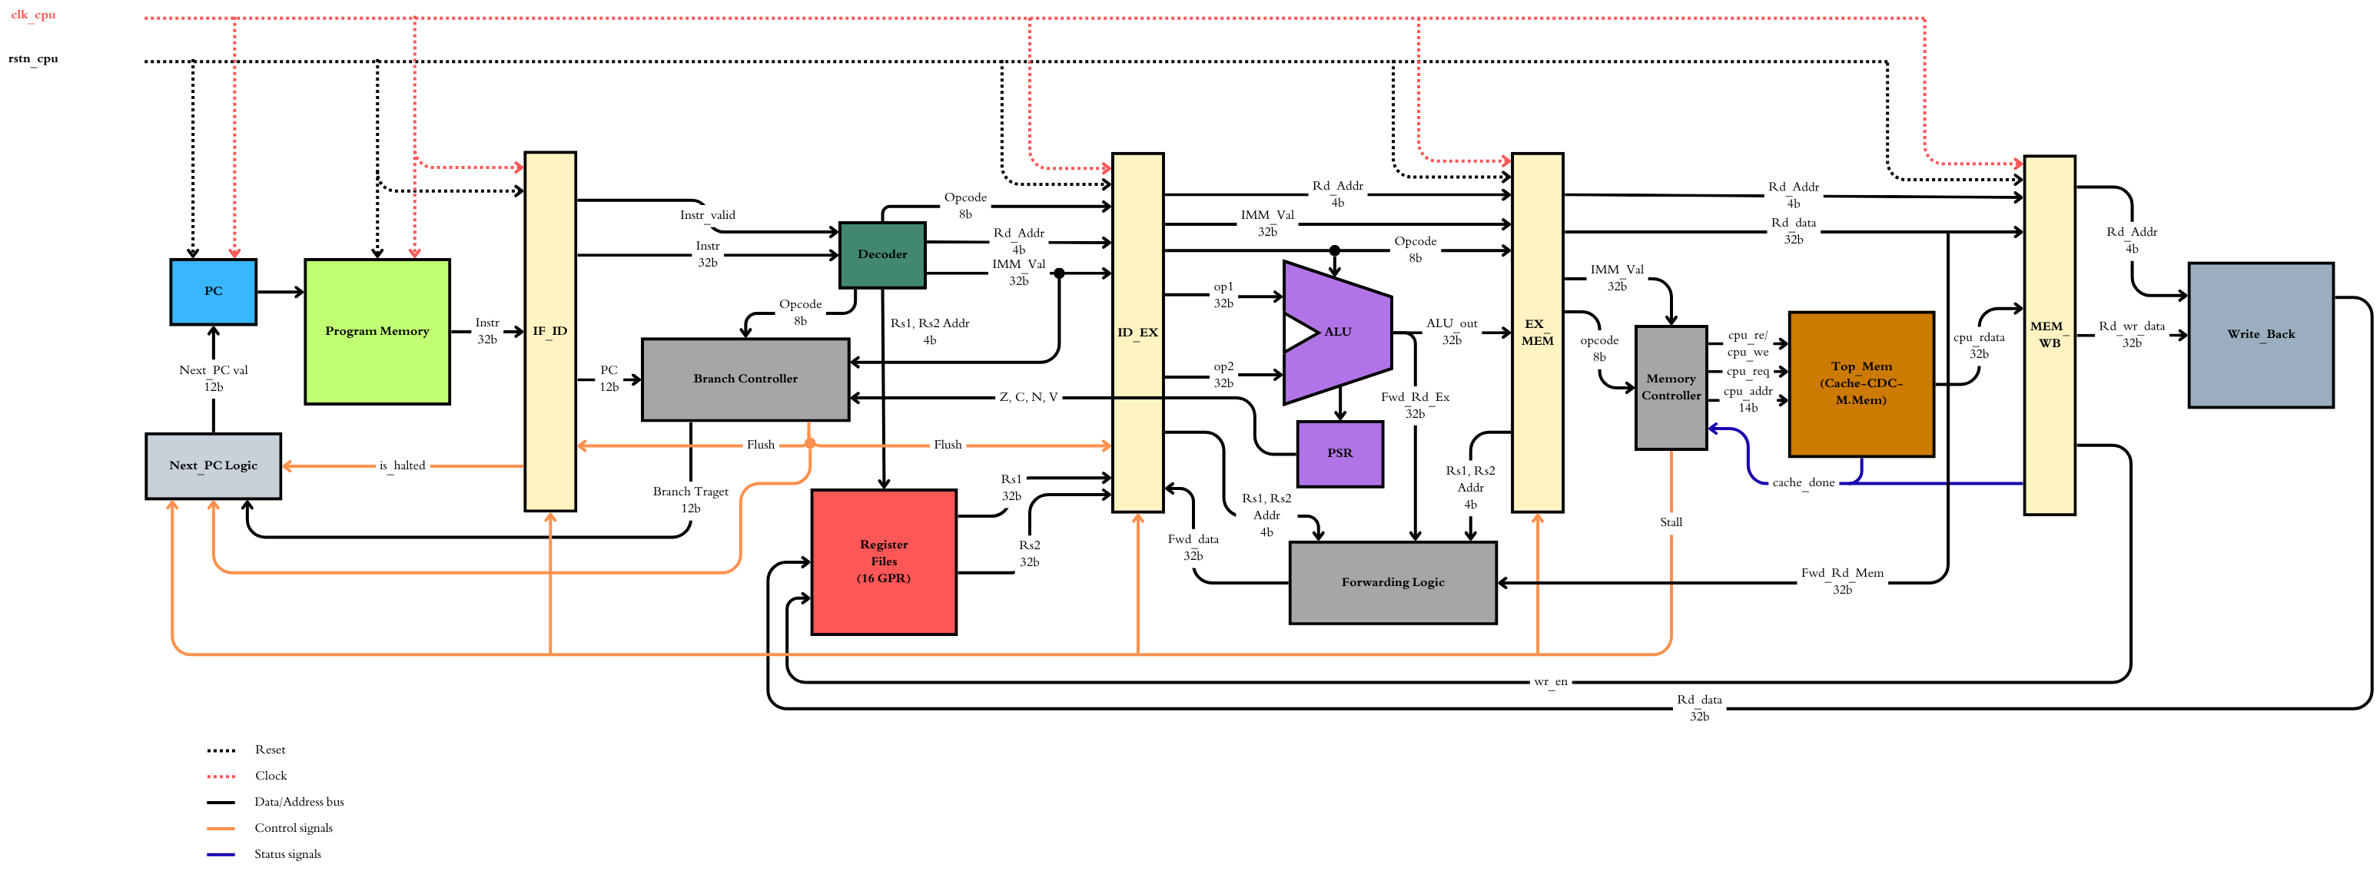
Top mem

Slide 6
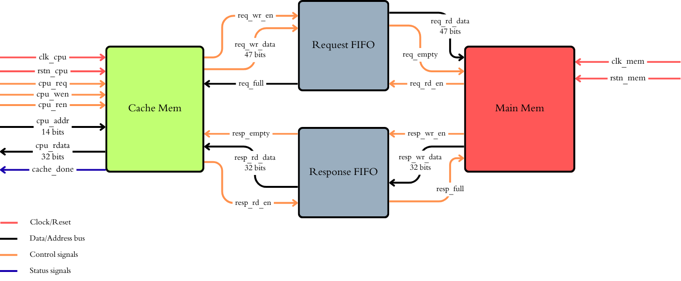

Slide 7
L1 Cache Parameters
Parameter | Value
Mapping | Direct-mapped
Line size | 4 words (128 bits)
Number of lines | 64 (parameterized)
Capacity | 256 words (1 KB)
Address | 14-bit word address
Write policy | Write-back, write-allocate

Slide 8
Cache Behavior
Access | Hit | Miss
Read | Return word in 1 cycle, no memory traffic | Fill line from memory, then return the word
Write | Update word, set dirty, no memory traffic | Fill line (write-allocate), apply write, set dirty
Miss on dirty line | n/a | Write back the old line first, then fill
Address Split:
| Tag [13:8] | Index [7:2] | Offset [1:0] |
-----------------------------------
| 6 bits | 6 bits | 2 bits |

Slide 9
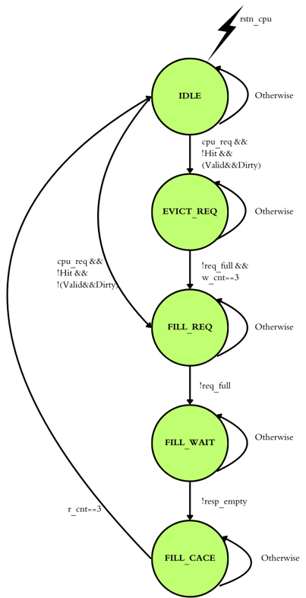
L1 Cache
Controller FSM

Slide 10
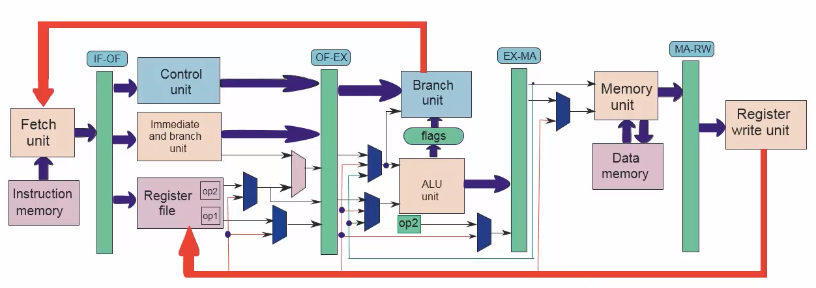
Forwarding Unit

Slide 11
Lint results

Slide 12
CDC results

Slide 13
Synthesis results

Slide 14
STA results

