Slide 1
-THIRD EYE-

Slide 2
GROUP MEMBERS
ABIRAM R
SERAJ AHAMAD
ABDUL BASITH C
KARAN G M
SREELAKSHMI KP
ATHIRA KV
MENTORS
ANGEL NEETHU
ABHIJITH BABU

Slide 3
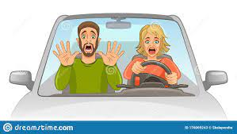
Motivation
The driving is art, elegance and ethics.
The human acts as the key element in this process and the weakest link in the same time
where 90% of traffic accidents are caused by human error and carelessness.

Slide 4
Abstract
Great changes have taken place in automation and machine vision technology in recent years. Meanwhile, the demands for driving safety, efficiency, and intelligence have also increased significantly.Third eye
that reside inside the vehicle and assist the main driver in a variety
of ways. Such as
Detect traffic sign and alert the driver
Detect Pedestrians
Detect vehicles ...etc

Slide 5
-THIRD EYE-
THIRD EYE aims at enabling the driver to master today's traffic in a more safe and comfortable way.
Essential applications of this are,
Pedestrian detection/avoidance
Traffic sign recognition
Blind spot detection

Slide 6
Technologies used
Image processing
This is a system which capture image from the Road and Process the image
extract important information from an image taken by a CCD camera installed at the rear-view mirror in a car
Three main tasks, namely
initial segmentation (object detection)
object tracking
object classification

Slide 7
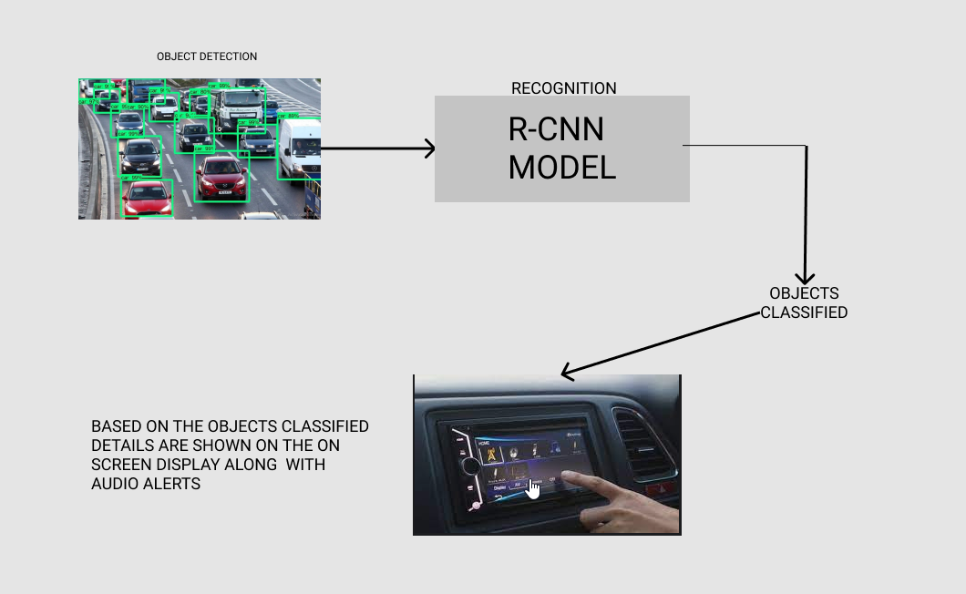
WorkFlow

Slide 8

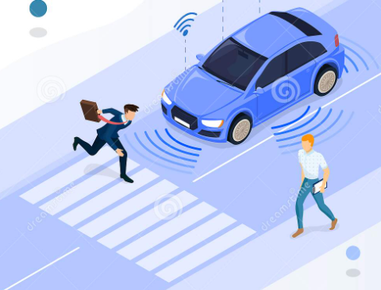
Conti..
Deep Learning
Pooling layer
Convolution + ReLU
OutPut layer
Input
Flatten layer
Dense layer

Slide 9
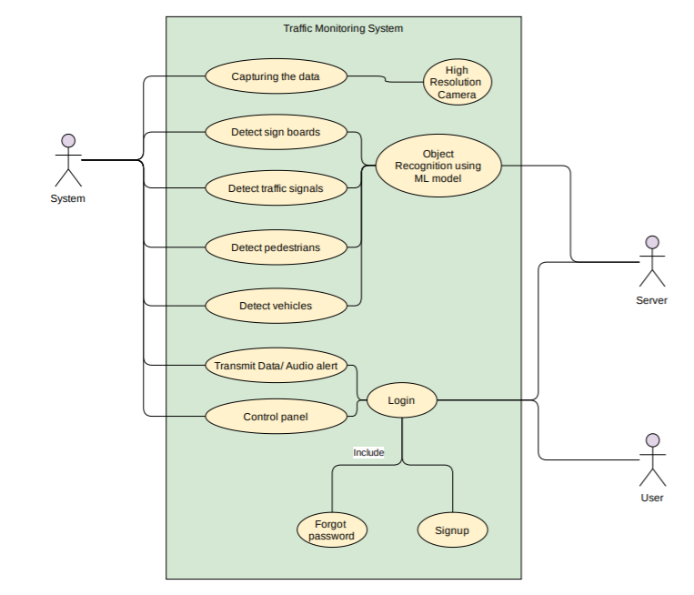
Use case Diagram

Slide 10
Software requirement
NumPy​
Python NumPy is a general-purpose array processing package which provides tools for handling the n-dimensional arrays.It provides various computing tools such as comprehensive mathematical functions, linear algebra routines. ​
Keras​
Keras is an open source deep learning framework for python. Keras runs on top of open source machine libraries like TensorFlow, Theano or Cognitive Toolkit (CNTK).Keras is an APIit minimizes the number of user actions required for common use cases, and it provides clear & actionable error messages.​

Slide 11
Conti.
TensorFlow​
It is used for implementing machine learning and deep learning applications.. TensorFlow is designed in Python programming language, hence it is considered an easy to understand framework.​
Open CV
OpenCV is a huge open-source library for computer vision, machine learning, and image processing. OpenCV supports a wide variety of programming languages like Python, C++, Java, etc. It can process images and videos to identify objects, faces, or even the handwriting of a human.

Slide 12
Hardware Requirement
Processors.
Electronic control units (ECUs)
Microcontroller units (MCUs)
sensors
actuators

Slide 13
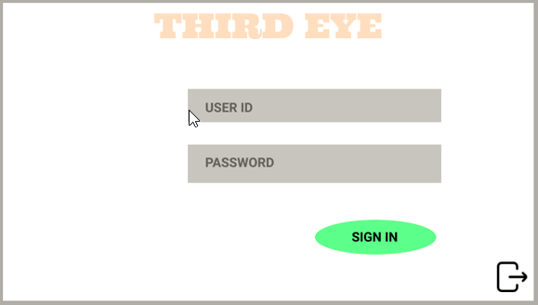
Wireframe

Slide 14
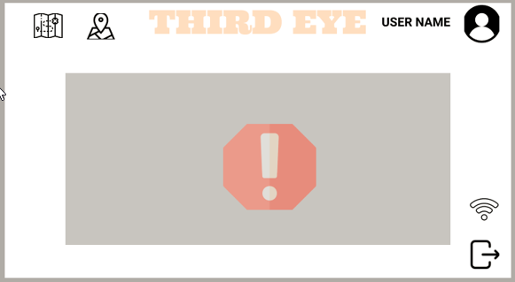
Conti.

Slide 15
Results
Traffic violations will decrease
Reduced journey time
Would be very helpful in autonomous cars
Accidents will decrease

Slide 16
Conclusion
THIRD EYE have tremendous potential to increase the safety, comfort, and effectiveness of our vehicles and transportation systems.
With all the enhanced features and pleasure content that are available in a vehicle, the driver must still focus on driving.
Thus we can ensure that people are safe and we can all have a better future.

Slide 17
Future Plans
Cruise mode
Faster and further object detection
Fully autonomous vehicles

Slide 18
THANK YOU

