Slide 1
PHASE 2 : PROJECT PROBLEM SOLVING AND DESIGN THINKING -INNOVATION
TITLE : AI BASED DIABETES PREDICTION SYSTEMS_PHASE 2
Name : B . Abirame Susee
Roll no:202109
St.Xavier Catholic college of engineering

Slide 2
agenda
Introduction
Problem Definition
Problem Explanation
Design
Machine Learning Classifiers
Types of Machine learning classifiers
Results and Discussion
Algorithm for AI based prediction system using Machine learning
Design Procedure
Conclusion

Slide 3
Introduction
After using the patient records, we are able to build a machine learning model ( random forest – best one ) to accurately predict whether or not the patients in the data set have diabetes or not along with that we cure able to draw some insights from the data via data analysis and visualization.

Slide 4
Problem Definition The problem is to build an AI powered spam classifier that can accurately distinguish between spam and non spam message in email or text messages. The goal is to reduce the number of false positives (classifying legitimate messages as spam) and false negatives (missing actual spam messages) while achieving a high level of accuracy.

Slide 5
Problem Explanation
Diabetes prediction is a classification technique with mutually exclusive possible outcomes either the person is diabetic or non diabetic on careful examination of the performance of techniques used in prevalent works, logistic regression, random forest, decision tree.

Slide 6
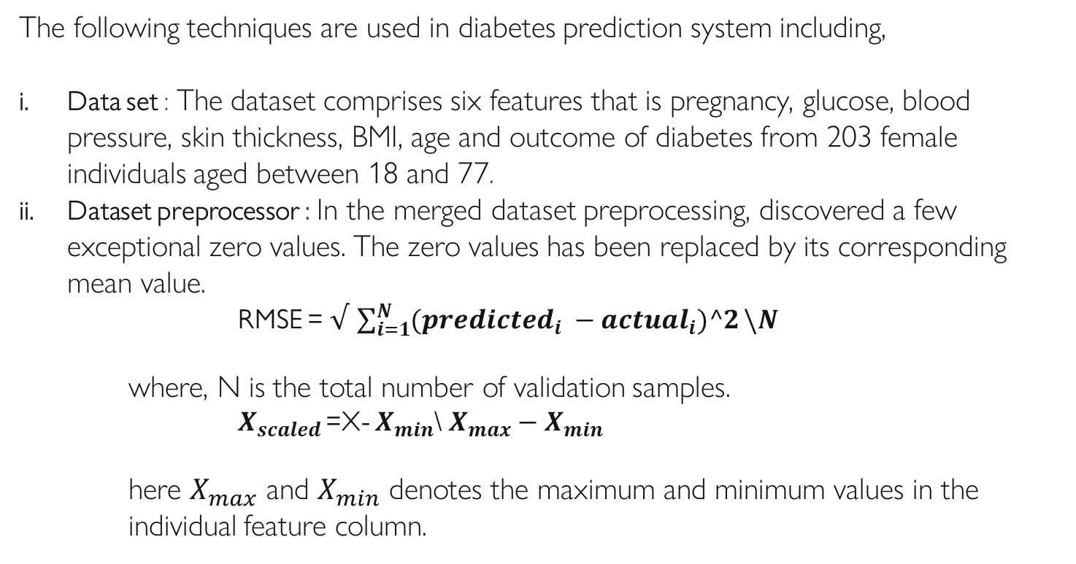
Design
The following techniques are used in diabetes prediction system including,
Data set : The dataset comprises six features that is pregnancy, glucose, blood pressure, skin thickness, BMI, age and outcome of diabetes from 203 female individuals aged between 18 and 77.
Dataset preprocessor : In the merged dataset preprocessing, discovered a few exceptional zero values. The zero values has been replaced by its corresponding mean value.
RMSE = $√$ $\sum_{i=1}^{N}{({predicted}_{i} −{actual}_{i})^2}\backslash N$
where, N is the total number of validation samples.
$X_{scaled }$=X- $X_{min}$\ $X_{max}−X_{min}$
here $X_{max}$ and $X_{min}$ denotes the maximum and minimum values in the individual feature column.

Slide 7
Machine Learning Classifiers Machine learning and ensemble techniques have been employed to implement the automatic diabetes prediction system . Machine Learning are classified into following types . Types of Machine Learning :
Random Forest : Random forest is a machine learning system that averages the predictions of several decision time.
Logistic Regression: Logistic regression can be used to predict a binary class .To predict the outcome , it fits an ‘s’ shaped function.
Ada Boost : Ada boost is an assemble technique . This classifier initially works on the original dataset.

Slide 8
XG Boost : XG Boost is an ensemble machine learning technique based on decision trees that employ a gradient boosting approach. Voting Classifier :I t is an ensemble technique to improve the classification by voting . This paper implemented a voting classifier that selects the majority classifier with ‘soft’ voting hyper parameter. Bagging : Bagging classifiers are ensemble classifiers that fit base classifiers to random subsets of original dataset.

Slide 9
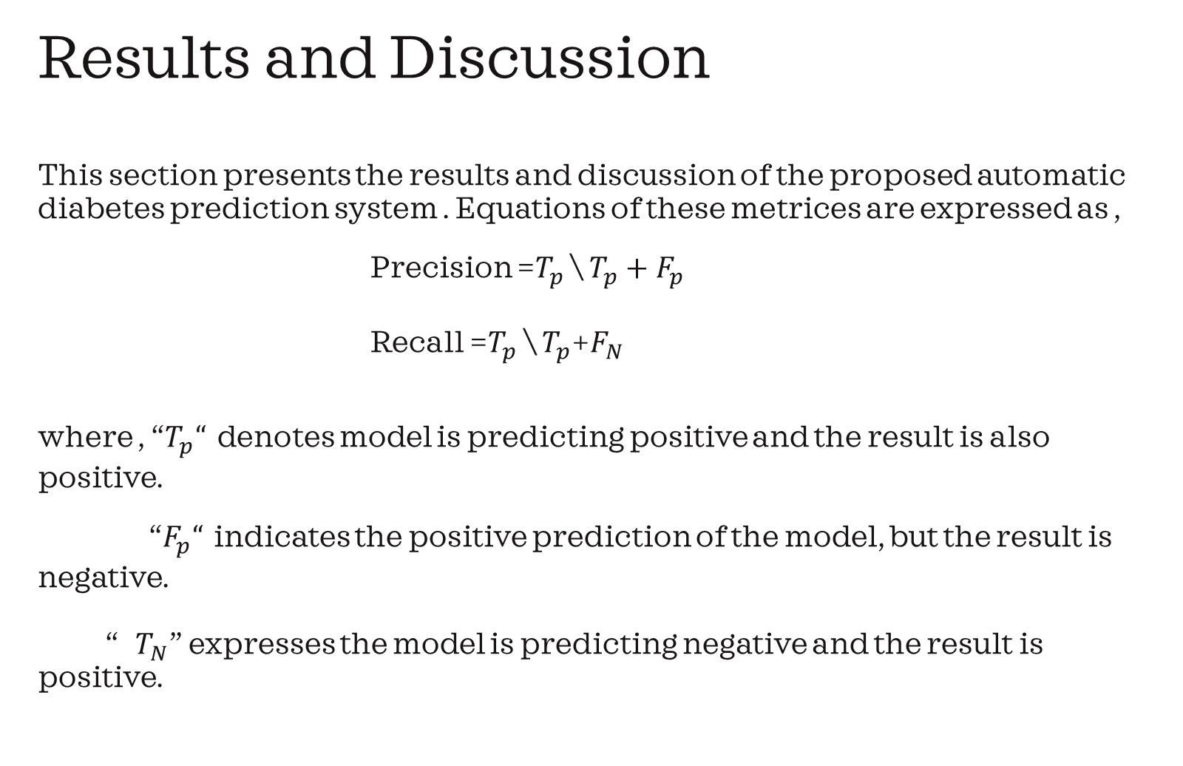
Results and Discussion This section presents the results and discussion of the proposed automatic diabetes prediction system . Equations of these metrices are expressed as , Precision =$T_{p }$\ $T_{p}+F_{p}$ Recall =$T_{p}$ \ $T_{p}$+$F_{N}$ where , “$T_{p}“$ denotes model is predicting positive and the result is also positive. “$F_{p}“$ indicates the positive prediction of the model, but the result is negative. “ $T_{N}$” expresses the model is predicting negative and the result is positive.

Slide 10
Program Importing the necessary librariesimport pandas as pdfrom sklearn.model_selection import train_test_splitfrom sklearn.preprocessing import StandardScalerfrom sklearn.svm import SVC# Loading the datasetdiabetes_data = pd.read_csv("diabetes.csv")# Splitting the dataset into features and target variableX = diabetes_data.drop("Outcome", axis=1)y = diabetes_data["Outcome"]# Splitting the dataset into training and testing setsX_train, X_test, y_train, y_test = train_test_split(X, y, test_size=0.2, random_state=42)# Scaling the featuresscaler = StandardScaler()X_train = scaler.fit_transform(X_train)X_test = scaler.transform(X_test)# Creating and training the SVM classifierclassifier = SVC()classifier.fit(X_train, y_train)# Making predictions on the test setpredictions = classifier.predict(X_test)# Evaluating the modelaccuracy = classifier.score(X_test, y_test)print("Accuracy:", accuracy)

Slide 11
Design Procedure To design an AI based diabetes prediction system using the Pima Indians diabetes database, can follow these general steps: 1. Data preprocessing : clean and preprocess the dataset by handling missing values, normalizing features, and handling outliers if necessary. 2. Feature selection : identify the most relevant features that can contribute to diabetes prediction .You can use techniques like correlation analysis of feature importance ranking. 3.Model selection : choose an appropriate machine learning algorithm for your prediction task , such as logistic regression, decision trees, random forests, or support vector machines.

Slide 12
4.Model Training :Split the dataset into training and testing sets . Train your chosen model on the training data. 5. Model Evaluation : Evaluate the performance of your model using the appropriate evaluation metrices like accuracy, precision, recall, or f1-score. Adjust your model and parameters if needed. 6. Prediction : Use the trained model to make predictions on new, unseen data.

Slide 13
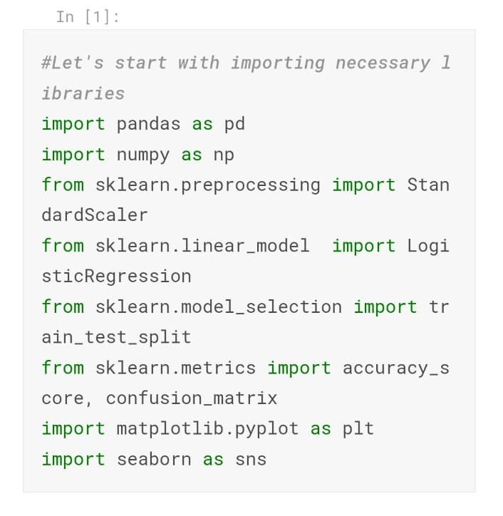
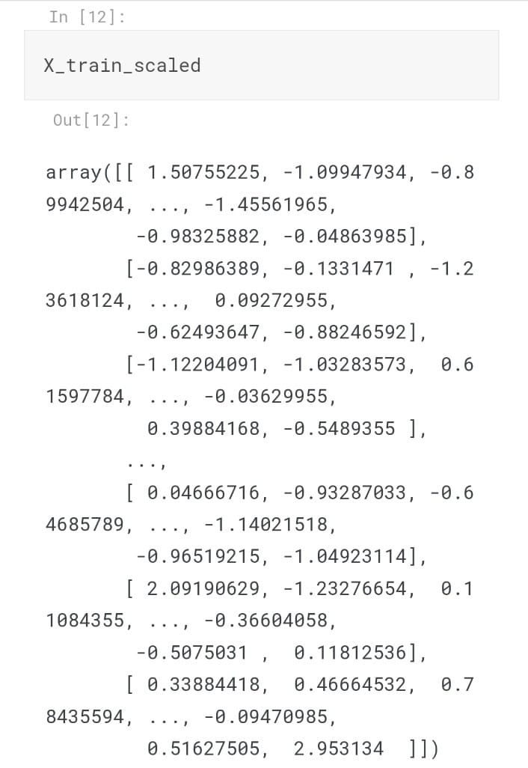
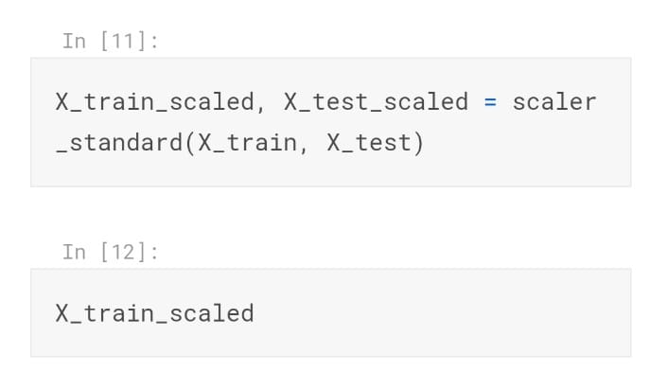
Dataset Programs

Slide 14
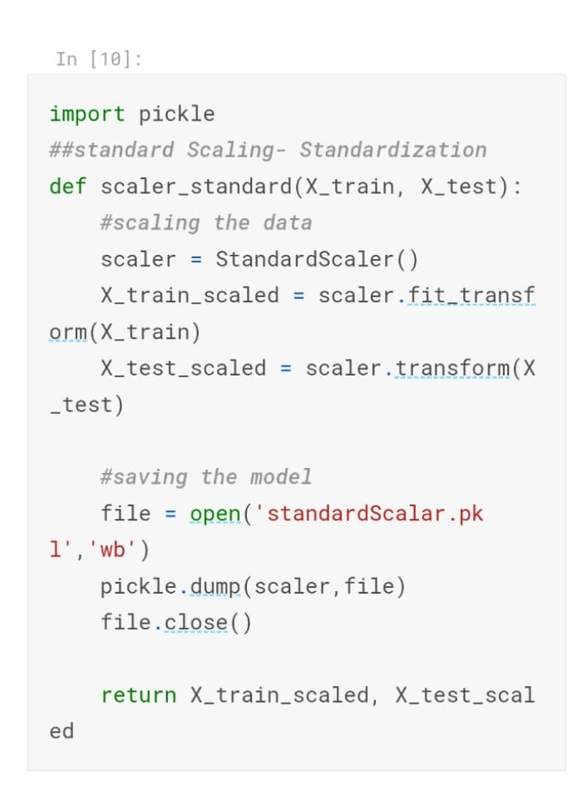
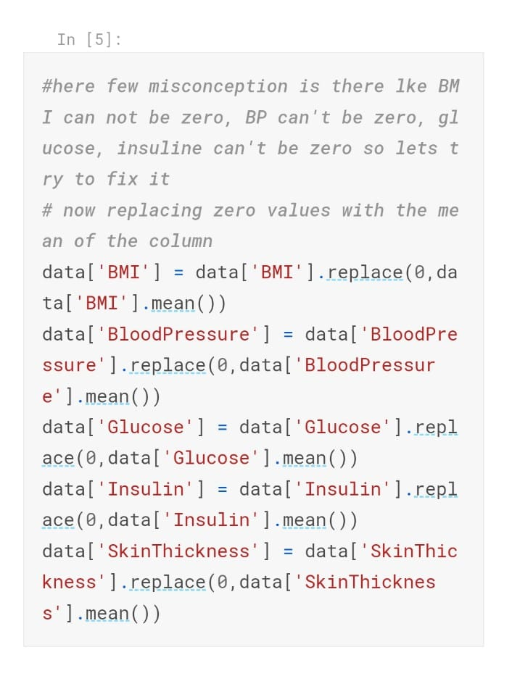
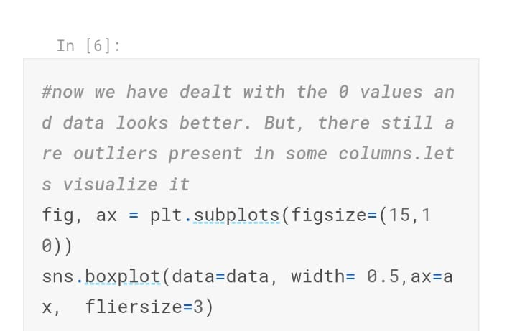

Slide 15
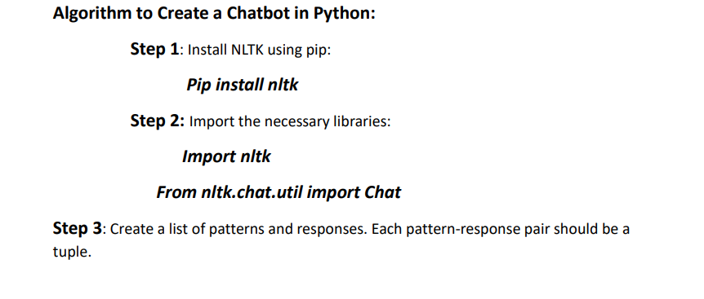
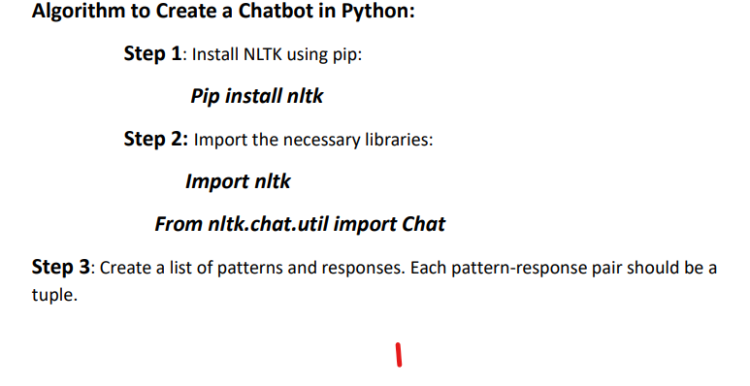

Slide 16
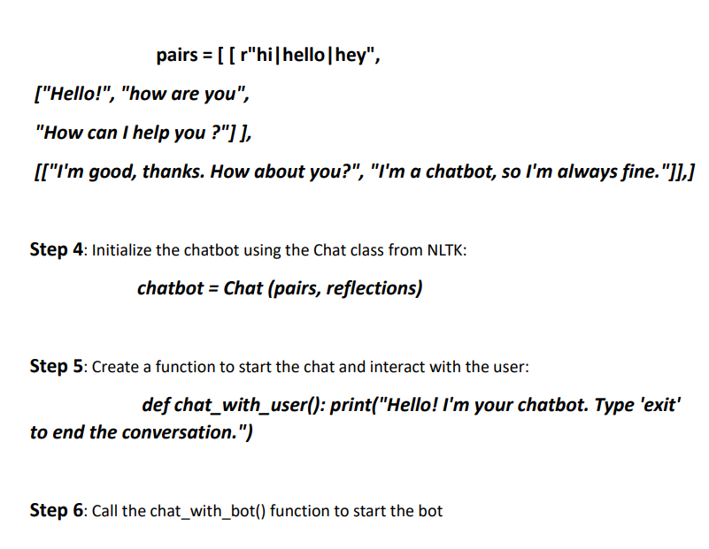

Slide 17
Conclusion The objective of the project was to develop a model with which could identify patients with diabetes who are high risk of the disease . The model makes the prediction with an accuracy of 98%.

