Slide 1



AI DEBUGGER & AUTOFIX COMPLIER
Presented By,
Abirami R(811722104006)
Danupriya S(811722104025)
Elakkiya A(811722104037)
Guided By,
Mrs.A.Thenmozhi , M.E.,
10/06/2025

Slide 2
ABSTRACT
Traditional debugging and compilation processes can be time-consuming, labor-intensive, and prone to human error.
An innovative AI-powered debugger and auto-fix compiler designed to revolutionize code remediation.
Leveraging large language model identifies bugs, suggests fixes, and automatically compiles corrected code.
10/06/2025

Slide 3
OBJECTIVE
To develop an intelligent compiler system integrated with AI-driven debugging capabilities that can automatically detect, analyze, and fix syntax and logical errors in source code.
This aims to enhance developer productivity and reduce debugging , suggest and implement real-time code corrections and optimizations.
10/06/2025

Slide 4
LITERATURE SURVEY
S.No. | Paper Title | Year | Remark
1 | Break-It-Fix-It: Unsupervised Learning for Program Repair | 2021 | Unsupervised bug fixing
2 | Getafix: Learning to Fix Bugs Automatically | 2019 | Learned fix suggestions
3 | BatFix: Repairing Language Model-Based Transpilation | 2024 | Transpilation bug repair
10/06/2025

Slide 5
LITERATURE SURVEY
S.No. | Paper Title | Year | Remark
4 | TransRepair: Context-Aware Program Repair for Compilation Errors | 2022 | Context-aware repair
5 | GenProg: A Generic Method for Automatic Software Repair | 2012 | Evolutionary bug fixing
6 | Automatic Program Bug Fixing by Focusing on Finding the Shortest Sequence of Changes | 2024 | Minimal edit sequence
10/06/2025

Slide 6
LITERATURE SURVEY
S.No. | Paper Title | Year | Remark
7 | Explainable Automated Debugging via Large Language Model–Driven Scientific Debugging | 2024–2025 | Explainable,LLM-driven, Interactive
8 | ROSE: An IDE-Based Interactive Repair Framework for Debugging | 2025 | AI-powered, IDE-integrated semantic repair.
9 | CodeBERT for Automated Program Repair of Java Bug | 2021 | Transformer-based, precise Java bug fixer
10/06/2025

Slide 7
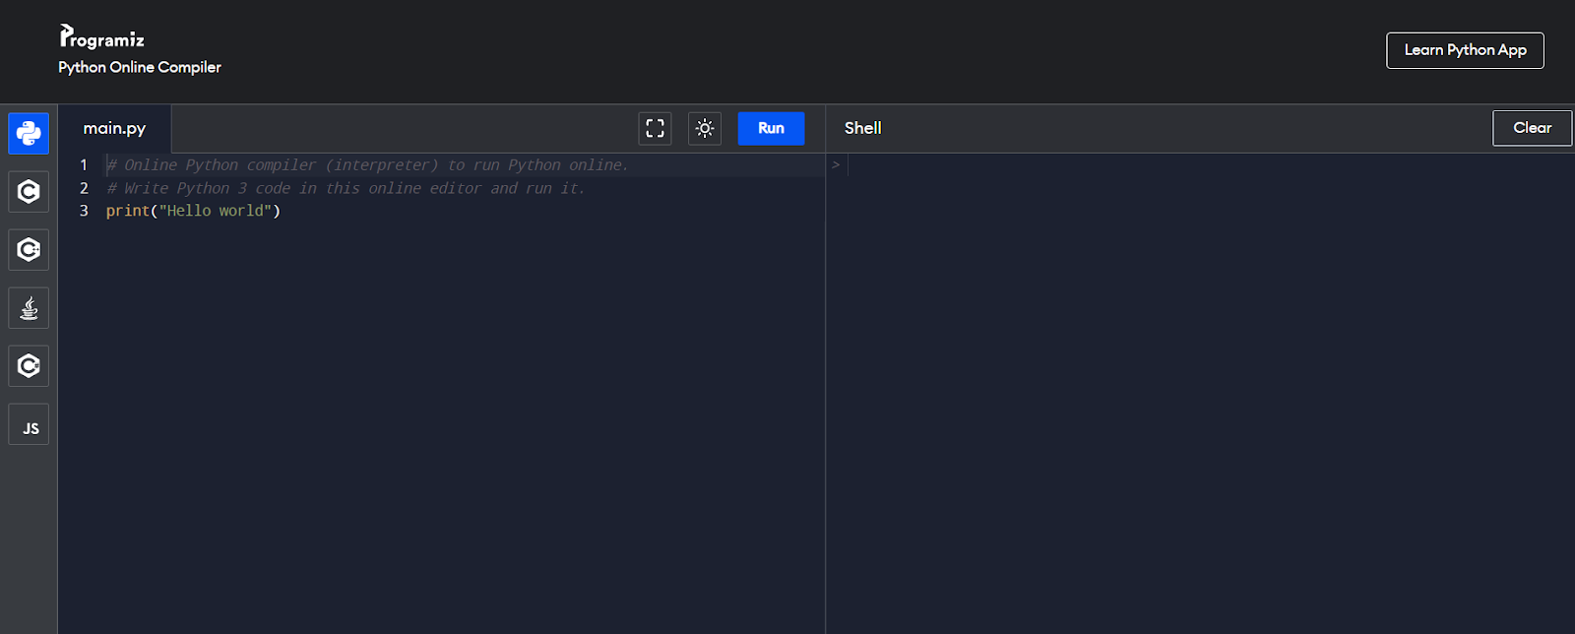
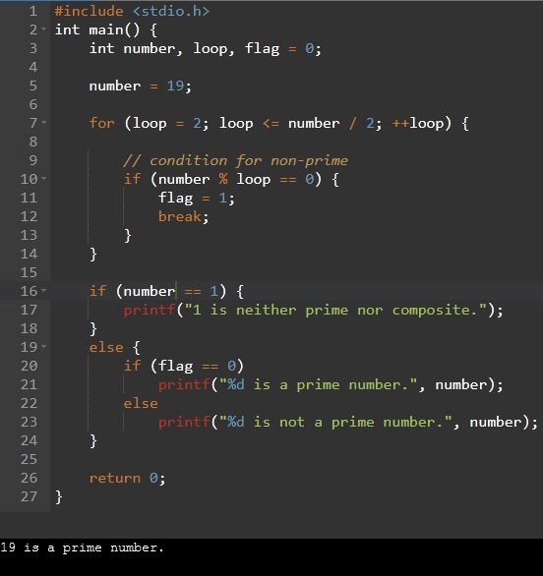
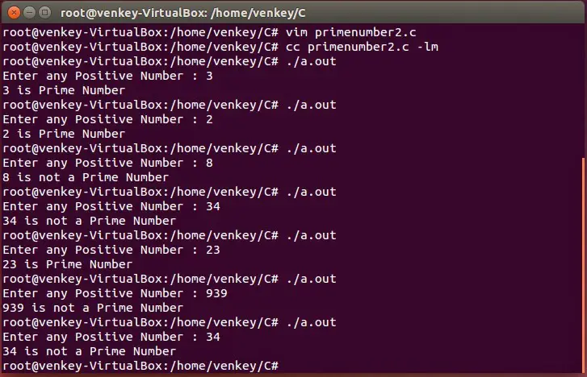
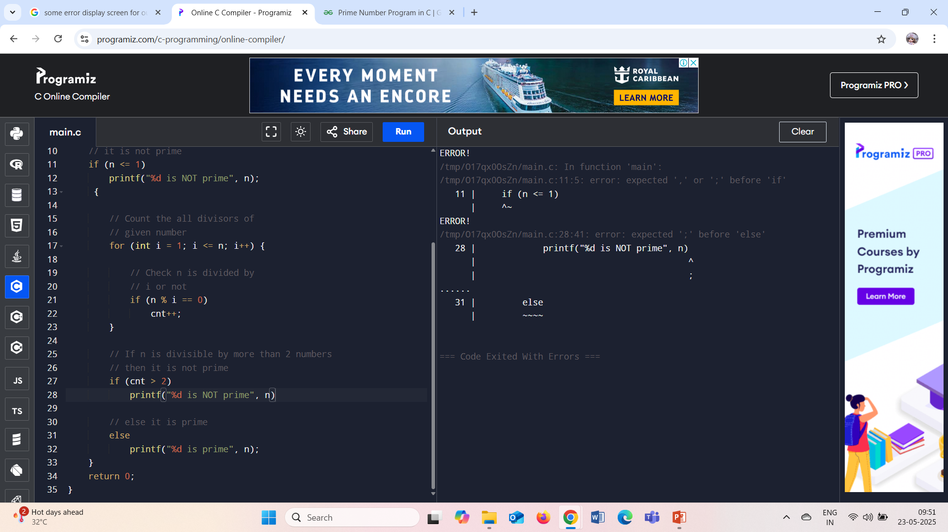
EXISTING SYSTEM
Open a compiler
Type your program
Output is executed in compiler
If error occurred
10/06/2025

Slide 8
PROPOSED SYSTEM
Initially a text editor is created where the code has to be typed.
Later a compiler is created and it is integrated with LLM where we can process our code if any error is found in our program then it is being processed and error is been identified and the suggestion is given as an output and also the rectified program is also given.
10/06/2025

Slide 9
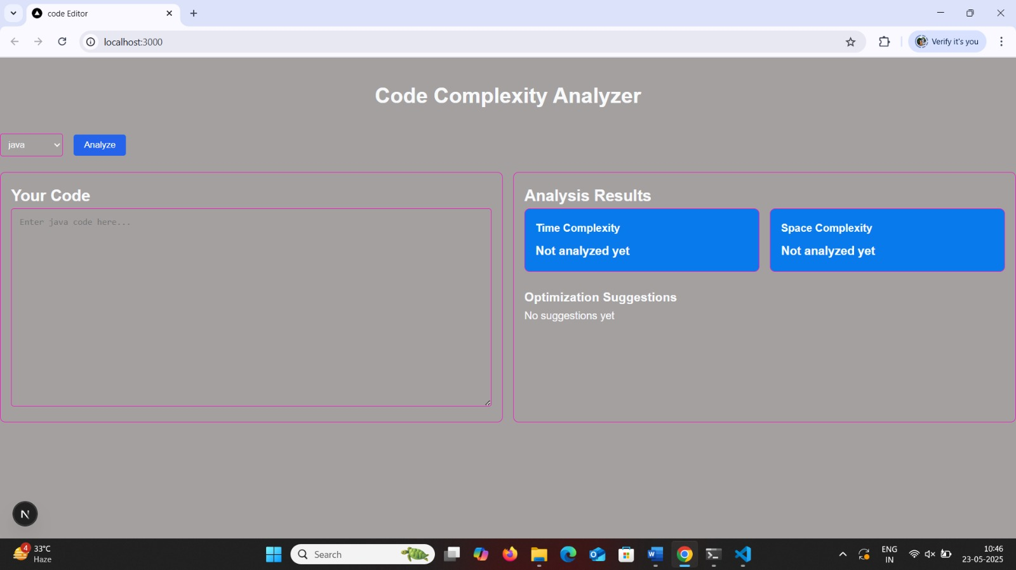
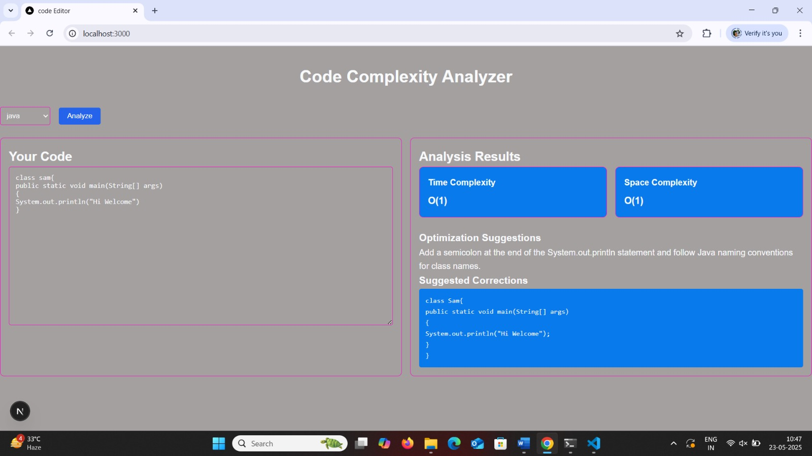
SYSTEM ARCHITECTURE
Open a compiler
Type your program
Output is executed with suggestions
10/06/2025

Slide 10
MODULE 1 :TEXTEDITOR (OR) CODE PLATFORM
A platform is created where the program is typed and processed.
Text editors are commonly used by developers to write and edit source code in various programming languages. They provide essential functionalities .
It refers to the environment or toolset used to write, edit, compile, and run computer programs. It can be of any languages C, C++, Java, Python etc….
10/06/2025

Slide 11
MODULE 2 :COMPILER(TERMINAL)
A compiler is a special type of computer program that translates code written in a high-level programming language (like C, C++, or Java) into machine language (binary code) that a computer’s hardware can understand and execute.
The different language such as C,C++,Java , Python etc.. programs can be compiled .
10/06/2025

Slide 12
MODULE 3 :INTERGETING LARGE LANGUAGE MODEL
In this module the compiler which is created in the previous module is Integrated with the Large Language Models (LLMs) with AI debuggers and auto-fix compilers enables the analysis of code and detection of errors using natural language processing techniques.
Here , LLMs can be fine-tuned for code understanding, allowing them to provide more accurate error detection, automated fixes, and code completion suggestions, improving overall code quality and development efficiency.
10/06/2025

Slide 13
MODULE 4 :AUTOFIX SUGGESTION ENGINE
An auto-fix suggestions engine uses code analysis techniques to provide automated fix suggestions for coding errors, reducing debugging time and effort.
The engine detects errors, predicts the root cause, and suggests corrections, enabling developers to quickly identify and fix issues, improving overall code quality and reliability.
10/06/2025

Slide 14
MODULE 5 :INTELLIGENT DEBUGGER
An intelligent debugger predicts and detect errors, allowing developers to identify and fix issues before they become major problems.
The debugger provides automated root cause analysis, enabling developers to quickly understand the underlying causes of errors and make informed decisions to fix them.
It displays your final output and if it has any errors , then it gives you corrected code with necessary suggestions.
10/06/2025

Slide 15
OUTPUT
10/06/2025

Slide 16
OUTPUT
10/06/2025

Slide 17
CONCLUSION & FUTURE ENHANCEMENT
The integration of artificial intelligence in debugging and automatic program repair has significantly transformed software development, enabling faster and more accurate bug detection and correction.
AI-based debuggers and autofix compilers leverage machine learning, deep learning, and program analysis techniques to understand code patterns, predict errors, and suggest or implement fixes with minimal human intervention.
These systems not only improve development efficiency but also enhance code quality by reducing human error and shortening debugging cycles.
10/06/2025

Slide 18
REFERENCES
White, M., Tufano, M., Vendome, C., & Poshyvanyk, D. (2019). SequenceR: Sequence-to-sequence learning for end-to-end program repair. IEEE Transactions on Software Engineering.
Yasunaga, M., & Liang, P. (2021). Break-it-fix-it: Unsupervised learning for program repair. In Proceedings of the 38th International Conference on Machine Learning (ICML).
Bader, J., Scott, A., Pradel, M., & Chandra, S. (2019). Getafix: Learning to fix bugs automatically. In Proceedings of the ACM on Programming Languages (OOPSLA).
Xie, Y., Du, Y., & Jin, Z. (2020). Automated program-semantic defect repair and false-positive elimination without side effects. Symmetry, 12(12), 2076.
Soares, G., Silva, R. S., & Gheyi, R. (2024). BatFix: Repairing language model-based transpilation. ACM Transactions on Software Engineering and Methodology.
10/06/2025

Slide 19

DD/MM/YYYY

