Slide 1
S.A. ENGINEERING COLLEGE- CHENNAI-77
(Autonomous- Institute Level Research Centre, Affiliated to Anna University)
DEPARTMENT OF ARTIFICIAL INTELLIGENCE & DATA SCIENCE
AD1703A - Project Phase-1
ZEROTH REVIEW
TITLE : AERIS
An Explainable Reasoning and Investigation System for Intelligent Aerospace Maintenance
BATCH NUMBER : 02
TEAM MEMBERS | SUPERVISOR
111923AI01003 – ABIRAMI M 111923AI01022 – DEVISHRI S | Mrs. NATHIYA M, Assistant Professor, Department of AI&DS

Slide 2
Agenda
Introduction
Base Paper [ IEEE Transactions, ACM, springer, etc.. Note: base paper should not be conference or survey paper]
Abstract
Scope and Motivation
Literature Survey [ Authors, year, journal/conference name, findings, limitations in table - min 10 papers]
Objectives / Problem Statement [ Minimum 3 objectives]
SDG Mapping and description
Proposed Work
  Architecture Diagram/Flow Diagram/Block Diagram
  Modules
  Module Description
Software & Hardware Requirements
References [ should include 10 references and follow MLA/ IEEE format ]

Slide 3
Introduction
Aircraft component failures pose significant challenges to aviation safety, operational reliability, and maintenance costs. AERIS is an AI-powered Evidence-Driven Investigation Platform that goes beyond conventional predictive maintenance by identifying not only what is likely to fail, but also why it is failing. By intelligently fusing aircraft sensor data, maintenance history, operational context, and engineering knowledge, the system reconstructs the most probable failure narrative and generates explainable insights with actionable maintenance recommendations, enabling engineers to make faster, more informed decisions while enhancing aircraft safety and reducing unexpected failures.

Slide 4
Base Paper
TITLE : Fault inference diagnosis based on causal network and large language model-enhanced knowledge graph network
YEAR : 2026
JOURNAL NAME: Chinese Journal of Mechanical Engineering
ARTICLE TYPE : Original Research Article
The base paper proposes a CN-LLM-KGN framework that integrates Causal Networks (CN), Knowledge Graphs (KG), and Large Language Models (LLMs) to perform fault diagnosis and root cause localization in rotating machinery. It improves explainability by identifying causal relationships behind equipment failures and achieved 81.12% root cause localization accuracy.

Slide 5
Abstract
Aircraft component failure investigation is critical for ensuring aviation safety and operational reliability. AERIS is an AI-powered Evidence-Driven Aircraft Investigation Platform that predicts potential failures while identifying the underlying causes through intelligent evidence fusion. By integrating aircraft sensor data, maintenance history, operational context, and engineering knowledge, the system generates explainable root-cause analysis, evidence-backed maintenance recommendations, and comprehensive investigation reports. It is designed to support maintenance engineers with transparent, reliable, and intelligent decision-making.

Slide 6
Scope and Motivation
Scope: AERIS predicts and investigates aircraft component failures using AI by integrating sensor data, maintenance history, and operational records. It provides explainable root-cause analysis, evidence-backed recommendations, and intelligent investigation reports for maintenance engineers.
Motivation: To improve aviation safety by developing a transparent AI system that not only predicts failures but also explains why they occur. This enables faster maintenance decisions, reduces unexpected failures, and improves aircraft reliability.

Slide 7
Literature Survey
S no | Title of the Paper | Year | Journal/ Conference | Inferences/Findings | Limitations
1 | Fault Inference Diagnosis Based on Causal Network and Large Language Model-Enhanced Knowledge Graph Network | 2026 | Chinese Journal of Mechanical Engineering | Improved root cause localization using CN + LLM + Knowledge Graph with explainable reasoning. | Limited to rotating machinery; not designed for aerospace systems.
2 | Aircraft Engine Root Cause Analysis (Nature Paper) | 2026 | Scientific Reports | Improved aircraft fault diagnosis using graph reasoning. | No LLM or RAG integration.
3 | DiagLLM: Multimodal Reasoning with Large Language Model for Explainable Bearing Fault Diagnosis | 2025 | Science China Information Sciences | Uses LLM for explainable fault diagnosis through multimodal reasoning. | Focused only on bearing faults; lacks multi-source evidence fusion.
4 | Causal Inference-Enabled Graph Neural Networks for Generalized Fault Diagnosis in Industrial IoT Systems | 2025 | Information Sciences | Applies causal inference with GNNs for generalized industrial fault diagnosis. | Industrial IoT focused; no knowledge retrieval or report generation.

Slide 8
Literature Survey
S no | Title of the Paper | Year | Journal/ Conference | Inferences/Findings | Limitations
6 | Large Language Model Assisted Fine-Grained Knowledge Graph Construction for Robotic Fault Diagnosis | 2025 | Advanced Engineering Informatics | Uses LLMs to enhance Knowledge Graph construction for diagnosis. | Focused on KG construction rather than complete investigation.
7 | Causal Discovery for Rolling Bearing Fault Under Missing Data: From the Perspective of Causal Effect and Information Flow | 2025 | IEEE Transactions on Instrumentation and Measurement | Discovers causal relationships from incomplete sensor data. | Limited to causal discovery; lacks recommendation and reporting.
8 | An Interpretable Integration Fusion Time-Frequency Prototype Contrastive Learning for Machine Fault Diagnosis with Limited Labeled Samples | 2025 | Information Fusion | Improves diagnosis accuracy using interpretable time-frequency learning. | Focuses on classification; no root cause investigation.
9 | A Trustworthy Lightweight Multi-Expert Wavelet Transformer for Rotating Machinery Fault Diagnosis | 2025 | Mechanical Systems and Signal Processing | Uses lightweight Transformer for accurate rotating machinery fault diagnosis. | Concentrates on prediction only; lacks explainable investigation and evidence fusion.

Slide 9
Objectives
The main objective of AERIS is to develop an AI-powered Aircraft Investigation Platform that predicts potential component failures and explains their root causes using evidence-driven AI. The system provides explainable insights and maintenance recommendations to support better decision-making.
Objective 1 : To Predict potential aircraft component failures..
Objective 2 : To Identify the root cause using multiple evidence sources.
Objective 3 : To Generate explainable maintenance recommendations and investigation reports.

Slide 10
Problem Statement
Aircraft component failures can compromise aviation safety, increase maintenance costs, and cause unexpected operational delays. Existing systems mainly predict failures or detect anomalies but often fail to explain why a failure is occurring or provide evidence-backed maintenance recommendations. AERIS addresses this by delivering explainable, evidence-driven failure investigation with root-cause analysis and intelligent maintenance recommendations for engineers.

Slide 11
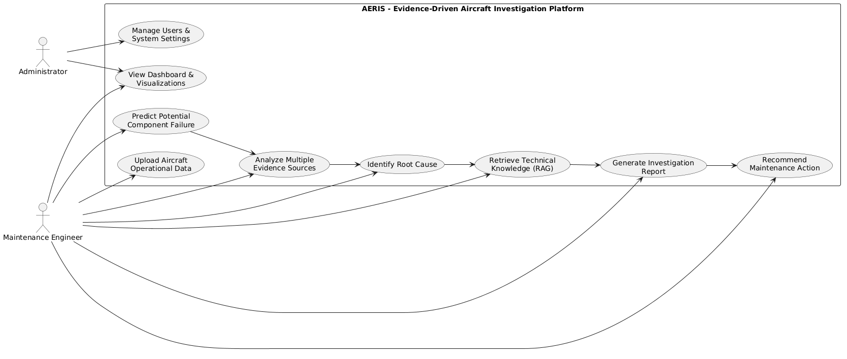
Proposed Work-Block Diagram

Slide 12
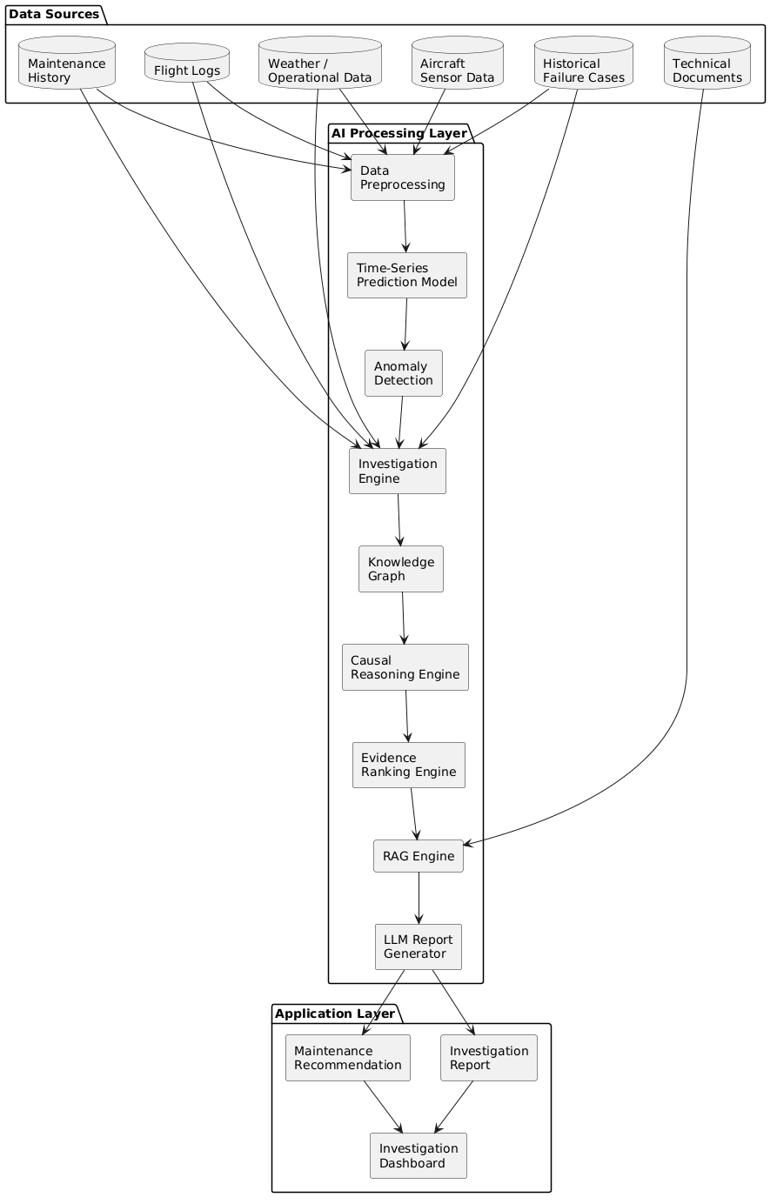
Architecture Diagram

Slide 13
Modules
Module 1 – Data Collection & Preprocessing
Module 2 – Failure Prediction
Module 3 – Investigation & Root Cause Analysis
Module 4 – Report Generation & Maintenance Recommendation

Slide 14
Proposed-Module Description
Module 1 – Data Collection & Preprocessing
Purpose: Collect and prepare aircraft operational data.
How it Works: Integrates sensor data, maintenance records, flight logs, and weather information, then cleans and transforms them into structured features.
Outcome: A high-quality dataset ready for AI analysis.
Module 2 – Failure Prediction
Purpose: Predict potential aircraft component failures.
How it Works: A Time-Series AI model analyzes historical patterns and detects anomalies to estimate failure risk.
Outcome: Early warnings with predicted failure probability and confidence score.

Slide 15
Proposed-Module Description
Module 3 – Evidence-Driven Investigation
Purpose: Identify the root cause behind predicted failures.
How it Works: The Investigation Engine combines maintenance history, operational context, and causal relationships to reconstruct the chain of evidence.
Outcome: Explainable root cause with supporting evidence and confidence level.
Module 4 – Recommendation & Report Generation
Purpose: Assist engineers in making maintenance decisions.
How it Works: RAG and an LLM retrieve relevant technical knowledge and generate evidence-based maintenance recommendations.
Outcome: A clear investigation report with actionable maintenance suggestions.

Slide 16
Software Requirements
Operating System: Windows 10/11 or Ubuntu
Programming Language: Python 3.11+
IDE: Visual Studio Code / Jupyter Notebook
Database: SQLite / PostgreSQL
Libraries & Frameworks:
    Pandas, NumPy – Data processing
    Scikit-learn – Machine Learning
    PyTorch – Time-Series Transformer
    NetworkX / Neo4j – Knowledge Graph
    LangChain – RAG Pipeline
    FAISS – Vector Database
    Hugging Face Transformers – LLM Integration
    Matplotlib, Seaborn – Visualization
    Streamlit – Dashboard Development

Slide 17
References
[1] Z. Guo, Z. Liu, E. Estupiñan, and D. Cabrera, “Fault Inference Diagnosis Based on Causal Network and Large Language Model-Enhanced Knowledge Graph Network,” Chinese Journal of Mechanical Engineering, vol. 39, Art. no. 100162, 2026.
[2] J. Wang, T. Li, Y. Yang, et al., “DiagLLM: Multimodal Reasoning with Large Language Model for Explainable Bearing Fault Diagnosis,” Science China Information Sciences, vol. 68, no. 1, 2025.
[3] S. Zheng, K. Pan, J. Liu, et al., “Empirical Study on Fine-Tuning Pre-trained Large Language Models for Fault Diagnosis of Complex Systems,” Reliability Engineering & System Safety, vol. 252, Art. no. 110382, 2024.
[4] Z. Zhang, Q. Li, S. Liu, et al., “Causal Inference-Enabled Graph Neural Networks for Generalized Fault Diagnosis in Industrial IoT Systems,” Information Sciences, vol. 694, Art. no. 121719, 2025.
[5] Z. Mao, H. Wang, B. Jiang, et al., “Graph Convolutional Neural Network for Intelligent Fault Diagnosis of Machines via Knowledge Graph,” IEEE Transactions on Industrial Informatics, vol. 20, no. 5, pp. 7862–7870, 2024.

Slide 18
References
[6] X. Liao, C. Chen, Z. Wang, et al., “Large Language Model Assisted Fine-Grained Knowledge Graph Construction for Robotic Fault Diagnosis,” Advanced Engineering Informatics, vol. 65, Art. no. 103134, 2025.
[7] X. Ding, H. Wu, J. Wang, et al., “Causal Discovery for Rolling Bearing Fault Under Missing Data: From the Perspective of Causal Effect and Information Flow,” IEEE Transactions on Instrumentation and Measurement, vol. 74, pp. 1–17, 2025.
[8] Y. Dong, H. Jiang, X. Wang, et al., “An Interpretable Integration Fusion Time-Frequency Prototype Contrastive Learning for Machine Fault Diagnosis with Limited Labeled Samples,” Information Fusion, vol. 124, Art. no. 103340, 2025.
[9] D. Song, F. Zhang, M. Lu, et al., “DTransE: Distributed Translating Embedding for Knowledge Graph,” IEEE Transactions on Parallel and Distributed Systems, vol. 32, no. 10, pp. 2509–2523, 2021.
[10]Y. Dong, H. Jiang, M. Mu, et al., “A Trustworthy Lightweight Multi-Expert Wavelet Transformer for Rotating Machinery Fault Diagnosis,” Mechanical Systems and Signal Processing, vol. 235, Art. no. 112945, 2025.

