Slide 1
Mini Job Portal Project
ABIRAMI RAMESH-43111190

Slide 2
Abstract
The Mini Job Portal project is a web-based application designed to connect job seekers and employers on a common platform. It allows users to register, upload resumes, and apply for jobs, while employers can post job openings and review applications. The project integrates basic ATS (Applicant Tracking System) features to filter resumes based on skills and keywords for faster recruitment.

Slide 3
Existing System
Job seekers depend on multiple online portals or manual applications.
Recruiters spend time sorting and filtering each resume manually.
No automation or tracking of applicant status.
Difficult for job seekers to know real-time job availability.
High chances of missing potential candidates due to unorganized data.

Slide 4
Proposed System
Developed an integrated web-based platform for job seekers and employers.
Allows users to register, log in, and manage profiles easily.
Employers can post job openings and review applications instantly.
Built-in ATS scans resumes and matches keywords automatically.
Provides faster recruitment, improved accuracy, and centralized access.

Slide 5
Advantages
Centralized job and applicant management
Automated resume screening using ATS
Faster job search and recruitment
Reduces human error
Easy access for both job seekers and recruiters

Slide 6
Disadvantages
Internet connection required
Limited ATS accuracy compared to AI-based systems
Data security and privacy concerns
Maintenance and server cost for hosting

Slide 7
Hardware Requirements
Processor: Intel Core i3 or higher
RAM: 4 GB minimum
Hard Disk: 500 GB or above
Internet connection for web access

Slide 8
Software Requirements
Operating System: Windows/Linux
Server: Apache Tomcat 9.0
IDE: Eclipse / IntelliJ IDEA
Backend: Java Servlet, JSP
Database: MySQL
Frontend: HTML, CSS, JS

Slide 9
Modules
1. User Registration & Login
2. Resume Upload
3. Job Posting
4. Job Search & Apply
5. ATS Resume Screening
6. Admin Dashboard

Slide 10
Module Description
Registration & Login: Enables job seekers and employers to register and log in securely.
Resume Upload: Allows candidates to upload resumes in PDF format.
Job Posting: Employers can add job details and publish openings.
ATS Screening: Automatically analyzes resumes for keyword matches.
Admin Dashboard: Monitors users and job activities.

Slide 11
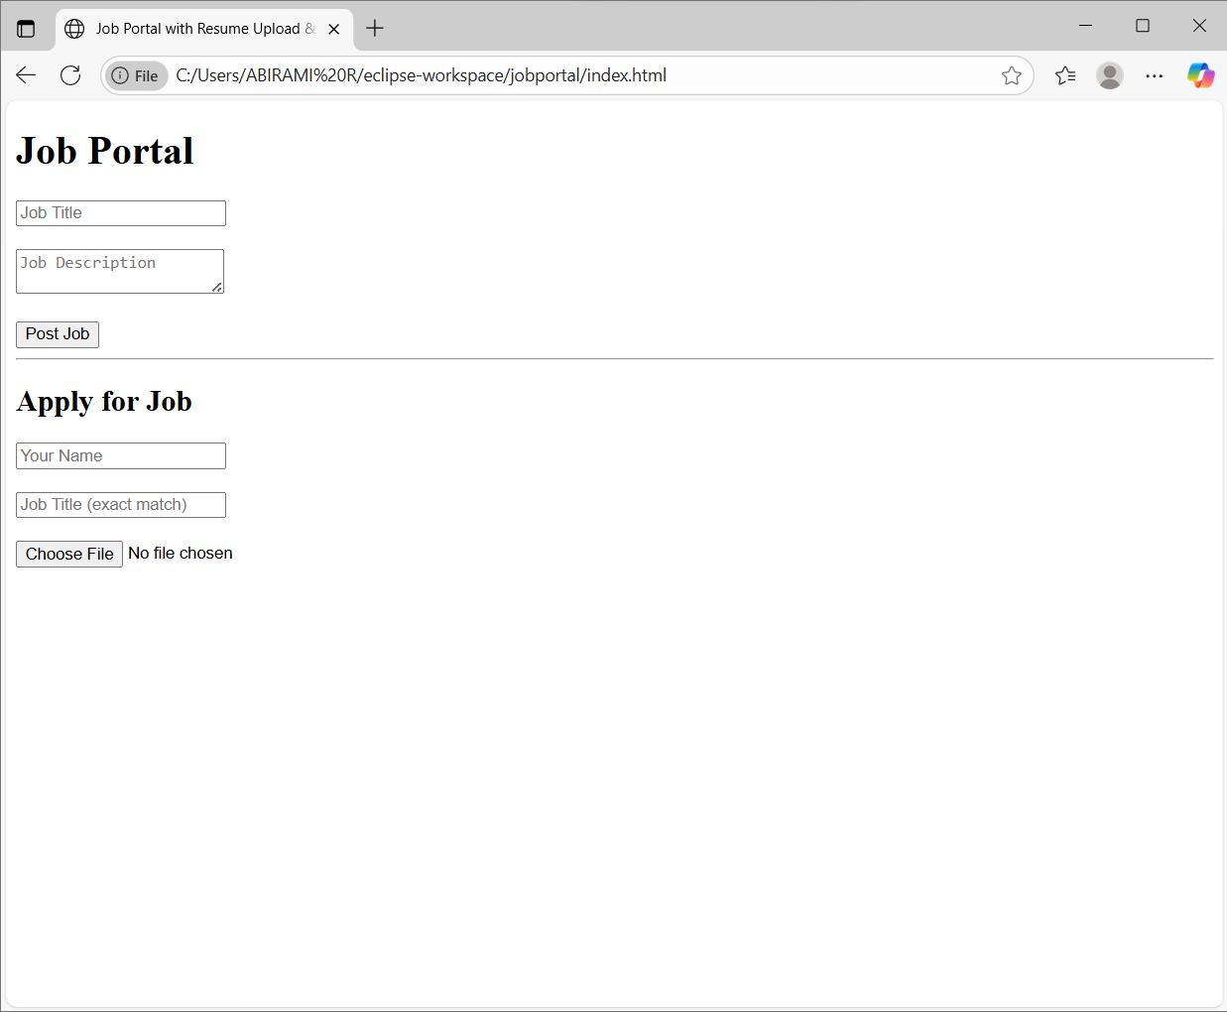
Sample Output (Screenshot)

