Slide 1


K.RAMAKRISHNAN COLLEGE OF ENGINEERING
(AUTONOMOUS)
TRAFFIC SIGN RECOGNITION
Presented by,
Name : ABIRAMI.P
Register No. : 8115U23AD004
Roll. No. : AD2304
Year : II

Slide 2
PRESENTATION OVERVIEW
Introduction
Problem identification
Objectives
Literature review
Architecture diagram
Dataset description / Working Principle
Exploratory Data Analysis
Modules identification

Slide 3
INTRODUCTION
Traffic Sign Recognition is an AI-driven system designed to identify traffic signs in real time. It aims to improve road safety by alerting drivers or autonomous systems about traffic signs as they appear in the visual field.
Applications:
Autonomous Driving: Helps self-driving vehicles follow traffic regulations.
Driver Assistance: Provides alerts for speed limits, stop signs, and other critical signals.
Road Safety Monitoring: Assists with monitoring compliance on highways.
Working Mechanism: The system uses a camera that continuously captures the road scene.
A trained model then processes the images to detect and classify traffic signs, producing a text or voice output specifying the type of sign.

Slide 4
PROBLEM IDENTIFICATION
Challenges Addressed by Traffic Sign Recognition:
Human Error: Drivers may overlook or misinterpret traffic signs due to distractions or poor visibility.
Time-Sensitive Decision-Making: Autonomous and driver-assist systems need accurate, instant recognition of signs to respond appropriately.
Environmental Factors: Traffic signs can be obscured by weather, lighting, or distance, making accurate detection difficult.
Solution: Develop a robust, real-time AI-based recognition system that leverages advanced image processing to classify traffic signs accurately.
Use visual and auditory feedback to communicate sign information immediately to drivers or vehicle control systems.

Slide 5
OBJECTIVES
Primary Goal: Create a dependable system for identifying and interpreting traffic signs to support road safety and navigation.
Real-Time Detection: System captures and processes images instantly to detect traffic signs.
High-Accuracy Classification: Correctly identifies various types of signs, such as speed limits, stops, and warnings.
Clear Output: Provides understandable feedback through text or audio, specifying the detected sign.
Scalability: System should handle a wide variety of signs under different conditions, from sunny to foggy weather.

Slide 6
LITERATURE REVIEW
S.NO | YEAR | TITLE | STRENGTH | ALGORITHM | DISADVANTAGE
1 | 2021 | Traffic Sign Recognition Using Convolutional Neural Networks (CNN)" | Highly accurate when used on well-labeled data | Convolutional Neural Network(CNN) | Requires significant computational resources, challenging for real-time processing in low-powered devices.

Slide 7
S.NO | YEAR | TITLE | STRENGTH | ALGORITHM | DISADVANTAGE
1 | 2022 | "Real-Time Traffic Sign Detection for Autonomous Vehicles" | Real-time performance suitable for embedded systems. | YOLO (You Only Look Once) | Struggles in low-light conditions.

Slide 8
S.NO | YEAR | TITLE | STRENGTH | ALGORITHM | DISADVANTAGE
1 | 2023 | "Lightweight Traffic Sign Recognition System" | Efficient on mobile platforms. | MobileNet | Lower accuracy with distant or partially visible signs.

Slide 9
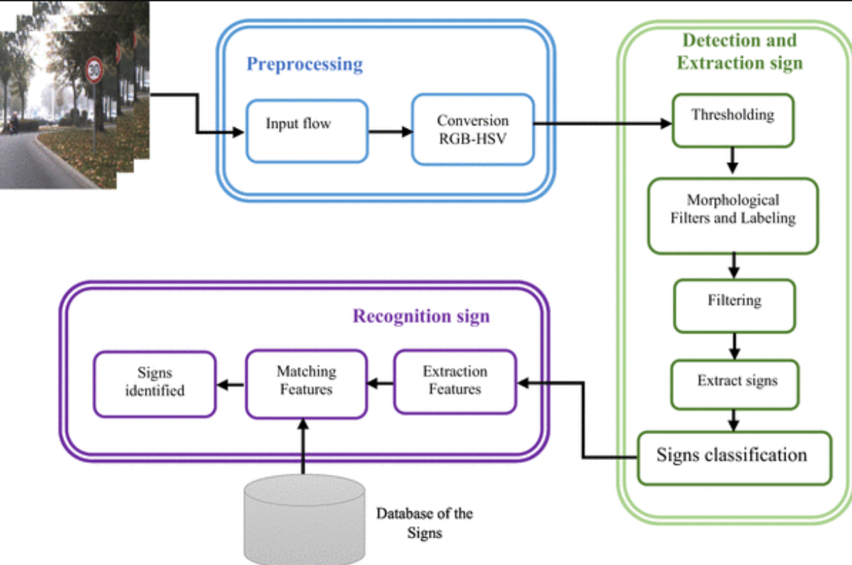
ARCHITECTURAL DIAGRAM
.

Slide 10
DATASET DESCRIPTION
Dataset Used: GTSRB (German Traffic Sign Recognition Benchmark)
Description:
Contains over 50,000 images of 43 different types of traffic signs.
The images cover various lighting, angle, and weather conditions, aiding in robust model training.
Working Principle:
Step 1: The camera captures frames from the environment.
Step 2: Frames are processed by a neural network to identify traffic signs.
Step 3: The model outputs the sign type (e.g., speed limit, stop sign) and confidence level.
Step 4: The output is relayed to the driver or system interface for action.

Slide 11
MODULE DESCRIPTION
Object Detection Module:
Purpose: Identify and classify traffic signs in real-time.
Implementation: Uses a trained model (e.g., SSD or YOLO) optimized for speed and accuracy.
Process:
Camera captures frames, feeding them into the object detection model.
Detected objects are classified as traffic signs with confidence scores.
Challenges Addressed: Ensures timely and accurate recognition for enhanced safety.

Slide 12
MODULE DESCRIPTION
Audio/Visual Feedback:
Purpose: Communicate detected sign information to the driver.
Functionality:
Detected signs are converted to either on-screen text or an audio output.
For example, a "STOP" sign would prompt an audio alert saying "Stop sign detected."
Challenges Addressed: Provides essential real-time feedback to improve driver awareness or autonomous system response.

Slide 13
CONTROL MODULE
System Coordination:
Purpose: Manages interactions between the detection and feedback modules.
Process:
Routes image data from the camera to the detection model.
Passes detection results to the feedback module.
Additional Controls: Allows for manual adjustments or stopping the system when not needed.
Challenges Addressed: Ensures smooth, lag-free performance in real-time applications.

Slide 14
POWER MANAGEMENT MODULE
Power Optimization:
Purpose: Optimize power usage for portable or embedded use.
Functionality:
Monitors battery levels, adjusts power consumption.
Ensures camera, processing units, and audio feedback remain operational throughout use.
Alerts: Provides low-battery warnings if needed.
Challenges Addressed: Balances system performance with energy efficiency for longer operational periods.

Slide 15
CONCLUSION
Summary of Key Points:
We have presented a traffic sign recognition system to enhance road safety through AI.
Discussed th e system's design, objectives, architecture, dataset, and core modules.
Highlighted its potential applications in autonomous driving and driver assistance.
Future Directions:
Improve detection in adverse conditions (e.g., nighttime, fog).
Explore lightweight model variants for mobile or embedded applications.
Integrate with GPS for contextual alerts (e.g., changing speed limits by region).

Slide 16


