Slide 1



CP1
KREATIVE GENESIS 2026
TITLE PAGE
PROBLEM STATEMENT TITLE: Pagir-Feed Lives
DOMAIN NAME: Sustainable Environment and Green Technology
PROBLEM STATEMENT: AI Powered Food Waste Reduction and Redistribution
TEAM-ID:KGH230
TEAM NAME:THIRAL

Slide 2
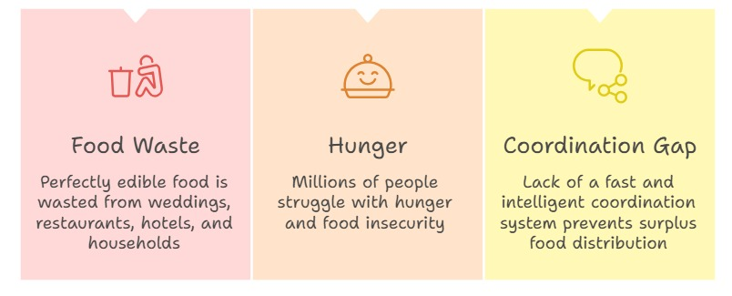
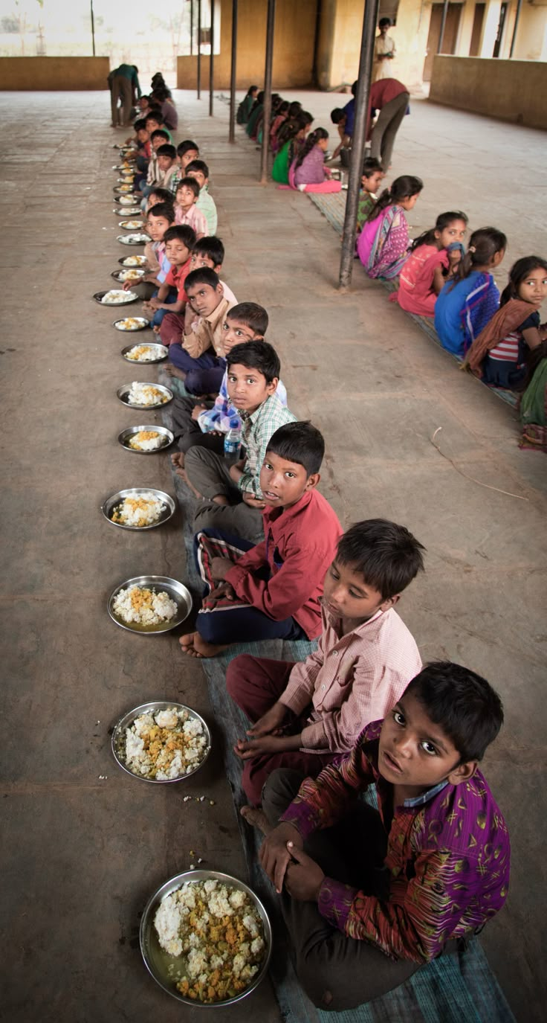
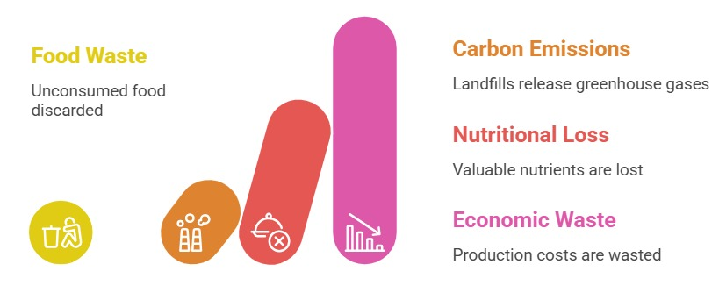

CP1
PROBLEM STATEMENT

Slide 3
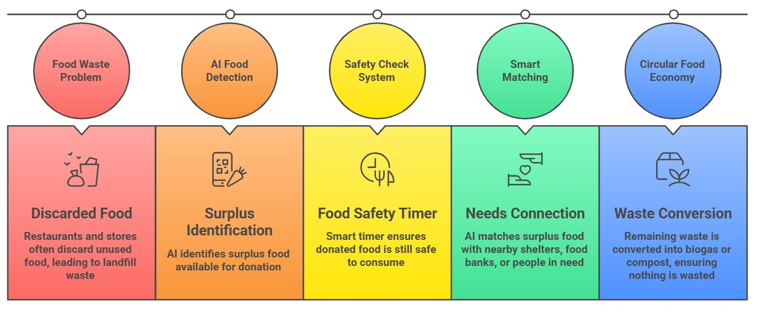
CP1
PROPOSED SOLUTION

Slide 4
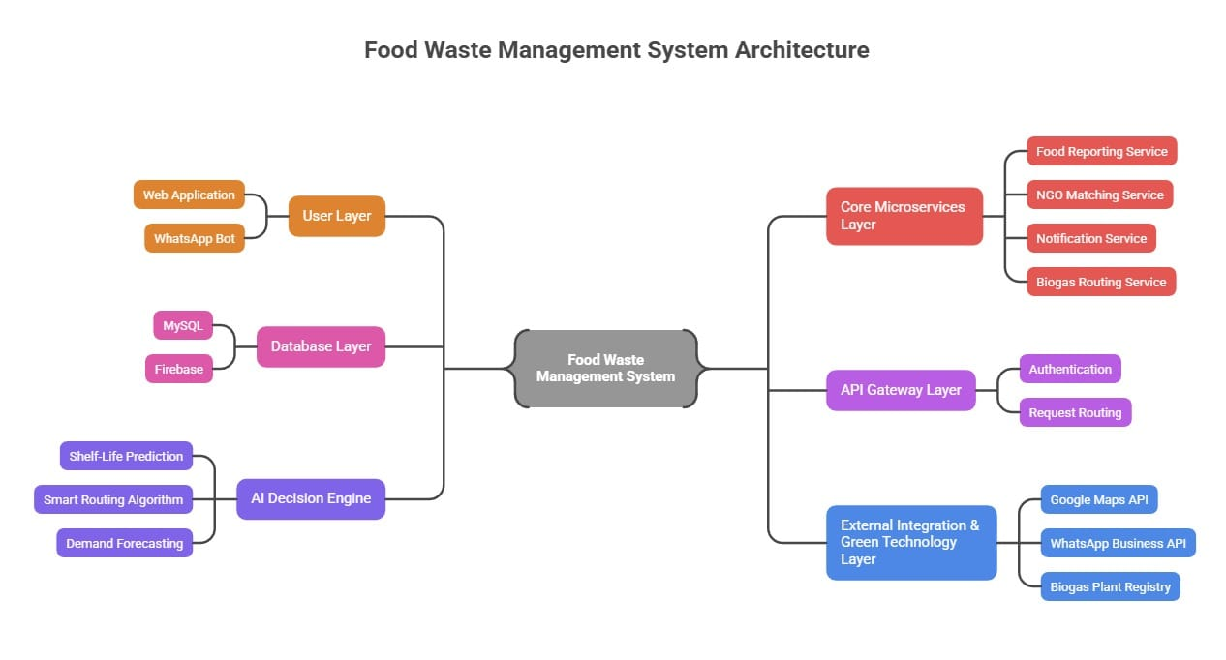
CP1
SYSTEM ARCHITECTURE

Slide 5
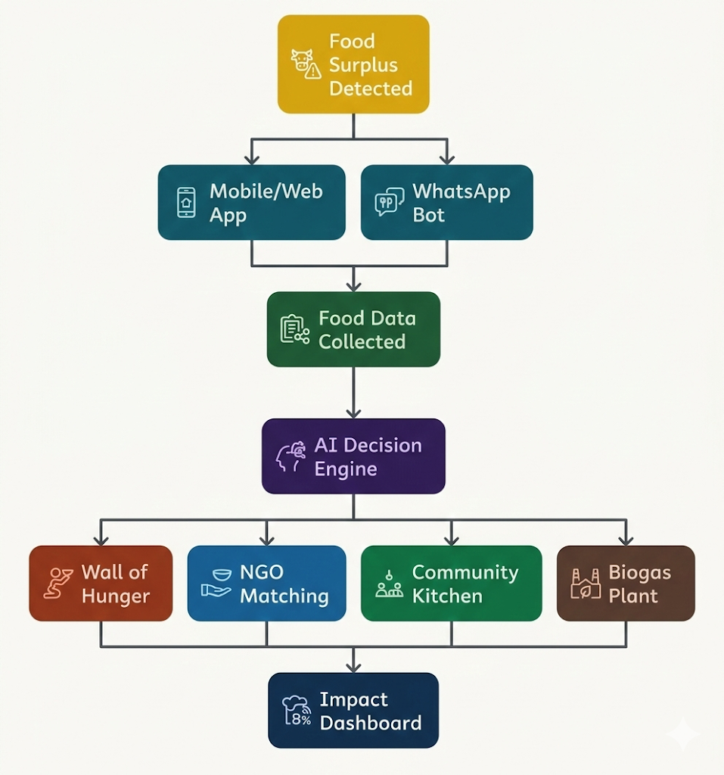
CP1
SYSTEM WORKFLOW

Slide 6
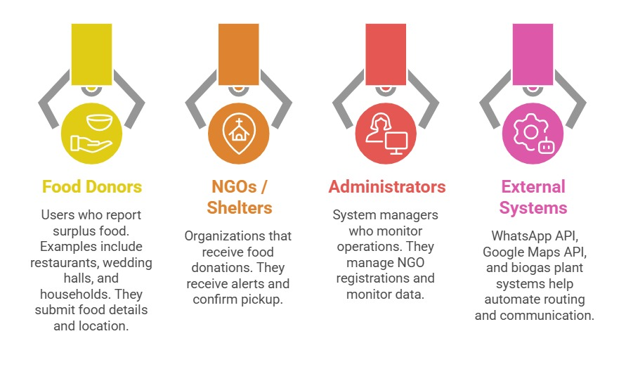
CP1
USER INTERACTION

Slide 7
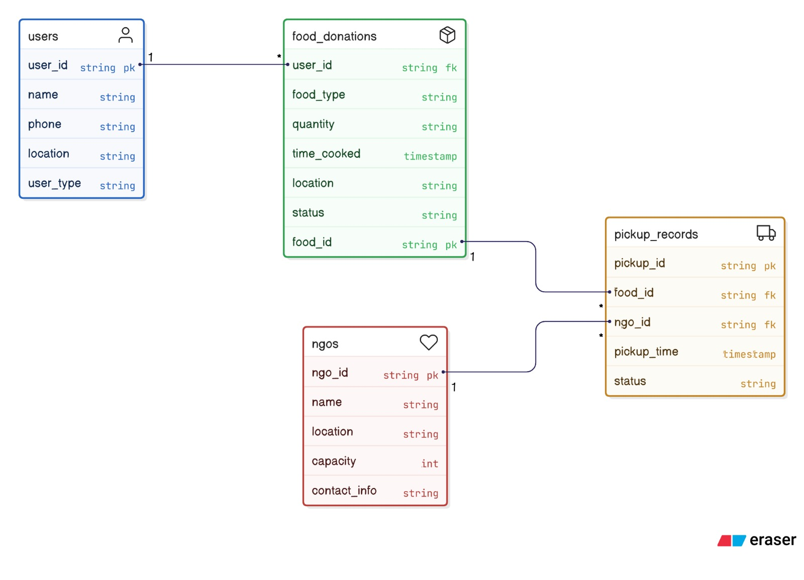
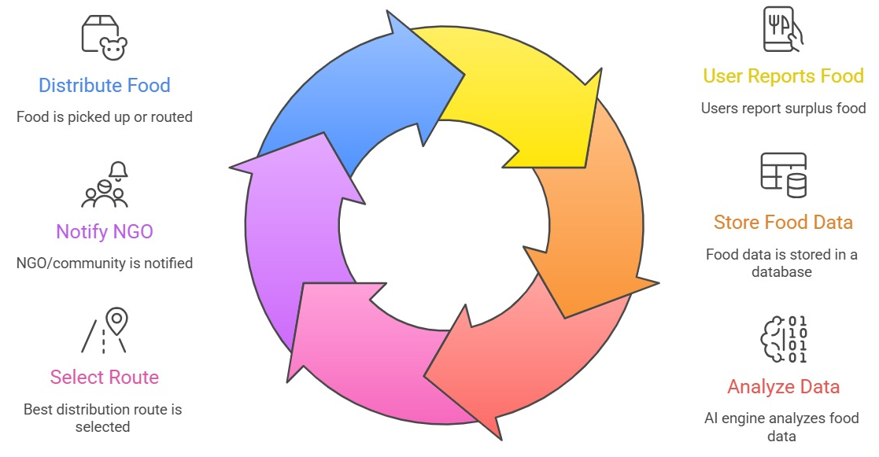
CP1
DATA/COMPONENT DESIGN

