Slide 1
Customer Insights
AdventureWorks Customer Profile Analysis
Project by Abish Inamdar

Slide 2
Source Data — “Sheet1”
Sample rows
Range
CustomerKey | Name | Marital | Gender | Income | Occupation | HomeOwner
11000 | Jon Yang | M | M | $90,000 | Professional | Y
11001 | Eugene Huang | S | M | $60,000 | Professional | N
11003 | Christy Zhu | S | F | $70,000 | Professional | N
11012 | Lauren Walker | M | F | $100,000 | Management | Y
11015 | Chloe Young | S | F | $30,000 | Skilled Manual | N
... | ... | ... | ... | ... | ... | ...
Sheet1!A1:M18149
Columns
CustomerKey • Prefix • FirstName • LastName • BirthDate • MaritalStatus • Gender • EmailAddress • AnnualIncome • TotalChildren • EducationLevel • Occupation • HomeOwner
▸ This flat table is the source for every summary, chart, and breakdown that follows.
18,148 customer records
One row per AdventureWorks customer, covering demographics, income, education, occupation, and home ownership.
Quick Stats
Avg income: $57,269 Avg children: 1.84
Homeowners: 12,260 (68%) Married: 9,817 (54%)

Slide 3
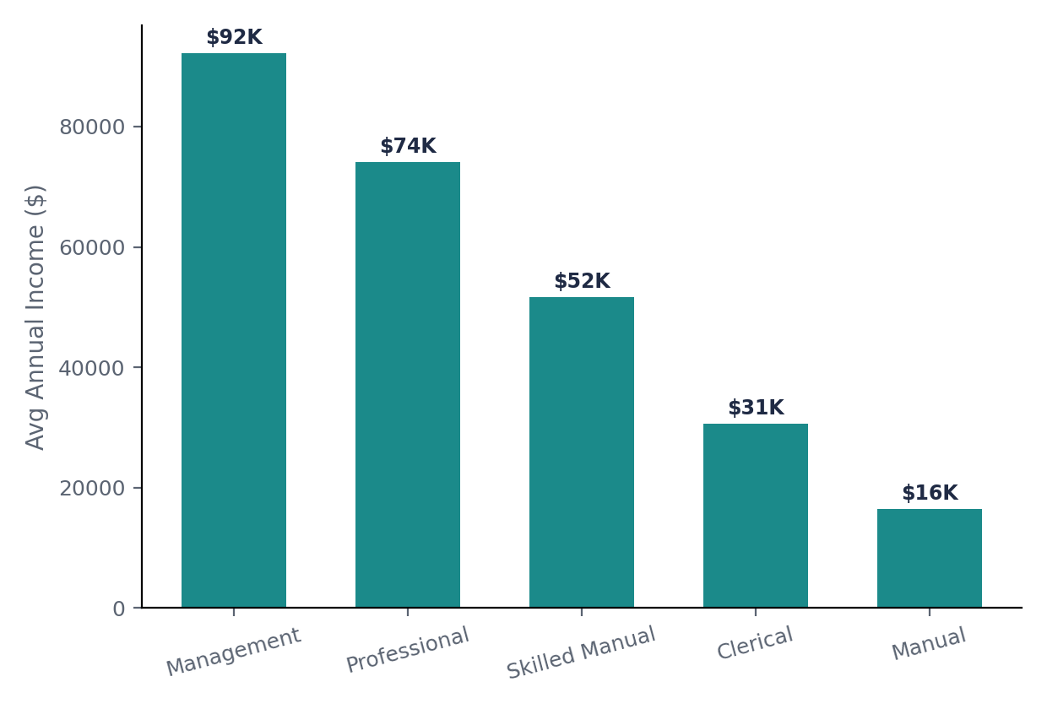
Income by Occupation
Average annual income varies sharply across the 5 occupation categories.
Ranking
Occupation | Avg Income
Management | $92,219
Professional | $74,167
Skilled Manual | $51,733
Clerical | $30,696
Manual | $16,473
▸ Management earners average nearly 6x what Manual-occupation customers earn — the widest gap in the dataset.

Slide 4
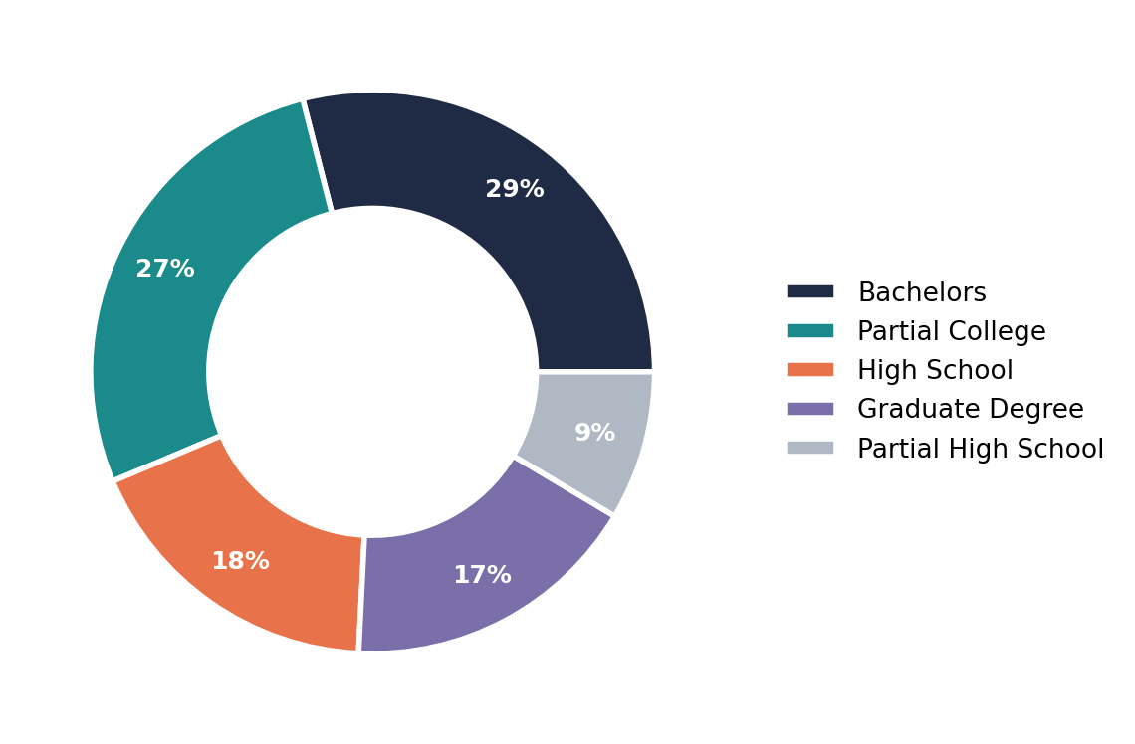
Education Level Distribution
How the 18,148 customers break down by highest education level attained.
Breakdown
Level | Count
Bachelors | 5,261
Partial College | 4,966
High School | 3,241
Graduate Degree | 3,125
Partial High Sch. | 1,555
▸ Nearly 1 in 3 customers hold a Bachelor's degree, the single largest education segment.

Slide 5
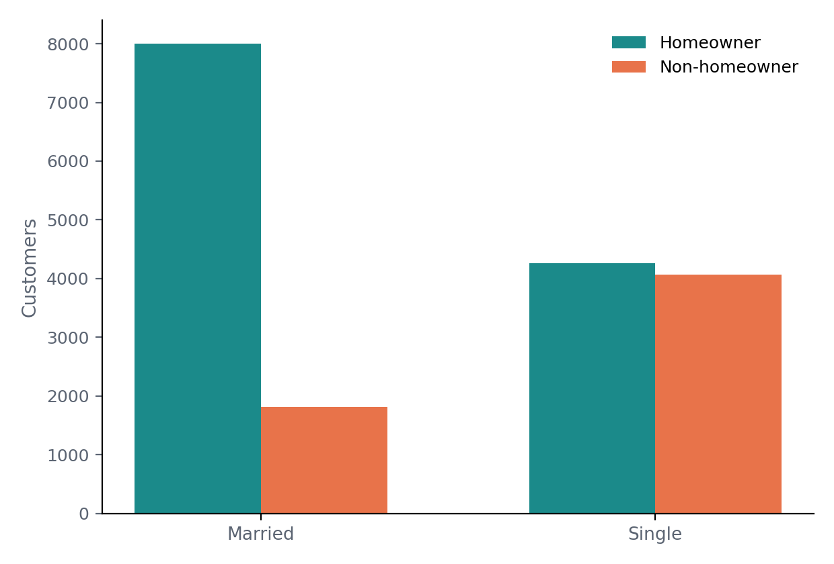
Home Ownership by Marital Status
Married customers own homes at a notably higher rate than single customers.
Totals
Status | Owner | Non-owner
Married | 8,001 | 1,816
Single | 4,259 | 4,072
Married ownership rate: 81.5% · Single ownership rate: 51.1%
▸ Married customers are homeowners 81.5% of the time, vs. 51.1% for single customers — a 30-point gap, the strongest relationship in this dataset.

Slide 6
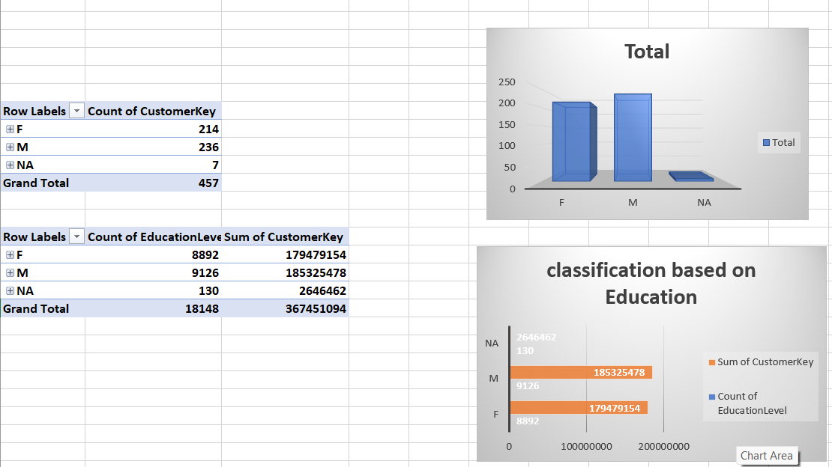
Pivot Table vs Pivot Chart
What is a Pivot Table?
What is a Pivot Chart?
A Pivot Table summarizes large amounts of raw data into a compact grid. It lets you group, filter, count, and sum rows (e.g. Sheet1!A1:M18149) by fields like Gender, EducationLevel, or Occupation — without writing formulas.
A Pivot Chart is a visual (bar, pie, column, etc.) built directly on top of a Pivot Table's output. It updates automatically whenever the Pivot Table refreshes, giving a live picture of the same summarized data — like the donut chart on this dashboard.
Pivot table screenshot

Slide 7
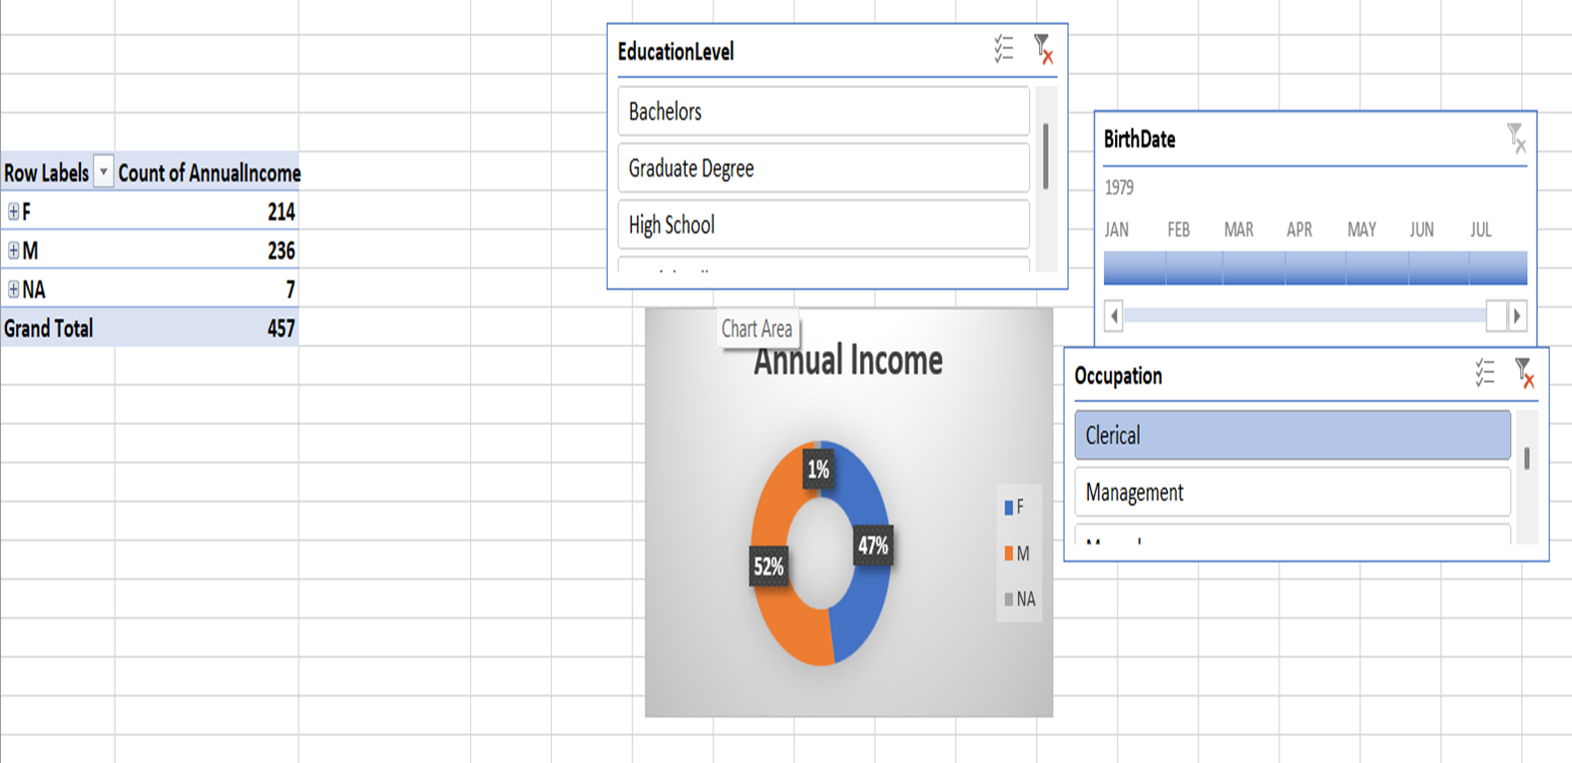
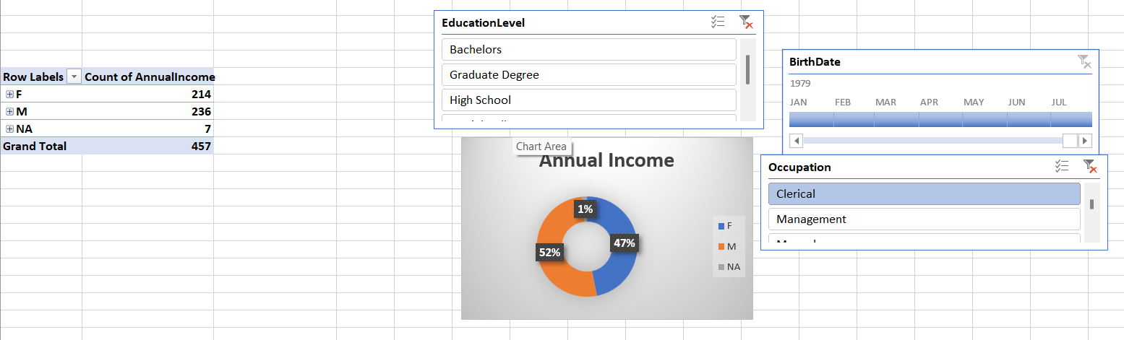
Pivot Table Views — Gender, Education & Income
Two pivot table views built from the same Sheet1!A1:M18149 source, sliced by Gender.
Left: Pivot table counting customers by Gender (F 214 · M 236 · NA 7), plus a second pivot crossing Gender with EducationLevel and total AnnualIncome. Right: The same Gender pivot with Sum of AnnualIncome as a donut (M 52% · F 47% · NA 1%), plus EducationLevel / BirthDate / Occupation slicers to filter it further.

Slide 8
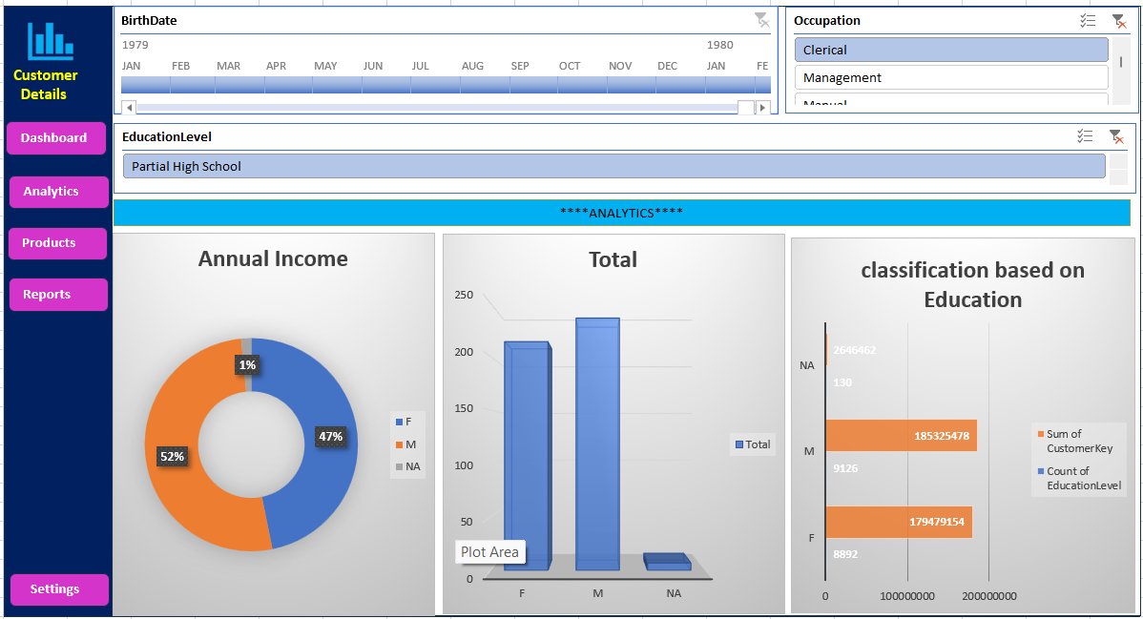
Dashboard

Slide 9


\

