Slide 1
📈
Equity Intelligence Dashboard
A Statistical & Machine Learning Dashboard for Indian Equity Markets
Streamlit · yfinance · Plotly · scikit-learn · SciPy
🌐 View Live Dashboard
AbishSajiNMIMS/Equity-Intelligence-Dashboard-2

Slide 2
Table of Contents
Click any section to jump directly to it
1. Project Overview
10. Theory: One-Way ANOVA
2. Architecture & File Structure
11. Sector Analysis (Tab 4)
3. Theory: Returns & Distributions
12. Theory: Logistic Regression
4. Price History (Tab 1)
13. ML Predictions (Tab 5)
5. Return Distribution (Tab 1)
14. Feature Engineering Pipeline
6. Theory: Confidence Intervals & MLE
15. Theory: Ridge & Lasso Regularisation
7. Risk Profile (Tab 2)
16. Ridge & Lasso Regression (Tab 6)
8. Theory: Hypothesis Testing
17. Regularization Path
9. Hypothesis Tests (Tab 3)
18. Summary & Conclusion
🔵 Theory slides 🟠 Dashboard slides (click any button to jump)

Slide 3
Project Overview
What the Equity Intelligence Dashboard does
📐 Purpose & Scope
Sectors & Stocks
• Interactive Streamlit app for analysing Indian NSE-listed stocks
• Combines descriptive stats, inferential tests, and ML models
• Live data downloaded from Yahoo Finance via yfinance
• Covers 5 major sectors — 25 stocks total
• Runs entirely in-browser; no local installation required
• Banking: HDFC Bank, ICICI, Kotak, Axis, SBI
• IT: TCS, Infosys, Wipro, HCL Tech, Tech Mahindra
• FMCG: HUL, Nestle, Britannia, Dabur, Marico
• Pharma: Sun Pharma, Dr. Reddy's, Cipla, Divi's, Biocon
• Energy: Reliance, ONGC, NTPC, Power Grid, BPCL
Key Capabilities
• Price history & daily return distributions
• Confidence intervals + Maximum Likelihood Estimation
• Z-Test, t-Tests (one-sample, two-sample, paired)
• One-Way ANOVA for sector comparison
• Logistic Regression: next-day direction signal
• Ridge & Lasso with auto-tuned regularisation
Tech Stack
• streamlit — reactive web UI framework
• yfinance — live market data from Yahoo Finance
• plotly — interactive charts
• scikit-learn — Logistic, Ridge, Lasso models
• SciPy / statsmodels — statistical tests
• pandas / NumPy — data wrangling
⬅ Contents

Slide 4
Architecture & File Structure
Modular design: separate files for data, stats, ML, and UI
streamlit_app.py
Main dashboard — tabs, charts, sidebar, caching
📄 Open in GitHub
data_loader.py
Data access — price downloads, feature engineering
📄 Open in GitHub
abish_stats.py
Statistical tests — CI, MLE, Z-test, t-tests, ANOVA
📄 Open in GitHub
laksh_ml.py
ML models — Logistic, Ridge, Lasso training & inference
📄 Open in GitHub
requirements.txt
Python dependencies (streamlit, yfinance, sklearn …)
📄 Open in GitHub
streamlit_app.py — Caching & Data Flow
streamlit_app.py — Sidebar
# streamlit_app.py — Cached data loading (lines 75-87)
@st.cache_data(ttl=3600, show_spinner=False)
def load_data(ticker1, ticker2, period):
prices1 = get_price_data([ticker1], period)
prices2 = get_price_data([ticker2], period)
sector_rets = get_sector_returns(period)
df_ml = engineer_features(ticker1, period)
return {
"prices1": prices1, "prices2": prices2,
"ret1": get_daily_returns(prices1)[ticker1].dropna(),
"ret2": get_daily_returns(prices2)[ticker2].dropna(),
"sector_rets": sector_rets, "df_ml": df_ml,
}
# Sidebar controls (lines 94-102)
with st.sidebar:
primary_sector = st.selectbox("Primary Sector", list(SECTORS))
ticker1 = st.selectbox("Stock 1", SECTORS[primary_sector])
compare_sector = st.selectbox("Compare Sector", ...)
ticker2 = st.selectbox("Stock 2", SECTORS[compare_sector])
period = st.select_slider("Data Period", PERIODS, value="2y")
alpha = st.slider("Significance Level (α)", 0.01, 0.10, 0.05)
🔗 streamlit_app.py lines 75-87
🔗 streamlit_app.py lines 94-102
⬅ Contents

Slide 5
Theory: Price Returns & Distributions
The mathematical foundations behind the Overview tab
📐 Daily Return
📐 Return Distribution
• Measures the percentage change in stock price from one trading day to the next.
• Formula: rₜ = (Pₜ − Pₜ₋₁) / Pₜ₋₁
• A return of +0.01 means the stock gained 1% that day.
• Returns are stationary (unlike prices), making them suitable for statistical analysis.
• The histogram shows how often each return magnitude occurred.
• Overlap of two histograms reveals relative volatility and central tendency.
• Skewness: asymmetry — positive skew = rare large gains.
• Kurtosis: fat tails — extreme moves more common than in a normal distribution.
• Finance returns typically show negative skewness and excess kurtosis.
📐 Annualised Return
• Scales average daily return to an annual figure.
• Formula: r̄_annual ≈ 252 × r̄_daily
• 252 = approximate number of trading days in a calendar year.
• Provides an intuitive comparison across different holding periods.
📐 Why It Matters
• Price history shows the raw trend and entry/exit context.
• Returns allow statistical comparison: mean, variance, normality tests.
• Distributions reveal tail risk — the probability of extreme losses.
• The dashboard uses 2 years (≈ 500 trading days) of data by default.
data_loader.py — Price & Return helpers
streamlit_app.py — Display helpers
# data_loader.py — Return calculation (lines 62-67)
def get_price_data(tickers, period="2y"):
return _extract_field(_download(tickers, period),
"Close", tickers).dropna(how="all")
def get_daily_returns(prices):
return prices.pct_change().dropna() # rₜ = (Pₜ-Pₜ₋₁)/Pₜ₋₁
# streamlit_app.py — Annualised metric (lines 141-144)
avg_return.metric("Avg Daily Return", pct(ret1.mean(), 3))
annualised.metric("Annualised Return", pct(ret1.mean() * 252, 1))
# pct() helper
def pct(value, digits=2):
return f"{value * 100:.{digits}f}%"
🔗 data_loader.py lines 62-67
🔗 streamlit_app.py lines 36-37, 141-144
⬅ Contents

Slide 6
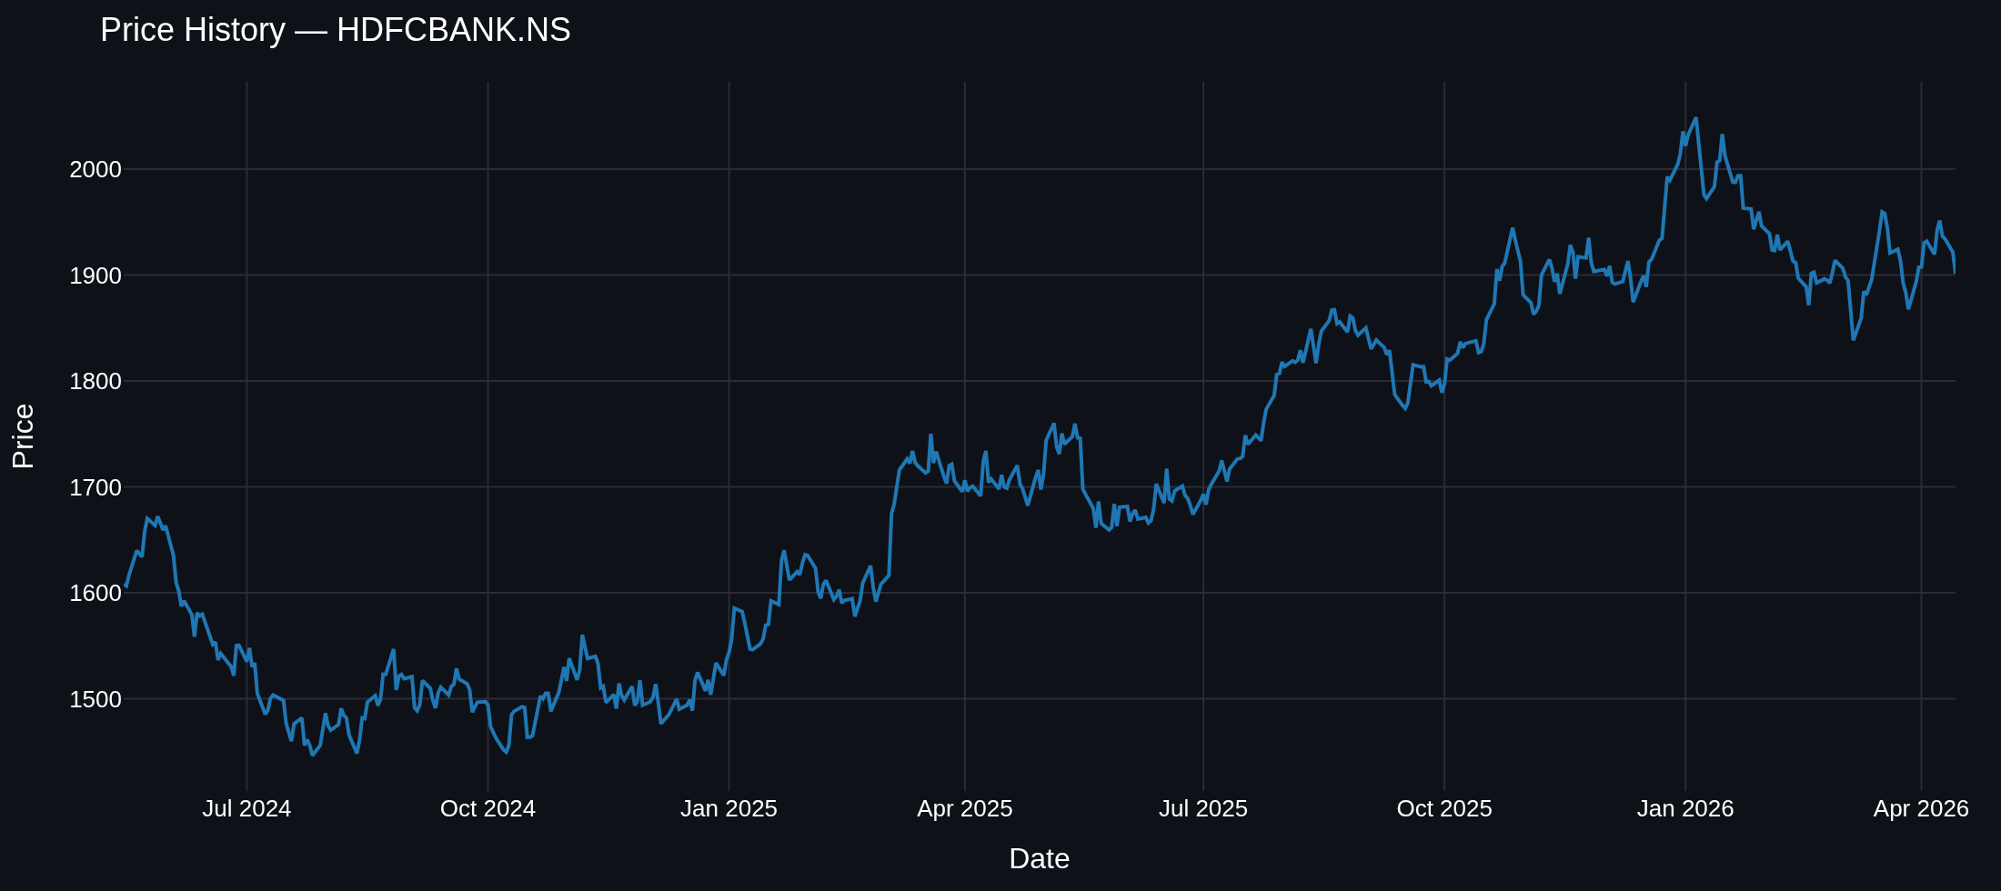
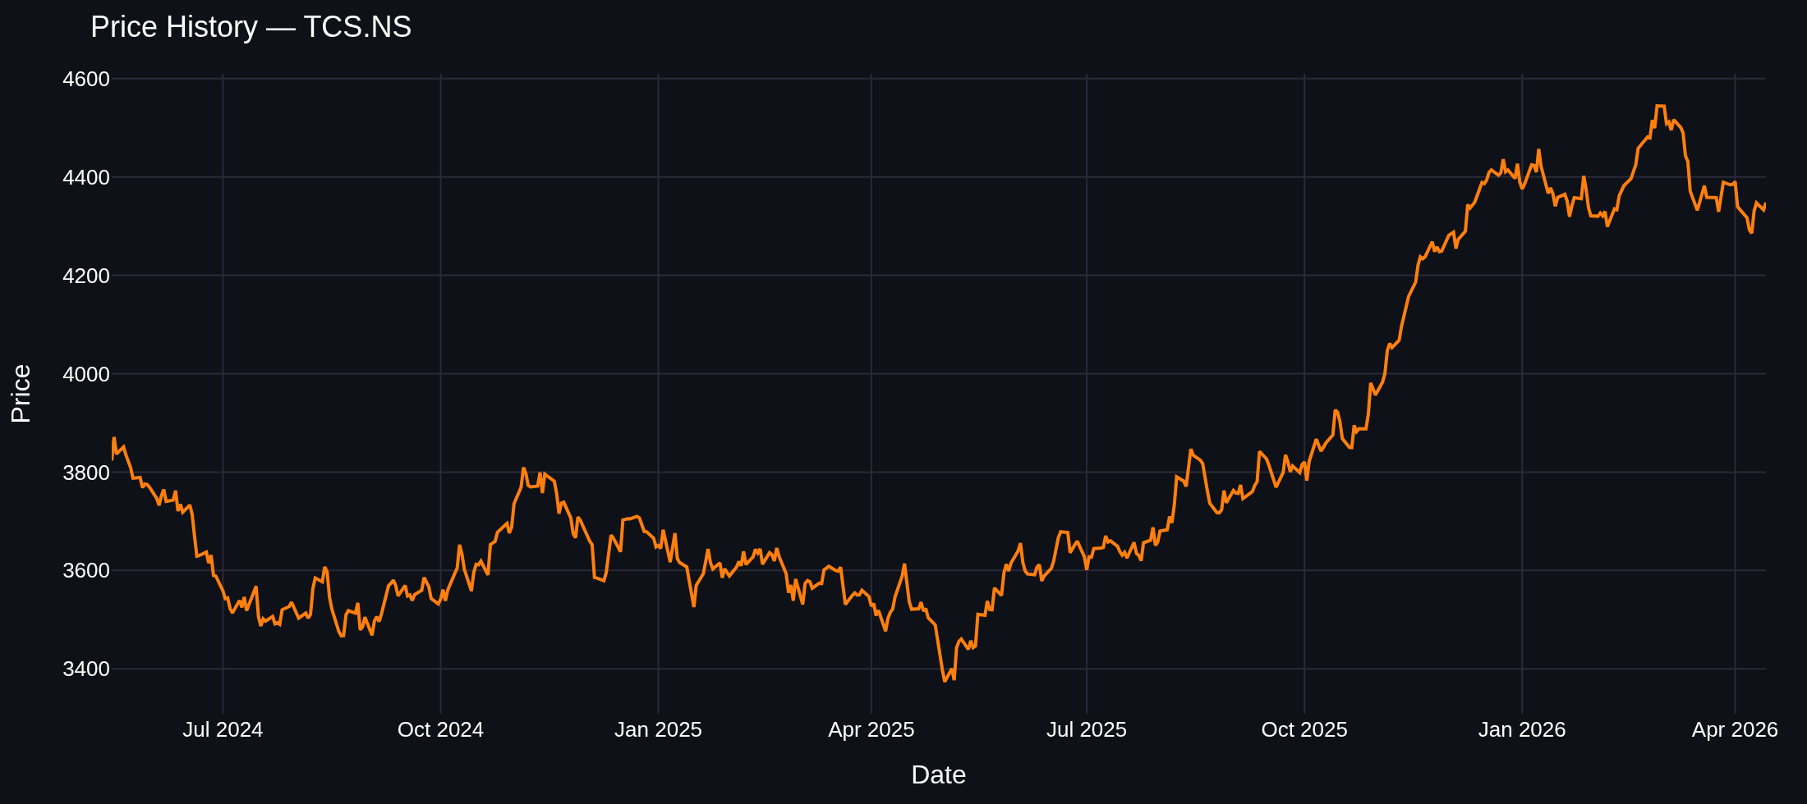
Tab 1 — Overview: Price History
Side-by-side adjusted-close price charts for two selected stocks
streamlit_app.py — Price chart builder & rendering
• Adjusted close price (auto-adjusted for splits & dividends)
• @st.cache_data caches the download for 1 hour
• Period selector: 6mo / 1y / 2y / 3y / 5y
• yfinance downloads from Yahoo Finance in one call
# streamlit_app.py — Price chart renderer (lines 47-51)
def line_chart(series, title, color):
fig = px.line(
series.rename_axis("Date").reset_index(),
x="Date", y=series.name, title=title
)
fig.update_traces(line_color=color)
fig.update_layout(height=320, margin=dict(l=10,r=10,t=40,b=10))
return fig
# Rendering both charts side-by-side (lines 146-148)
left.plotly_chart( line_chart(prices1[ticker1], f"Price — {ticker1}", COLORS["primary"]))
right.plotly_chart(line_chart(prices2[ticker2], f"Price — {ticker2}", COLORS["secondary"]))
🔗 streamlit_app.py lines 47-51, 146-148
⬅ Contents

Slide 7
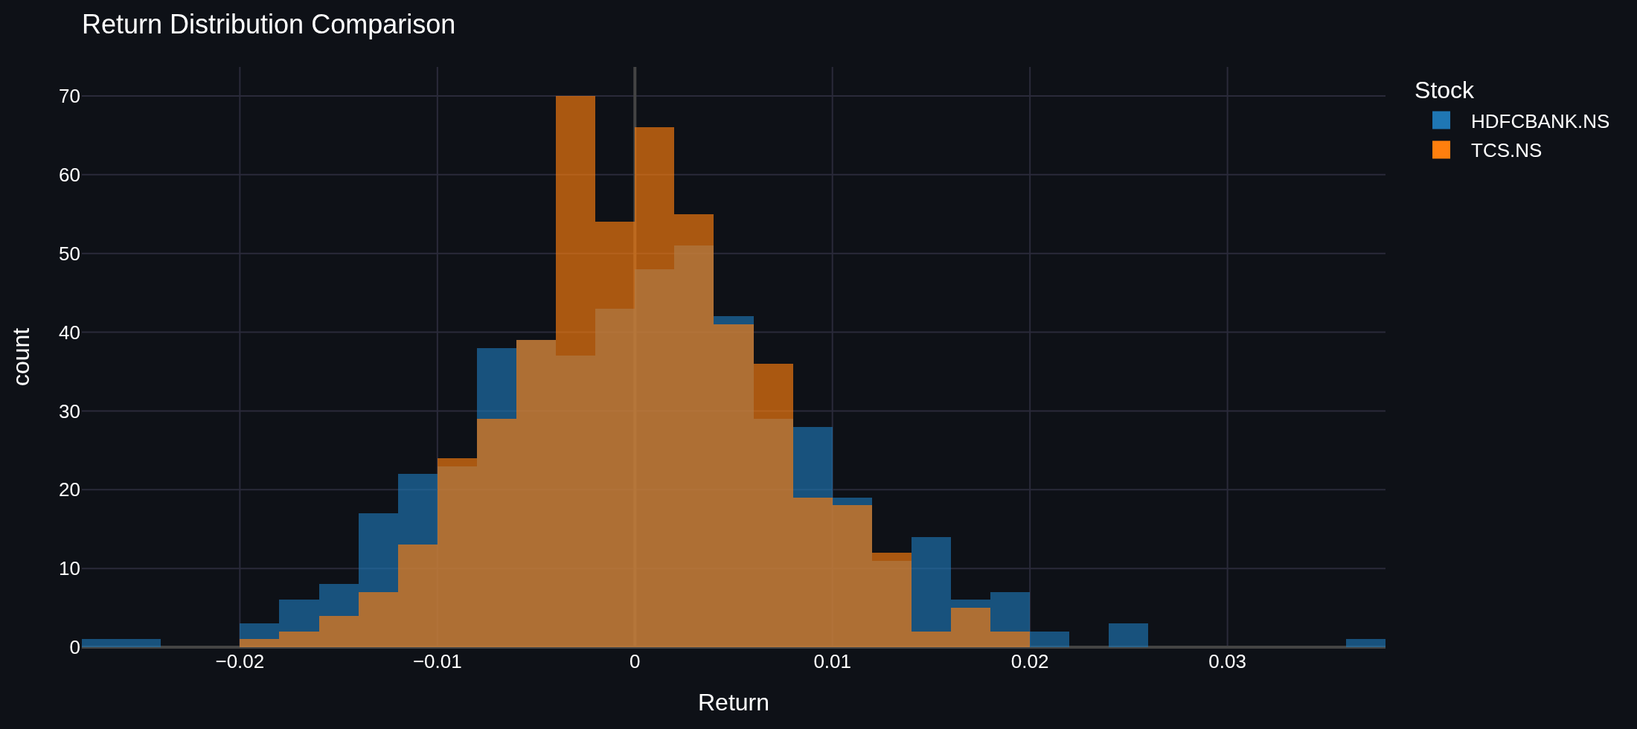
Tab 1 — Overview: Return Distribution
Overlaid histograms showing the distribution of daily returns for both stocks
📐 Reading the Histogram
• Width: wider = higher volatility (larger σ)
• Centre: the average daily return
• Overlap: similar return profiles
• Tail weight: fat tails → tail risk
📐 Interpretation
• 60 bins give fine-grained shape
• Transparency (opacity=0.65) preserves overlap visibility
• Blue = Stock 1 (primary selection)
• Orange = Stock 2 (comparison)
streamlit_app.py — Overlaid Histogram
# streamlit_app.py — Return Distribution histogram (lines 150-167)
dist = pd.concat([
pd.DataFrame({"Return": ret1, "Stock": ticker1}),
pd.DataFrame({"Return": ret2, "Stock": ticker2}),
])
fig = px.histogram(
dist, x="Return", color="Stock",
nbins=60, barmode="overlay", opacity=0.65,
color_discrete_map={
ticker1: COLORS["primary"], # blue
ticker2: COLORS["secondary"], # orange
},
)
fig.update_layout(height=350)
st.plotly_chart(fig, use_container_width=True)
⬅ Contents
🔗 streamlit_app.py lines 150-167

Slide 8
Theory: Confidence Intervals & Maximum Likelihood
Statistical estimation methods powering the Risk Profile tab
📐 Confidence Interval for the Mean
📐 Why Both?
• Gives a range that plausibly contains the true population mean return.
• Formula: CI = x̄ ± c · SE where SE = s / √n
• n > 30: Z-distribution used (normal approximation valid).
• n ≤ 30: t-distribution used (heavier tails, more conservative).
• 95% CI means: if we repeated the study many times,
• 95% of constructed intervals would contain the true mean.
• Narrower CI = more data or less volatility.
• CI gives a sampling-variability range around the mean.
• MLE gives the best-fit Normal model for the full return distribution.
• Together they answer: 'What is the expected return and how uncertain are we?'
• The log-likelihood surface shows how sharply the data
• identifies the true mean (narrow peak = well-identified).
abish_stats.py — CI & MLE implementation
# abish_stats.py — Confidence Interval (lines 16-30)
def confidence_interval_mean(data, confidence=0.95):
n = len(data)
mean = np.mean(data)
se = stats.sem(data)
# Z for large sample, t for small sample
critical = norm.ppf((1+confidence)/2) if n > 30 \
else t_dist.ppf((1+confidence)/2, n-1)
margin = critical * se
return {"mean": mean, "lower": mean-margin,
"upper": mean+margin, "std_error": se,
"method": "Z-interval" if n>30 else "t-interval"}
# MLE Normal (lines 33-43)
def mle_normal(data):
mu = np.mean(data)
sigma = np.std(data, ddof=0) # MLE uses n not n-1
ll = np.sum(norm.logpdf(data, mu, sigma))
return {"mu_mle": mu, "sigma_mle": sigma,
"log_likelihood": ll, "aic": 4-2*ll}
📐 Maximum Likelihood Estimation (MLE)
• Finds the parameter values most consistent with the observed data.
• Assumes returns ~ Normal(μ, σ²).
• Log-likelihood: ℓ(μ,σ) = Σ log f(xᵢ | μ, σ)
• MLE estimates: μ̂ = x̄ (sample mean)
σ̂ = √(Σ(xᵢ-x̄)²/n) (biased std dev)
• AIC = 4 − 2ℓ (lower = better fit; penalises extra parameters).
• The likelihood surface peaks exactly at the MLE estimate.
🔗 abish_stats.py lines 16-43
⬅ Contents

Slide 9
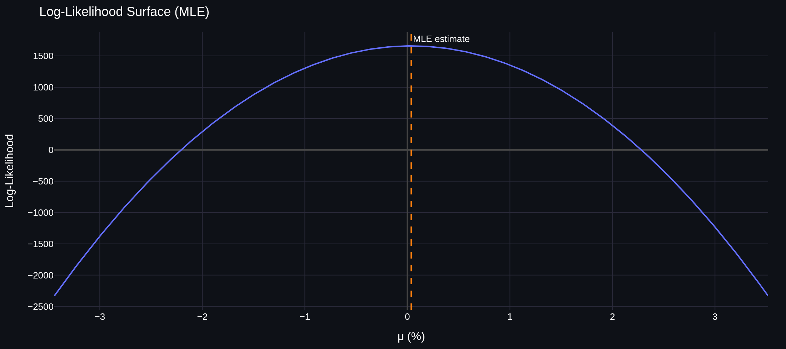
Tab 2 — Risk Profile
Confidence interval, MLE parameters, and log-likelihood surface
📐 Reading the Likelihood Surface
• x-axis: candidate μ values (in %)
• y-axis: log-likelihood of the data given μ
• Peak (dashed line): MLE estimate μ̂
• Wider peak → more uncertainty about true mean
• Sharper peak → data is more informative
streamlit_app.py — CI display
# streamlit_app.py — CI display (lines 188-197)
ci = confidence_interval_mean(ret1.values, confidence=1-alpha)
mle = mle_normal(ret1.values)
st.metric("Mean Daily Return", pct(ci["mean"], 4))
st.write(f"{int((1-alpha)*100)}% CI: "
f"{pct(ci['lower'],4)} to {pct(ci['upper'],4)}")
st.caption(f"{ci['method']} | n = {ci['n']}")
abish_stats.py + streamlit_app.py — Likelihood computation & rendering
# abish_stats.py — Likelihood Surface (lines 46-52)
def plot_likelihood_surface(data, mu_range=None):
sigma = np.std(data, ddof=0)
mu = np.mean(data)
low, high = mu_range or (mu-4*sigma, mu+4*sigma)
mu_grid = np.linspace(low, high, 300)
log_liks = np.array(
[np.sum(norm.logpdf(data, m, sigma)) for m in mu_grid]
)
return {"mu_grid": mu_grid, "log_likelihoods": log_liks, "mle_mu": mu}
# streamlit_app.py — Rendering (lines 208-212)
ll = plot_likelihood_surface(ret1.values)
ll_fig = px.line(x=ll["mu_grid"]*100, y=ll["log_likelihoods"],
labels={"x":"μ (%)","y":"Log-Likelihood"},
title="Likelihood Surface")
ll_fig.add_vline(x=ll["mle_mu"]*100, line_dash="dash", line_color=COLORS["secondary"])
st.plotly_chart(ll_fig, use_container_width=True)
🔗 streamlit_app.py lines 188-197
⬅ Contents
🔗 abish_stats.py lines 46-52 | streamlit_app.py lines 208-212

Slide 10
Theory: Hypothesis Testing
The statistical framework for testing claims about returns
📐 Core Framework
📐 t-Tests
• H₀ (null): 'nothing interesting happening' — e.g. mean return = 0
• H₁ (alternative): the claim we want to establish
• p-value: P(observing data this extreme | H₀ is true)
• If p-value < α (significance level): reject H₀
• α = 0.05 means we tolerate a 5% false-positive rate
• One-Sample: σ unknown, estimate from data; t = (x̄−μ₀)/(s/√n)
• Two-Sample Welch: compare means of TWO stocks
• H₀: μ₁ = μ₂; t = (x̄₁−x̄₂) / √(s₁²/n₁ + s₂²/n₂)
• Welch does NOT assume equal variances (safe default).
• Paired: compare same stock in two time windows
• Forms differences dᵢ = x₁ᵢ − x₂ᵢ; t = d̄ / (s_d/√n)
📐 Z-Test (One Sample)
• Use when population σ is known (or n is very large).
• Statistic: z = (x̄ − μ₀) / (σ / √n)
• Compare |z| to z_critical = z_{α/2} (e.g., 1.96 at 5%)
• Reject H₀ if |z| > z_critical or p < α
abish_stats.py — Two-Sample t-Test implementation
# abish_stats.py — Two-Sample Welch t-Test (lines 105-122)
def t_test_two_sample(data1, data2, label1, label2, alpha=0.05):
t_stat, p_value = ttest_ind(data1, data2, equal_var=False)
reject = p_value < alpha
return {
"test": "Two-Sample Welch's t-Test",
"mean1": np.mean(data1), "mean2": np.mean(data2),
"t_statistic": t_stat, "p_value": p_value,
"reject_H0": reject,
"conclusion": f"{'REJECT' if reject else 'FAIL TO REJECT'} H₀.",
}
abish_stats.py — Z-Test implementation
# abish_stats.py — Z-Test (lines 59-83)
def z_test_mean(data, pop_mean, pop_std, alpha=0.05, tail="two"):
sample_mean = np.mean(data)
z_stat = (sample_mean - pop_mean) / (pop_std / np.sqrt(len(data)))
if tail == "two":
p_value = 2 * (1 - norm.cdf(abs(z_stat)))
z_critical = norm.ppf(1 - alpha/2)
reject = p_value < alpha
return {"z_statistic": z_stat, "z_critical": z_critical,
"p_value": p_value, "reject_H0": reject}
🔗 abish_stats.py lines 105-122
⬅ Contents
🔗 abish_stats.py lines 59-83

Slide 11
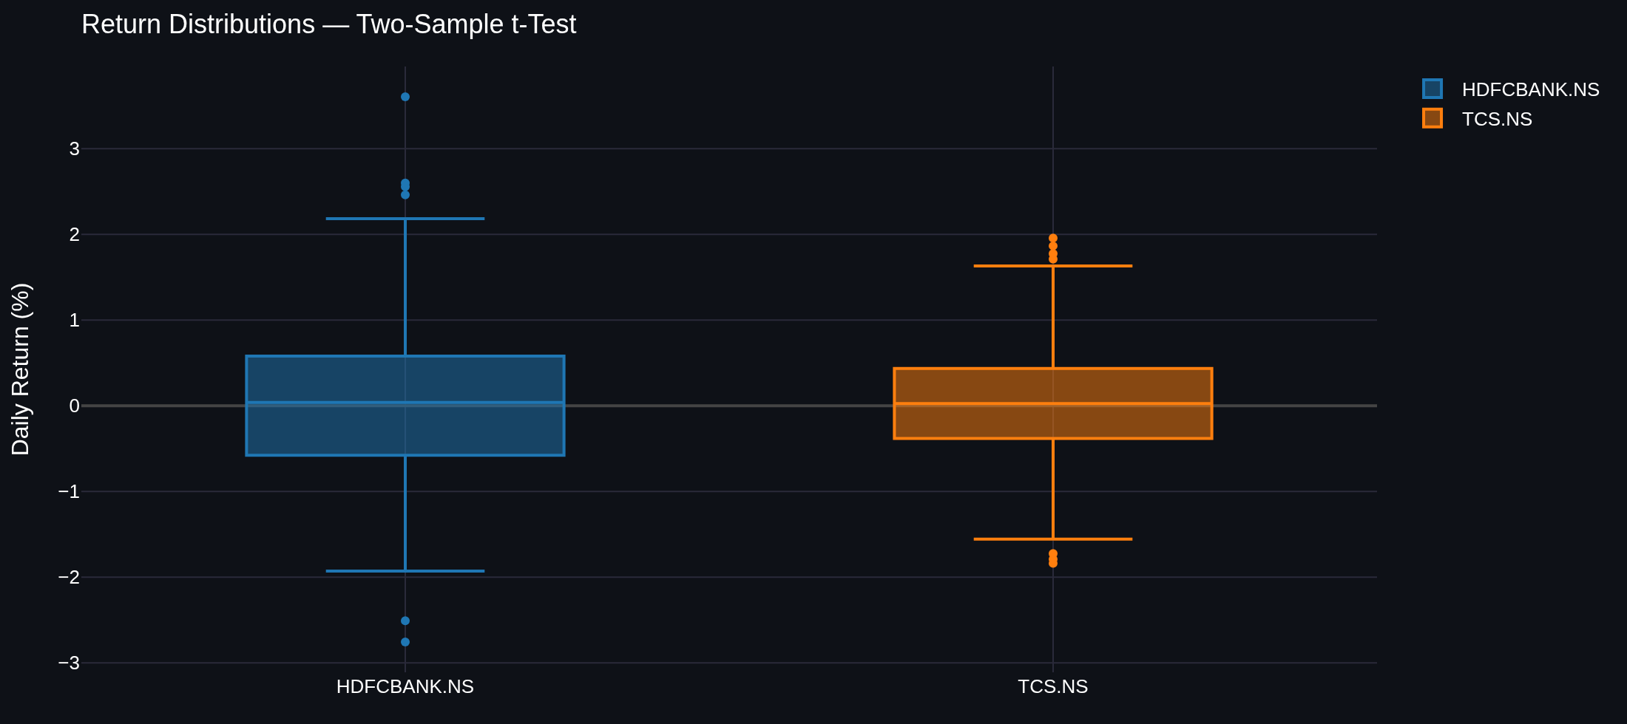
Tab 3 — Hypothesis Tests
Interactive test selector: Z-Test, One-Sample, Two-Sample & Paired t-Tests
📐 Two-Sample t-Test Output
• Box shows median, IQR, whiskers (1.5×IQR), and outliers
• Overlapping boxes → means may not differ significantly
• Widely separated medians → likely significant difference
• p-value < 0.05 → reject H₀ (means are different)
streamlit_app.py — Result display helper
# streamlit_app.py — show_result helper (lines 40-44)
def show_result(result, details=None):
(st.error if result["reject_H0"]
else st.success)(
"Reject H0" if result["reject_H0"]
else "Fail to reject H0"
)
for line in details or []:
st.write(line)
st.caption(result["conclusion"])
streamlit_app.py — Hypothesis Test rendering
# streamlit_app.py — Test selector + Two-Sample rendering (lines 218-301)
test = st.radio("Choose a test",
["Z-Test","One-Sample t-Test","Two-Sample t-Test","Paired t-Test"],
horizontal=True)
# Two-Sample branch:
result = t_test_two_sample(ret1.values, ret2.values,
ticker1, ticker2, alpha)
a.metric(f"Mean {ticker1}", pct(result["mean1"], 4))
c.metric("p-value", result["p_value"])
show_result(result, [f"t-Statistic: {result['t_statistic']}"])
# Box plot
box = go.Figure()
box.add_trace(go.Box(y=ret1*100, name=ticker1, marker_color=COLORS["primary"]))
box.add_trace(go.Box(y=ret2*100, name=ticker2, marker_color=COLORS["secondary"]))
st.plotly_chart(box, use_container_width=True)
🔗 streamlit_app.py lines 40-44
⬅ Contents
🔗 streamlit_app.py lines 218-301

Slide 12
Theory: One-Way ANOVA
Comparing mean returns across multiple sectors simultaneously
📐 The Problem ANOVA Solves
📐 Descriptive Statistics Table
• We want to test if the 5 sector means are all equal.
• Running multiple pairwise t-tests inflates Type-I error (false positive rate).
• ANOVA tests ALL groups at once while controlling error at α.
• H₀: μ_Banking = μ_IT = μ_FMCG = μ_Pharma = μ_Energy
• H₁: At least one sector mean differs from the others.
• Mean (%): average return per sector
• Std Dev (%): volatility — higher = riskier sector
• Skewness: +ve = rare large gains; −ve = rare large losses
• Kurtosis: >0 means fatter tails than Normal
• Together they profile each sector's risk-return characteristics.
📐 The F-Statistic
data_loader.py — Sector index construction
• F = MS_between / MS_within
• MS_between: variance BETWEEN group means (signal)
• MS_within: variance WITHIN each group (noise)
• Large F → means vary more than expected by chance → reject H₀
• F follows an F-distribution with df₁=k−1, df₂=N−k
• k = number of groups, N = total observations
# data_loader.py — Sector returns (lines 70-74)
def get_sector_returns(period="2y"):
return {
sector: get_daily_returns(
get_price_data(tickers, period)
).mean(axis=1) # equal-weight sector index
for sector, tickers in SECTORS.items()
}
abish_stats.py — ANOVA implementation
🔗 data_loader.py lines 70-74
# abish_stats.py — One-Way ANOVA (lines 149-162)
from scipy.stats import f_oneway
def one_way_anova(*groups, labels=None, alpha=0.05):
f_stat, p_value = f_oneway(*groups)
reject = p_value < alpha
return {
"test": "One-Way ANOVA",
"f_statistic": round(f_stat, 4),
"p_value": round(p_value, 6),
"reject_H0": reject,
"conclusion": (
f"{'REJECT' if reject else 'FAIL TO REJECT'} H₀. "
f"Sector returns {'ARE' if reject else 'ARE NOT'} "
f"significantly different."
),
}
⬅ Contents
🔗 abish_stats.py lines 149-162

Slide 13
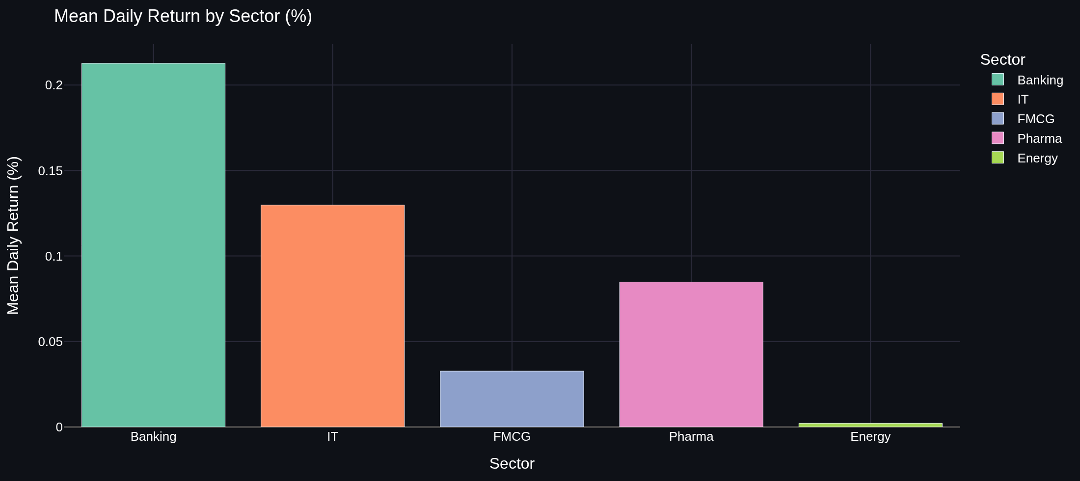
Tab 4 — Sector Analysis
One-Way ANOVA comparing mean daily returns across Banking, IT, FMCG, Pharma, Energy
📐 Dashboard Output
• F-Statistic and p-value shown as metrics
• Green banner = fail to reject H₀ (sectors similar)
• Red banner = reject H₀ (at least one sector different)
• Descriptive table: mean, std, skewness, kurtosis per sector
streamlit_app.py — Sector Analysis tab rendering
# streamlit_app.py — Sector Analysis tab (lines 315-352)
labels = list(sector_rets)
groups = [sector_rets[l].dropna().to_numpy() for l in labels]
result = one_way_anova(*groups, labels=labels, alpha=alpha)
st.metric("F-Statistic", result["f_statistic"])
st.metric("p-value", result["p_value"])
show_result(result)
# Descriptive stats table
stats_df = pd.DataFrame([{
"Sector": label,
"Mean (%)": round(group.mean() * 100, 4),
"Std Dev (%)": round(group.std(ddof=1) * 100, 4),
"Skewness": round(pd.Series(group).skew(), 4),
"Kurtosis": round(pd.Series(group).kurtosis(), 4),
"Observations": len(group),
} for label, group in zip(labels, groups)])
st.dataframe(stats_df, use_container_width=True)
⬅ Contents
🔗 streamlit_app.py lines 315-352

Slide 14
Theory: Logistic Regression for Direction Prediction
Binary classification model: will the stock go UP or DOWN tomorrow?
📐 Logistic Regression
📐 Feature Importance via Coefficients
• Models P(Y=1 | X) — probability of an UP move given today's features.
• Uses the sigmoid function: P(Y=1|X) = 1 / (1 + e^(−(β₀ + βᵀX)))
• The log-odds (logit) is a linear function: log(p/(1−p)) = β₀ + βᵀX
• Prediction: UP if P(Y=1) > 0.5, else DOWN.
• Coefficients: positive βᵢ pushes P(UP) higher;
• negative βᵢ pushes P(UP) lower.
• After scaling, coefficients are directly comparable.
• Largest |coefficient| → most influential feature.
• Blue bars: positive effect (pushes P(UP) up)
• Orange bars: negative effect (pushes P(UP) down)
• Example: positive lag_1 coefficient means 'if yesterday
• was up, tomorrow is more likely up too' (momentum).
laksh_ml.py — Logistic Regression training
📐 Model Evaluation
# laksh_ml.py — Logistic model (lines 68-106)
def train_logistic_model(df, test_size=0.2, random_state=42):
X, y = df[FEATURE_COLS].values, df["target"].values
X_train, X_test, y_train, y_test = _split_series(X, y, test_size)
model = Pipeline([
("scaler", StandardScaler()), # z-score normalise
("model", LogisticRegression(
max_iter=1000,
class_weight="balanced", # handle imbalance
solver="lbfgs",
random_state=random_state,
)),
])
model.fit(X_train, y_train)
cv_acc = cross_val_score(model, X, y, # time-aware CV
cv=TimeSeriesSplit(n_splits=5), scoring="accuracy")
return {
"model": model,
"accuracy": accuracy_score(y_test, model.predict(X_test)),
"cv_accuracy_mean": cv_acc.mean(),
"confusion_matrix": confusion_matrix(y_test, y_pred),
"coef_df": _coef_frame(model.named_steps["model"].coef_[0]),
}
• Accuracy: fraction of correct UP/DOWN calls on test set.
• Cross-Validation (TimeSeriesSplit): prevents data leakage
• — future data never used to train the model.
• Confusion Matrix: TP (correct UP), TN (correct DOWN),
• FP (predicted UP but was DOWN), FN (missed UP move).
• class_weight='balanced': corrects for class imbalance
• (equal numbers of UP/DOWN training examples).
🔗 laksh_ml.py lines 68-106
⬅ Contents

Slide 15
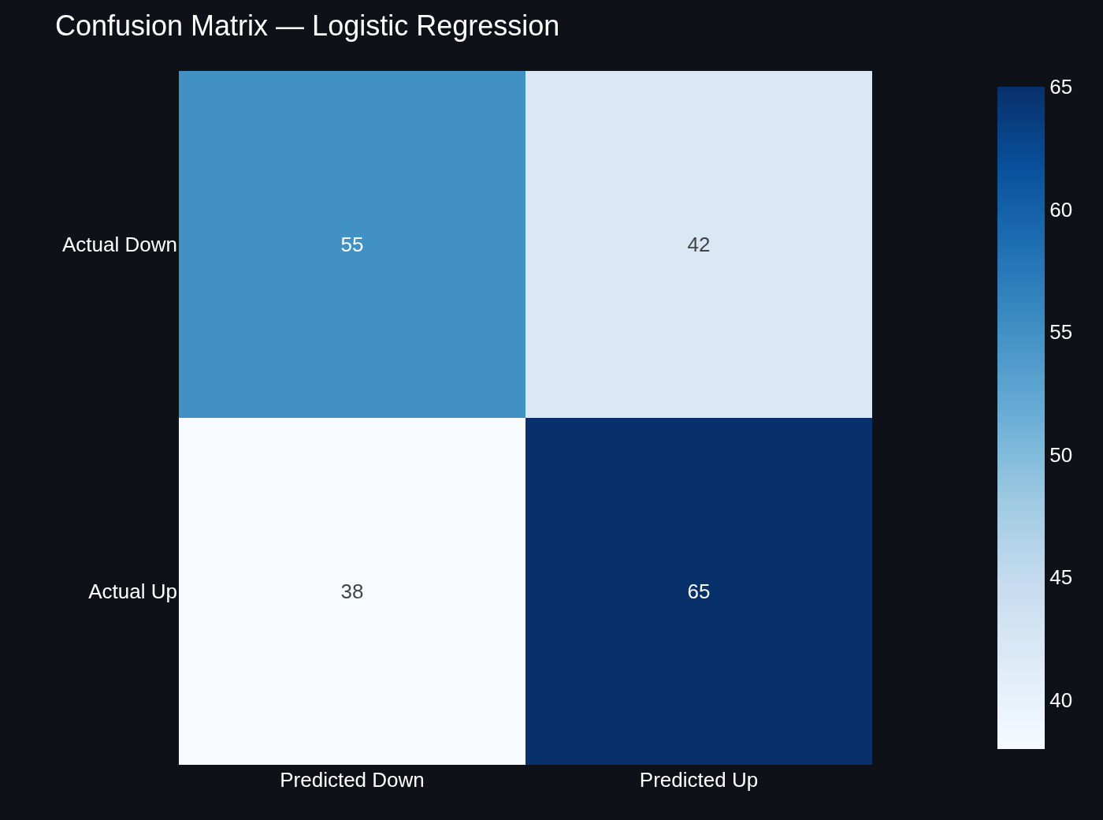
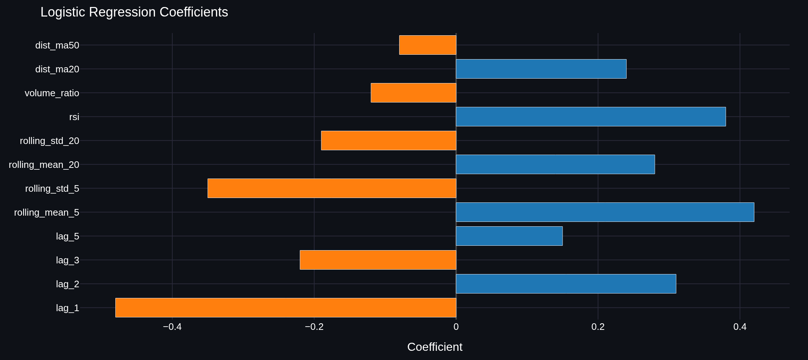
Tab 5 — ML Predictions: Logistic Regression
Next-day direction signal, confusion matrix, and feature coefficients
laksh_ml.py + streamlit_app.py — Prediction & display
streamlit_app.py — Confusion matrix rendering
# laksh_ml.py — Next-day prediction (lines 109-116)
def predict_tomorrow(model_result, latest_row):
probs = model_result["model"].predict_proba(
latest_row[FEATURE_COLS].to_numpy().reshape(1,-1)
)[0]
return {
"direction": "UP" if probs[1] > 0.5 else "DOWN",
"prob_up": round(probs[1], 4),
"prob_down": round(probs[0], 4),
"confidence": round(max(probs) * 100, 1),
}
# streamlit_app.py — Metric display (lines 379-383)
a.metric("Signal", pred["direction"])
b.metric("P(Up)", f"{pred['prob_up']*100:.1f}%")
c.metric("P(Down)", f"{pred['prob_down']*100:.1f}%")
d.metric("Confidence", f"{pred['confidence']}%")
# streamlit_app.py — Confusion matrix chart (lines 394-403)
cm = px.imshow(
log_res["confusion_matrix"],
x=["Down","Up"], y=["Down","Up"],
labels={"x":"Predicted","y":"Actual","color":"Count"},
text_auto=True,
color_continuous_scale="Blues",
)
cm.update_layout(height=320)
st.plotly_chart(cm, use_container_width=True)
🔗 streamlit_app.py lines 394-403
🔗 laksh_ml.py lines 109-116 | streamlit_app.py lines 379-383
⬅ Contents

Slide 16
Feature Engineering Pipeline
12 signals derived from price & volume that feed all three ML models
📐 Why Feature Engineering?
• Raw closing prices are not stationary and can't feed an ML model directly.
• We transform price → return, then extract predictive signals.
• Goal: capture momentum, volatility, trend, and volume anomalies.
data_loader.py — engineer_features() — complete pipeline
Feature Summary
# data_loader.py — Full feature engineering pipeline (lines 89-119)
def engineer_features(ticker, period="2y"):
df["return"] = df["close"].pct_change()
# ① Lag features — yesterday's / 2-days-ago / etc. return
for lag in (1, 2, 3, 5):
df[f"lag_{lag}"] = df["return"].shift(lag)
# ② Rolling statistics — rolling mean & std over 5-day and 20-day windows
for window in (5, 20):
df[f"rolling_mean_{window}"] = df["return"].rolling(window).mean()
df[f"rolling_std_{window}"] = df["return"].rolling(window).std()
# ③ RSI — Relative Strength Index (14-day)
delta = df["close"].diff()
gain = delta.clip(lower=0).rolling(14).mean()
loss = (-delta.clip(upper=0)).rolling(14).mean()
df["rsi"] = 100 - (100 / (1 + gain / loss))
# ④ Volume ratio — today's volume vs 20-day average
df["volume_ratio"] = df["volume"] / df["volume"].rolling(20).mean()
# ⑤ Distance to moving averages — how far price is from its MA
for window in (20, 50):
ma = df["close"].rolling(window).mean()
df[f"dist_ma{window}"] = (df["close"] - ma) / ma
# ⑥ Target variable — binary: 1 if NEXT DAY return > 0 (UP)
df["target"] = (df["return"].shift(-1) > 0).astype(int)
return df.dropna()
lag_1 … lag_5
Momentum / mean-reversion signals
rolling_mean_5/20
Short & medium-term trend
rolling_std_5/20
Volatility regime
rsi
Overbought / oversold (0-100)
volume_ratio
Unusual trading activity
dist_ma20/50
Deviation from 20/50-day MA
target (label)
1 = UP next day, 0 = DOWN
⬅ Contents
🔗 data_loader.py lines 89-119

Slide 17
Theory: Ridge & Lasso Regularisation
Shrinkage methods that prevent overfitting by penalising large coefficients
📐 The Regularisation Idea
📐 Lasso Regression (L1 penalty)
• OLS regression minimises Σ(yᵢ − ŷᵢ)² (residual sum of squares).
• With many features, OLS overfits the training data.
• Regularisation adds a penalty on coefficient size to the loss function.
• Effect: coefficients are 'shrunk' toward zero, reducing variance at
• the cost of a small increase in bias (bias–variance tradeoff).
• Penalty: λ Σ |βⱼ| (sum of absolute coefficients)
• Can force weak coefficients exactly to zero → feature selection.
• Best when only a few features truly matter.
• Optimal α found by cross-validated LassoCV.
• Higher α → more features zeroed out.
📐 Ridge Regression (L2 penalty)
📐 TimeSeriesSplit CV
• Penalty: λ Σ βⱼ² (sum of squared coefficients)
• All features retained but shrunk — never exactly zero.
• Best when many features each contribute a small effect.
• Optimal α found by cross-validated RidgeCV over log-spaced grid.
• Higher α → stronger shrinkage → simpler model.
• Standard k-fold CV shuffles data — INVALID for time series
• (future data would leak into training).
• TimeSeriesSplit expands training window forward in time:
• Fold 1: train on [0..n/5], test on [n/5..2n/5]
• Fold k: train on [0..kn/(k+1)], test on next window
• Ensures the model is always evaluated on truly unseen future data.
laksh_ml.py — Feature list & Ridge CV
laksh_ml.py — Lasso CV training & selection
# laksh_ml.py — shared features & Ridge training (lines 23-36, 123-152)
FEATURE_COLS = ["lag_1","lag_2","lag_3","lag_5",
"rolling_mean_5","rolling_std_5",
"rolling_mean_20","rolling_std_20",
"rsi","volume_ratio","dist_ma20","dist_ma50"]
# Ridge CV with time-series-safe cross-validation
alphas = np.logspace(-3, 4, 100)
best_alpha = RidgeCV(alphas=alphas,
cv=TimeSeriesSplit(n_splits=5)).fit(X_train, y_train).alpha_
model = Ridge(alpha=best_alpha).fit(X_train, y_train)
# laksh_ml.py — Lasso CV training (lines 155-190)
alphas = np.logspace(-6, 2, 80)
best_alpha = LassoCV(alphas=alphas,
cv=TimeSeriesSplit(n_splits=5),
max_iter=5000).fit(X_train, y_train).alpha_
model = Lasso(alpha=best_alpha, max_iter=5000).fit(X_train, y_train)
selected = model.coef_ != 0 # binary mask: which features survived?
⬅ Contents
🔗 laksh_ml.py lines 23-36, 123-152
🔗 laksh_ml.py lines 155-190

Slide 18
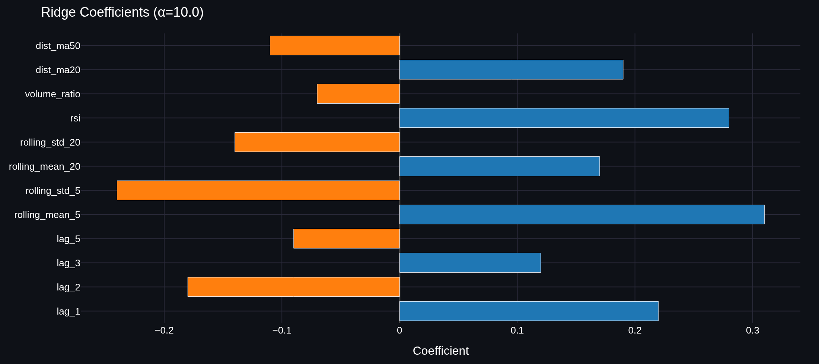
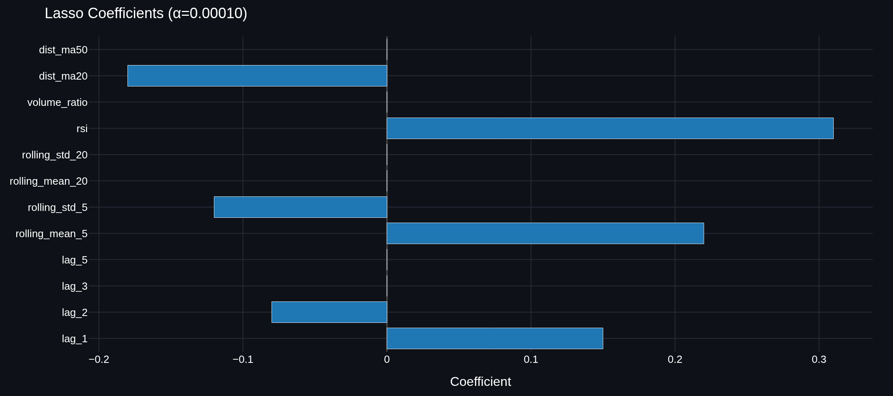
Tab 6 — Ridge & Lasso Regression
Comparison table, coefficient charts, and regularization path
streamlit_app.py — Ridge chart rendering
streamlit_app.py — Lasso chart rendering
# streamlit_app.py — Ridge rendering (lines 436-444)
st.plotly_chart(coef_chart(
ridge_res["coef_df"],
f"Ridge Coefficients (α={ridge_res['best_alpha']})",
f"Coefficient (α={ridge_res['best_alpha']})",
), use_container_width=True)
st.write(f"R²: {ridge_res['r2_score']}")
st.write(f"RMSE: {pct(ridge_res['rmse'], 4)}")
# streamlit_app.py — Lasso rendering (lines 447-455)
st.plotly_chart(coef_chart(
lasso_res["coef_df"],
f"Lasso Coefficients (α={lasso_res['best_alpha']:.5f})",
selected=True, # grey-out zeroed features
), use_container_width=True)
st.write(f"Selected: {lasso_res['n_selected']}")
st.write(f"Zeroed: {lasso_res['n_zeroed']}")
st.write(f"Kept: {', '.join(lasso_res['selected_features'])}")
🔗 streamlit_app.py lines 436-444
🔗 streamlit_app.py lines 447-455
laksh_ml.py — Model comparison table
# laksh_ml.py — Ridge vs Lasso comparison table (lines 197-214)
def compare_ridge_lasso(ridge, lasso):
return pd.DataFrame({
"Metric":["R² Score","RMSE","Best Alpha","Features Used"],
"Ridge": [ridge["r2_score"], ridge["rmse"], ridge["best_alpha"], 12],
"Lasso": [lasso["r2_score"], lasso["rmse"], lasso["best_alpha"], lasso["n_selected"]],
})
st.dataframe(compare_ridge_lasso(ridge_res, lasso_res), use_container_width=True)
⬅ Contents
🔗 laksh_ml.py lines 197-214

Slide 19
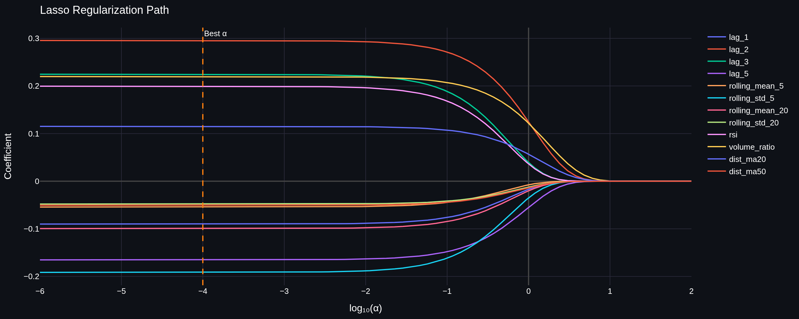
Lasso Regularization Path
How each feature's coefficient evolves as the penalty strength α increases
📐 Reading the Path
• x-axis: log₁₀(α) — increases from left (weak penalty) to right (strong)
• y-axis: coefficient value
• Each coloured line = one feature
• Lines that reach zero early = first eliminated features
• Lines surviving at the dashed line = features Lasso selected
• Dashed vertical line: the cross-validated optimal α
laksh_ml.py — path helper
# laksh_ml.py — coef path helper (lines 60-62)
def _coef_path(model_cls, alphas, X, y, **kwargs):
return np.array([
model_cls(alpha=a, **kwargs).fit(X, y).coef_
for a in alphas
])
streamlit_app.py — Lasso path chart
# streamlit_app.py — Regularization path chart (lines 457-478)
path = go.Figure()
colors = px.colors.qualitative.Plotly
for i, feature in enumerate(FEATURE_COLS):
path.add_trace(go.Scatter(
x=np.log10(lasso_res["alpha_path"]),
y=lasso_res["coef_path"][:, i],
mode="lines", name=feature,
line=dict(color=colors[i % len(colors)])
))
path.add_vline(
x=np.log10(lasso_res["best_alpha"]),
line_dash="dash", line_color=COLORS["secondary"]
)
path.update_layout(
title="Regularization Path",
xaxis_title="log10(alpha)",
yaxis_title="Coefficient Value",
)
st.plotly_chart(path, use_container_width=True)
🔗 laksh_ml.py lines 60-62
⬅ Contents
🔗 streamlit_app.py lines 457-478

Slide 20
Summary & Conclusion
What we built and what it delivers
📐 What the Dashboard Covers
📐 Engineering Highlights
• Tab 1 — Overview: Price history & return distributions
• Tab 2 — Risk Profile: Confidence intervals & MLE
• Tab 3 — Hypothesis Tests: Z-Test + three variants of t-Test
• Tab 4 — Sector Analysis: One-way ANOVA across 5 sectors
• Tab 5 — ML Predictions: Logistic regression direction signal
• Tab 6 — Ridge & Lasso: Regularised return-prediction models
• Modular: UI, data, stats, and ML in separate files
• @st.cache_data: 1-hour data caching for responsiveness
• TimeSeriesSplit CV: leakage-free model evaluation
• Welch's t-test: robust to unequal variances
• Balanced class weights: handles UP/DOWN imbalance
• Auto-alpha: RidgeCV / LassoCV find optimal λ automatically
• 12 engineered features: lag, rolling, RSI, volume, MA distance
• 5 sectors · 25 NSE stocks · up to 5 years of data · no local install needed
🌐 Live Streamlit Dashboard
📦 Source Code on GitHub
Thank you!
⬅ Contents

