Slide 1
CSS
ICT-Training Technical Skills

Slide 2
CSS- Cascading Style Sheet
For improving the presentation of HTML document. It used cascading Style Sheet.
CSS use three types:
Various type of Selectors
Add HTML document
Bootstrap

Slide 3
Introduction to CSS
Cascading Style Sheets, fondly referred to as CSS, is a simply designed language intended to simplify the process of making web pages presentable.
CSS allows you to apply styles to web pages.
More importantly, CSS enables you to do this independent of the HTML that makes up each web page.
CSS describes how HTML elements are to be displayed on screen, paper, or in other media
CSS saves a lot of work. It can control the layout of multiple web pages all at once
External stylesheets are stored in CSS files.

Slide 4
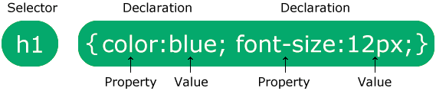
Syntax
p {
color: red;
text-align: center;
}

Slide 5
Types of Selector
Universal Selector
Type Selectors
Class Selectors
Id Selector
Grouping Selector

Slide 6
Universal Selector
Presentation of whole page. It denoted by *.
* {
color: red;
}

Slide 7
Type Selector
What is the presentation of rule.
P {
text-align : center;
color: red;
}

Slide 8
Id Selector
Id selector denoted by #.
# {
color: red;
}

Slide 9
Class Selector
Class selector denoted by
{
color: red;
}

Slide 10
Group Selector
h1,h2,p{ text-align:center;
color: red;
}

Slide 11
Three Ways to Insert CSS
Inline style
Internal style sheet
External style sheet

Slide 12
Inline Styles Sheet
<body>
<p style=``color: red”>Welcome to CSS</p>
</body>

Slide 13
Internal Style Sheet
It is also called as embedded style sheet.
<head>
<title>Internal css</title>
<style>
p{ color: blue}
</style>
</head>

Slide 14
External style sheet:
Save file name-style.css
p{
color: yellow
}
Save file name-External.html

Slide 15
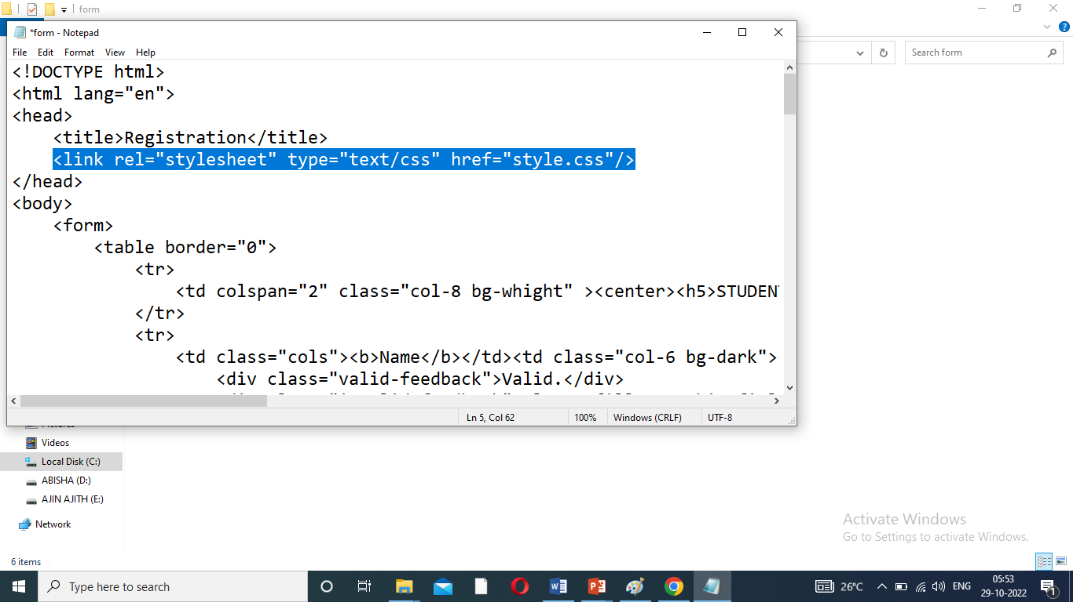
Link to HTML document
<link rel="stylesheet" type="text/css" href=“style.css">

Slide 16
Example of Code
Login1.css
h1 {
color: green;
}
input[type=text] {
width: 100%;
padding: 12px 20px;
margin: 8px 0;
box-sizing: border-box;
border: 2px solid gray;
border-radius: 4px;
}
b {
color: blue;
font-size: x-large;
}

Slide 17
Continue Code..
Login1.html
<html>
<head>
<title>Form</title>
<link rel="stylesheet" type="text/css" href="login1.css">
</head>
<body>
<form>
<table>
<tr><td colspan="2"><h1>Registration Form</h1></td></tr>
<tr><td><b>First name:</b></td>

Slide 18
Continue Code..
<td><input type="text" id="fname" name="fname"></td></tr>
<tr><td><b>Last name:</b></td>
<td><input type="text" id="lname" name="lname"></td></tr>
<tr><td colspan="2"><center><input type="submit" value="submit"></center></td></tr>
</table>
</form>
</body>
</html>

