Slide 1
BioMed-QA: An Intelligent Search and Question-Answering System for Medical Research
Presented by: Abishai Tom (2448005)
Alphin Roy(2448011)
Presented to: Dr. Saleema JS

Slide 2
Agenda
The Challenge: Information Overload in Scientific Literature
Our Solution: The BioMed-QA System
Methodology: How It Works Under the Hood
Results: Evaluating System Performance
Conclusion & Future Directions

Slide 3
The Problem: A Needle in a Haystack
The world of biomedical research is vast and growing exponentially. PubMed, a major research database, contains over 36 million citations.
Researchers, doctors, and students face a significant challenge: finding specific answers to complex questions is like finding a needle in an ever-growing haystack.
Traditional keyword search often fails. It can't understand synonyms, context, or the underlying meaning of a query, leading to missed information or irrelevant results.

Slide 4
Our Solution: The BioMed-QA System
Goal: To build an intelligent system that moves beyond simple document retrieval to provide direct answers to natural language questions.
Input: A user's question, such as "What chemicals are used to treat Parkinson's disease?"
Output:
A concise list of candidate answers (e.g., "Levodopa", "Carbidopa").
The source abstracts with the answers and query terms highlighted for verification.
Scope: The system operates on a processed sample of 5,000-10,000 abstracts from the PubMed dataset.

Slide 5
Novelty & Domain Relevance
Beyond Search: The key novelty is the two-stage Retrieve-then-Extract process. We don't just give you a list of documents; we read them for you and pull out the answers.
Domain-Specific Intelligence: Instead of using generic NLP models, we leverage BioBERT, a language model specifically pre-trained on biomedical text. This provides a deep, contextual understanding of scientific language.
Comparative Framework: The application is built as a tool for analysis, allowing for a direct, quantitative comparison of multiple Information Retrieval and NER techniques.

Slide 6
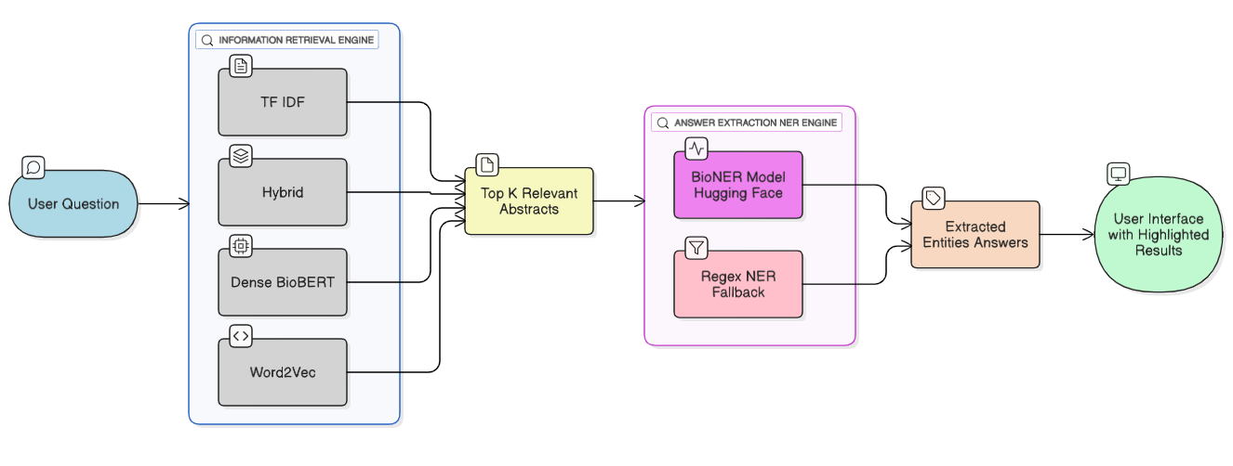
System Architecture

Slide 7
About the Dataset
Source: The project utilizes the "PubMed Multi Label Text Classification Dataset" available on Kaggle. The data originates from the PubMed repository, a premier database for biomedical literature.
Scope & Size: The dataset contains 55,655 research article abstracts. For our project, we work with a processed sample to ensure computational efficiency.
High-Quality Annotation: A key feature of this dataset is its quality. Each article was manually annotated by biomedical experts with 10-15 relevant Medical Subject Headings (MeSH labels). This expert curation provides a strong, reliable foundation.

Slide 8
Data Preprocessing
Loading & Cleaning: Loaded the data, handled different column names (title vs articleTitle), and removed abstracts that were empty.
Sampling: Created a representative sample of abstracts to ensure the project was computationally feasible.
Embedding Generation: This is the most critical step. We used the BioBERT model to convert the text of each of the abstracts of our choice into a numerical vector (an embedding). These embeddings capture the semantic meaning of the text.
Saving: The cleaned data and the computed embeddings were saved to disk (.csv and .pkl files). This one-time process makes the main application fast and responsive.

Slide 9
Tools & Libraries: Justification of Choices
1. Streamlit
Role: Building the interactive web application UI.
Justification: Chosen for its simplicity and speed in creating data-centric apps directly from Python. It allows for rapid prototyping and creating an effective live demo without requiring web development expertise.
2.Hugging Face Transformers / Sentence-Transformers
Role: Loading state-of-the-art NLP models for embeddings (BioBERT) and NER.
Justification: Provides direct access to SOTA pre-trained models. We specifically chose this to leverage BioBERT, a model fine-tuned on biomedical text, which offers superior domain-specific understanding compared to generic models.

Slide 10
Tools & Libraries: Justification of Choices
3. Scikit-learn
Role: Implementing the TF-IDF vectorization.
Justification: It's the industry standard for traditional machine learning in Python. Its implementation of TF-IDF is highly optimized and provides a robust baseline for our keyword search engine.
4. Gensim & NLTK
Role: Implementing the Word2Vec baseline (Gensim) and demonstrating POS tagging (NLTK).
Justification: These are foundational libraries in NLP, perfect for demonstrating the classic techniques required by the syllabus (Unit 2 & 3) and providing a solid point of comparison against modern transformer-based methods.

Slide 11
Tools & Libraries: Justification of Choices
5. Plotly
Role: Creating interactive data visualizations.
Justification: Selected over static libraries like Matplotlib because it generates fully interactive, web-native charts. This is ideal for a Streamlit app, allowing for a more engaging and exploratory analysis of results.

Slide 12
Core Technique: Information Retrieval
TF-IDF: A classic keyword-based method. Fast and effective for matching specific terms.
Word2Vec: A baseline semantic method. Understands word relationships but is less context-aware than modern transformers.
Dense (BioBERT): A state-of-the-art semantic method. Understands the deep contextual meaning of queries and documents.
Hybrid: Combines the strengths of TF-IDF and BioBERT, balancing keyword relevance with semantic understanding.

Slide 13
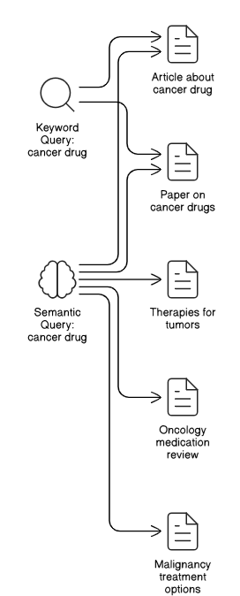
Core Technique: Information Retrieval

Slide 14
Core Technique: Answer Extraction (NER)
BioNER Model (Primary): Utilizes a powerful pre-trained model from Hugging Face (d4data/biomedical-ner-all) to identify entities like CHEMICAL, DISEASE, and GENE with high accuracy based on context.
Regex NER (Fallback): A system based on hand-crafted rules (Regular Expressions). For example, it identifies words ending in "-itis" as diseases. It serves as a reliable baseline and ensures the app works even if the main model can't be loaded.

Slide 15
Quantitative Results: IR Evaluation
To evaluate our search methods, we used standard IR metrics: Precision@k, Recall@k, and nDCG@k.
The "IR Comparison" tab allows us to run a query and see these metrics calculated in real-time.
Observation: As shown in the results for the query "Alzheimer's treatment," the Dense and Hybrid methods consistently achieve higher nDCG@k scores. This indicates they are better at finding relevant documents and ranking them higher than the purely keyword-based TF-IDF.

Slide 16
Quantitative Results: NER Evaluation
We evaluated our two NER systems on a small, hand-labeled "gold standard" dataset.
We measured Precision, Recall, and F1-Score for each entity type.
Observation: This proves that a model's performance is highly dependent on the quality and nature of the evaluation data. The results highlight that a simplistic test set can be misleading, and they underscore the importance of building larger, more nuanced evaluation datasets to accurately benchmark the performance of powerful, context-aware NLP models like BioNER.

Slide 17
Qualitative Analysis (Live Demo)
Let's demonstrate with the question: "Which genes are associated with breast cancer?“
The system retrieves relevant abstracts and highlights the query terms (breast cancer) and the extracted answers (GENE entities).
As you can see, the system correctly identifies well-known genes like BRCA1, BRCA2, and TP53 from the text. This provides a clear, visual confirmation of the end-to-end system's effectiveness.

Slide 18
Discussion of Limitations
Answer Context: The current system identifies an answer if it's in a sentence that also contains a query term. This is a heuristic and can sometimes miss more complex relationships.
Evaluation Heuristic: The relevance metric for the IR evaluation is simple (presence of a keyword). A human-judged dataset would provide more accurate scores.
Extractive Nature: The system is purely extractive—it can only pull out words that are physically present in the text. It cannot synthesize or summarize answers.

Slide 19
Conclusion
We successfully designed and built a multi-engine biomedical QA system that effectively moves beyond simple keyword search.
Our analysis quantitatively demonstrated the superiority of modern semantic search models (BioBERT) over traditional methods (TF-IDF, Word2Vec).
The project successfully integrates a wide range of NLP techniques from sequence labeling (NER, POS) and vector semantics to information retrieval and QA, creating a powerful and insightful tool.

Slide 20
Future Work
Scale Up: Integrate the system with a scalable search backend like Elasticsearch to handle millions of documents.
Improve Answer Extraction: Implement more advanced reading comprehension models to handle more complex questions and relationships between entities.
Abstractive QA: Explore generative models (like T5 or GPT) to synthesize and summarize answers in natural language instead of just extracting them.

Slide 21
THANK YOU!

