Slide 1
Speech Processing 20DS705 Term Project: Study of Hu-BERT & Conformer for ASR application
Team 7
Aakash Jignesh Modi (CB.EN.P2CEN20001)
Mredulraj S. Pandianchery (CB.EN.P2CEN20019)
Vinay R. (CB.EN.P2CEN20028)

Slide 2
Hu-BERT: Self Supervised Speech Representation Learning by Masked Prediction of Hidden Units
Objective:
There are some challenges in self supervised approaches for speech representation
multiple sound units in speech utterance
absence of lexicon of sound unit during pretraining
sound units have variable length in different utterances.
Hu-BERT is a self supervised approach for speech representation which overcomes these challenges and provide better generalization.

Slide 3
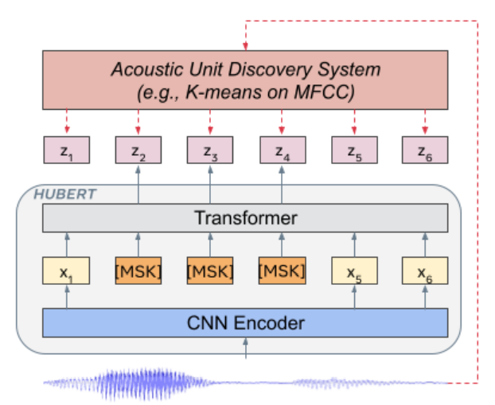
Hu-BERT: Self Supervised Speech Representation Learning by Masked Prediction of Hidden Units
Uniqueness
Learning the hidden units for Hu-BERT. Representation learning via masked prediction. Learning with cluster ensembles. Iterative refinement of cluster assignment.

Slide 4
Hu-BERT: Self Supervised Speech Representation Learning by Masked Prediction of Hidden Units
Advantages | Problem Gap
Hu-BERT (1Billion parameter model) gives 19% and 13% reduction in WER for dev-other & test-other dataset as compared to the state of art performance by wave2vec 2.0 model. | Instead of k-means clustering algorithm, performance of other algorithms can be studied (Scope for improvement).

Slide 5
Hu-BERT: Self Supervised Speech Representation Learning by Masked Prediction of Hidden Units
WER with LM | Time (2620 samples) | Model Size | # of Parameters | Jupyter Notebook
0.020104230066 | 35min | 3.63 GB | 962538400 (.96 Billion) | https://colab.research.google.com/drive/1U03xQP3d26ZA7FOZfxVDLPmgnkYu4xpE?usp=sharing

Slide 6
Conformer: Convolution-augmented Transformer for Speech Recognition
Objective
Transformer architecture based on self attention can exploit the global features and long term interaction in the speech, but cannot extract the local features in the speech.
Convolution can capture the local connectivity in the speech, is unable to capture the global features.
The objective of this study is to capture the global and local features in the speech by a single architecture called Conformer.

Slide 7
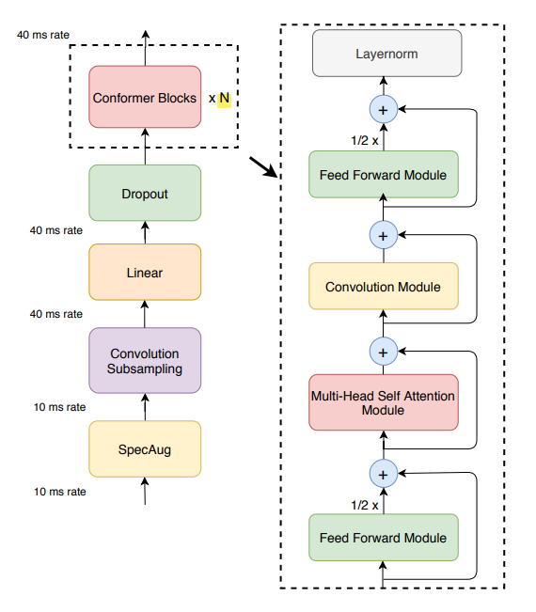
Conformer: Convolution-augmented Transformer for Speech Recognition

Slide 8
Conformer: Convolution-augmented Transformer for Speech Recognition
Uniqueness | Advantages | Problem Gap
The Conformer architecture captures the global and local interaction present in the speech. | The conformer architecture outperforms both transformer and convolution achieving the state of art performance with wer of 2.1%/4.3% without language model & 1.9%/3.9% with language model for test-clean/other. | In literature, the ablation study has not done for number of conformer block in the architecture (There is a scope of study for optimization of the number of conformer block).

Slide 9
Conformer: Convolution-augmented Transformer for Speech Recognition
WER with LM | Time (2620 samples) | Model Size | # of Parameters | Jupyter Notebook
0.02575319537 | 8hrs 15min | 649 MB | 116146960 (116.15 M) | https://colab.research.google.com/drive/11lKE_uJjVq67rY6NowUy4Bf7TyREvm1j?usp=sharing

Slide 10
Q/A

