Slide 1
REAL TIME EV FLEET MONITORING AND PREDICTIVE ANALYIS MONITORING

Slide 2
INTRODUCTION
In today's rapidly evolving landscape of electric vehicles (EVs), efficient fleet management is essential to optimize operations, reduce costs, and enhance sustainability
With the growing adoption of EVs worldwide, managing a fleet of electric vehicles goes beyond traditional fleet management practices. It requires leveraging advanced technologies to address unique challenges

Slide 3
Build a comprehensive application for electric vehicle (EV) fleet management to help fleet managers efficiently monitor and manage their EVs.
PROBLEM STATEMENT
Traditional fleet management systems are not equipped to handle unique challenges of EV fleets, such as predicting electric range, monitoring battery health.

Slide 4
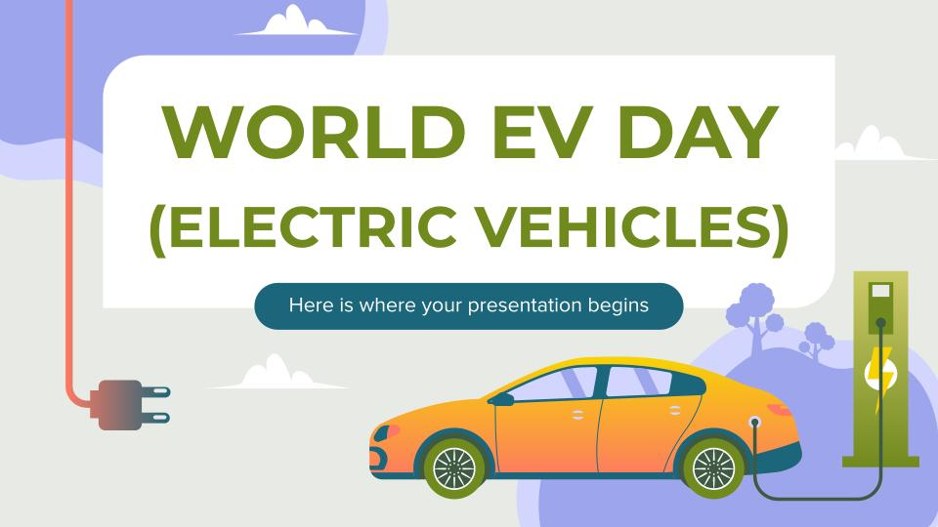
Our proposed Real-Time EV Fleet Monitoring and Predictive Analytics Solution aims to revolutionize fleet management by providing real-time insights into vehicle performance, battery health, etc and predictive analytics for Electric Range.
PROPOSED SYSTEM

Slide 5
Key Features of EV Fleet Monitoring System
User Management: Create secure user accounts with roles for Fleet Managers and Drivers.
Real-Time Monitoring: Track location, speed, battery levels, charging status, and energy consumption patterns.
Fleet Administration: Register, update, and assign EVs to drivers, ensuring efficient fleet operations.
Analytics & Reporting: Generate and export detailed reports on fleet performance, energy usage, and operational costs for informed decision-making.

Slide 6
TECHNOLOGY STACK
Frontend Development
HTML, CSS, JavaScript: For building an intuitive and user-friendly interface.
Visualization Libraries: Streamlit (v1.23.1) Visualization library for generating charts.
Backend Development
Python (v3.7.0): Core language for backend logic and machine learning model implementation.
Django (v3.2.25): Framework providing pre-built components for efficient development.
Database Management
MySQL (v8.0.37): Stores vehicle data, user information, and historical records for analysis.
Development and Collaboration Tools
Visual Studio Code: Integrated development environment for project implementation.
Google Colab: For developing and testing machine learning models.

Slide 7
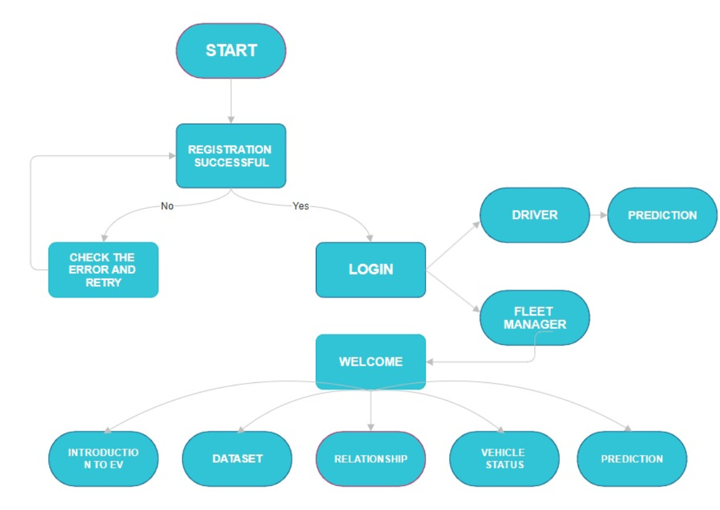
FLOW CHART

Slide 8
SYNTHETIC DATA GENERATION
Purpose: Created realistic synthetic data to simulate EV fleet operations for monitoring and predictive analysis.
Tool: Used the Faker package to generate detailed data for vehicles, routes, battery status, and real-time metrics.

Slide 9
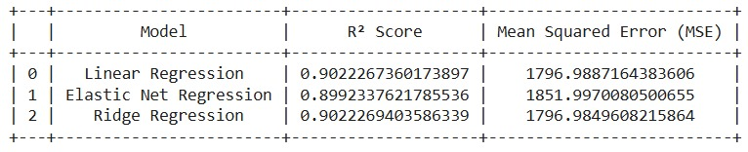
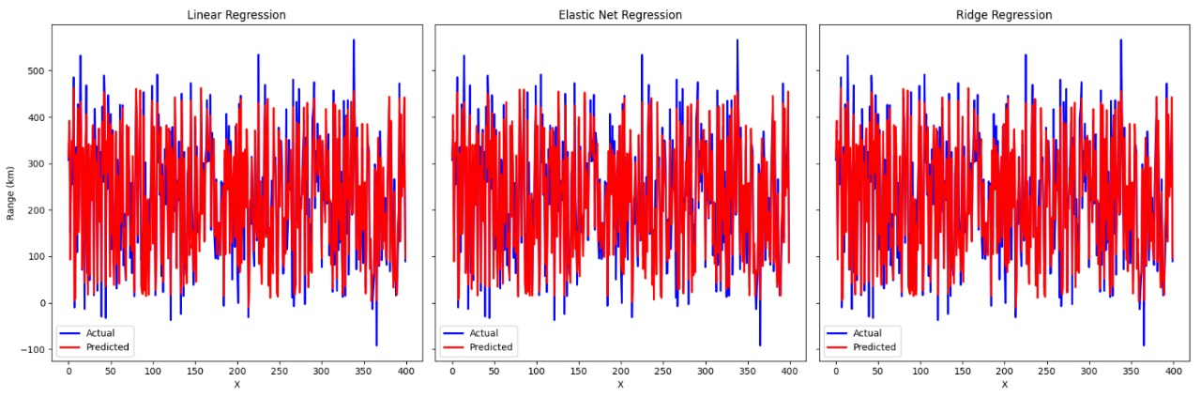
MODEL’S COMPARISON

Slide 10
MODEL PREDICTION PAGE DEPLOYMENT
STREAMLIT URL : https://electric-vehicle-range-prediction.streamlit.app/
Platform: Deployed on Streamlit Community Cloud for seamless accessibility
Key Features:
User-friendly interface for predicting the electric range of EVs.
Real-time prediction based on trained machine learning models.
Accessible from any device with internet connectivity.

Slide 11
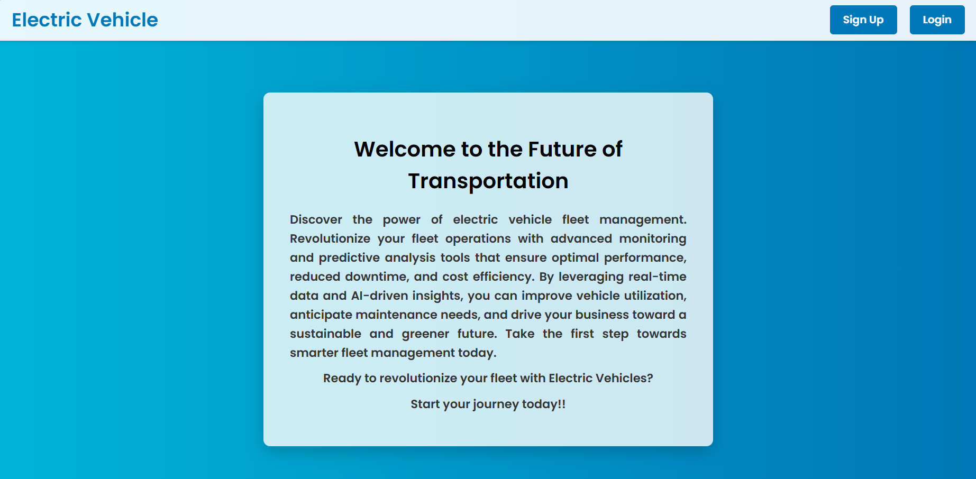



OUTPUT SCREENS

Slide 12

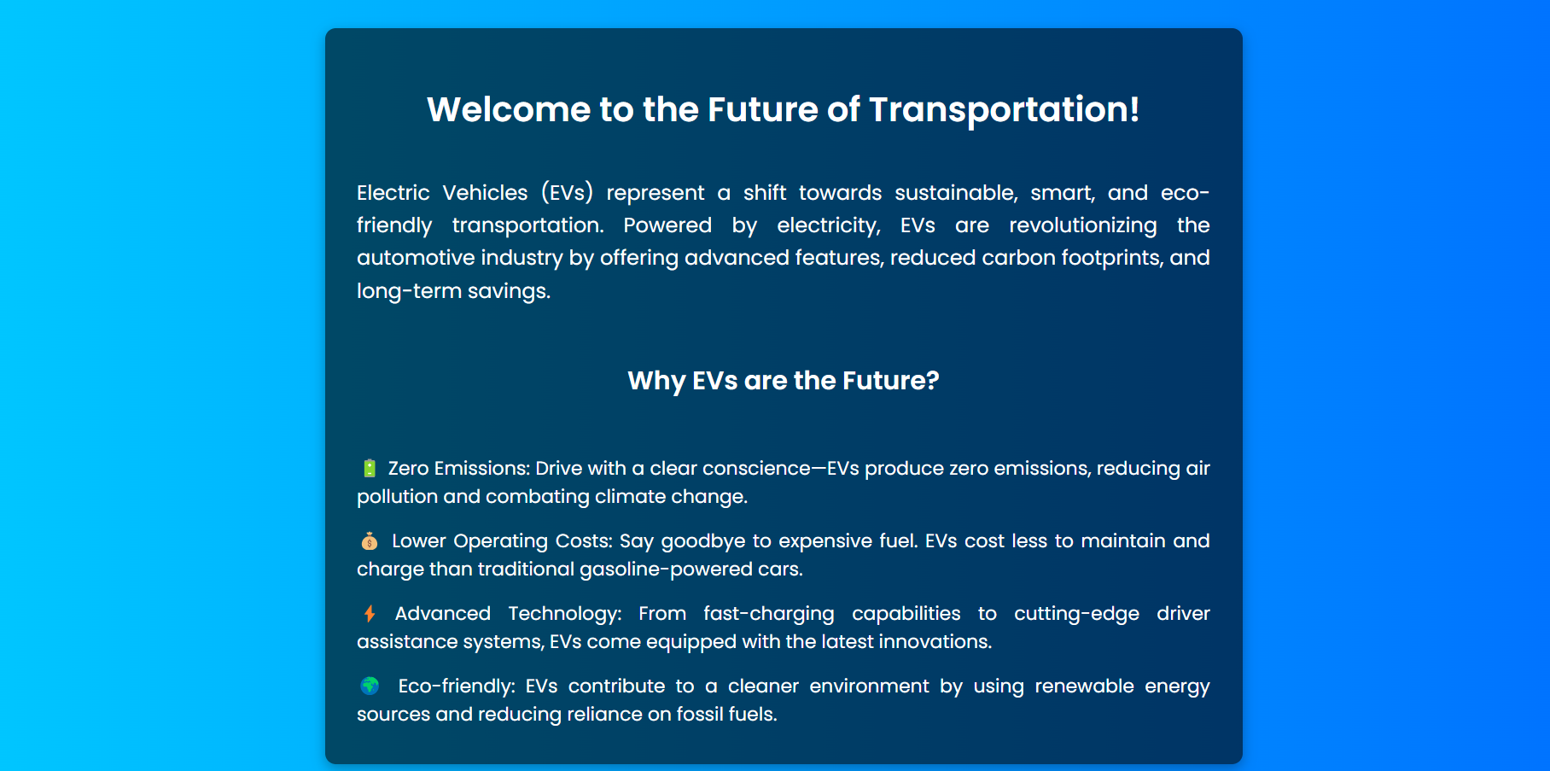
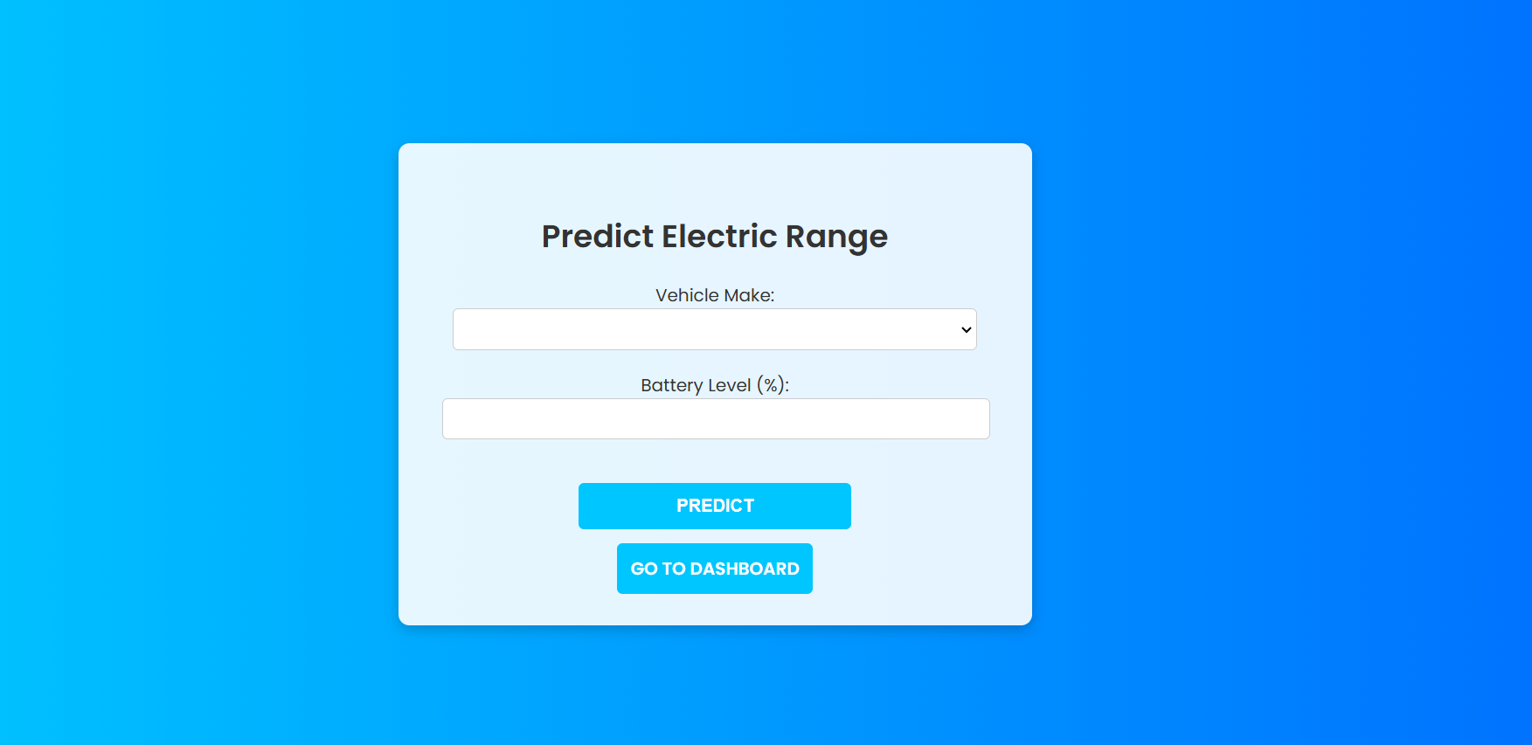
OUTPUT SCREENS

Slide 13
Scalability: Integrating more vehicle types and larger datasets
Technology:
Enhanced prediction with deep learning
FUTURE
SCOPE
Real-Time Tracking:
Provide real-time updates on vehicle location using GPS, traffic conditions, and optimal route suggestions.
Anomaly Detection:
Develop AI-based systems
detect anomalies
such as battery drain or
irregular driver behavior.

Slide 14
CONCLUSION
The Real-Time EV Fleet Monitoring and Predictive Analytics Solution will enable fleet managers to monitor their electric vehicles' performance and health in real-time.
This includes tracking battery status, charging levels and optimizing fleet operations. This reduces operational costs and ensures vehicles are maintained proactively, enhancing overall fleet efficiency.
The system will offer comprehensive energy consumption analysis, along with customizable report generation.

Slide 15
TEAM MEMBERS
Sanasya Sasikumar
Akshaya G
Mahitha Sri Sathwika K
Kruthika C
Abishek M

Slide 16
THANK YOU

